Slide 1
FEAT
Ian Armitstead & Kie O’Donnell
October 5, 2026

Slide 2
Housekeeping
We want to keep things informal but ask that you keep yourself on mute unless you want to ask a question or make a comment. ​
​You can also comment or ask questions using the “chat.”​
​This session will not be recorded since it is interactive, and we strongly encourage participants to actively engage, ask questions, or share personal examples when appropriate.

Slide 3
Online Materials and Resources
Materials included for entire series
PowerPoint handouts​
Glossary​
Activities​
Plan for Employment​
Links to related resources​
Website for resources – www.featri.net

Slide 4

Agenda
Who we are
Introduction to FEAT
Employment First in RI
Employment possibilities
Types of employment supports
Other services, benefits, and programs

Slide 5
Paul V. Sherlock Center on Disabilities
Rhode Island’s University Center for Excellence in Developmental Disabilities (UCEDD). ​
Provide training and technical assistance, research, and information.​
Individuals with disabilities, their families, and those who support them.​
Across the age span.​
www.sherlockcenter.org ​

Slide 6

Parent Perspective on Employment Fears
You can use this link to watch a video. In the video, you will hear from Sue Donovan. She is a mom of a daughter with a disability. She talks about what she fears about her daughter getting a job.

Slide 7
Activity – Question for you …
What is the biggest barrier to successful employment for people with disabilities?
​
(Type in Chat or unmute to share your thoughts.)

Slide 8

Barriers and Concerns
Losing benefits (SSI, SSDI, SNAP, Housing Assistance​
​Losing health insurance (Medicaid, Medicare)​
​Being treated equally and fairly by co-workers​
​Safety at the workplace​
Having the necessary skills to do the job

Slide 9
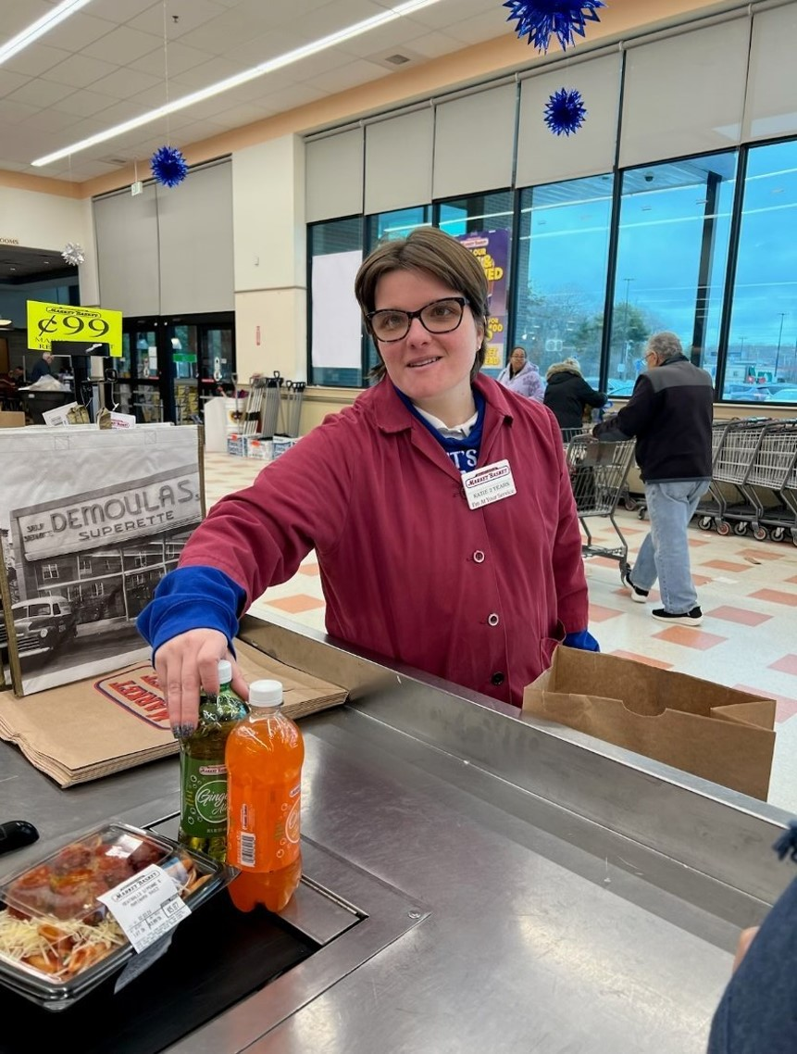
Contributing, not just Participating!
Why Employment
Increases Income​
Promotes self-determination​
Gives a chance to use strengths and build skills​
Increases confidence and sense of belonging and community​
Fosters social relationships​
Supports meaning and purpose in life

Slide 10
FEAT MISSION
Key principles
To raise the expectations of families and people with disabilities about the possibility of finding meaningful and satisfying work in their home communities.
Everyone with a disability can work when given the right supports and services.​​
​Everyone with a disability can have a job or be a business owner that is both enjoyable and satisfying.​​
​Everyone with a disability will always make more money working than by relying on public benefits alone.​

Slide 11
Any Questions for us?

Slide 12
Employment First in RI
U.S. Department of Justice Consent Decree, April 9, 2014​
“… Employment opportunities in fully integrated work settings shall be the first and priority option explored in the service planning for working-age adults with developmental disabilities in Rhode Island.” (2013)​
https://bhddh.ri.gov/developmentaldisabilities/about/employmentcommunity/ ​
Person-Centered Planning – students age 14 and up​
Career Development Plan – students age 14 and up​
At least two community-based work trials before exiting high school​
www.olmstead-ddnews.org – updates on Consent Decree News​

Slide 13
Path to Employment Success
Supported employment
Self-employment
Customized

Slide 14
Types of Employment: Traditional
“Typical” ways people get hired
  Common themes include:
    “Help Wanted” signs and advertisements
    Job postings
    Online applications
    Rapid employment
What we know is that although some people with disabilities benefit from this approach, the majority require more creative ways to be successful in the long term.

Slide 15
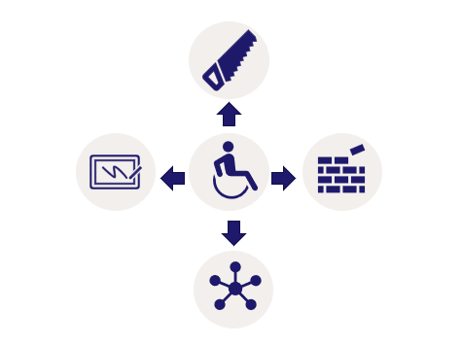
Types of Employment: Customized
        “Reversed” way to Secure Employment: Instead of looking at a job posting (square hole) and trying to fit the person to it (triangle peg) …
Four Major Steps
  Discovery and a Strength-Based Approach
  Developing an Individual Search Plan
  Negotiating Value-Adds with a Business
  Long-Term Plan for Ongoing Success

Slide 16

Employment Possibilities
Integrated competitive employment, supported employment, and customized employment
Created jobs​
Carved jobs​
Resource ownership​
Self-employment​
Business within a business ​
Employer-initiated models

Slide 17
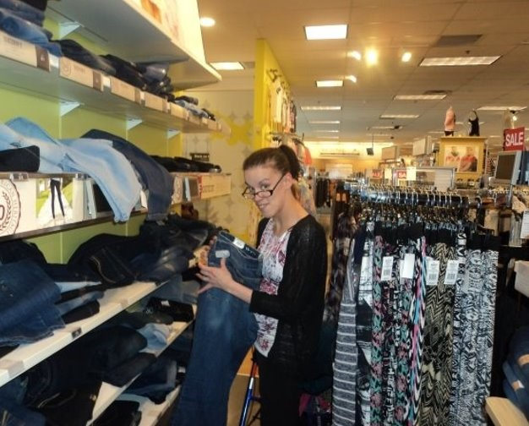
Integrated Competitive Employment
Real work in real businesses
Minimum wage or higher
Individualized supports
Check out this APSE – “Why is Integrated Employment Important” video

Slide 18
Supported and Customized Employment
Supported Employment
Customized Employment
Real work
Integrated businesses
Job match
Assistance from a job coach
Ongoing support services
Real work
Integrated businesses
Negotiation between the needs of the employer and the individual
One person at a time … one employer at a time

Slide 19
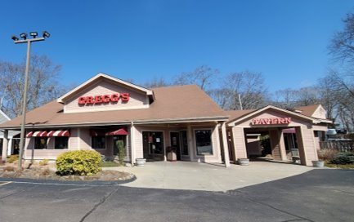
Meet Mike – Works at Gregg’s Restaurant
Mike’s Video
Gregg’s in North Kingstown, RI​
Prep cook​
Agency providing support:
Spurwink RI

Slide 20




Customized Employment Styles
Carved
Restructured
Shared
Created
Taking elements of a position and developing a new position based on those tasks
Taking parts of more than one position and changing the way they are completed
Completing job functions by sharing parts, time, or tasks
Developing new tasks or enterprises based on unmet needs

Slide 21
Created Job
What is it?
Possibilities …
Establishes a new job or job duties that did not previously exist as a position within a business
Driven by the skills and support needs of the individual and the needs of the business
Negotiated by a skilled developer, job coach, or employment specialist

Slide 22
Carved Job
What is it?
Possibilities …
Redistributes job duties from one position to another, tailoring them to the job seeker’s unique skills and abilities
Creates a job description consisting of one or more tasks from the traditional job in the employment setting
A way to make somebody’s strengths and assets become a strength and asset for an employer
Real tasks, at a real job, that are a cost-effective strategy for an employer

Slide 23


Thank you to CPNRI -
Meet Jacob – Works at Seven Stars Bakery
Dream Job – Jacob’s Story

Slide 24
Self-Employment
What is it?
Who can help with funding & plan development?
Sue Babin recording
RI Developmental Disabilities Council
Small Business Development Center (RISBDC)
SCORE – Counselors to America’s Small Businesses
Crowdfunding (e.g., GoFundMe or Indiegogo)
Additional Resources
Women’s Business Centers
Center for Women & Enterprise

Slide 25
Resource Ownership
What is it?
Possibilities ….
Purchased equipment, machinery, or other items that an individual owns and brings to the workplace as part of their employment with a business, offering an additional resource to the employer.
Resource ownership increases the value of the employee (similar to having a college degree).
Resource ownership benefits the business by increasing profits or service capacity in some way.

Slide 26

Business within a Business
What is it?
Possibilities ….
Develop a self-employment venture within an existing business setting.
Offer something the business does not have but would enhance their market.
Established customer base.
Access to coworkers and natural supports.
A win-win situation.

Slide 27
Questions?

Slide 28




Family / Parent Role
Building a support network
Contributing to the employment process
Creating partnerships
Monitoring service quality

Slide 29
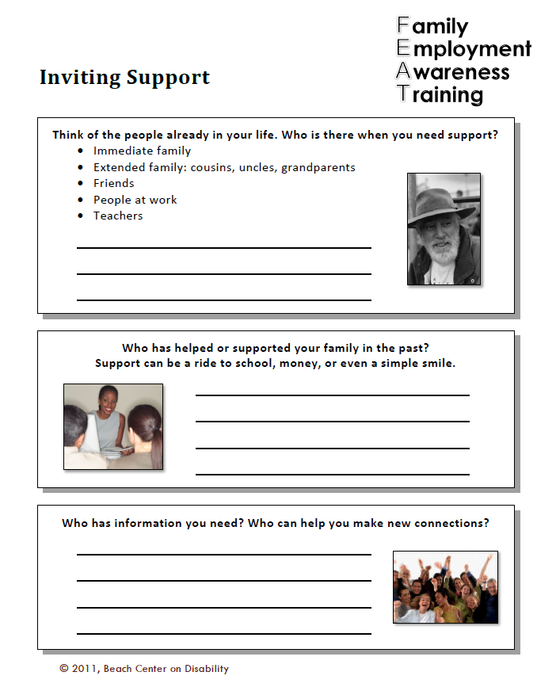
Inviting Support
Find at www.featri.net
Who are the
  People in your life?
  People who have helped?
  People who have information?
  People with whom you would like to connect?

Slide 30
Building a Support Network
Inviting people to become a support
Person-centered planning
  PATH – Planning Alternative Tomorrows with Hope
  MAPS – Making Action Plans
  Person-Centered Discovery Process
  LifeCourse Framework Tools

Slide 31
Partnership Strategies
Build trust - communication, respect
Shared responsibility
Common goals
Strengths-based
Celebrate successes
Offer solutions and be willing to be part of a solution

Slide 32


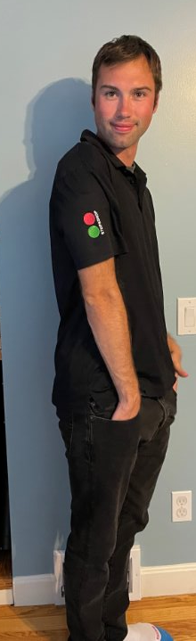
Meet Deavon – Front-End Clerk at Stop and Shop
Partnership:
  Personal strengths
  Family
  Employment supports
  Employer

Slide 33
Valuing Life Experiences
Where do I start?
You have already started!
Decisions inform decisions
Changes expectations
Revisit mapping routinely
Right to Risk
Provides guidance and accountability for supports

Slide 34
Contributing to the Employment Process
What are quality employment services:
What are not quality employment services:
Person-centered
Industry-based
Community-based work trials, if needed
Individualized job development
Total focus on “readiness” rather than real job experience
Long-term “internships” that never lead to employment
Group “job clubs” extending over years that lead nowhere

Slide 35

Types of Employment Supports
Job developer/job coach
Natural supports
Assistive technology
Self monitoring

Slide 36
Job Developer/Job Coach
Assists with finding a job
Negotiates issues with the employer (job carving, creating, customizing, accommodations, etc.)
Teaches how to do the job
Facilitates relationships and natural supports
Models interactions and support for the employer
Ensures the job is done to the employer’s standards
Provides ongoing support

Slide 37

Natural Supports
People
  Employer and co-workers
  Family and friends
  Community
Strategies
  Environmental modifications
Instructional techniques

Slide 38
Assistive Technology
Items, equipment, or systems used to increase, improve, or maintain the capabilities of people with disabilities
Low-tech items – an adjustable desk, penholders, or cup holders
Medium tech – Smartphone or tablet apps
High-tech items – switches, voice output communication devices, or specially designed robotics
www.atap.ri.gov

Slide 39
How to Build Capacity with Current Supports
Free Resources:
Office of Disability Employment Policy (ODEP)
Job Accommodation Network (JAN)
Association of People Supporting Employment First (APSE)
Virginia Commonwealth University (VCU)
The Sherlock Center
ACRE Training and Certification:
Some elements are billable service hours (fieldwork)

Slide 40
Reasons Beneficiaries say No to WORK
Fear and Misinformation:
Good News:
I heard this … my friend said that … even Social Security told me this …
Fear of losing cash benefits and/or health insurance
Rules can be complicated
Not sure where to get answers
“You can work with benefits!”
  Social Security offers great work incentives
    There are “safety nets”
  Benefits counseling provides guidance

Slide 41
Other Services, Benefits, and Programs​
Social Security Work Incentives​
Benefits Planning​
ABLE Accounts​
Transportation

Slide 42
More online resources at the ​​Sherlock Center's WI Webpage
Work Incentives and Benefits Counseling
Info you need to know
How to access
Impact of earnings
Work Incentives
Wage Reporting
Avoiding Overpayments
Ticket to Work Helpline
  1-866-968-7842 or
  1-866-833-2967​ TTY/TDD
ORS – referral by counselor
BHDDH – online EE-RF

Slide 43
Is benefits counseling right for you?
Do you have concerns about your SSDI, SSI, Medicaid, SNAP, or Housing Assistance changing?
Are you working now and don’t know how to report your wages?
Have you heard you can only work part-time and wonder if that it true?
Have you received letters from SSA or DHS you don’t understand?
If you answer ”yes” to one or more of these questions, consider getting Work Incentive Benefits Counseling to learn how you can work with benefits!​

Slide 44
Social Security Work Incentives
Supplemental Security Income (SSI)
Social Security Disability Insurance (SSDI)
Income Exclusions​
Impairment Related Work Expenses (IRWE)
Plan for Achieving Self-Support​
Youth:​
  SEIE​
  Section 301​
​Medicaid – 1619(b) $46,819 (2026)
IRWE​
Subsidy/Special Conditions​
Income Averaging​
Plan for Achieving Self-Support​
Three Work Phases​
  TWP, EPE, Post-EPE
Medicare – EPMC, continues for over seven years

Slide 45
Medicaid for the Working Disabled
Read more on the EOHHS website
​​ | Ticket to Work ​​ | Sherlock Plan ​​
Age ​​ | 16 – 64 ​​ | 65+ ​​
Income Limit ​​ | None ​​ | 250% FPL ​​
Asset Limit ​​ | None ​​ | $10,000 individual / $20,000 couple ​​
Two categories: ​​
  Ticket to Work for ages 16-64 ​​
  Sherlock Plan for ages 65 and older ​​​
Full Medicaid medical benefits​:
  LTSS & HCBS​​, Supported Employment ​​
Premium Payment based on earnings (greater than 150% FPL)

Slide 46
ABLE accounts
Achieving A Better Life Experience (ABLE) Act of 2014.​
RI's ABLE helps individuals save while preserving their SSI and Medicaid – up to $20,000 per year in 2026 (additional if contributing from wages).​
Balances of $100,000 or less not counted toward asset limits.​
RI website – https://savewithable.com/ri/home.html​
National Resource Center http://www.ablenrc.org/​

Slide 47
Transportation
Supported options
More options
Public transportation – RIPTA, RIDE Anywhere​
Travel Training (Learning how to use public transit)​
Driver assessment and training​
Carpooling​
Friends or family​
Volunteer drivers
Ride-hailing (Taxi, Uber, and Lyft)​
IRWEs may help with the costs of transportation

Slide 48
Questions?

Slide 49
Help is available
Sherlock Center on Disabilities
www.sherlockcenter.org
RIPIN
http://www.ripin.org/
Providing coaching and being able to answer individual questions
Ian Armitstead
Email: iarmitstead@ric.edu
Call: 401-456-2760
Can provide information and assistance related to transition IEPs and connecting with DDD.
Call: 401-270-0101

Slide 50
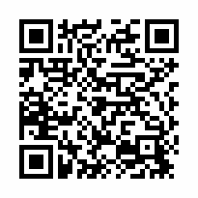
Thank You!
EVALUATION FOR TODAY
Click on this link, find it in the chat, or use the QR code.
Please complete!

