Slide 1
FEAT – Youth
Ian Armitstead & Kerri Collins
October 7, 2026

Slide 2
Housekeeping
We want to keep things informal but ask that you keep yourself on mute unless you want to ask a question or make a comment. ​
​You can also comment or ask questions using the “chat.”​
​This session will be recorded. It is interactive, and we strongly encourage participants to actively engage, ask questions, or share personal examples when appropriate, and we will stop recording.

Slide 3
Online Materials and Resources
Materials included for entire series
PowerPoint handouts​
Glossary​
Activities​
Plan for Employment​
Links to related resources​
Website for resources – www.featri.net

Slide 4
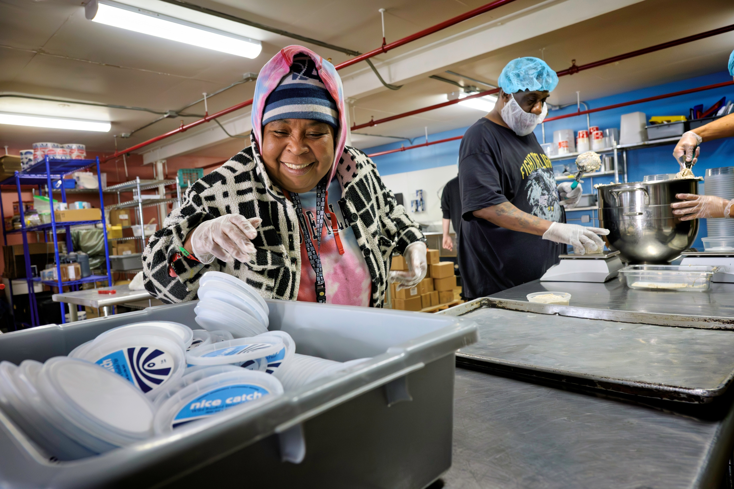
Agenda
Who we are
RI Panelists
Family/Parent & School role in transition to work
Adult employment supports funding
Planning for tomorrow

Slide 5
Path to Employment Success
Research says that students with disabilities are more likely to become employed as adults when:
Family expects that the student can and will find work they enjoy.​
​Student receives instruction in self-determination – being in control of what happens, making choices, setting goals.​
​Student engages in several long-term work trials that match their interests in real work settings(preferably paid) before exiting school.

Slide 6

Let’s hear from some Rhode Island Workers
To be announced

Slide 7
Transition to Employment is a Partnership
Roles of:
Family ​
School – IEP Team and Transition Supports​
Connecting to adult supports ​
  Office of Rehabilitation Services (ORS)​
  Department of Behavioral Healthcare Developmental Disabilities and Hospitals (BHDDH) – Division of Developmental Disabilities (DDD)

Slide 8
Contributing to the Employment Process
Look for the individual’s contributions and passions
Assist with brainstorming business/job ideas
Encourage creativity
Plan for employment through IEP transition goals
Network – Share job contacts
Inform the job coach/employment team of any problems or issues
Participate in problem-solving

Slide 9
Activity
What are your child’s postsecondary goals in their IEP?
What career assessments has your child participated in?

Slide 10

School – Transition to Work (ages 14-22)
IEP Transition Provisions
Planning Process

Slide 11

Watch Video
Transition IEP Provisions
Transition planning is required starting at age 14 (or before) in R.I.
Transition assessments are used to develop measurable goals for after high school (postsecondary goals) in the following areas:
  Employment
  Education/training
  Independent living skills (when appropriate)
These goals are supported by Transition Services and Activities

Slide 12
Transition IEP Planning Process
Present levels – What do we already know about the student
Age-appropriate transition assessments – What do we need to know about the student
Postsecondary (after HS) goals – What does the student want to do after HS in the areas of Employment, education and training, and independent living
Transition services and activities – What can we do to help the student make informed decisions based on what they want to do
Measurable annual goals – Will help the student achieve their long-term postsecondary goals

Slide 13
Transition IEP Planning Process
The Transition IEP is:
  A coordinated set of activities and services that builds each year to help the student make informed decisions
  The entire document – not an add on or a transition plan
  Intended to foster meaningful conversations with students
Career Development Plan – Required for students with intellectual or developmental disabilities
  Career planning tool for student and their school teams – aligned with IEP

Slide 14
Transition IEP Planning Process
The Transition IEP
  Builds each year based on the student’s interests
  Should include the student’s:
    Strengths
    Preferences
    Interests
    Needs
Watch Video

Slide 15
Transition IEP Planning Process
The Transition IEP:
  Makes the connection between what is happening now and the student’s postsecondary goals.
  Creates a coordinated set of activities and services that help students and families make informed decisions.
  Should include representatives from adult funding organizations and service providers to identify potential adult supports needed.

Slide 16
Monitor for Quality Employment Services
What are quality services:
What are not quality services:
  Community-based work experiences
  Self-determination skill development
  Job, social, and work-related skills development
  Interagency collaboration
  Lead to permanent paid employment as soon as possible – before exiting high school, if possible
  Developmental approaches that focus only on readiness
  Segregated day services, waiting lists

Slide 17
Questions?

Slide 18
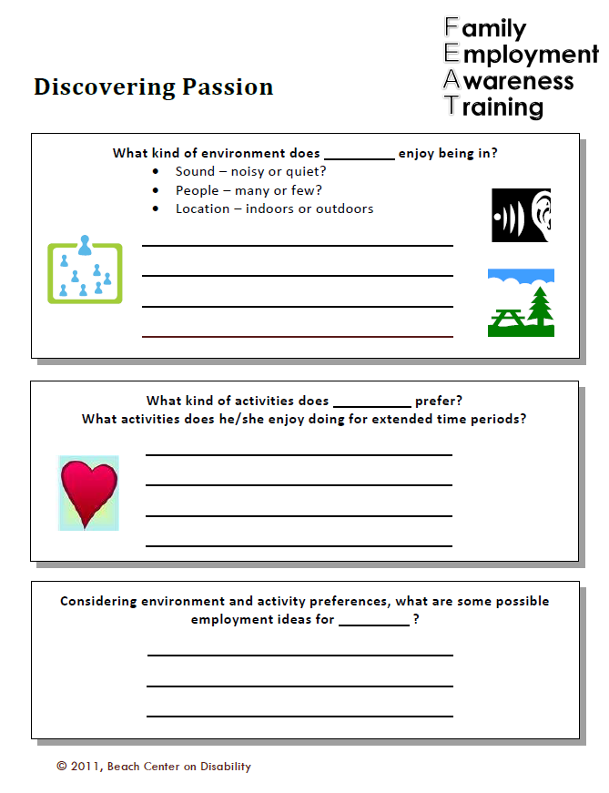
Discovering Passions Activity
What are my family members’ passions?
Environment
Activities
Possible employment ideas?

Slide 19
Funding for Adult Employment Services
Office of Rehabilitation Services (ORS)
Department of Behavioral Healthcare, Developmental Disabilities and Hospitals – Division of Developmental Disabilities (BHDDH-DDD)
Rhode Island Medicaid

Slide 20
Medicaid– Home and Community Based Services (HCBS)
Funds community services (e.g., supported employment, day services, personal assistance)
For people with developmental disabilities in Rhode Island, administered by BHDDH-DDD.
Virtually all DDD supports are Medicaid HCBS.
Common source of funding for ongoing job support following or along with ORS time-limited vocational rehabilitation
HCBS rules – Services must be based on person-centered plan and integrated into the community

Slide 21

BHDDH Division of Developmental Disabilities (DDD)
Watch video clip with Susan Haywood

Slide 22
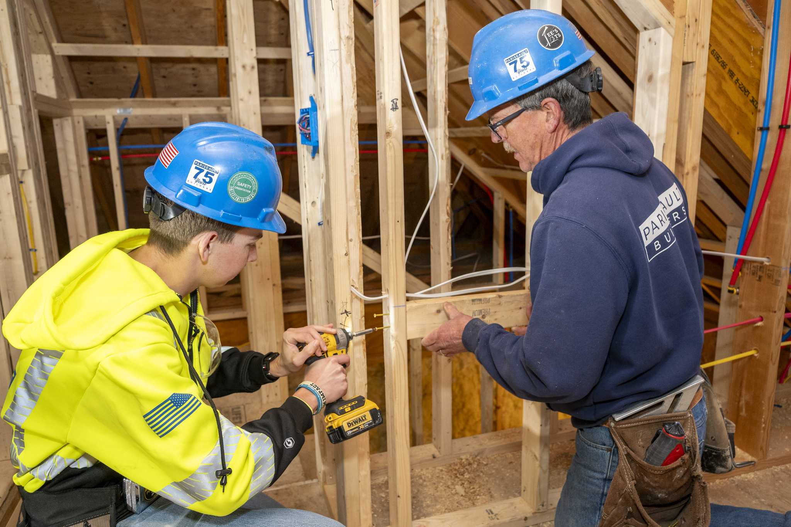
www.ors.ri.gov
Office of Rehabilitation Services (ORS)
Vocational Rehabilitation (VR)
Watch ORS video clip

Slide 23
Activity Questions …
Steps for your “Plan for Employment”
Do you know who your HS assigned ORS counselor is? Have you met them?
www.ors.ri.gov
Are there employment supports that your family member needs that ORS could provide?
While still in HS? After HS?

Slide 24
ORS Employment Supports & Services
Supported Employment
Employment Supports
Community-based work experiences
Job development and placement
Supported employment –
  Including job coaching (as needed and time limited)
On-the job training
Self-employment support
Rehabilitation technology
Transportation supports (job related)
Uniforms and tools
Postsecondary education or training

Slide 25
Community Rehabilitation Providers
Organization or agency that provides vocational rehabilitation services through ORS
Services may include:
  Assessment for determining vocational rehabilitation needs
  Job development, placement and retention services
  Supported employment services and extended services
  Customized employment supports

Slide 26
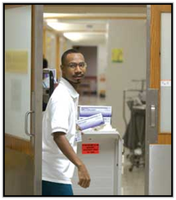
Project SEARCH video clip

Slide 27
Employment Services and Supports
Employment supports are DD services that focus on work. These services help adults with I/DD find meaningful jobs in the community. Learn more on the Employment webpage.
Some examples include
  Job Discovery
  Job Development / Job Coaching
    Assistive Technology
  Job Retention
  Personal Supports in the Workplace

Slide 28
Employment Services and Supports
You can use some or all of your DDD funding for ongoing employment supports. You may also qualify for short-term job help from ORS.
You can make your money go further by:
Braiding:
  Using money from different programs at the same time for different services.
Blending:
  Putting money from different programs together to pay for services.
Sequencing:
  Happens when different funding sources are used one after the other to pay for specific services that help a person.
All of these help people find, get, or keep a job in the community.

Slide 29

Planning for Tomorrow
Next steps towards Employment
Big Picture Outcomes of Employment
Individual quality of life
Family quality of life
The desirable life

Slide 30
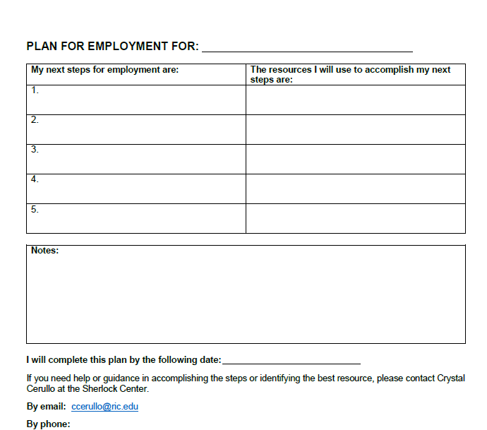
PLAN FOR EMPLOYMENT
What is your action plan?
Use the activity sheet to plan steps for the next six months
What are your steps to employment?
What resources will you use to accomplish those steps?

Slide 31
Help is available
Sherlock Center on Disabilities
www.sherlockcenter.org
RIPIN
http://www.ripin.org/
Providing coaching and being able to answer individual questions
Ian Armitstead
Email: iarmitstead@ric.edu
Call: 401-456-2760
Can provide information and assistance related to transition IEPs and connecting with DDD.
Call: 401-270-0101

Slide 32
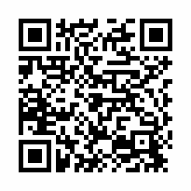
Thank You!
EVALUATION FOR TODAY
Click on this link, find it in the chat, or use the QR code.
Please complete!

