Slide 1
FEAT - Adult
Ian Armitstead & Kie O’Donnell
October, 2026

Slide 2
Housekeeping
We want to keep things informal but ask that you keep yourself on mute unless you want to ask a question or make a comment. ​
​You can also comment or ask questions using the “chat.”​
​This session will be recorded. It is interactive, and we strongly encourage participants to actively engage, ask questions, or share personal examples when appropriate, and we will stop recording.

Slide 3
Online Materials and Resources
Materials included for entire series
PowerPoint handouts​
Glossary​
Activities​
Plan for Employment​
Links to related resources​
Website for resources – www.featri.net

Slide 4
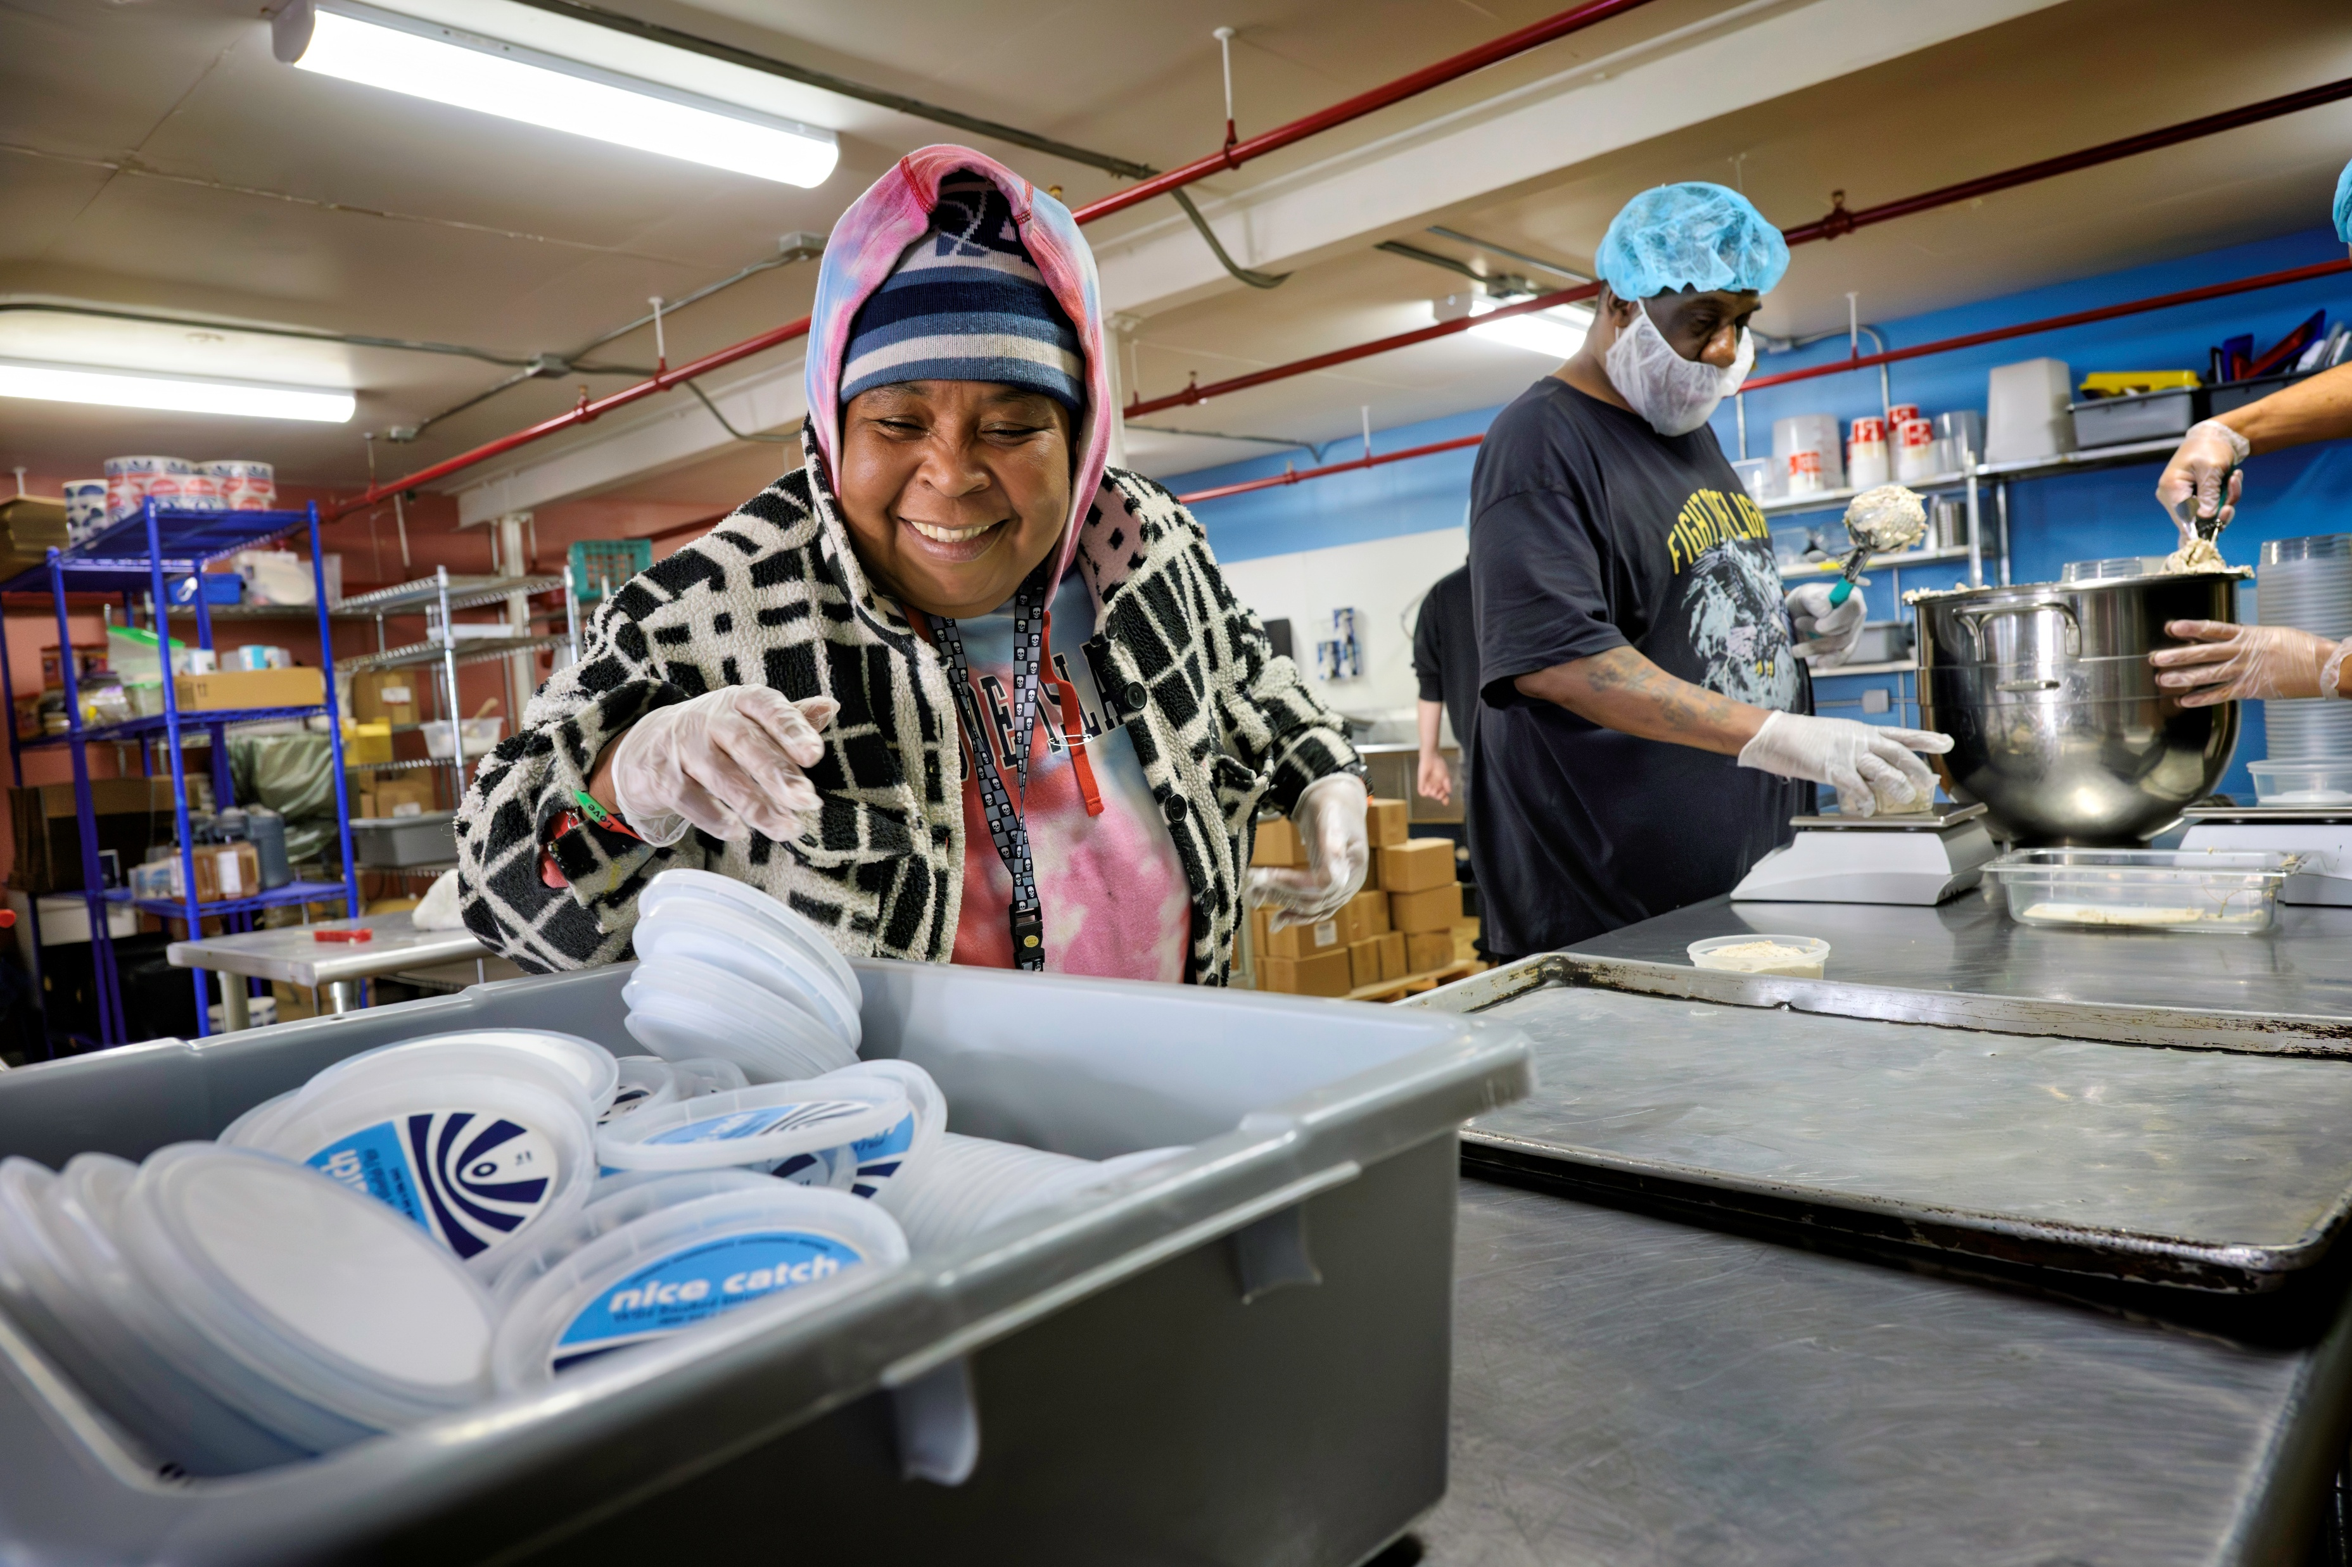
Agenda
Who we are
RI Panelists
Contributing to the employment process
Accessing adult services
Planning for tomorrow

Slide 5
Where were YOU in 2013?
High School
Day Program
Sheltered Workshop
Self-Directing your Supports
Not Receiving Services
Let’s hear from Steven!

Slide 6
Recognition
We RECOGNIZE that this may not be a “new path” for you and your family.
We ACKNOWLEDGE that your participation in this series supports the belief and expectation that your child has gifts, talents, and skills that a business would value.
We STRIVE to share resources and help provide guidance toward success!
Embracing success, large and small.

Slide 7

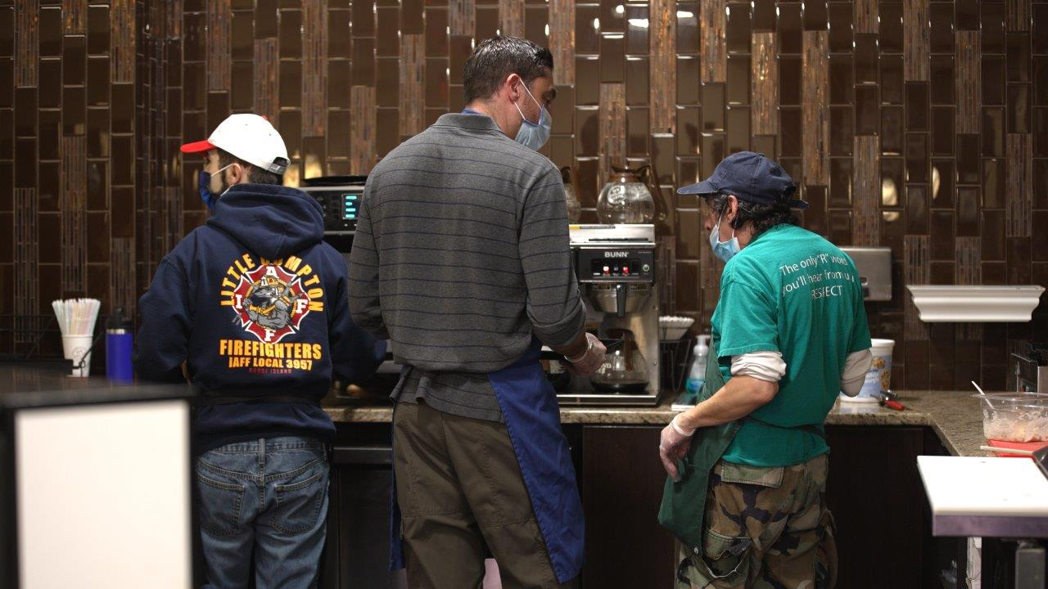
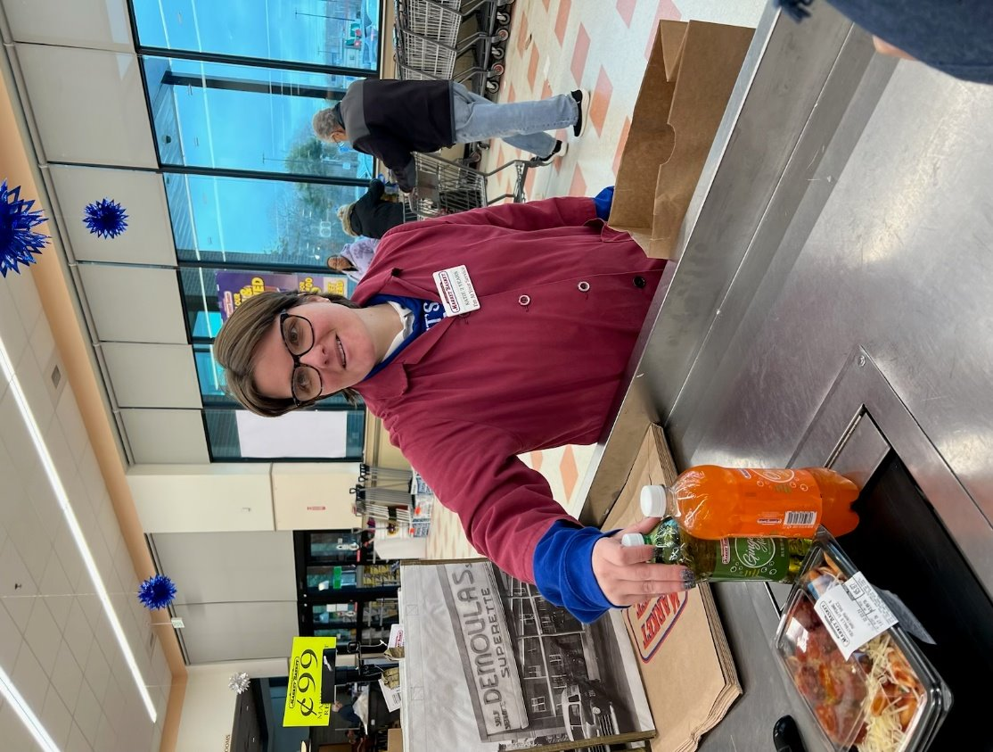
Pathways
There is no one way to success.

Slide 8

Let’s hear from some Rhode Island Workers
To be announced

Slide 9
Major Steps to Employment
Explore, Identify, Prepare, Pursue
  Planning and Assessment
Get
  Development and Hiring
Keep and Grow
  Coaching, Retention, and Advancement

Slide 10
Discovery and Career Exploration
Discovery:
A way to help people find work that fits them best. Spend time with the person, watch what they like to do, and see what they are good at, instead of using tests.
Career exploration:
Like discovery, career exploration helps a person learn what kind of job might be a good fit. They learn what tasks they enjoy, what kinds of places they like to work in, and what people they want to work with. This helps them find the best job for them.

Slide 11
Real Training to Support Real Work
“Supporting, not Simulating”
Industry-based training and education
Job Trials and Community-Based Work Experiences
Job Shadowing
Informational Interviews
Tours
Apprenticeships

Slide 12

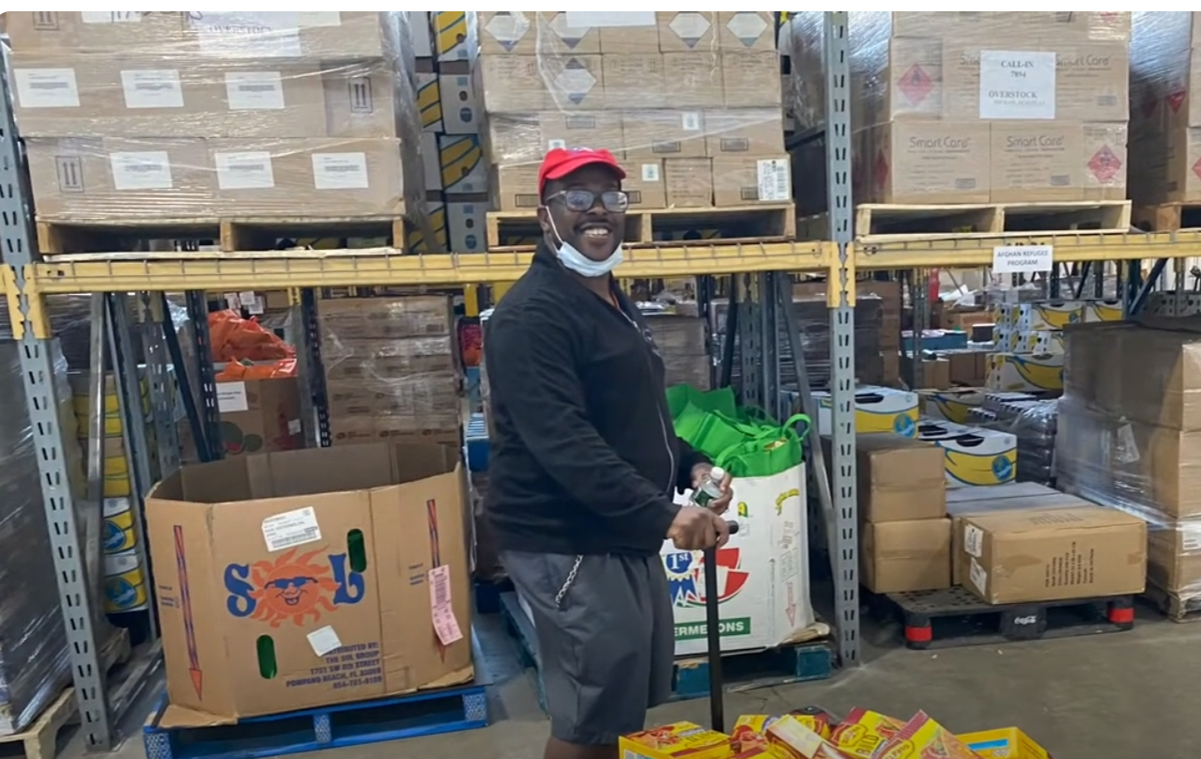

Meet Corey – Works as a Warehouse Associate
Corey’s Video

Slide 13
The Role of Volunteering
Historically:
People with disabilities were placed in volunteer positions that never ended, without the promise of moving forward into paid positions using the skills they learned. This devalued them and their ability to work.
However, for some, purposeful volunteer opportunities can:
Build skills
Gain work experience
Become familiar with workplace culture
Develop connections
Learn about work environments and settings

Slide 14
Contributing to Employment Process
Look for the individual’s contributions and passions
Assist with brainstorming business/job ideas
Encourage creativity
Plan for employment through the Individualized Service Plan (ISP) goals
Network – share job contacts
Inform the team of what works when faced with challenges
Participate in problem-solving
  What other ways/ideas do you have to help contribute?

Slide 15
Medicaid – Home and Community Based Services (HCBS)
Funds community services (e.g., supported employment, day services, personal assistance)
For people with developmental disabilities in Rhode Island, administered by BHDDH-DDD.
Virtually all DDD supports are Medicaid HCBS.
Common source of funding for ongoing job support following or along with ORS time-limited vocational rehabilitation
HCBS rules – Services must be based on a person-centered plan and integrated into the community

Slide 16
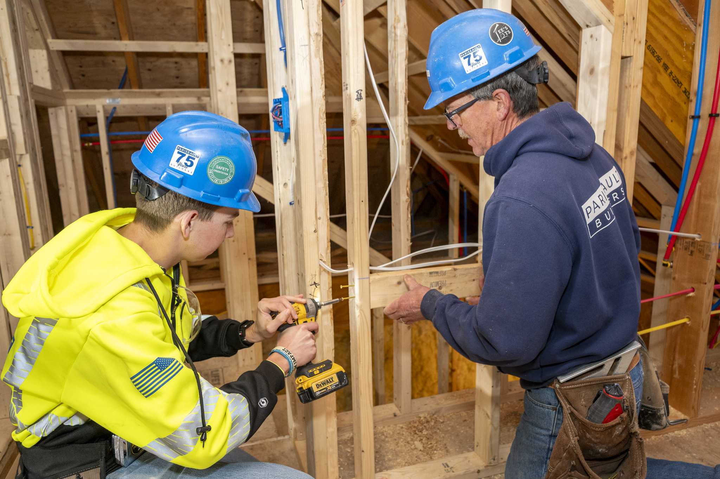
www.ors.ri.gov
Office of Rehabilitation Services (ORS)
Vocational Rehabilitation (VR)
Watch the ORS video clip

Slide 17
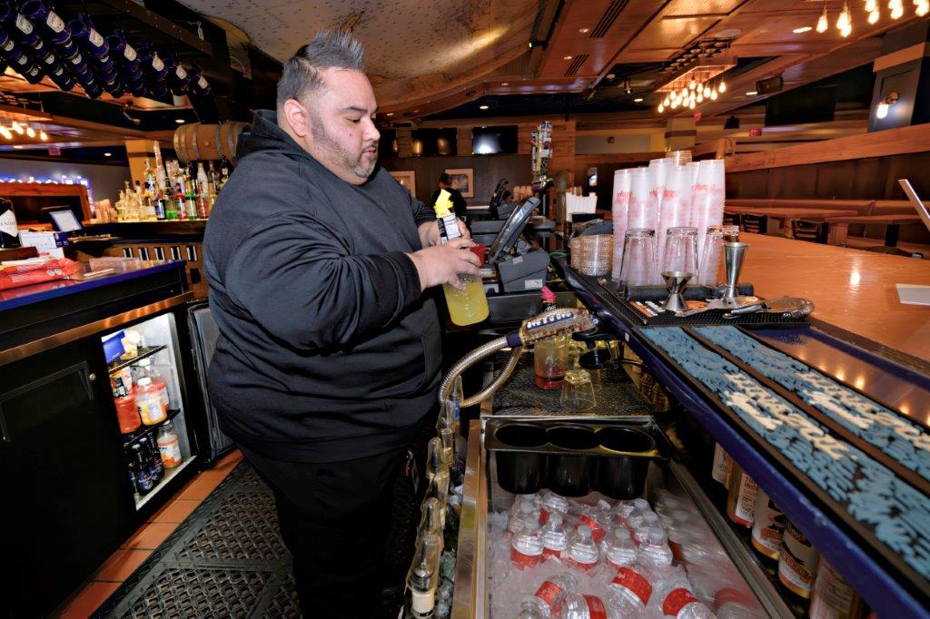
BHDDH Division of Developmental Disabilities (DDD)
Watch the BHDDH video clip
BHDDH Employment Webpage

Slide 18
Employment Services and Supports
You can use some or all of your DDD funding for ongoing employment supports. You may also qualify for short-term job help from ORS.
You can make your money go further by:
Braiding
Blending
Sequencing
All of these help people find, get, or keep a job in the community.
Watch video

Slide 19
Questions?

Slide 20

Antidiscrimination Laws
Federal laws
  Americans with Disabilities Act (ADA)
State laws
  Rhode Island Fair Employment Practice Act

Slide 21
Americans with Disabilities Act (ADA)
Right to reasonable accommodations
  Change or adjustment to job, work environment, or work practices
Employee is responsible for asking for reasonable accommodations
  During the application process OR
  After hire
To file a complaint
  http://www.ada.gov/filing_complaint.htm

Slide 22
Rhode Island Fair Employment Practices Act (RIGL 28-5-1et seq.)
Prohibits employment discrimination
Enforcement:
  Rhode Island Commission for Human Rights
    401-222-2661 (V), -2664 (TTY)
Disability Rights Rhode Island (formerly RI Disability Law Center)
    1-800-733-5332
    401-831-5335 (TTY)
Mediation – Governor’s Commission on Disabilities
    401-462-0107

Slide 23

Strength-Based Profile Building
Person-centered approach
Draws from whole life experiences
Encourages positive input and participation from varying sources
Focuses on strengths, with consideration of support needs / strategies

Slide 24
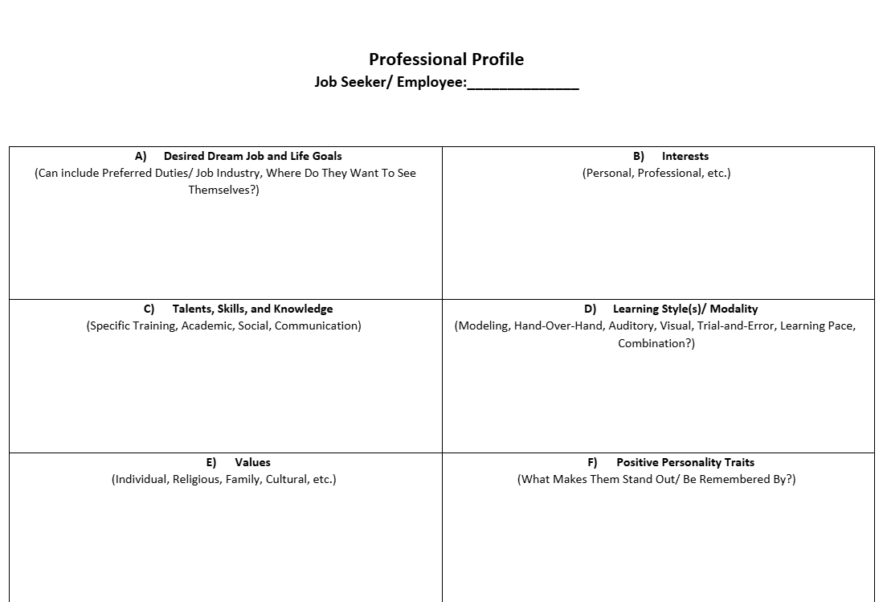
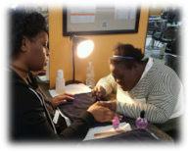
Strength-Based Profile Building
Specified and defined areas
“Living / breathing document”
(should be added to frequently)
Watch the video clip

Slide 25
Let’s Build a little Together!

Slide 26

Planning for Tomorrow
Next steps towards Employment
Big Picture Outcomes of Employment
Individual quality of life
Family quality of life
The desirable life

Slide 27
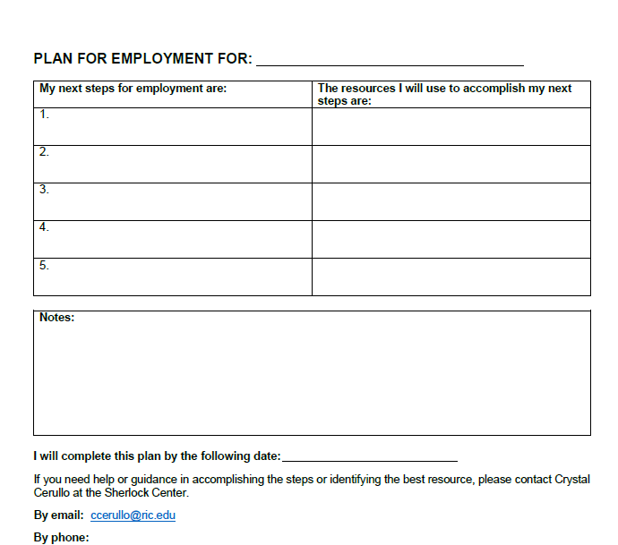
PLAN FOR EMPLOYMENT
What is your action plan?
Use the activity sheet to plan steps for the next six months
What are your steps to employment?
What resources will you use to accomplish those steps?

Slide 28
Help is available
Sherlock Center on Disabilities
www.sherlockcenter.org
RIPIN
http://www.ripin.org/
Providing coaching and being able to answer individual questions
Ian Armitstead
Email: iarmitstead@ric.edu
Call: 401-456-2760
Can provide information and assistance related to transition IEPs and connecting with DDD.
Call: 401-270-0101

Slide 29
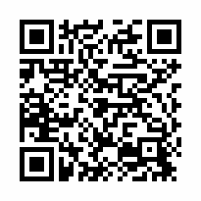
Thank You!
EVALUATION FOR TODAY
Click on this link, find it in the chat, or use the QR code.
Please complete!

