Slide 1
Adapted from the original text, Alexander and the Terrible, Horrible, No Good, Very Bad Day, by Judith Viorst.
Notes:
Alexander and the Terrible, Horrible, No Good, Very Bad Day. Adapted from the original text by Judith Viorst.

Slide 2
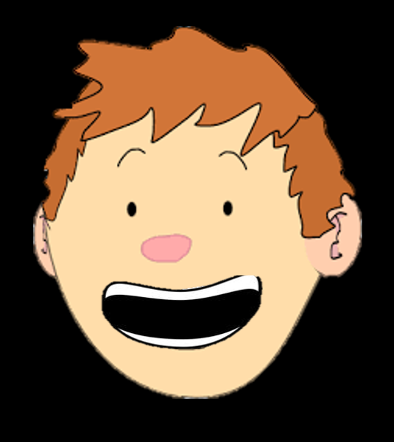
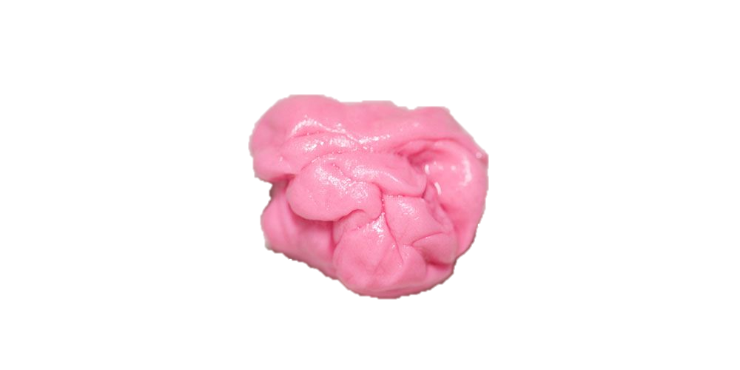
Notes:
Alexander has gum in his hair, he trips on a skateboard, and gets his sweater wet. Alexander knows it is a bad day.

Slide 3
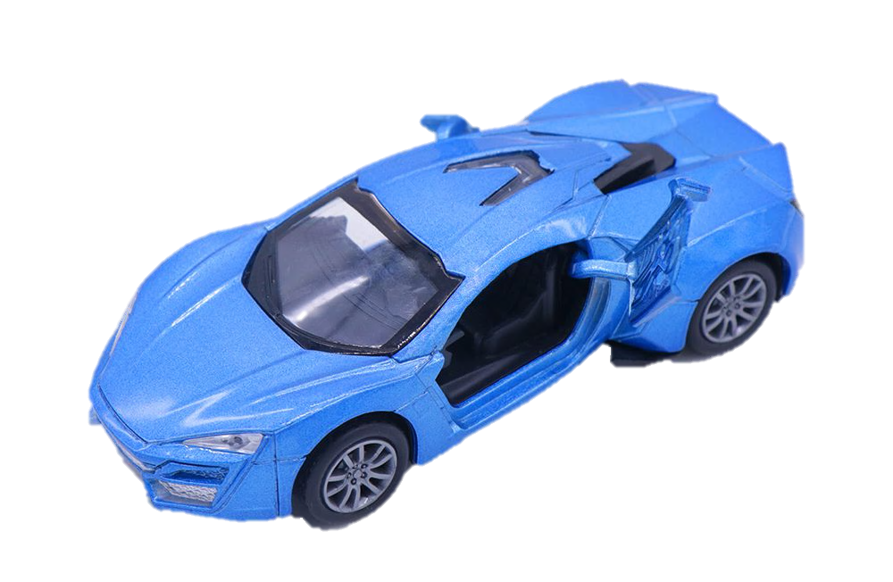
Notes:
Alexander eats breakfast with his brothers. His brothers get a toy in their cereal. Alexander doesn’t get a toy.

Slide 4
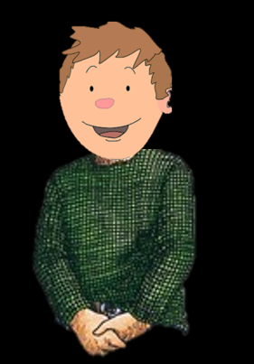
Notes:
Alexander wants to move to Australia.

Slide 5
Notes:
Alexander rides to school. His friends get to sit next to the windows, but he gets squished in the middle. Alexander knows it’s a bad day.

Slide 6
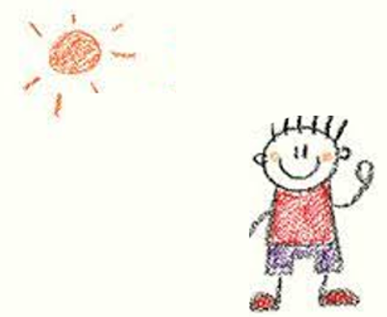
Notes:
Alexander and his friends draw pictures in school. His teacher likes his friend’s picture better.

Slide 7
Notes:
Alexander’s teacher says he is too loud. He knows it’s a bad day.

Slide 8
Notes:
Alexander's friend is not nice to him. He is not nice to his friend. Alexander is angry.

Slide 9
Notes:
Alexander goes to lunch with his friends. His friends have yummy desserts. He does not have any dessert. It is a bad day.

Slide 10
Notes:
Alexander has to go to the dentist after school. He has a cavity and needs to get it fixed. He wants to move to Australia.

Slide 11
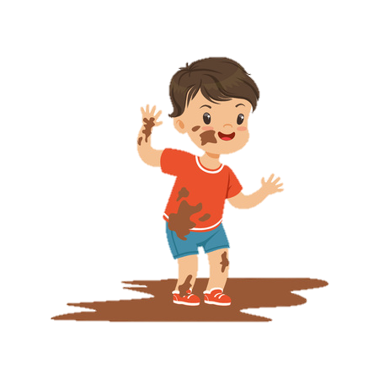
Notes:
Then the elevator door closes on Alexander’s foot. His brother pushes him in the mud and teases him for crying.

Slide 12
Notes:
Alexander is muddy and not being very nice. His mother is angry with him. It is a bad day.

Slide 13
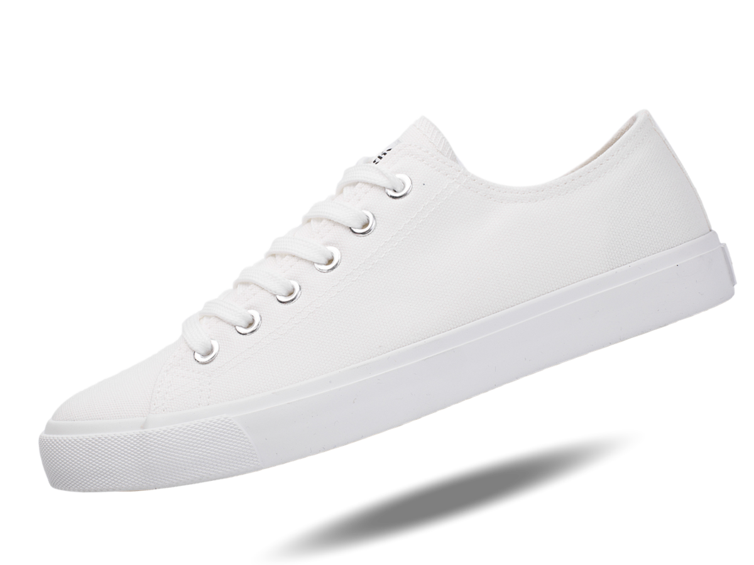
Notes:
His mother takes them to the shoe store. Alexander’s brothers get cool new shoes. Alexander gets plain white. He does not like his new shoes.

Slide 14
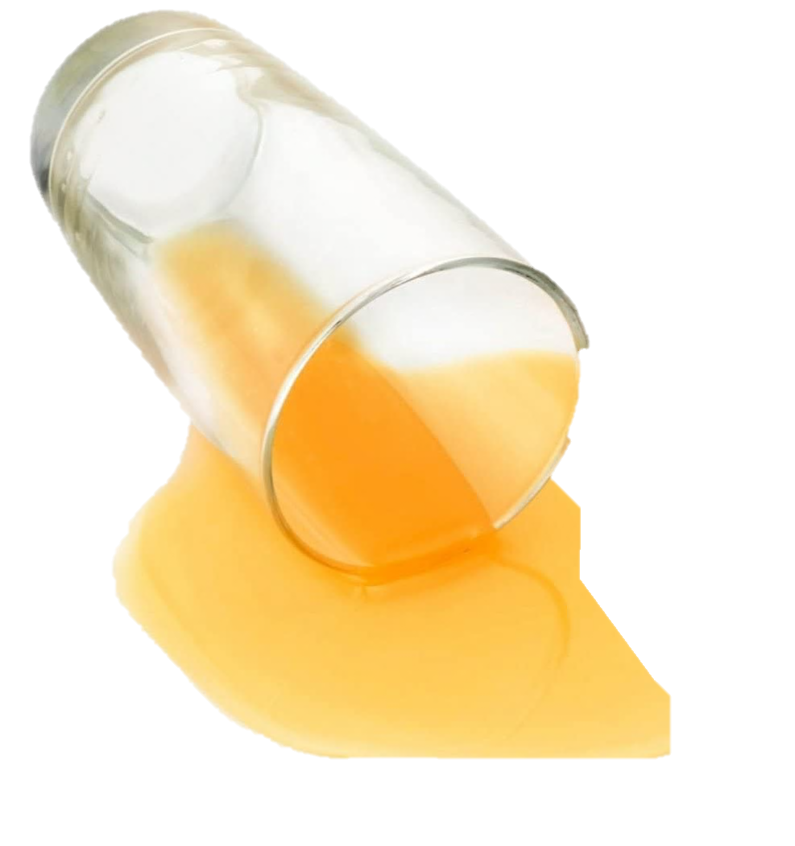
Notes:
Alexander goes to his dads office and makes a mess. His dad is upset. It is a bad day.

Slide 15
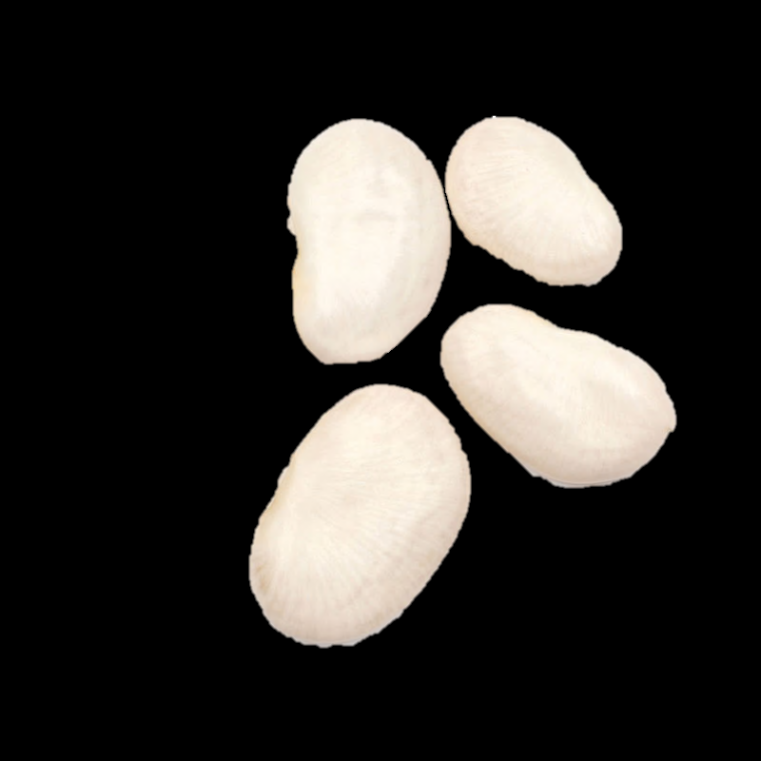
Notes:
Alexander’s family makes lima beans for dinner. He does not like lima beans. Then they watch tv with kissing. Alexander does not like kissing. Yuck!

Slide 16
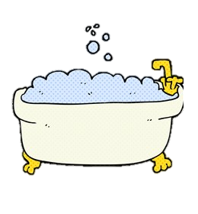
Notes:
Alexander gets ready for bed. He takes a bath but the water is too hot. He gets soap in his eyes, drops his marbles down the drain, and doesn’t like his pajamas.

Slide 17
Notes:
Alexander goes to bed. He doesn’t have his pillow or night light, he bites his tongue, and his cat won’t sleep with him.

Slide 18
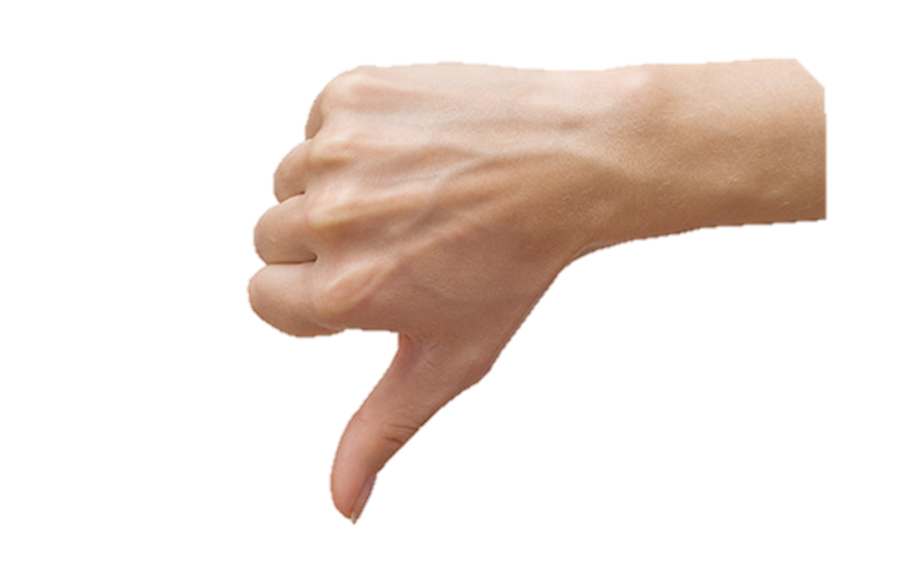
Notes:
It is a bad day. Alexander’s mom says some days are bad. Even in Australia.

Slide 19
Notes:
The End.

Slide 20
This Adapted Literature resource is available through the Sherlock Center Resource Library. The text and graphics are adapted from the original source. These resources are provided for teachers to help students with severe disabilities participate in the general curriculum. Please limit the use and distribution of these materials accordingly.
Paul V. Sherlock Center on Disabilities / RI College
600 Mt. Pleasant Avenue, Providence RI 02908
Website: www.sherlockcenter.org

