Slide 1
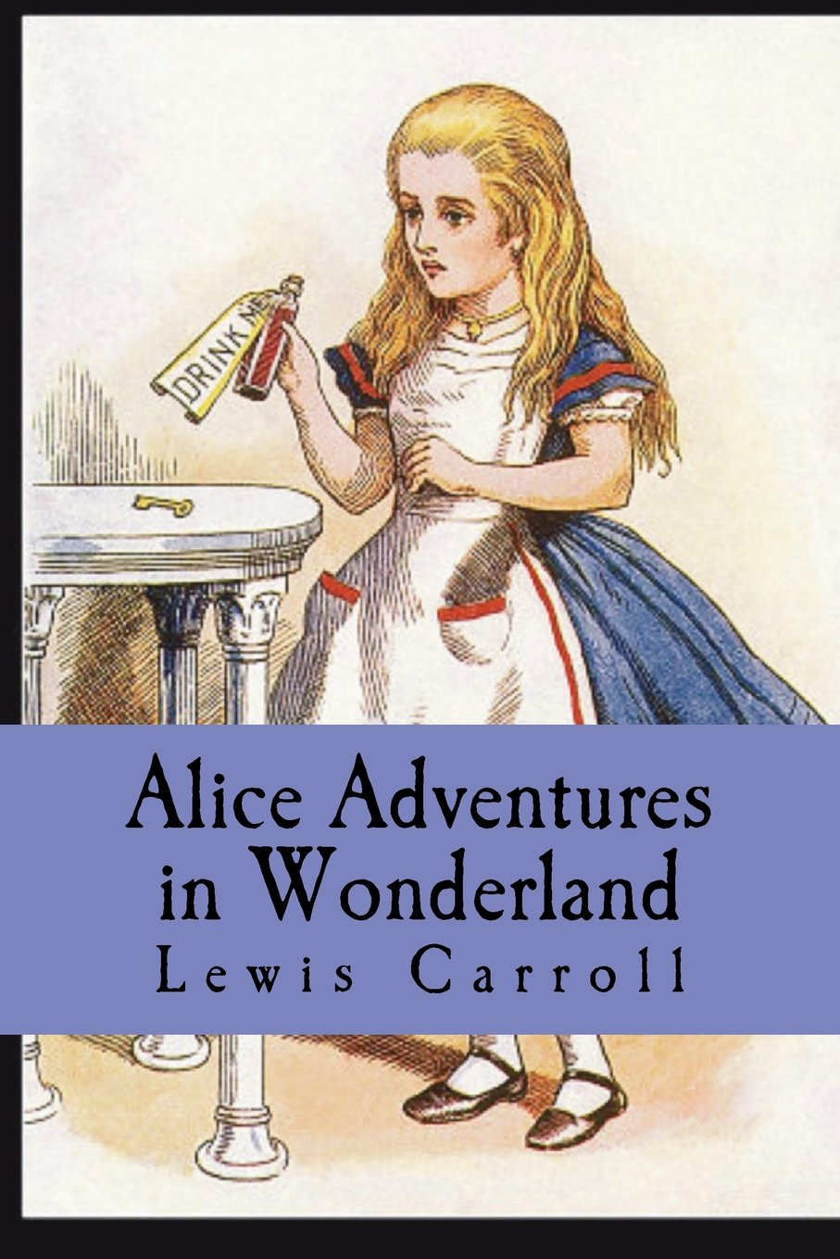
Adapted from the original text, Alice Adventures in Wonderland, by Luis Carroll.

Slide 2
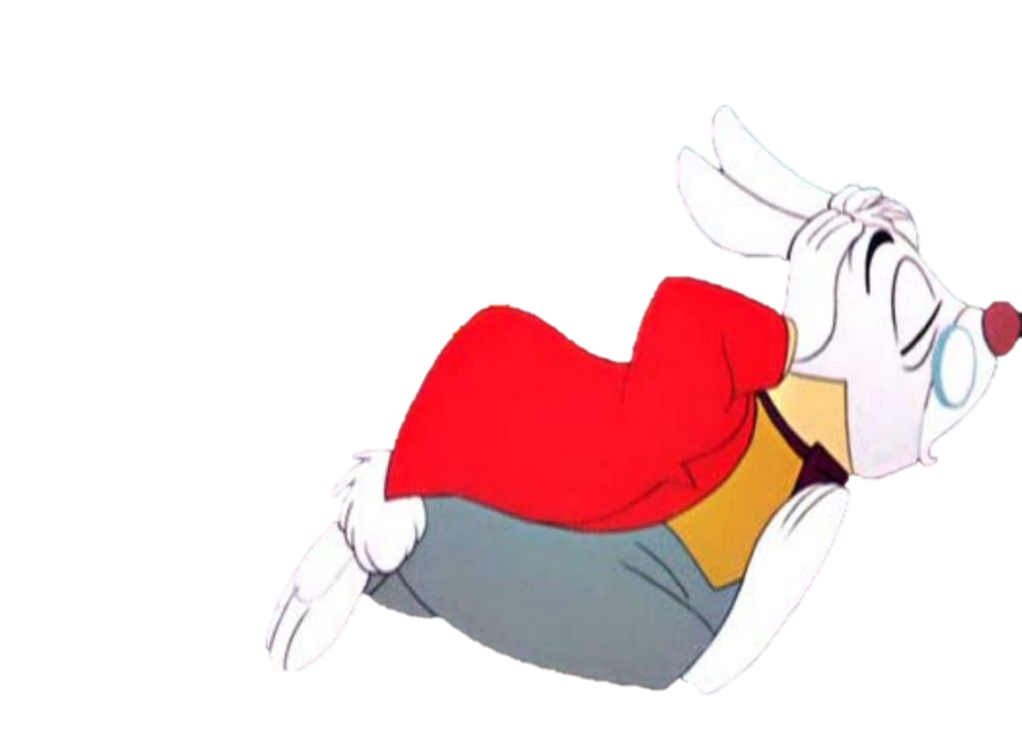
Notes:
Alice is sleepy when she sees a rabbit.

Slide 3
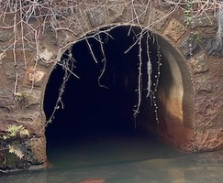
Notes:
Alice follows the rabbit down a big hole.

Slide 4
Notes:
Alice drinks a potion that she finds, and it makes her so big!

Slide 5
Notes:
Alice gets scared and starts crying. She cries so much she is in a bath of tears!

Slide 6
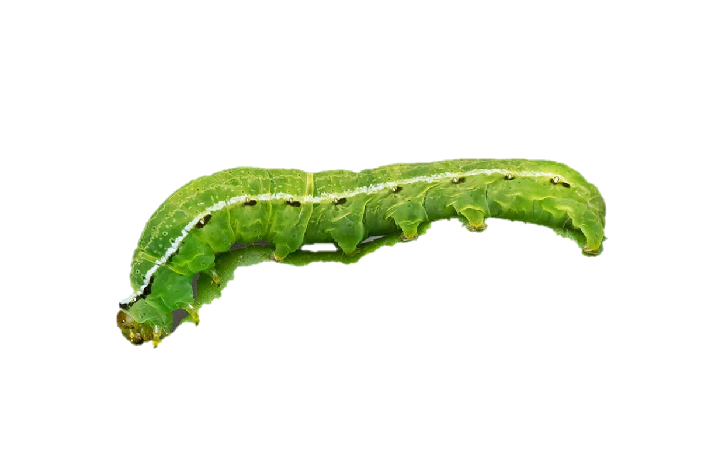
Notes:
Alice finds a caterpillar. He asked Alice a lot of questions.

Slide 7
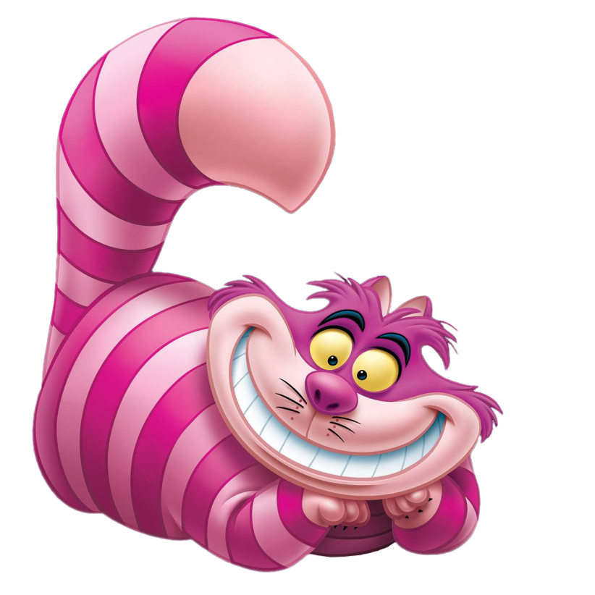
Notes:
Then she finds a cat. His name is Chesire Cat. He has a scary smile. Alice doesn’t like his smile.

Slide 8
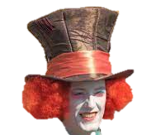
Notes:
Alice then meets the Mad Hatter. She does not like him either, so she runs through a door to a garden.

Slide 9
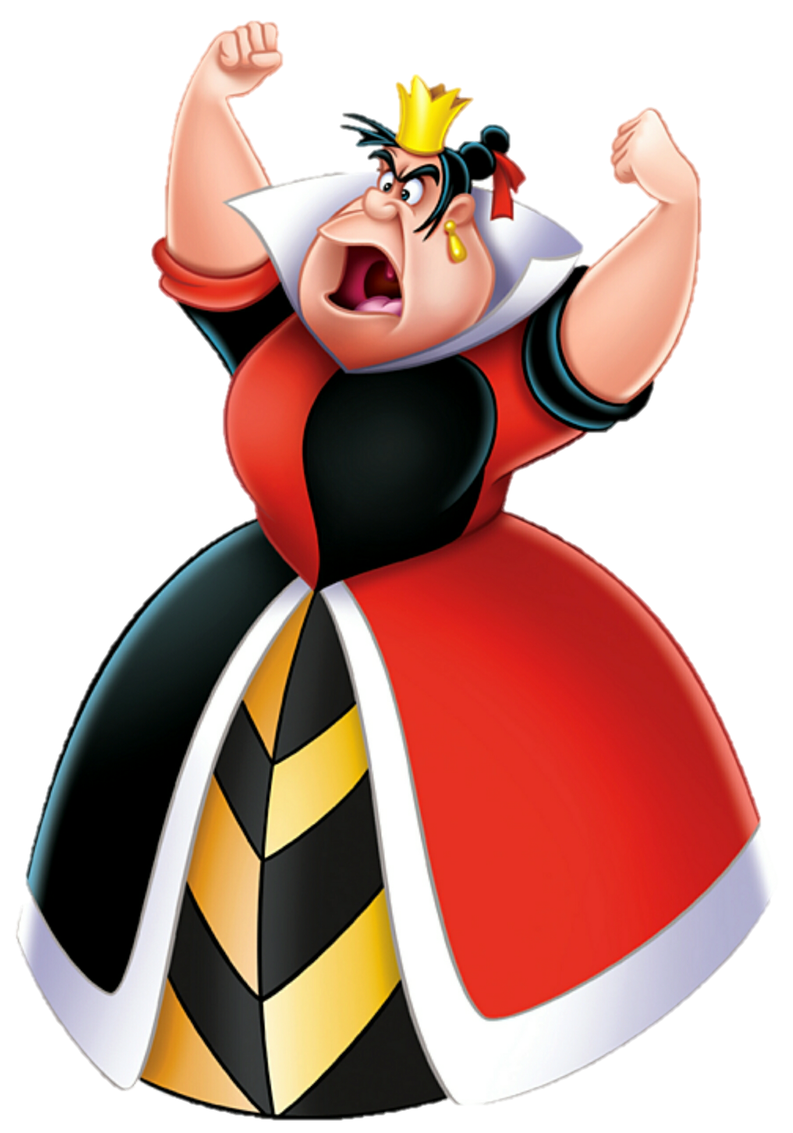
Notes:
In the garden, Alice finds the Queen. But the queen is mean and sends Alice to jail!

Slide 10
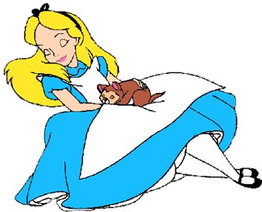
Notes:
Alice is asleep, but her sister wakes her up. Alice tells her sister about her dream.

Slide 11
Notes:
The End.

Slide 12
This Adapted Literature resource is available through the Sherlock Center Resource Library. The text and graphics are adapted from the original source. These resources are provided for teachers to help students with severe disabilities participate in the general curriculum. Please limit the use and distribution of these materials accordingly.
Paul V. Sherlock Center on Disabilities / RI College
600 Mt. Pleasant Avenue, Providence RI 02908
www.sherlockcenter.org

