Slide 1
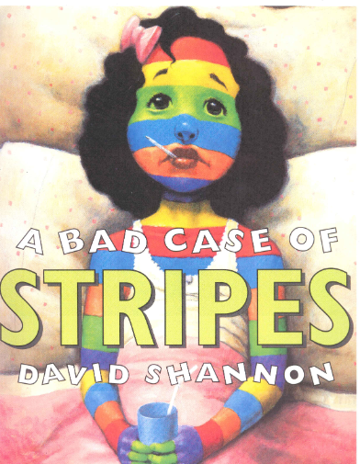

Adapted from the original text, A Bad Case of Stripes,
written by David Shannon
Notes:
This book was adapted from the original text, A Bad Case of Stripes, written by David Shannon

Slide 2
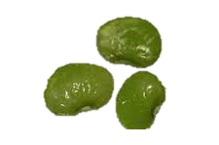
Notes:
Camilla loved lima beans. They are green and round and taste so good! Camilla did not eat them because her friends did not like them.

Slide 3
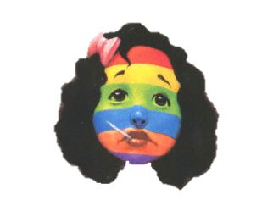
Notes:
Camilla was getting ready for the first day of school. Camilla looked in the mirror and screamed. Camilla had stripes all over her body. She had stripes of many colors: red, blue orange, green, purple and yellow!

Slide 4
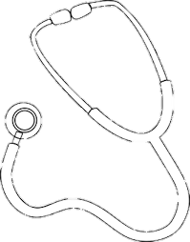
Notes:
The doctor came to check Camilla. Camilla felt good but did not look good. The doctor said Camilla could go to school.

Slide 5
Notes:
At school, all the children laughed. Camilla’s stripes changed when the children called her names. Camilla has red white and blue stripes across her face.

Slide 6

Notes:
The children changed Camilla’s stripes all day long. The children laughed and now Camilla has a blue face with dots on it.

Slide 7
Notes:
The principal told Camilla she could not come back to school. Camilla went to see more doctors. The doctors did not know why Camila had stripes.

Slide 8
Notes:
A man from the newspaper came to ask about Camilla’s stripes.

Slide 9
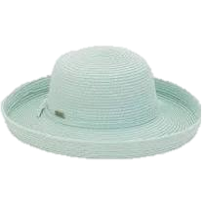
Notes:
An old woman with a hat knocked on Camilla’s door. The woman thought she could help Camilla.

Slide 10
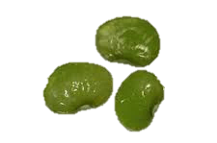
Notes:
The old woman fed Camilla lima beans. Camilla told the old woman how much she loved lima beans.

Slide 11
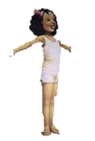
Notes:
Camilla turned back into a girl with no stripes. She was so happy that she jumped up and down.

Slide 12
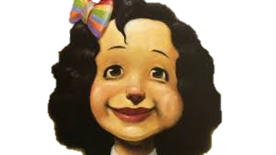
Notes:
Camilla never pretended to not like lima beans again. Camilla was happy

Slide 13

Notes:
The End

Slide 14
This Adapted Literature resource is available through the Sherlock Center Resource Library. The text and graphics are adapted from the original source. These resources are provided for teachers to help students with severe disabilities participate in the general curriculum. Please limit the use and distribution of these materials accordingly.
Paul V. Sherlock Center on Disabilities / RI College
600 Mt. Pleasant Avenue, Providence RI 02908
www.sherlockcenter.org
Notes:
This Adapted Literature resource is available through the Sherlock Center Resource Library. The text and graphics are adapted from the original source. These resources are provided for teachers to help students with severe disabilities participate in the general curriculum. Please limit the use and distribution of these materials accordingly.

