Slide 1
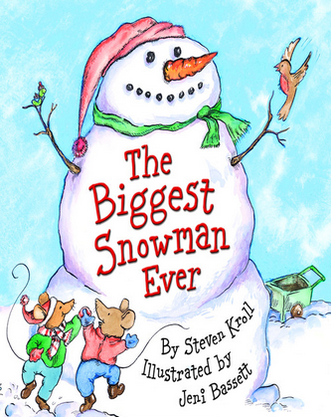

Adapted from the original text, The Biggest Snowman Ever,
written by Steven Kroll and illustrated by Jeni Bassett
Notes:
Adapted from the original text, The Biggest Snowman Ever, written by Steven Kroll and illustrated by Jeni Bassett.

Slide 2
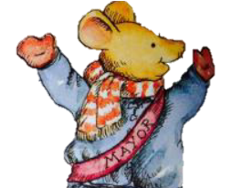
Notes:
The mayor of Mouseville said, “Whoever makes the biggest snowman will win a prize.” The mice had two weeks to build their snowman.

Slide 3
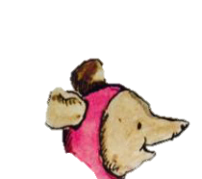
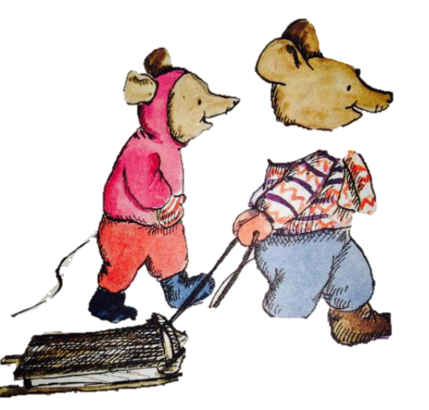
Notes:
Penelope Mouse and James Mouse talked about the snowman contest.

Slide 4

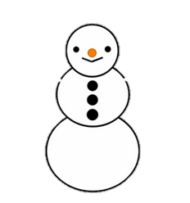
Notes:
Penelope Mouse said “I’m going to make a Big princess snowman with a crown.”

Slide 5

Notes:
James Mouse said, “I’m going to make a BIG green snowman Martian.”

Slide 6
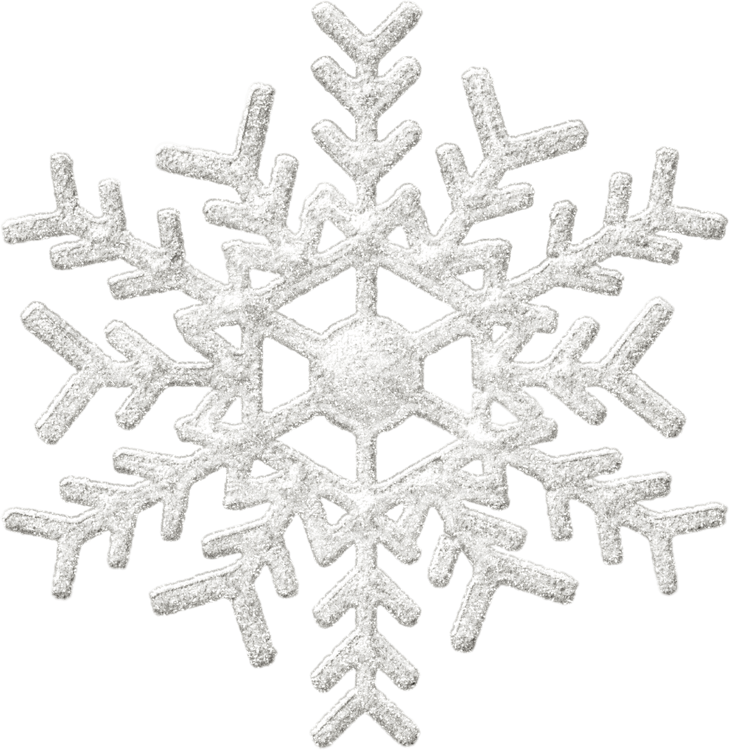
Notes:
That night, it snowed and snowed and snowed and snowed.

Slide 7
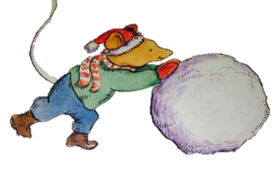
Notes:
In the morning, the mice made snowmen. They made a snowball and rolled, and rolled it until it was very big.

Slide 8
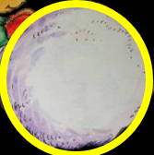
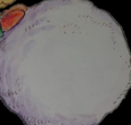
Notes:
The next day, Desmond mouse made a big snowball for his snowman’s belly. He put it on top of his other snowball.

Slide 9
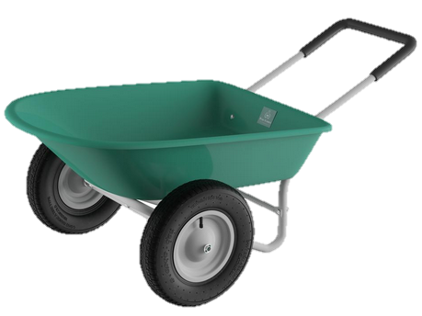
Notes:
At night, Clayton Mouse showed his dad his snowman. His dad said, “It’s going to be big, but I’m not sure if it will be the biggest. If you want to work faster, use a wheelbarrow to carry the snow.

Slide 10
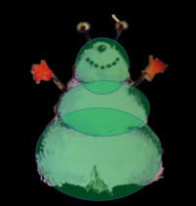
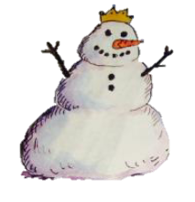
Notes:
Desmond looked at the Princess Snowman. Desmond looked at the Martian Snowman. All of the snowmen are the same size.

Slide 11
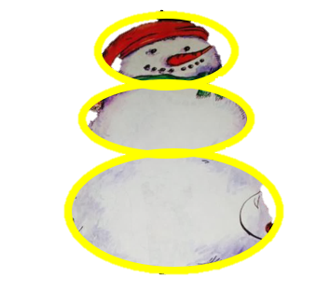
Notes:
Clayton and Desmond had a GREAT idea! We should work together!
The mice worked together and made an ENORMOUS snowman. It was the biggest snowman ever!

Slide 12


Slide 13
This Adapted Literature resource is available through the Sherlock Center Resource Library. The text and graphics are adapted from the original source. These resources are provided for teachers to help students with severe disabilities participate in the general curriculum. Please limit the use and distribution of these materials accordingly.
Paul V. Sherlock Center on Disabilities / RI College
600 Mt. Pleasant Avenue, Providence RI 02908
www.sherlockcenter.org

