Slide 1


Adapted from the original text, A Chair for My Mother,
written by Vera B. Williams
Notes:
Adapted from the original text, A Chair for My Mother,
written by Vera B. Williams

Slide 2
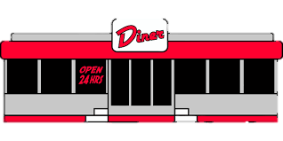
Notes:
My mother’s a waitress at the Blue Tile Diner. After school, I go there and help when I finish. I get paid. After I get paid, I put half the money in a jar.

Slide 3
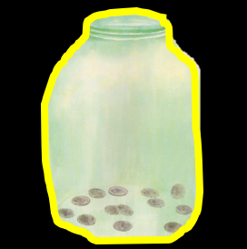
Notes:
It takes a long time to fill the jar. My momma put all of her change in the jar, too. Some days, she gets a lot of tips; and some days, she gets a little. Grandma helps count the money.

Slide 4
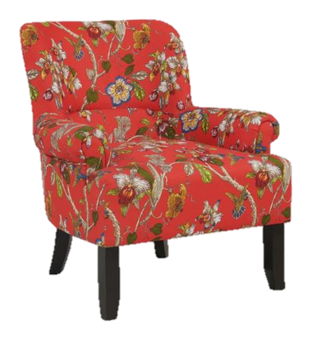
Notes:
When we fill the jar, we are going to buy a chair; a beautiful chair with flowers on it. Our other chairs burned in a fire in our house.

Slide 5

Notes:
A few years ago, when my mother and I were walking home from the store, fire engines were at our house. The house was full of flames. Thankfully, everyone was okay, but our chair was burned.

Slide 6
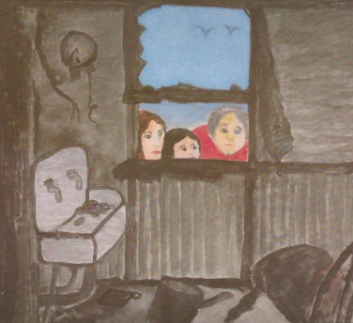
Notes:
Our old house was ruined and full of ashes. We went to stay with my aunt and uncle. We moved into the apartment downstairs.

Slide 7

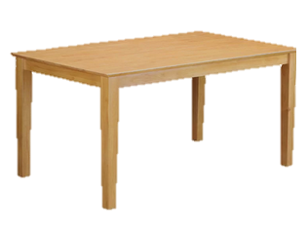
Notes:
When we moved into the apartment, the neighbors brought pizza and ice cream. They also brought over a table, a rug, curtains, and silverware, but momma still had no comfortable chair to sit in.

Slide 8
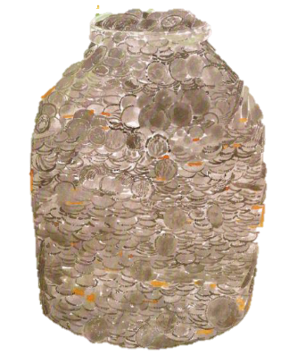
Notes:
One night, we looked at the money jar, and it was FULL. We took the coins to the bank.

Slide 9
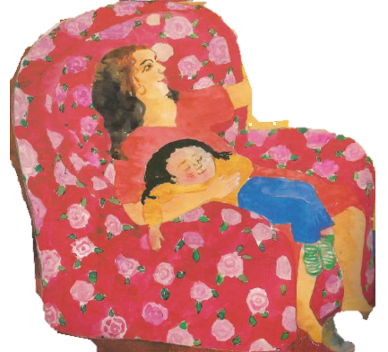
Notes:
We shopped in many stores looking for a chair. Some chairs were big. Some were small. Some were soft and some were hard.
Finally, we found the chair we were dreaming about. We brought the chair right home. My grandma sits in it during the day, momma sits in it after work. After dinner, I get to sit with momma and fall asleep on her lap.

Slide 10

Notes:
The end.

Slide 11
This Adapted Literature resource is available through the Sherlock Center Resource Library. The text and graphics are adapted from the original source. These resources are provided for teachers to help students with severe disabilities participate in the general curriculum. Please limit the use and distribution of these materials accordingly.
Paul V. Sherlock Center on Disabilities / RI College
600 Mt. Pleasant Avenue, Providence RI 02908
www.sherlockcenter.org
Notes:
This Adapted Literature resource is available through the Sherlock Center Resource Library. The text and graphics are adapted from the original source. These resources are provided for teachers to help students with severe disabilities participate in the general curriculum. Please limit the use and distribution of these materials accordingly.

