Slide 1


Adapted from the original text, A Christmas Carol, written by Charles Dickens and illustrated by Dean Morrissey
Notes:
Adapted from the original text, A Christmas Carol, written by Charles Dickens and illustrated by Dean Morrissey

Slide 2
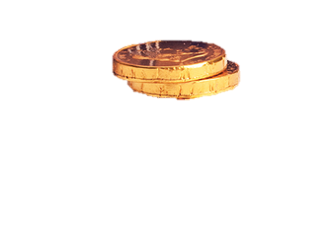
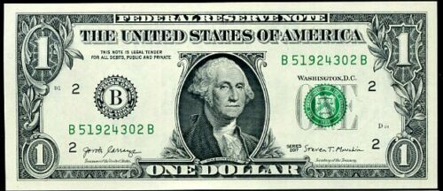
Notes:
It is Christmas Eve. Scrooge counts his money. Scrooge wants to work on Christmas. Bob Cratchett says, “no work. I need to be with my family.”

Slide 3

Notes:
Scrooge goes to bed and dreams. His dead friend tells Scrooge he must not be mean. His dead friend has heavy chains on him because he was mean when he was alive.

Slide 4
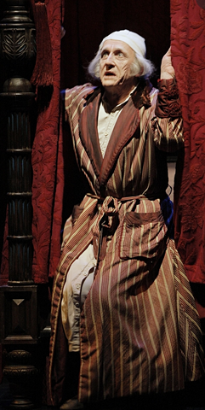
Notes:
Yesterday’s Ghost visits Scrooge. Scrooge was a young man and happy. Scrooge was in love and he didn’t have a lot of money.

Slide 5
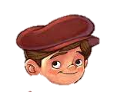
Notes:
A second ghost visits Scrooge. This ghost is Today’s Ghost. Today’s Ghost says Scrooge is sad and Scrooge has no friends. Today’s Ghost shows Bob Cratchett. Bob Cratchett’s son, Tiny Tim, is happy.

Slide 6
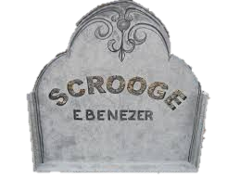
Notes:
A third ghost visits Scrooge. This ghost is called Tomorrow’s Ghost. Tomorrows Ghost is dark and scary. Tomorrow’s Ghost shows Scrooge is dead. Scrooge had no friends because he was mean and mad. Tomorrow’s Ghost shows Bob Cratchett’s family. Tiny Tim is sick. Bob Cratchett is sad

Slide 7
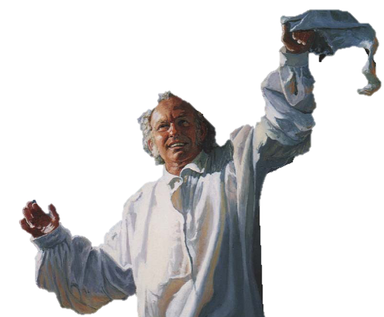
Notes:
Scrooge wakes up. It is Christmas Day. Scrooge want to change and not be mad and mean. Scrooge wants to be good and have friends.

Slide 8
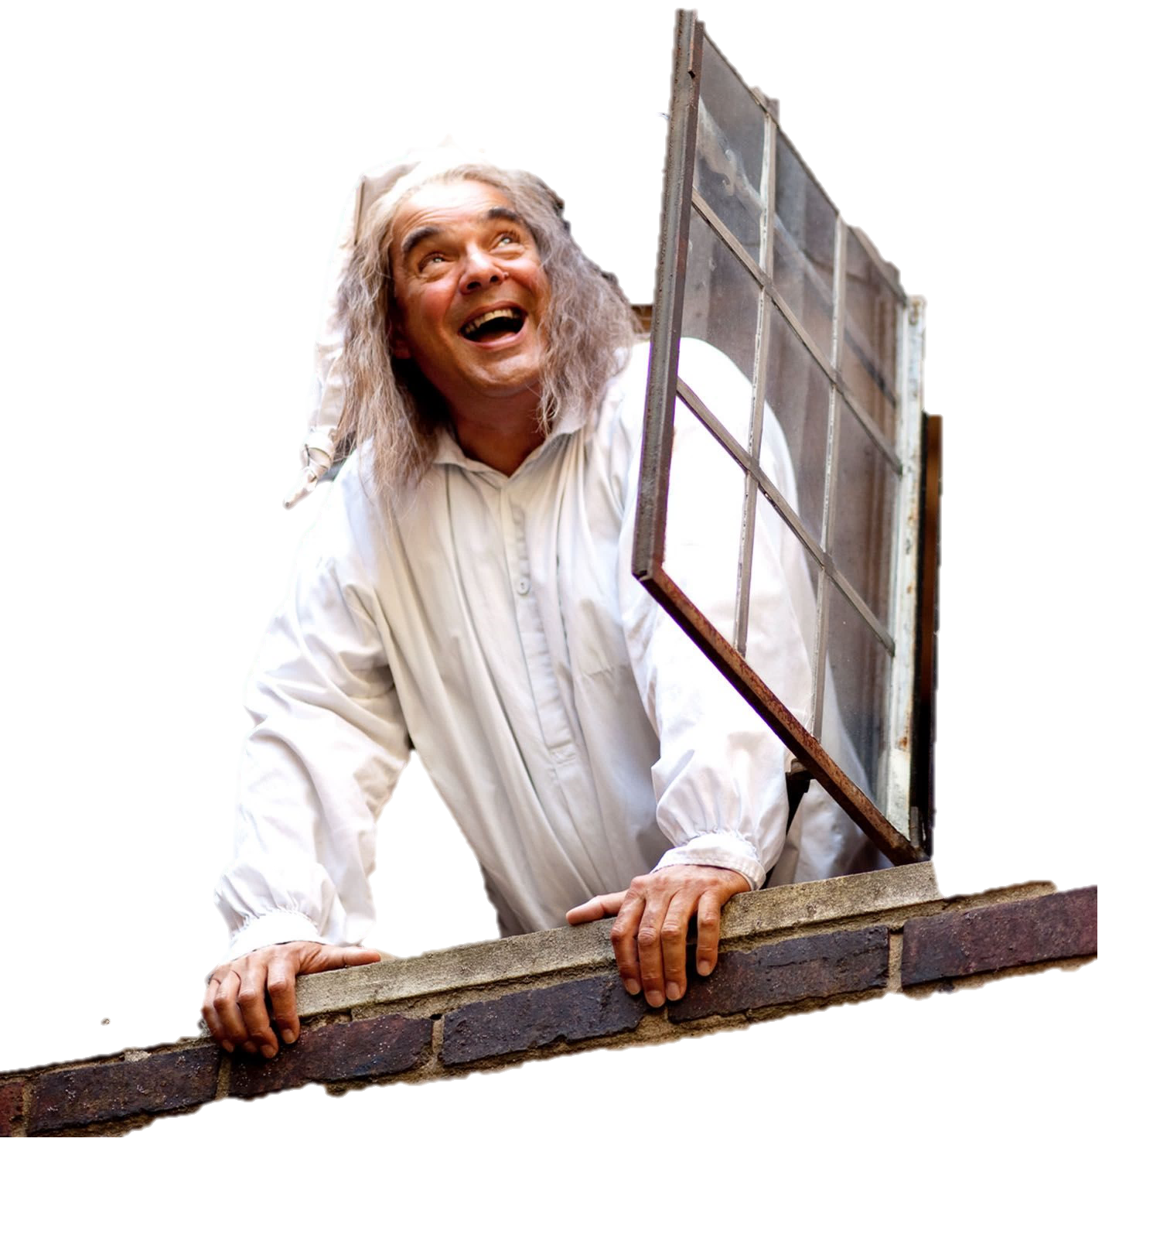
Notes:
Scrooge looks out his window. He sees a young boy. He gives the young boy money to buy his friend Bob Cratchett a BIG turkey. It will be delicious to eat on Christmas. Scrooge is good.

Slide 9
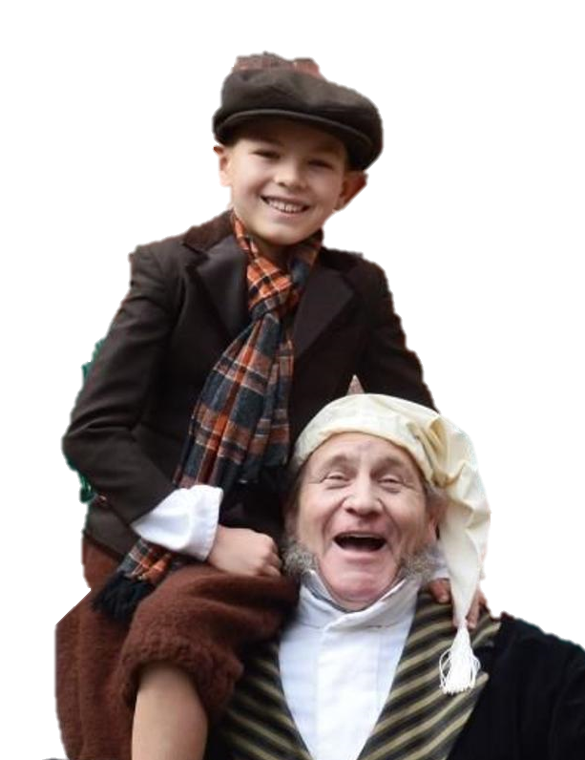
Notes:
Scrooge gives money to help Tiny Tim. Tiny Tim goes to a doctor and is NOT sick. Scrooge is a friend to Tiny Tim. Scrooge is happy.

Slide 10

Notes:
The end.

Slide 11
This Adapted Literature resource is available through the Sherlock Center Resource Library. The text and graphics are adapted from the original source. These resources are provided for teachers to help students with severe disabilities participate in the general curriculum. Please limit the use and distribution of these materials accordingly.
Paul V. Sherlock Center on Disabilities / RI College
600 Mt. Pleasant Avenue, Providence RI 02908
www.sherlockcenter.org
Notes:
This Adapted Literature resource is available through the Sherlock Center Resource Library. The text and graphics are adapted from the original source. These resources are provided for teachers to help students with severe disabilities participate in the general curriculum. Please limit the use and distribution of these materials accordingly.

