Slide 1


Adapted from the original text, Chrysanthemum, written by Kevin Henkes.
Notes:
This book is adapted from the original text, Chrysanthemum, written by Kevin Henkes.

Slide 2
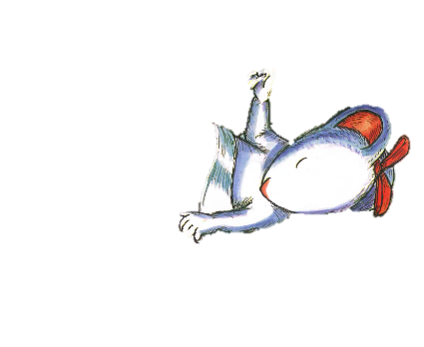
Notes:
Chrysanthemum’s parents were very happy the day Chrysanthemum became their daughter. Chrysanthemum’s parents gave Chrysanthemum her name because of a beautiful flower.

Slide 3
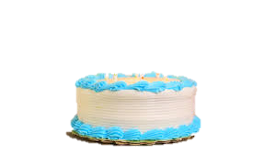

Chrysanthemum
Chrysanthemum
Notes:
Chrysanthemum loved her name.
Chrysanthemum loved the way her name looked on everything. Her name looked great on a letter and on a birthday cake.

Slide 4
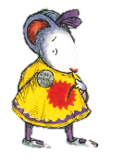
Notes:
Chrysanthemum began school. The children at school laughed at Chrysanthemum about her name. The children said Chrysanthemum’s name was too long.

Slide 5
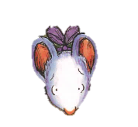

Notes:
Chrysanthemum was sad the entire day. She cried.

Slide 6
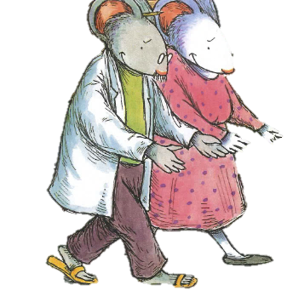
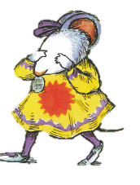
Notes:
Chrysanthemum went home to her family.
Her mother and father gave her a big hug. That made her feel better.

Slide 7
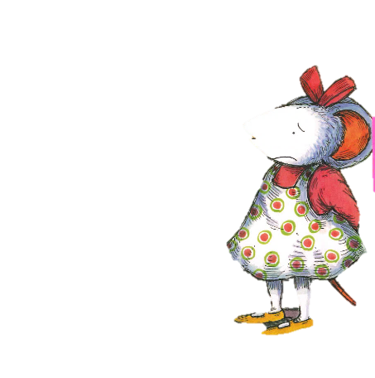
Notes:
Chrysanthemum went to school the next day. The children were not nice. Chrysanthemum was still sad and walked away to be alone.

Slide 8
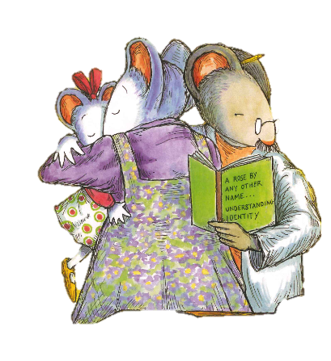
Notes:
Chrysanthemum went home.
Chrysanthemum’s mother told her the other children were jealous.
Chrysanthemum’s father told her that her name was beautiful. Mother and father gave her another big hug.

Slide 9

Notes:
Chrysanthemum returned to school. The children at school still laughed at Chrysanthemum.

Slide 10
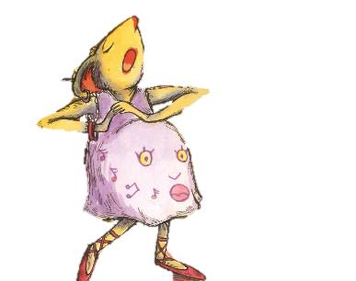
Notes:
Chrysanthemum had music class with Ms. Twinkle. Ms. Twinkle told the other children that Chrysanthemum’s name was a flower. The children felt sad for laughing at Chrysanthemum.

Slide 11
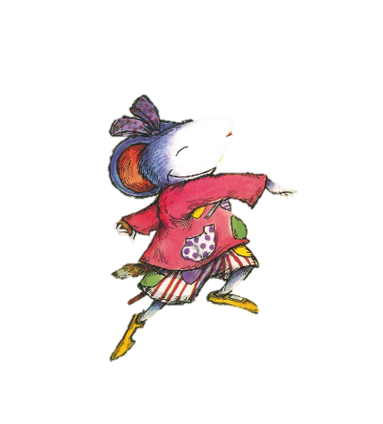
Notes:
Chrysanthemum loved her name again. Chrysanthemum was so happy that she danced all the way home!

Slide 12

Notes:
The End

Slide 13
This Adapted Literature resource is available through the Sherlock Center Resource Library. The text and graphics are adapted from the original source. These resources are provided for teachers to help students with severe disabilities participate in the general curriculum. Please limit the use and distribution of these materials accordingly.
Paul V. Sherlock Center on Disabilities / RI College
600 Mt. Pleasant Avenue, Providence RI 02908
www.sherlockcenter.org
Notes:
This Adapted Literature resource is available through the Sherlock Center Resource Library. The text and graphics are adapted from the original source. These resources are provided for teachers to help students with severe disabilities participate in the general curriculum. Please limit the use and distribution of these materials accordingly.

