Slide 1
Adapted from the original text, A Color of His Own, by Leo Lionni.
Notes:
Adapted from the original text, A Color of His Own, by Leo Lionni.

Slide 2
Notes:
Parrots are green.

Slide 3
Notes:
Goldfish are red.

Slide 4
Notes:
Elephants are gray.

Slide 5
Notes:
Pigs are pink.

Slide 6
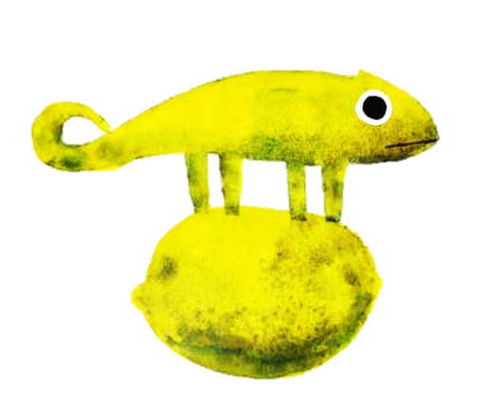
Notes:
Except for Chameleons

Slide 7
Notes:
Chameleons change color wherever they go.

Slide 8
Notes:
On lemons chameleons are yellow.

Slide 9
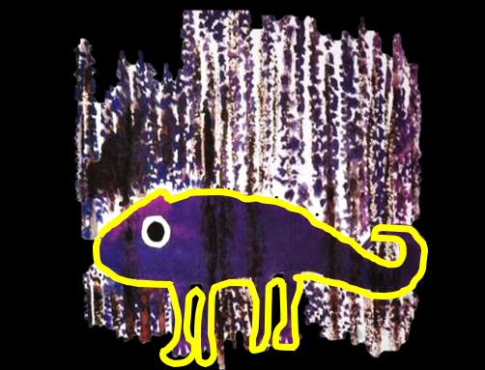
Notes:
In the heather they are purple.

Slide 10
Notes:
And on the tiger they are striped like tigers.

Slide 11
Notes:
One day a chameleon who was sitting on a tigers tail said to himself,

Slide 12
Notes:
"If I remain on a leaf, I shall be green forever, I too shall have a color of my own."

Slide 13
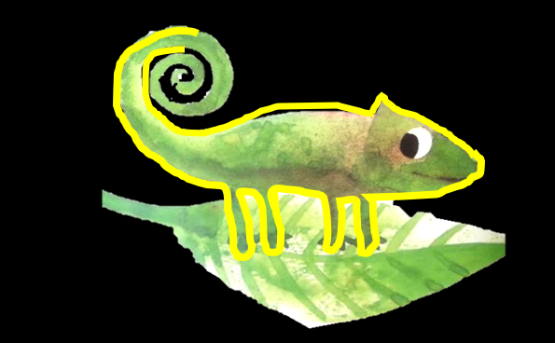
Notes:
The chameleon climbed onto the greenest leaf.

Slide 14
Notes:
But in Autumn the leaf turned yellow – and so did the chameleon.

Slide 15
Notes:
Later the leaf turned red and the chameleon too turned red.

Slide 16
Notes:
And then the winter winds blew the leaf from the branch and with it the chameleon.

Slide 17
Notes:
But when spring came, he walked out into the green grass, and there he met another chameleon.

Slide 18
Notes:
The chameleon told his color story. Will we ever have our own color?

Slide 19
Notes:
No, said the other chameleon. "Why don’t we stay together?"

Slide 20
Notes:
"We will still change color you and I will always be alike."

Slide 21
Notes:
They were green together...

Slide 22
Notes:
And purple

Slide 23
Notes:
And yellow

Slide 24
Notes:
And they lived happily ever after.

Slide 25
Notes:
The End

Slide 26
This Adapted Literature resource is available through the Sherlock Center Resource Library. The text and graphics are adapted from the original source. These resources are provided for teachers to help students with severe disabilities participate in the general curriculum. Please limit the use and distribution of these materials accordingly.
Paul V. Sherlock Center on Disabilities / RI College
600 Mt. Pleasant Avenue, Providence RI 02908
www.sherlockcenter.org

