Slide 1
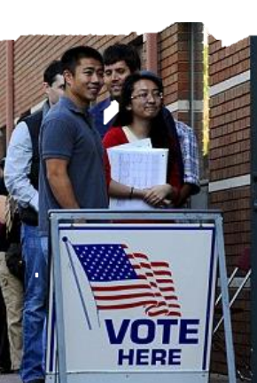

Election Day
Notes:
This book is about Election Day in the United States of America.

Slide 2

Notes:
Voting is when people tell who they want to lead the American Government in Washington DC. American leaders meet in the Capitol building. The Capitol is a white building that has a dome on the top and many offices for all the leaders in the building.

Slide 3
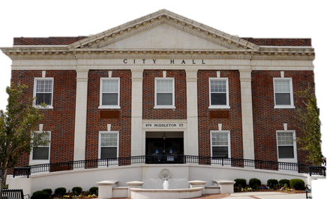
Notes:
People also vote for who they want to lead their state and town government.

Slide 4
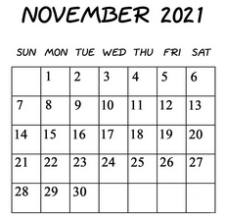
Notes:
Election Day is on a Tuesday in early November. The date is different each year.

Slide 5
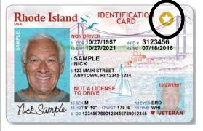
18
Notes:
You need to say you want to vote. This is called REGISTERING. You need to be 18 years old and a citizen of the United States. You need an identification card with your photo on it.

Slide 6
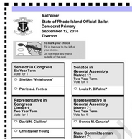
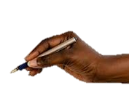
Notes:
You mark who you want as a leader on a paper called a BALLOT. You use a pen to mark the ballot. If you need help, you can tell someone you trust who you want and they can help you mark your ballot. Some ballots have you vote for how the government should spend money. On these questions, you mark YES or NO.

Slide 7
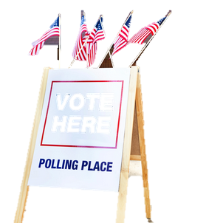
Notes:
Most people vote in their town at a place called a POLLING PLACE. You can call your town hall to find out where you should go to vote.

Slide 8
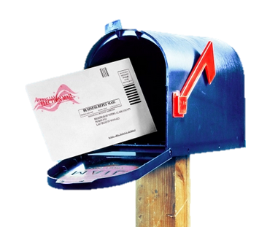
Notes:
Some people ask for a ballot that they can mail in. People can put these ballots in their mailbox or drop them in a post office box.

Slide 9

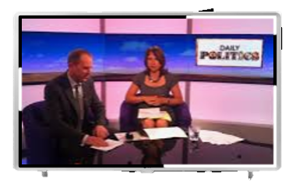
Notes:
You need to learn about the leaders on the ballot. You can find about the leaders by listening to the radio, reading the newspaper, and watching television. Some leaders send you letters in the mail to share information.

Slide 10

Notes:
Some people make a group called a political party. One group is the Democratic Party. They use a donkey with big ears for their picture. There are more groups too.

Slide 11

Notes:
One group is the Republican Party. They use an elephant with a long trunk as their picture.

Slide 12

Notes:
Every American should vote. You should be proud to be a voting American.

Slide 13


Slide 14
This Adapted Literature resource is available through the Sherlock Center Resource Library. The text and graphics are adapted from the original source. These resources are provided for teachers to help students with severe disabilities participate in the general curriculum. Please limit the use and distribution of these materials accordingly.
Paul V. Sherlock Center on Disabilities / RI College
600 Mt. Pleasant Avenue, Providence RI 02908
www.sherlockcenter.org

