Slide 1
A Good Day, adapted from the original text, A Good Day by Kevin Henkes.
Notes:
A Good Day, adapted from the original text, A Good Day by Kevin Henkes.

Slide 2
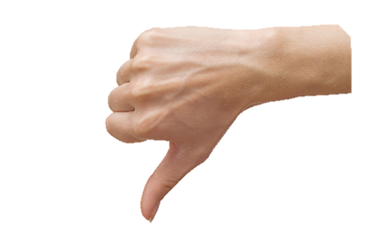
Notes:
Today was a bad day.

Slide 3
Notes:
Yellow bird lost his favorite tail feather

Slide 4
Notes:
White dogs leash got tangled in the fence

Slide 5
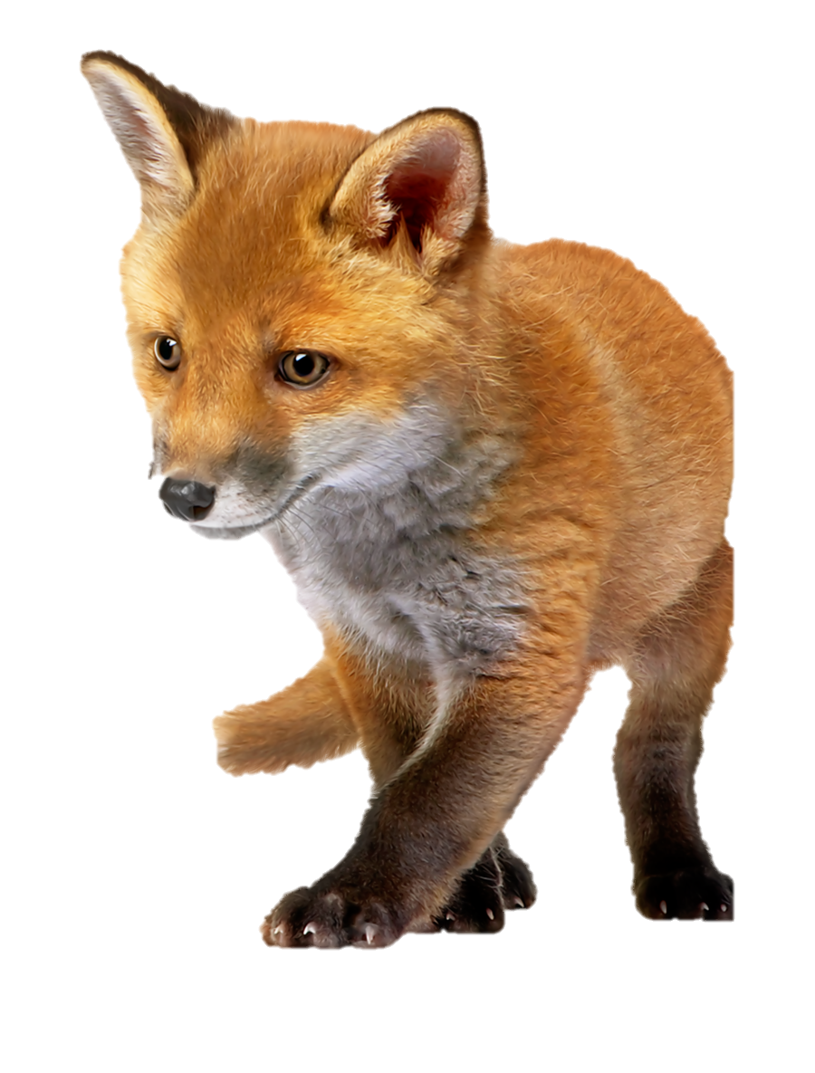
Notes:
Orange fox couldn’t find his mother.

Slide 6
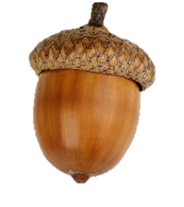
Notes:
And brown squirrel dropped her nut.

Slide 7
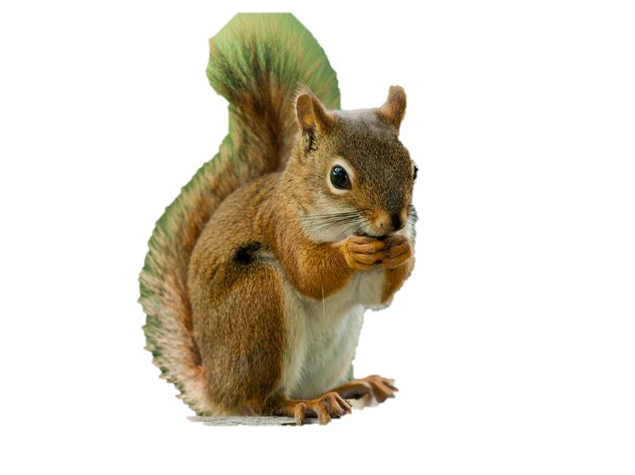
Notes:
But then…brown squirrel found the biggest nut

Slide 8
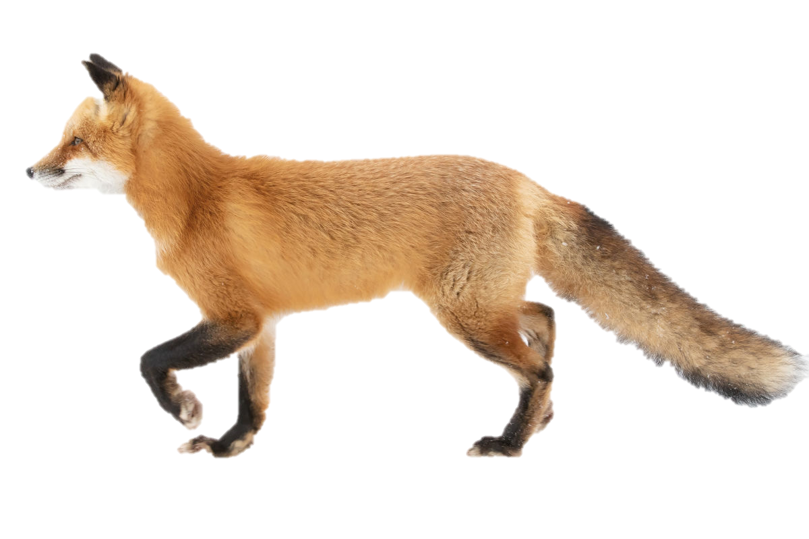
Notes:
Orange fox found his mother.

Slide 9
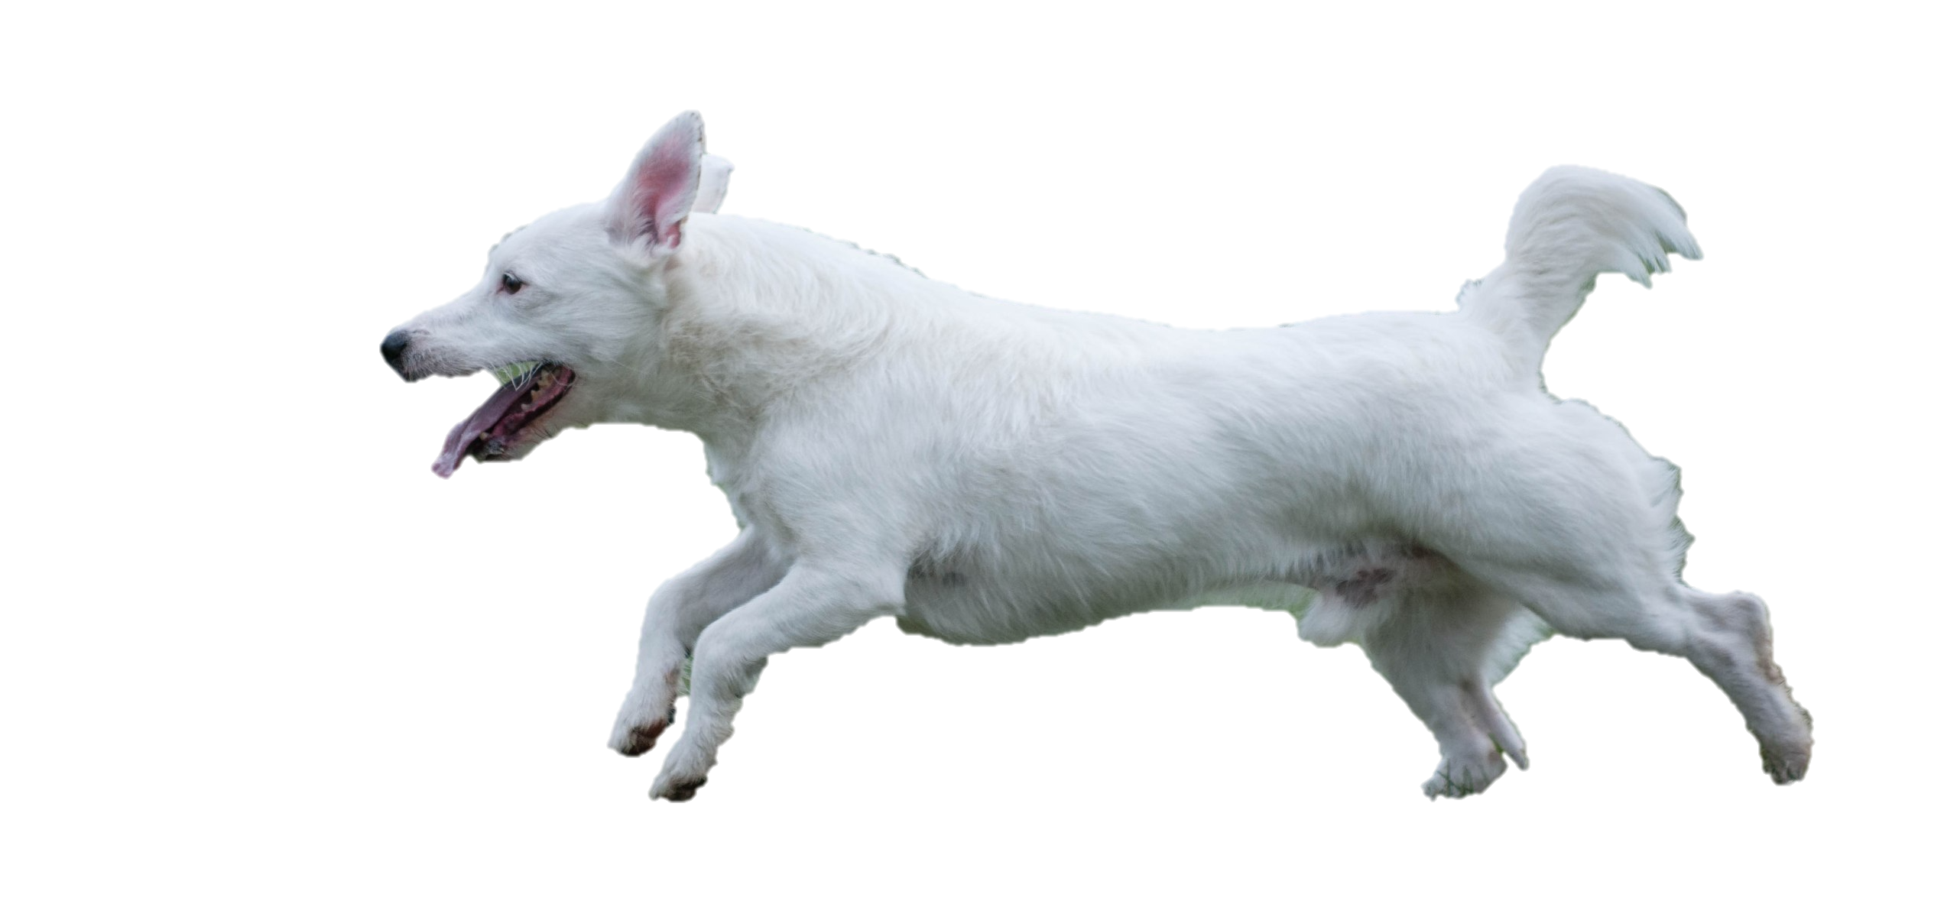
Notes:
White dog worked herself free and ran circles in the dandelions.

Slide 10
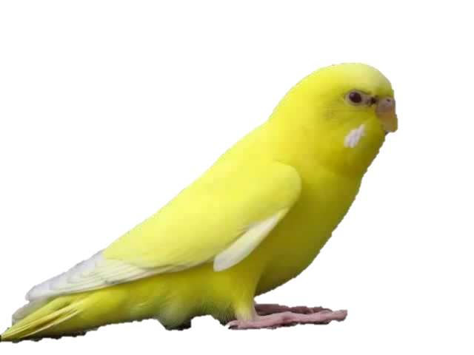
Notes:
And yellow bird forgot all about his feather and flew higher than ever.

Slide 11
Notes:
And there’s more. A little girl found the yellow feather, picked it up, tucked it behind her ear… and ran to her mother shouting, “Mama what a good day!”

Slide 12
Notes:
The End

Slide 13
This Adapted Literature resource is available through the Sherlock Center Resource Library. The text and graphics are adapted from the original source. These resources are provided for teachers to help students with severe disabilities participate in the general curriculum. Please limit the use and distribution of these materials accordingly.
Paul V. Sherlock Center on Disabilities / RI College
600 Mt. Pleasant Avenue, Providence RI 02908
www.sherlockcenter.org

