Slide 1
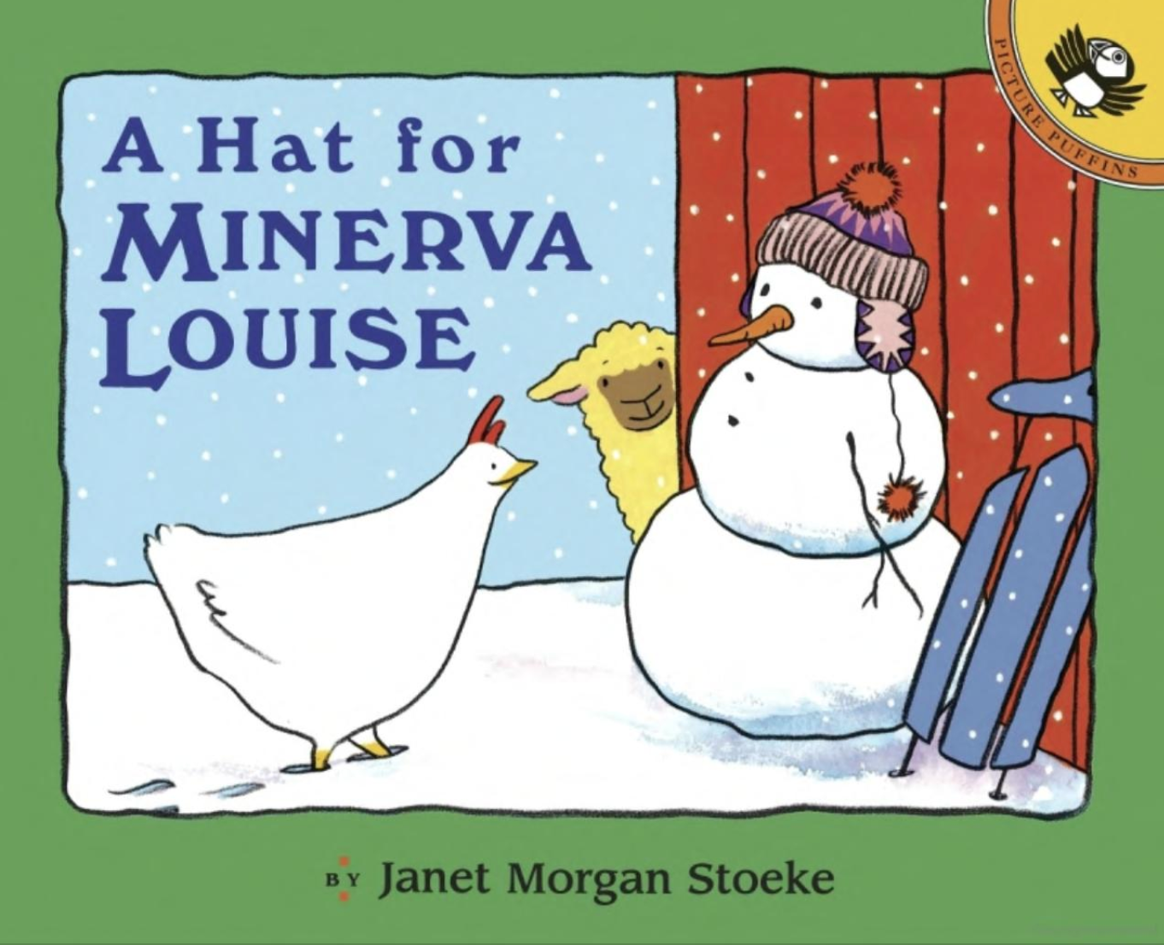

Adapted from the original text, A Hat for Minerva Louise,
by Janet Morgan Stoeke.
Notes:
A Hat for Minerva Louise. Adapted from the original text, A Hat for Minerva Louise, by Janet Morgan Stoeke.

Slide 2
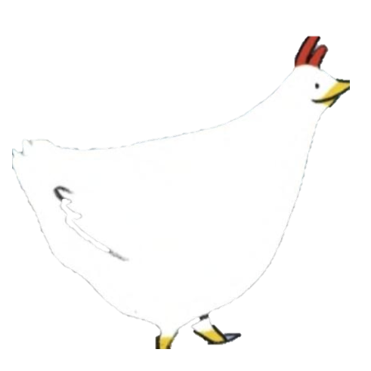
Notes:
Minerva Louise loved snowy mornings.

Slide 3

Notes:
But her friends didn’t like them one bit. They stayed inside all day with their heads tucked under their wings.

Slide 4
Notes:
Not Minerva Louise. She couldn’t wait to go out exploring. Everything was so beautiful! She wanted to stay out all day. But it was too cold.

Slide 5
Notes:
“If I had some warm things like you,” she said to the scarecrow, “I could stay out and play all day.”

Slide 6
Notes:
“A scarf might help. But not this one. It’s way too big.”

Slide 7
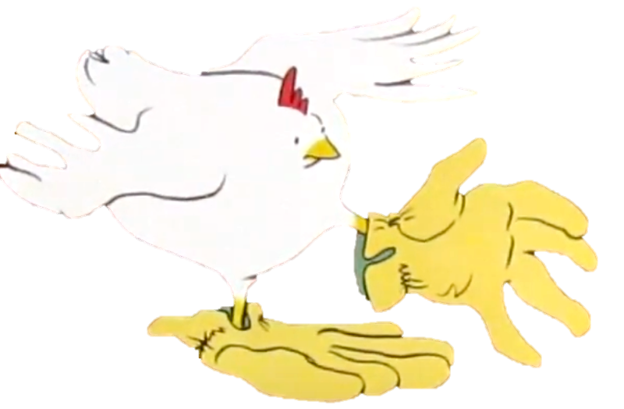
Notes:
“And these shoes are too big, too.”

Slide 8
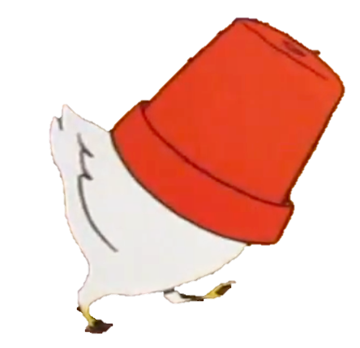
Notes:
“A hat! That’s just what I need. But not this one.”

Slide 9
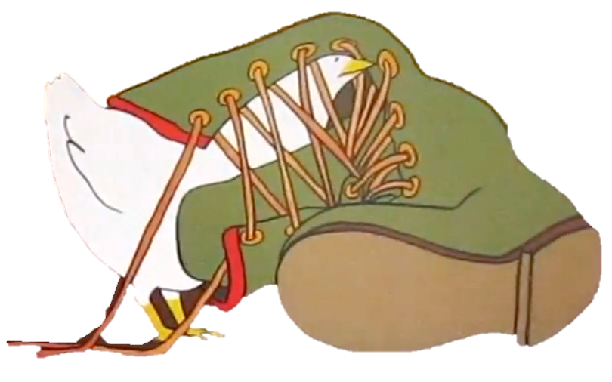
Notes:
“And not this one, either. It’s too heavy.”

Slide 10

Notes:
“There must be a hat around here somewhere.” Minerva Louise looked outside. Everyone had a fluffy white hat!

Slide 11
Notes:
“Oh, your hat is wonderful,” she said to the snowman. “Where did you get it?"

Slide 12
Notes:
“Oh, look! What’s over here? A hat. It’s perfect!”

Slide 13
Notes:
“But what’s this? Oh, it’s two hats!” Which was just fine with Minerva Louise.

Slide 14
Notes:
The End

Slide 15
This Adapted Literature resource is available through the Sherlock Center Resource Library. The text and graphics are adapted from the original source. These resources are provided for teachers to help students with severe disabilities participate in the general curriculum. Please limit the use and distribution of these materials accordingly.
Paul V. Sherlock Center on Disabilities / RI College
600 Mt. Pleasant Avenue, Providence RI 02908
www.sherlockcenter.org

