Slide 1
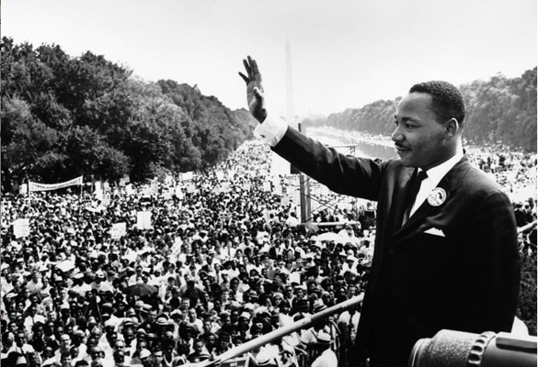

Martin Luther King’s
I Have a Dream Speech
August 28, 1963

Slide 2
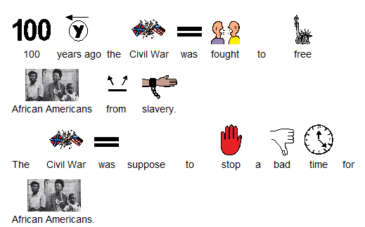

Slide 3
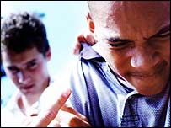
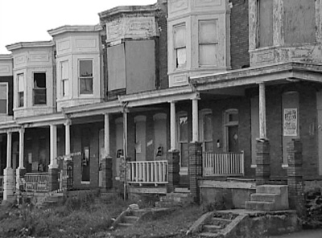
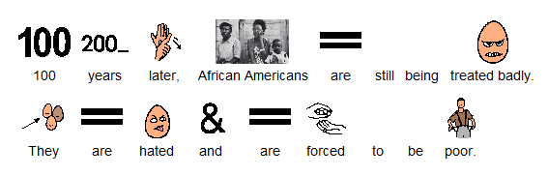

Slide 4
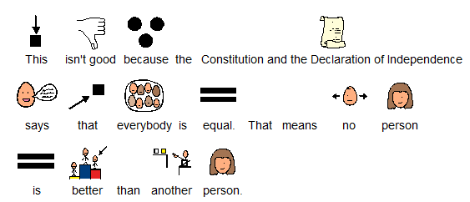

Slide 5
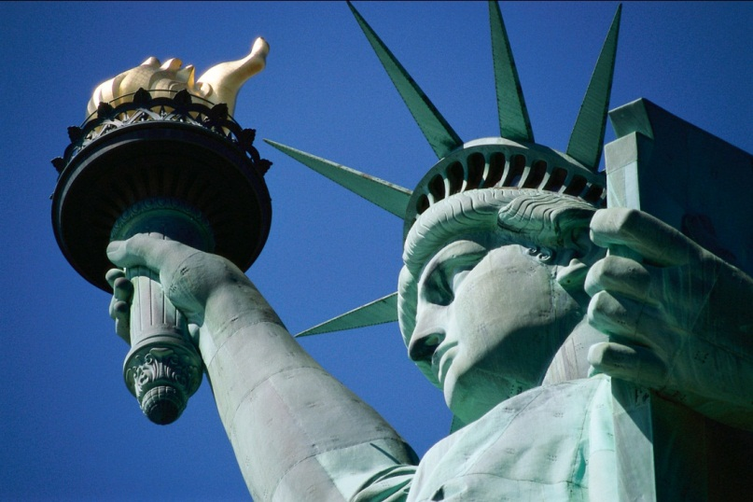
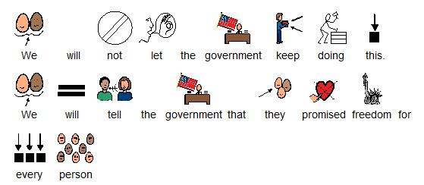

Slide 6
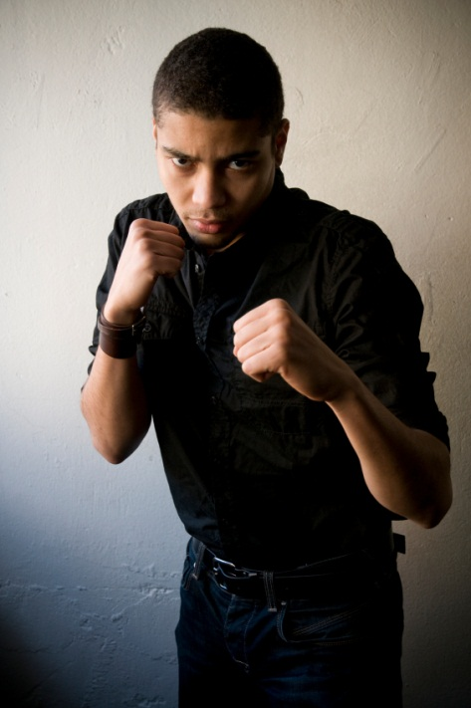
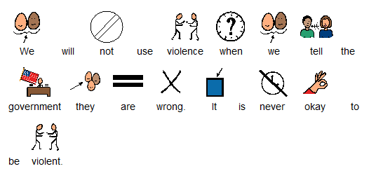
WRONG!
WRONG!

Slide 7
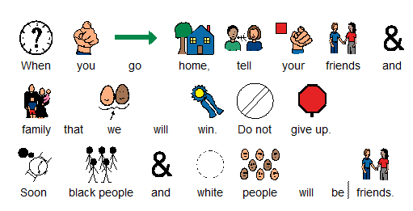

Slide 8
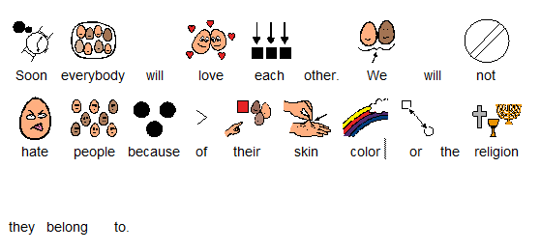

Slide 9

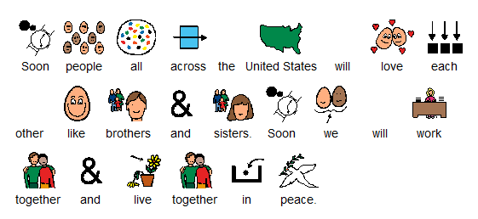

Slide 10

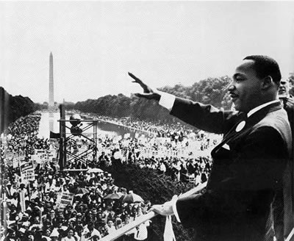

Slide 11
This Adapted Literature resource is available through the Sherlock Center Resource Library. The text and graphics are adapted from the original source. These resources are provided for teachers to help students with severe disabilities participate in the general curriculum. Please limit the use and distribution of these materials accordingly.
Paul V. Sherlock Center on Disabilities / RI College
600 Mt. Pleasant Avenue, Providence RI 02908
www.sherlockcenter.org

