Slide 1


Adapted from the original text, A Bicycle for Rosaura,
written by Daniel Barbot, and illustrated by Morella Fuenmayor
Notes:
This book is adapted from the original text, A Bicycle for Rosaura,
written by Daniel Barbot, and illustrated by Morella Fuenmayor

Slide 2
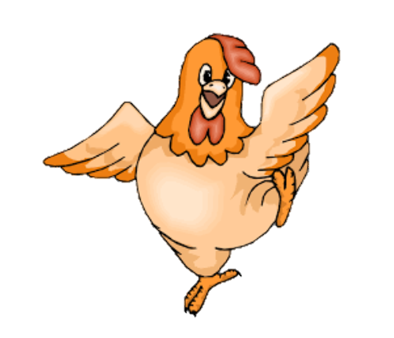
Notes:
Amelia loves animals. Amelia has a dog, kitten, turtle, and hen. The hen’s name is Rosaura.

Slide 3
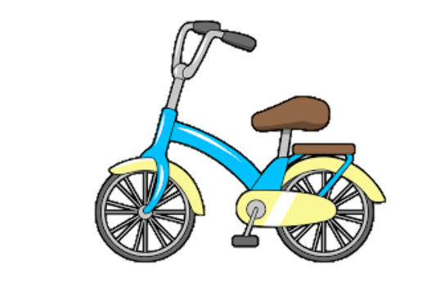
Notes:
It is Rosaura’s birthday.
Rosaura asks Amelia for a bicycle
Amelia says that hens don’t ride bicycles
Rosaura wants to be the first hen to ride a bicycle.

Slide 4
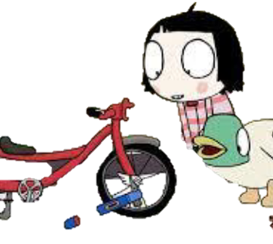
Notes:
Amelia takes the bus to every bicycle shop.
Everyone tells Amelia that they don’t make bicycles for a hen.
Amelia is sad.

Slide 5
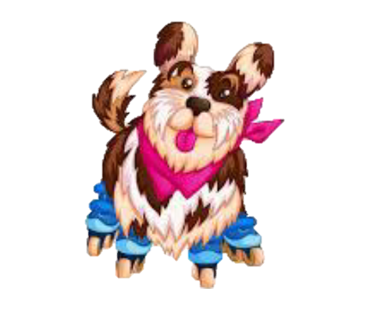
Notes:
A man comes to Amelia’s town. The man says he can make anything. He made skates for a dog. Amelia asks if he can make a bicycle for a hen.

Slide 6
Notes:
The man makes a new bicycle for a hen. It should be ready for Rosaura’s birthday.

Slide 7
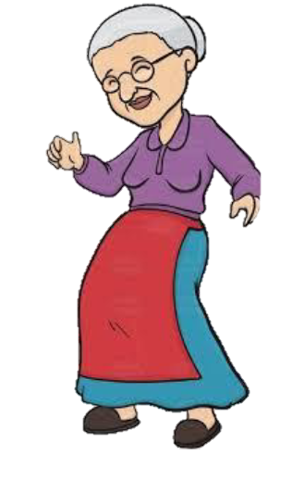
Notes:
Amelia waits and waits. She hears a knock at the door. She is so happy that she dances.

Slide 8

Notes:
There is a big blue box. Around the box is a bright red ribbon.

Slide 9
Notes:
Inside the box is a wonderful bicycle for Rosaura. Amelia is very happy!

Slide 10


Notes:
Amelia has a birthday party with all the animals. There is a birthday cake for Rosaura.
Rosaura blows out the candles.

Slide 11

Notes:
Rosaura rides the bicycle every day.

Slide 12
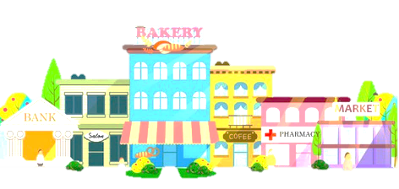
Notes:
Rosaura rides her bicycle to the bank, the bakery, and the market.

Slide 13
Notes:
Rosaura needs to be very careful. She doesn’t know how to stop her bicycle! Watch out!

Slide 14

Notes:
The end

Slide 15
This Adapted Literature resource is available through the Sherlock Center Resource Library. The text and graphics are adapted from the original source. These resources are provided for teachers to help students with severe disabilities participate in the general curriculum. Please limit the use and distribution of these materials accordingly.
Paul V. Sherlock Center on Disabilities / RI College
600 Mt. Pleasant Avenue, Providence RI 02908
www.sherlockcenter.org
Notes:
This Adapted Literature resource is available through the Sherlock Center Resource Library. The text and graphics are adapted from the original source. These resources are provided for teachers to help students with severe disabilities participate in the general curriculum. Please limit the use and distribution of these materials accordingly

