Slide 1


Adapted from the original text, Socks,
written by Beverly Cleary.
Notes:
This book is adapted from the original text, Socks, written by Beverly Cleary.

Slide 2

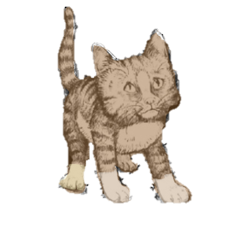
Notes:
Chapter 1: The Kitten Sale.
The little girl sat in front of the market with a box of kittens for sale. One of the kittens had white paws. The kitten kept trying to climb out of the box. The little girl named the kitten “Socks.”

Slide 3
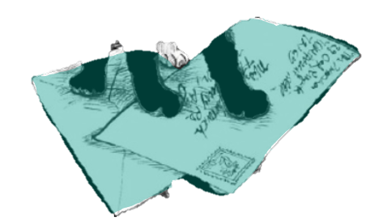
Notes:
A boy wanted Socks. The boy took Socks and put him in a mailbox and then left Socks all alone. Socks was afraid. The mailman found Socks and gave him to Mr. and Mrs. Bricker

Slide 4
Notes:
Chapter 2: The Bricker’s Other Pet
The Brickers loved Socks. Socks slept on the couch. The Brickers fed him tasty food. The Brickers let Socks play with a ping-pong ball.

Slide 5
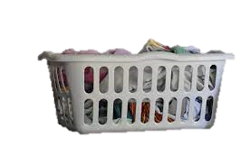
Notes:
Socks liked being around people. When the Brickers were gone, Socks used his claws on the chair. Mr. Bricker was mad and put Socks in the laundry room.

Slide 6
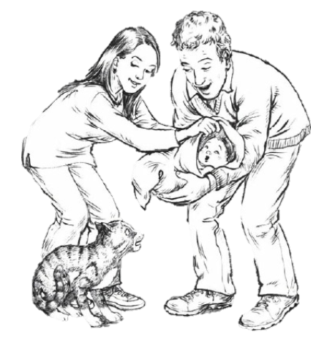
Notes:
Socks was scared. He heard all sorts of noises. Socks heard the doorbell and a phone. Socks saw something in Mr. Bricker’s arms. Socks heard a cry and thought the Brickers had a new pet.

Slide 7
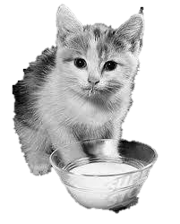
Notes:
Socks saw the new pet on Mrs. Bricker’s lap. Socks tried to go on Mrs. Bricker’s lap. Socks was put on the floor. The new pet is called Charles. Charles went to sleep. Mrs. Bricker poured milk from Charles’s bottle into a bowl. Socks drank the milk.
.

Slide 8
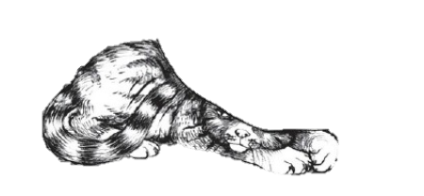
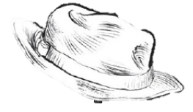
Notes:
Chapter 3: Socks and the Formula
People came over to see Charles, not Socks. No one wanted to play ball with Socks. Uncle gave Socks his red hat. Cousin Mike made scary cat and dog noises. Socks was afraid and hid under the bed.

Slide 9
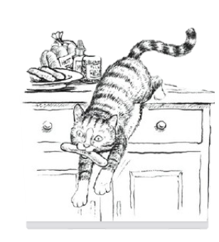
Notes:
Chapter 4: The Babysitter
Socks was hungry. Socks sat in front of the refrigerator and meowed. Socks jumped on the counter and took a hot dog. The Babysitter said, “Bad Socks! Leave that food alone!”

Slide 10
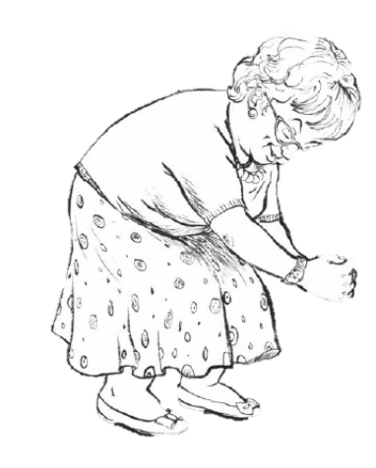
Notes:
A new babysitter, Mrs. Risley came over. Mrs. Risley pet Socks and called him a beautiful cat. Socks was happy.

Slide 11
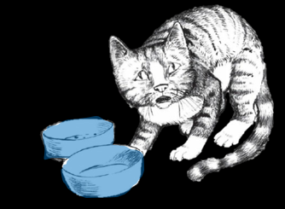
Notes:
Chapter 5: A Visit from Nana
Mr. and Mrs. Bricker cleaned the floors and used the vacuum. Socks didn’t like the noise or the smell. Nana came to see baby Charles. Nana did not like Socks. Socks went into the laundry room and ate and drank from his blue bowls.

Slide 12
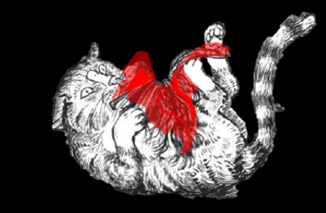
Notes:
Socks found a red wig on the table. A wig is like a hat made of hair. It was Nana’s wig. Socks played with the red wig. Nana didn’t like that Socks took her wig and hit Socks. Socks bit Nana’s foot. Socks was put outside.

Slide 13
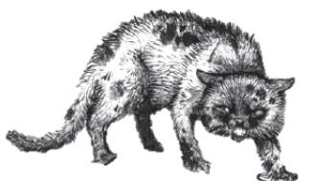
Notes:
Chapter 6: Old Taylor
A little girl named Tiffy asked why Socks was outside all the time. “we can’t have a cat who bites people.” is what Mr. Bricker said. Socks saw a yellow outside cat named Old Taylor. Socks and Old Taylor had a fight. Socks was hurt and dirty. Socks ran into his garage.

Slide 14
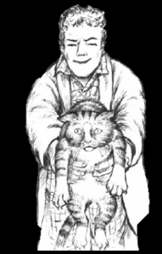
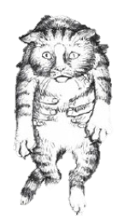
Notes:
Mr. Bricker found Socks in the garage. He pet Socks and brought him inside. Mr. Bricker says, “We were wrong Socks. You need to live in the house.” Mr. Bricker picked up Socks and walked inside. Just then Baby Charles said “ticky, ticky” and Socks smiled. Charles was trying to say “kitty kitty.” Socks was happy and went to sleep

Slide 15
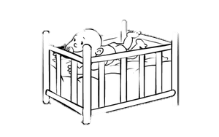
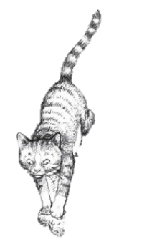
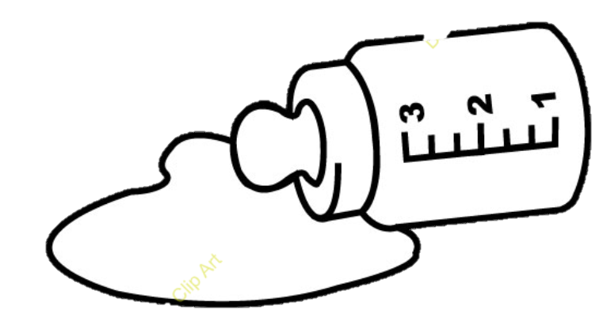
Notes:
Chapter 7: Baby Charles and Socks
Baby Charles cries and tries to get out of his crib.. Baby Charles shook his crib and threw his bottle. “Ticky,” said Baby Charles. Mrs. Bricker came inside

Slide 16
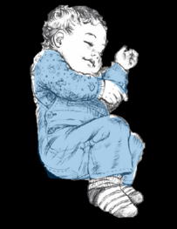
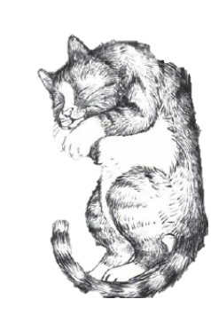
Notes:
Mrs. Bricker found Baby Charles and Socks asleep together. They were friends. Everyone was happy.

Slide 17


Notes:
The end

Slide 18
This Adapted Literature resource is available through the Sherlock Center Resource Library. The text and graphics are adapted from the original source. These resources are provided for teachers to help students with severe disabilities participate in the general curriculum. Please limit the use and distribution of these materials accordingly.
Paul V. Sherlock Center on Disabilities / RI College
600 Mt. Pleasant Avenue, Providence RI 02908
www.sherlockcenter.org
Notes:
This Adapted Literature resource is available through the Sherlock Center Resource Library. The text and graphics are adapted from the original source. These resources are provided for teachers to help students with severe disabilities participate in the general curriculum. Please limit the use and distribution of these materials accordingly.

