Slide 1
A Squash and A Squeeze, adapted from the original text, A Squash and A Squeeze by Julia Donaldson and Illustrated by Axel Scheffler.
Notes:
A Squash and A Squeeze, adapted from the original text, A Squash and A Squeeze by Julia Donaldson and Illustrated by Axel Scheffler.

Slide 2
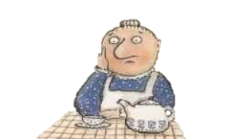
Notes:
A little old lady lived all by herself, with a table and chairs and a jug on the shelf.

Slide 3
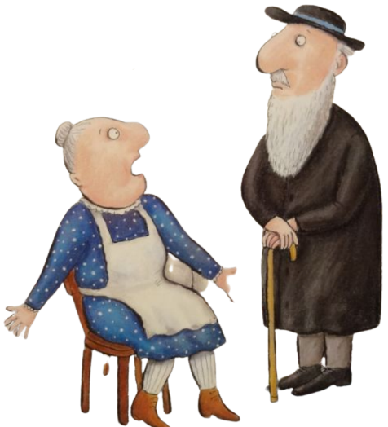
Notes:
A wise old man heard her grumble and grouse, “There’s not enough room in my house. Wise old man, won’t you help me please? My house is a squash and a squeeze.”

Slide 4
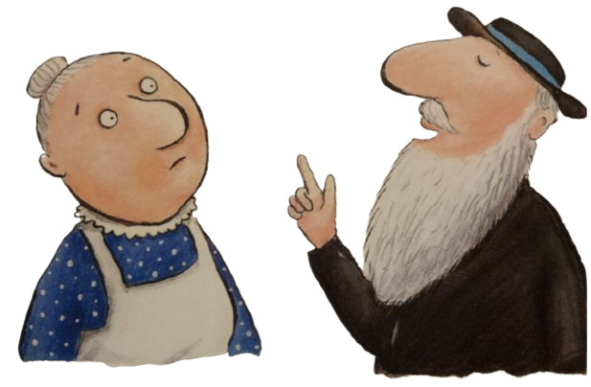
Notes:
“Take in your hen,” said the wise old man

Slide 5
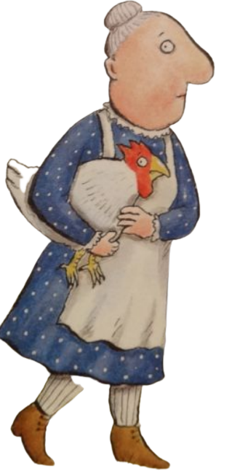
Notes:
“Take in my hen? What a curious plan.”

Slide 6
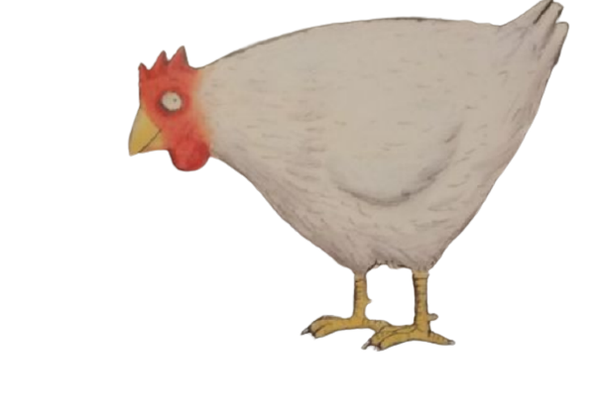
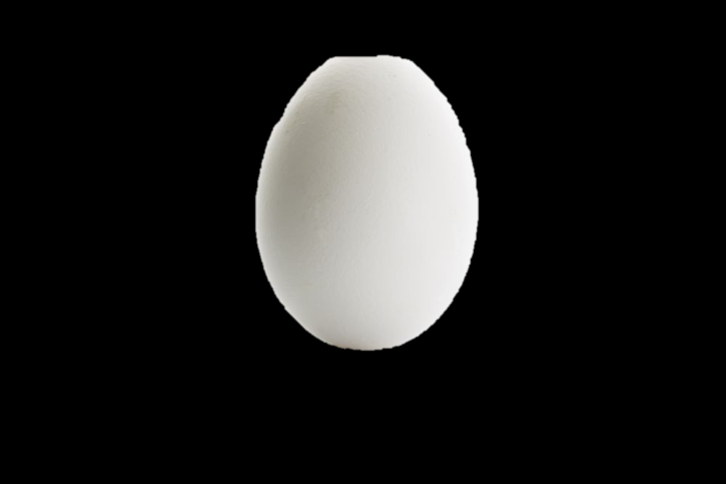
Notes:
Well, the hen laid an egg on the fireside rug,

Slide 7
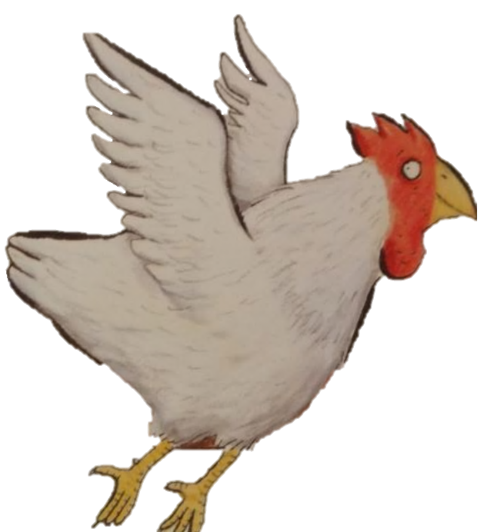
Notes:
And flapped around the room knocking over the jug.

Slide 8
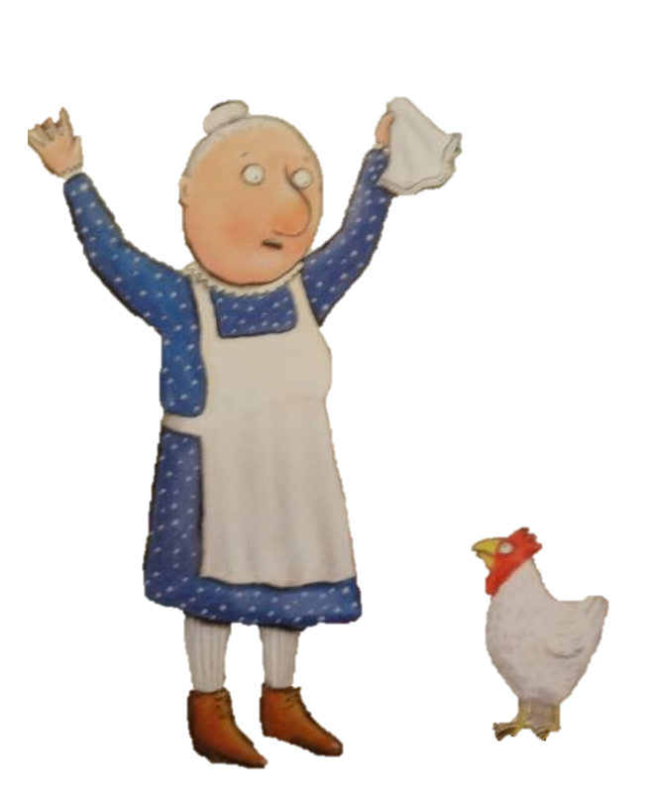
Notes:
The little old lady cried, “What shall I do? It was pokey for one and tiny for two. My nose has a tickle and there’s no room to sneeze. My house is a squash and a squeeze.”

Slide 9
Notes:
“Wise old man, won’t you help me please? My house is a squash and a squeeze.”

Slide 10
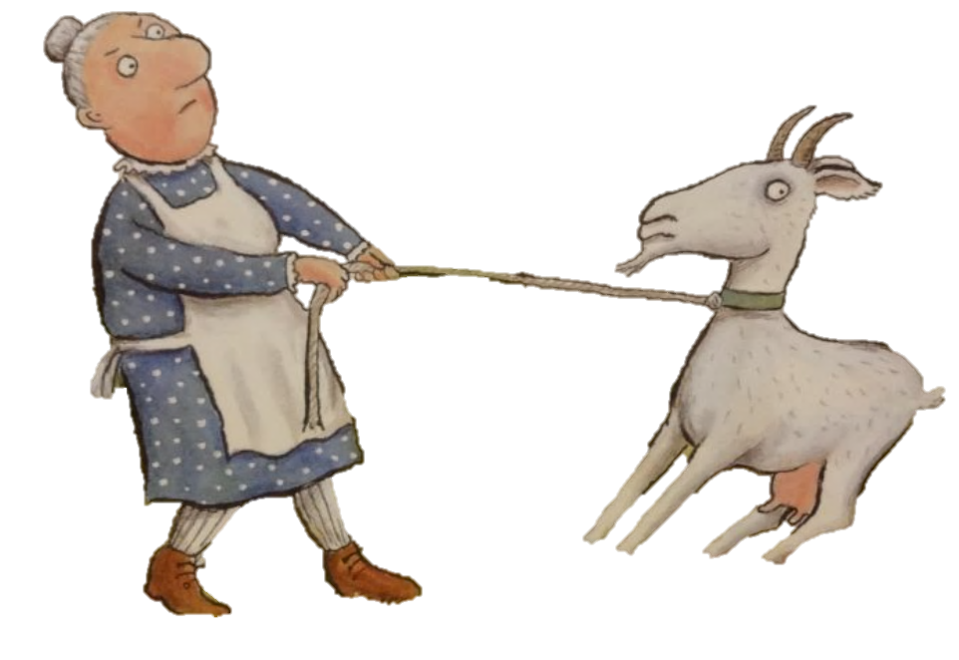
Notes:
“Take in your goat,” said the wise old man. “Take in my goat? What a curious plan.”

Slide 11
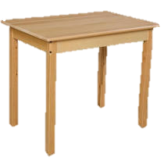
Notes:
Well, the goat chewed the curtains and trod on an egg, Then sat down to nibble on the table leg.

Slide 12
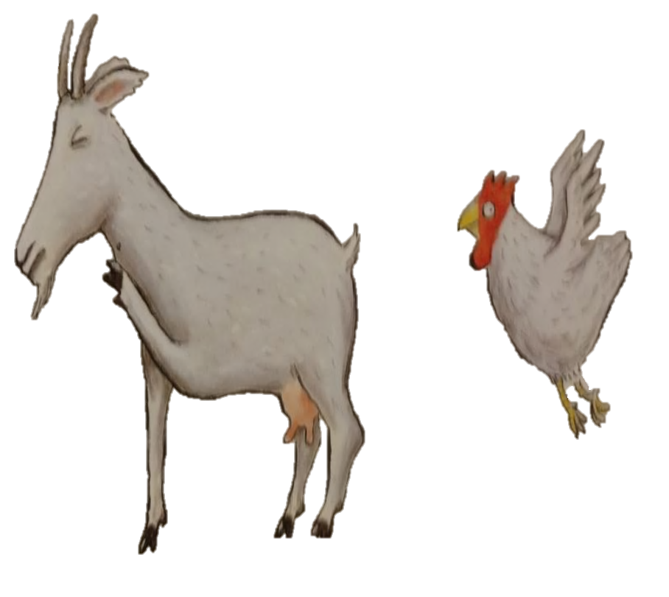
Notes:
The little old lady cried,” Glory be! It was tiny for two and it’s itchy for three. The hen pecks the goat and goat’s got fleas. My house is a squash and a squeeze.”

Slide 13
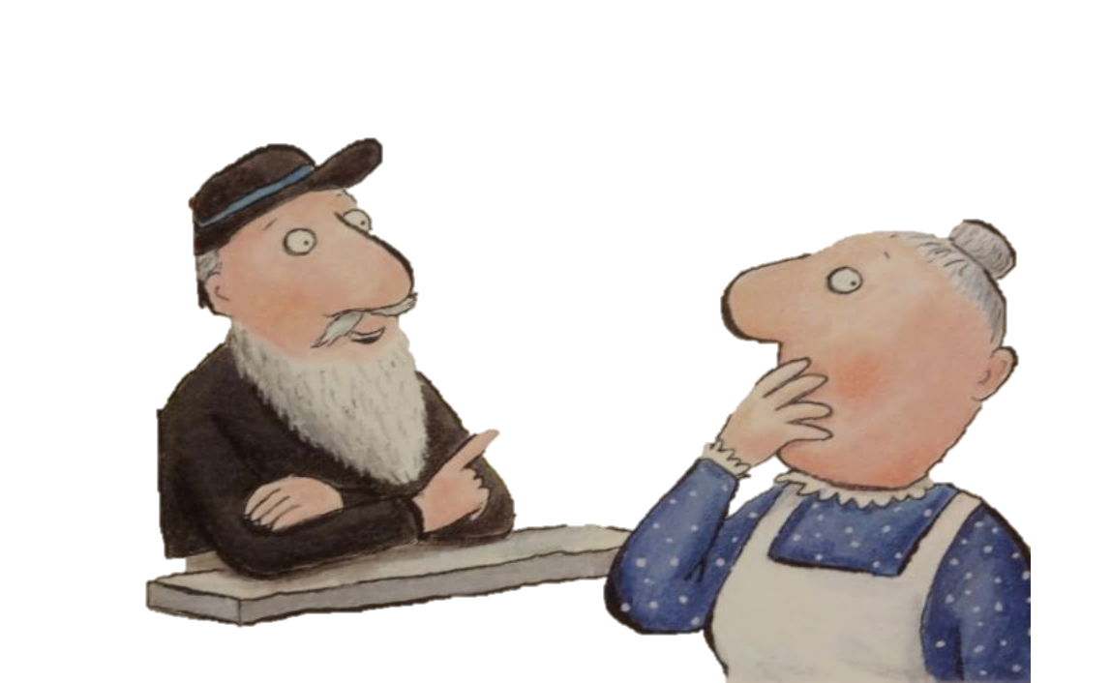
Notes:
“Take in your pig,” said the wise old man. “Take in my pig? What a curious plan.”

Slide 14
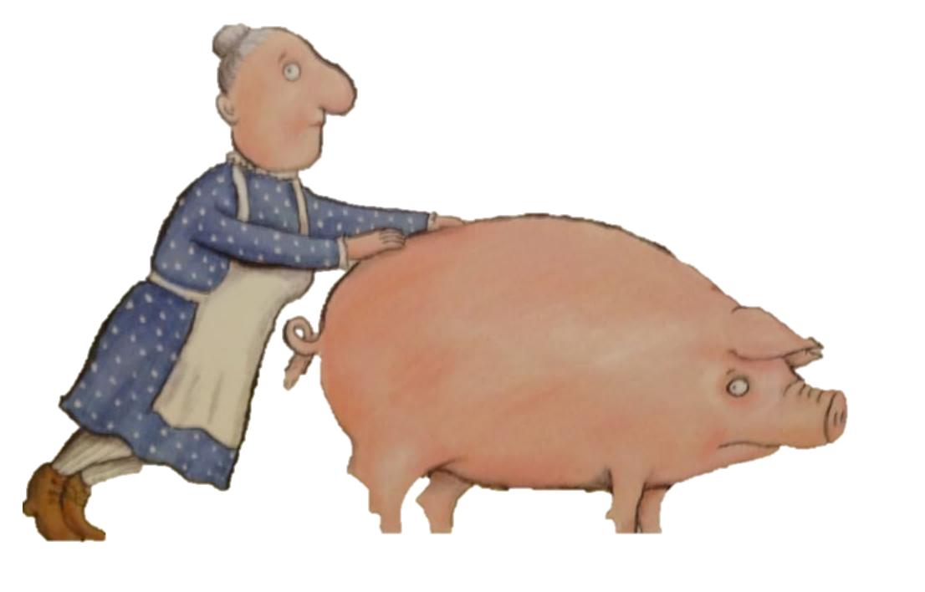
Notes:
So she took in the pig who kept chasing the hen, And raiding the larder again and again.

Slide 15
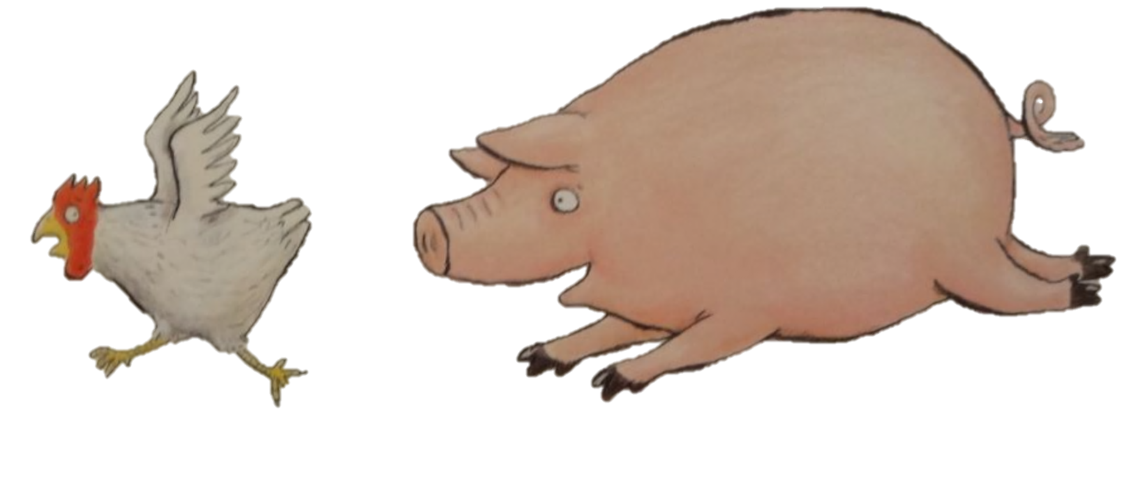
Notes:
The little old lady cried, “Stop I implore! It was itchy for three and it's teeny for four. Even the pig in the larder agrees. My house is a squash and a squeeze.”

Slide 16
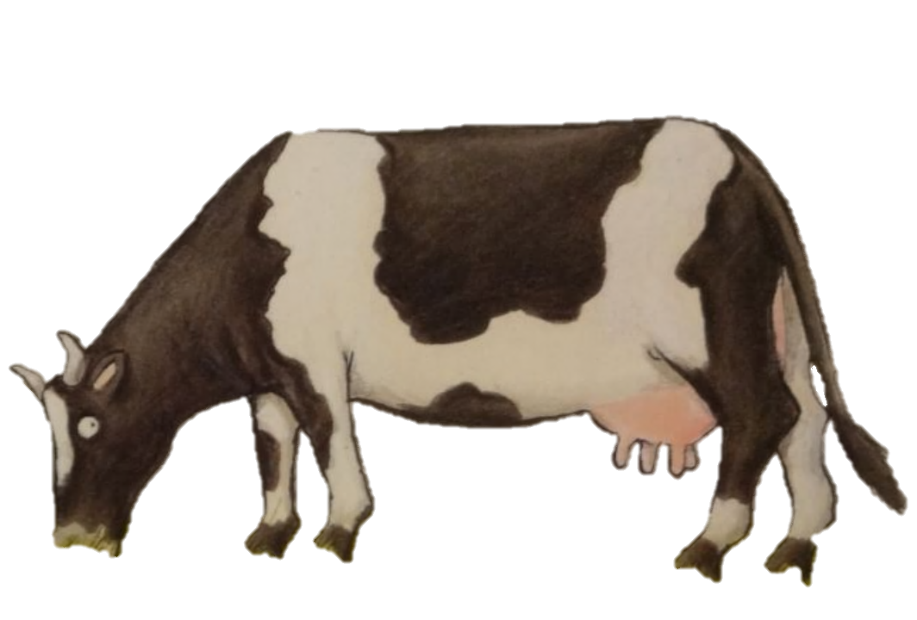
Notes:
“Take in your cow,” said the wise old man. “Take in my cow? What a curious plan.”

Slide 17
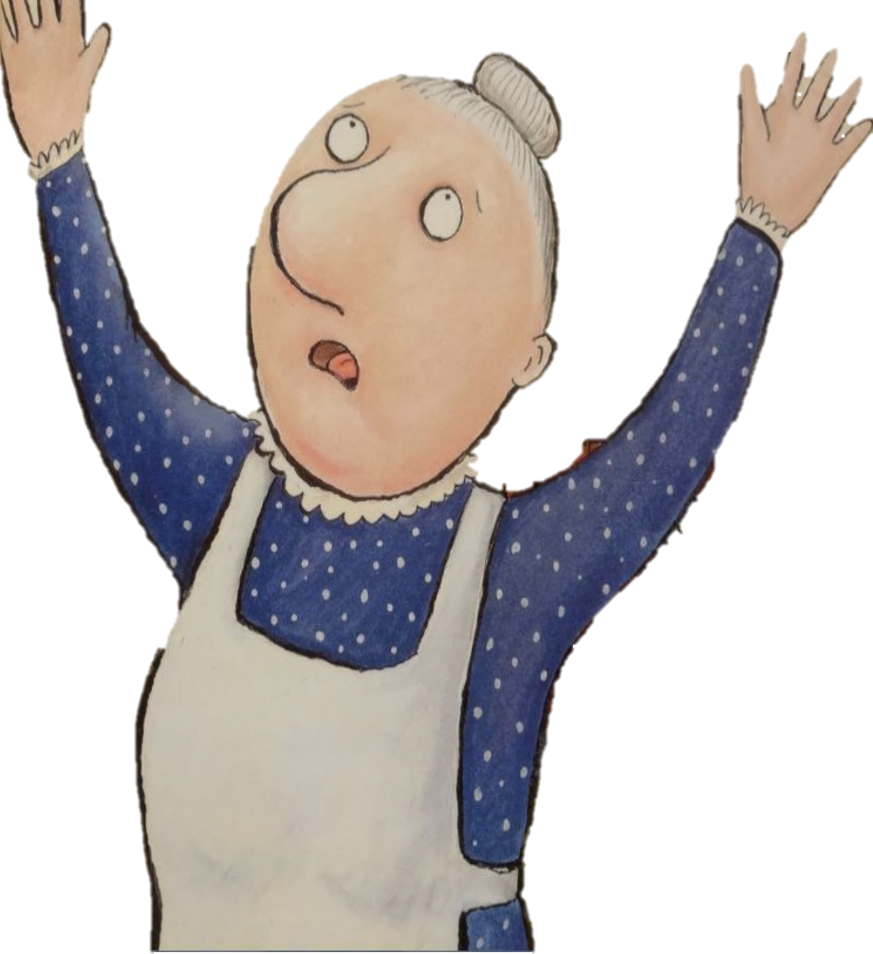
Notes:
The little old lady cried, “Heavens alive! It was teeny for four and it’s weeny for five. I’m tearing my hair out, I’m down on my knees. My house is a squash and a squeeze.”

Slide 18
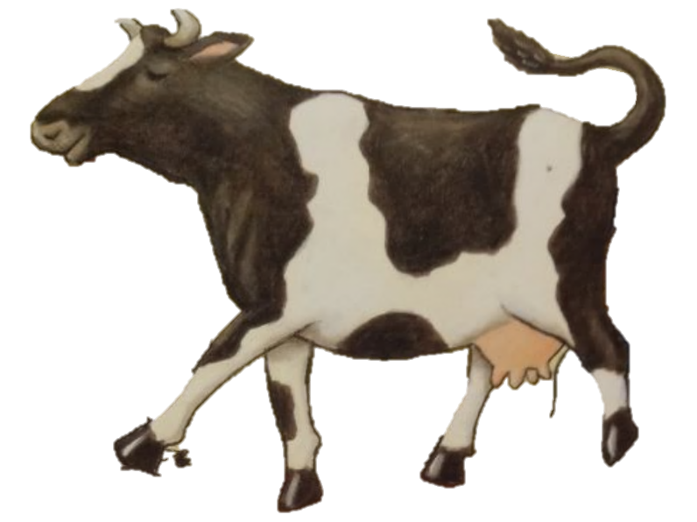
Notes:
Well, the cow took one look and charged straight at the pig, then jumped on the table and tapped out a jig.

Slide 19
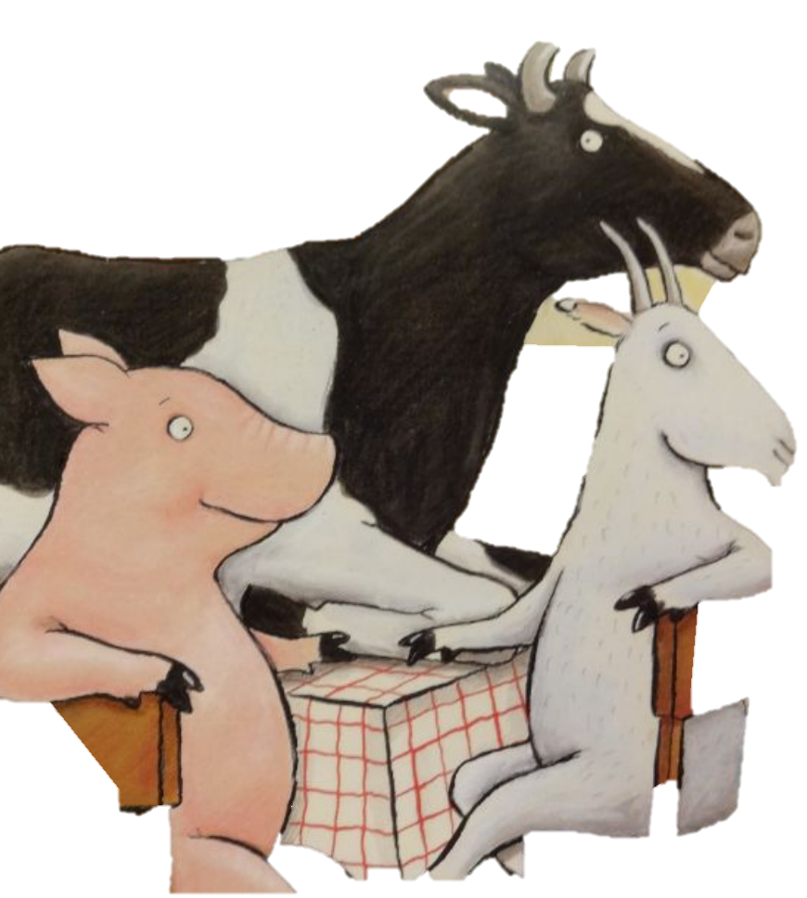
Notes:
“Wise old man, won’t you help me, please? My house is a squash and a squeeze.”

Slide 20
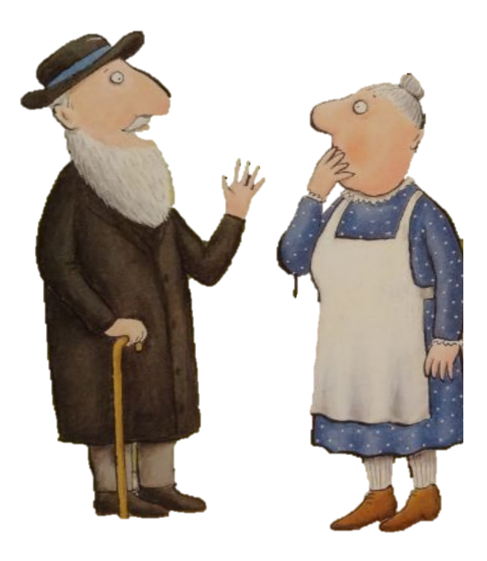
Notes:
“Wise old man, won’t you help me, please? My house is a squash and a squeeze.”
“Take them all out,” said the wise old man. “But then I’ll be back where I first began.”

Slide 21
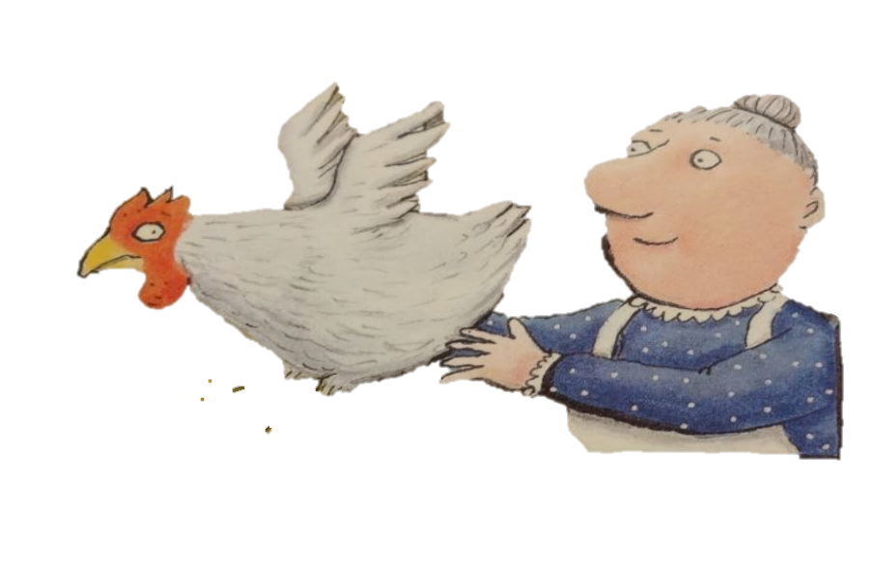
Notes:
So she opened the window and out flew the hen. “That’s better - at last I can sneeze again.”

Slide 22
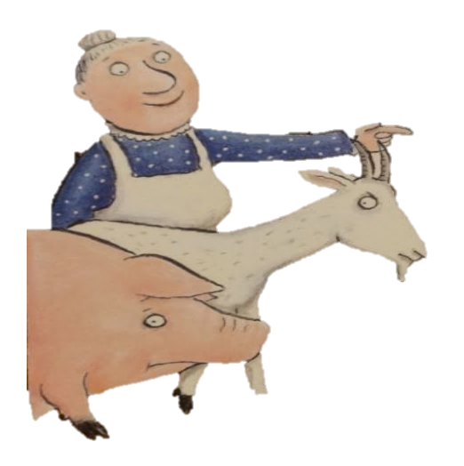
Notes:
She shooed out the goat and she shoved out the pig. “My house is beginning to feel pretty big.”

Slide 23
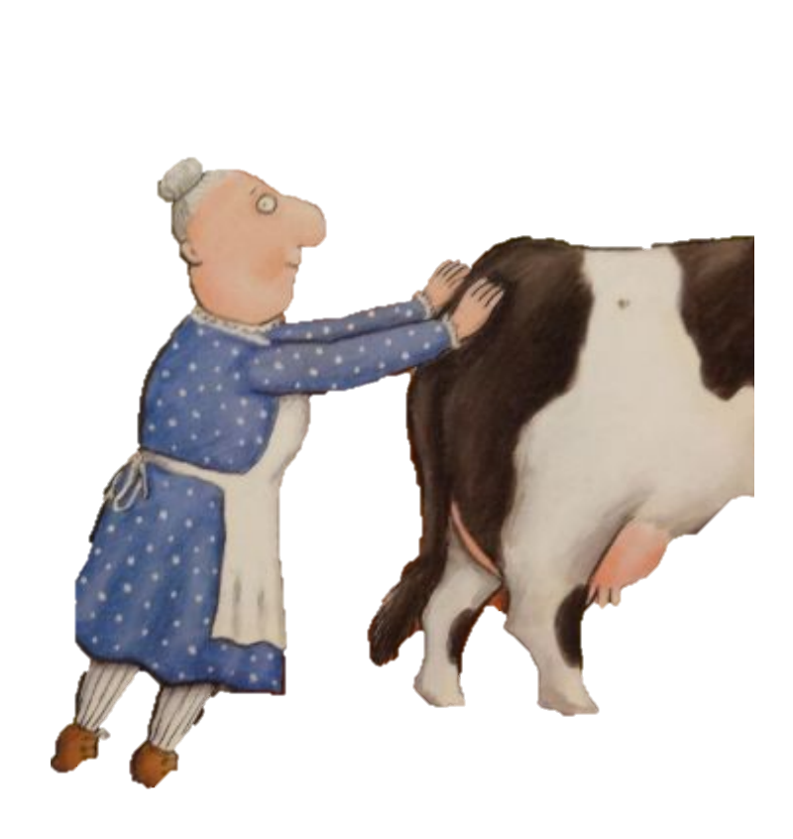
Notes:
She huffed and she puffed and she pushed out the cow. “Just look at my house, it’s enormous now.”

Slide 24
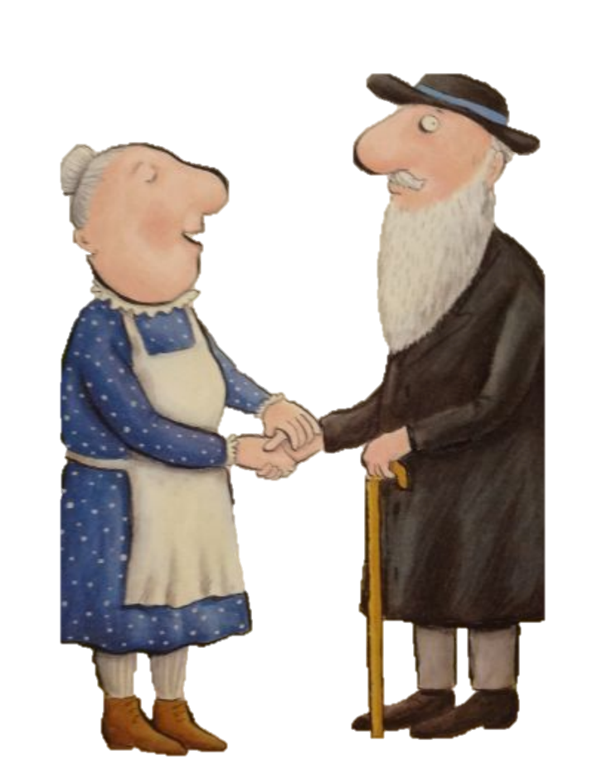
Notes:
“Thank you, old man, for the work you have done. It was weeny for five, it’s gigantic for one. There’s no need to grumble and there’s no need to grouse. There’s plenty of room in my house.”

Slide 25
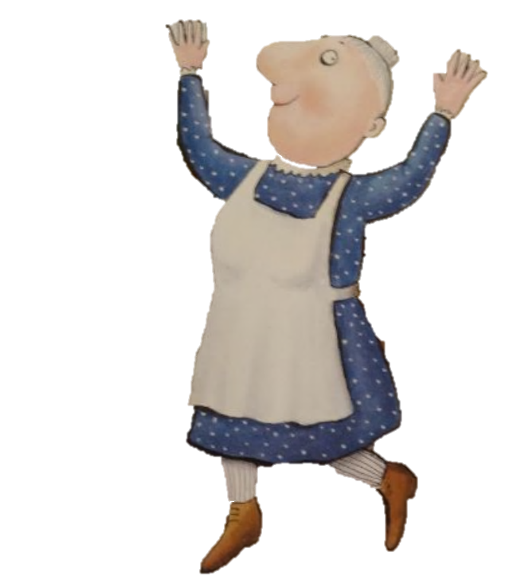
Notes:
And now she’s full of frolics and fiddle-de-dees. It isn’t a squash and it isn’t a squeeze.

Slide 26
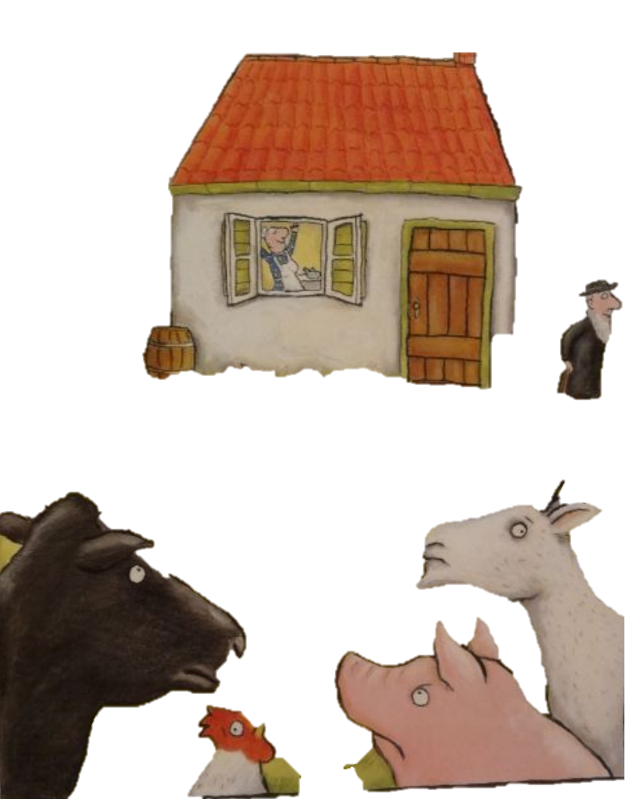
Notes:
Yes, she’s full of frolics and fiddle-de-dees. It isn’t a squash and a squeeze.

Slide 27
Notes:
The End

Slide 28
This Adapted Literature resource is available through the Sherlock Center Resource Library. The text and graphics are adapted from the original source. These resources are provided for teachers to help students with severe disabilities participate in the general curriculum. Please limit the use and distribution of these materials accordingly.
Paul V. Sherlock Center on Disabilities / RI College
600 Mt. Pleasant Avenue, Providence RI 02908
www.sherlockcenter.org

