Slide 1
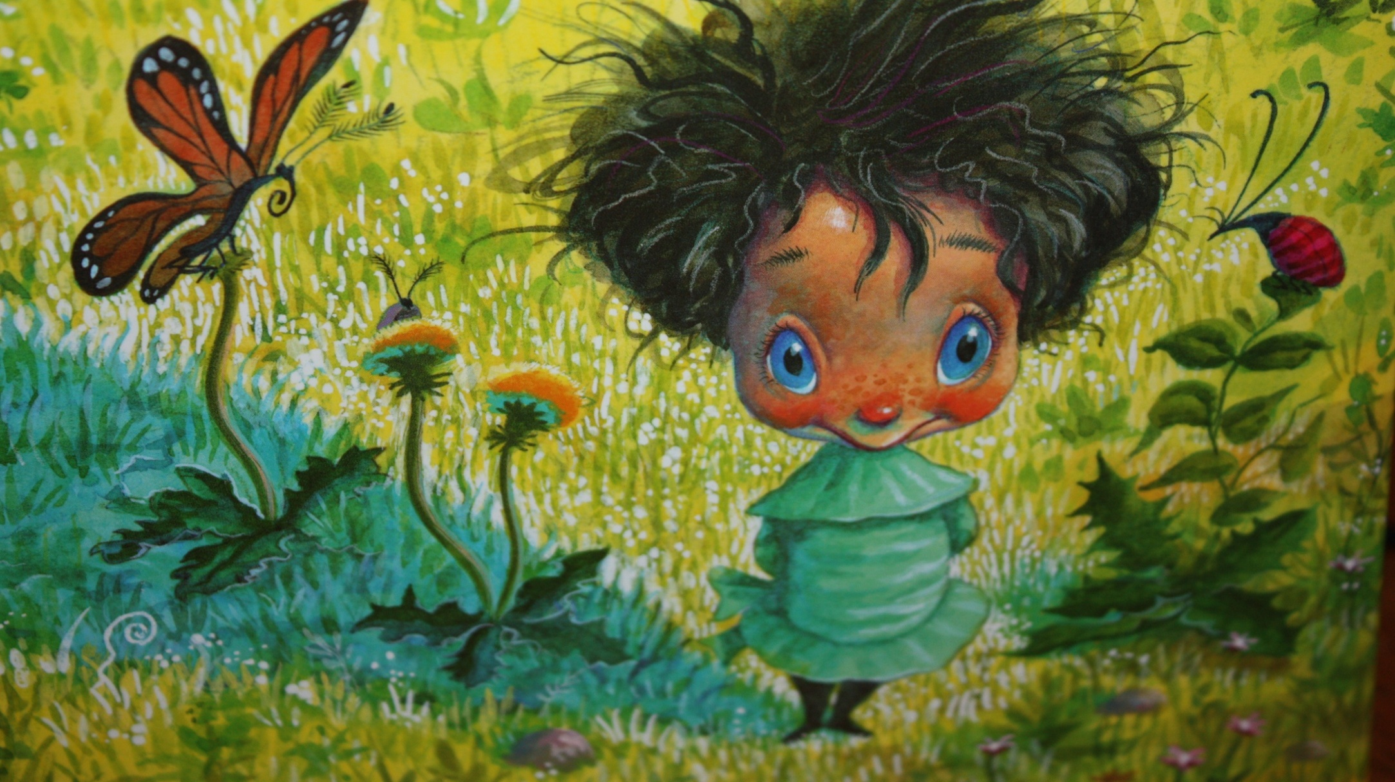
STAND TALL, MOLLY LOU MELON

Slide 2
Adapted from the original book, Stand Tall Molly Lou Melon
By Susan Kinney
Penguin Books

Slide 3
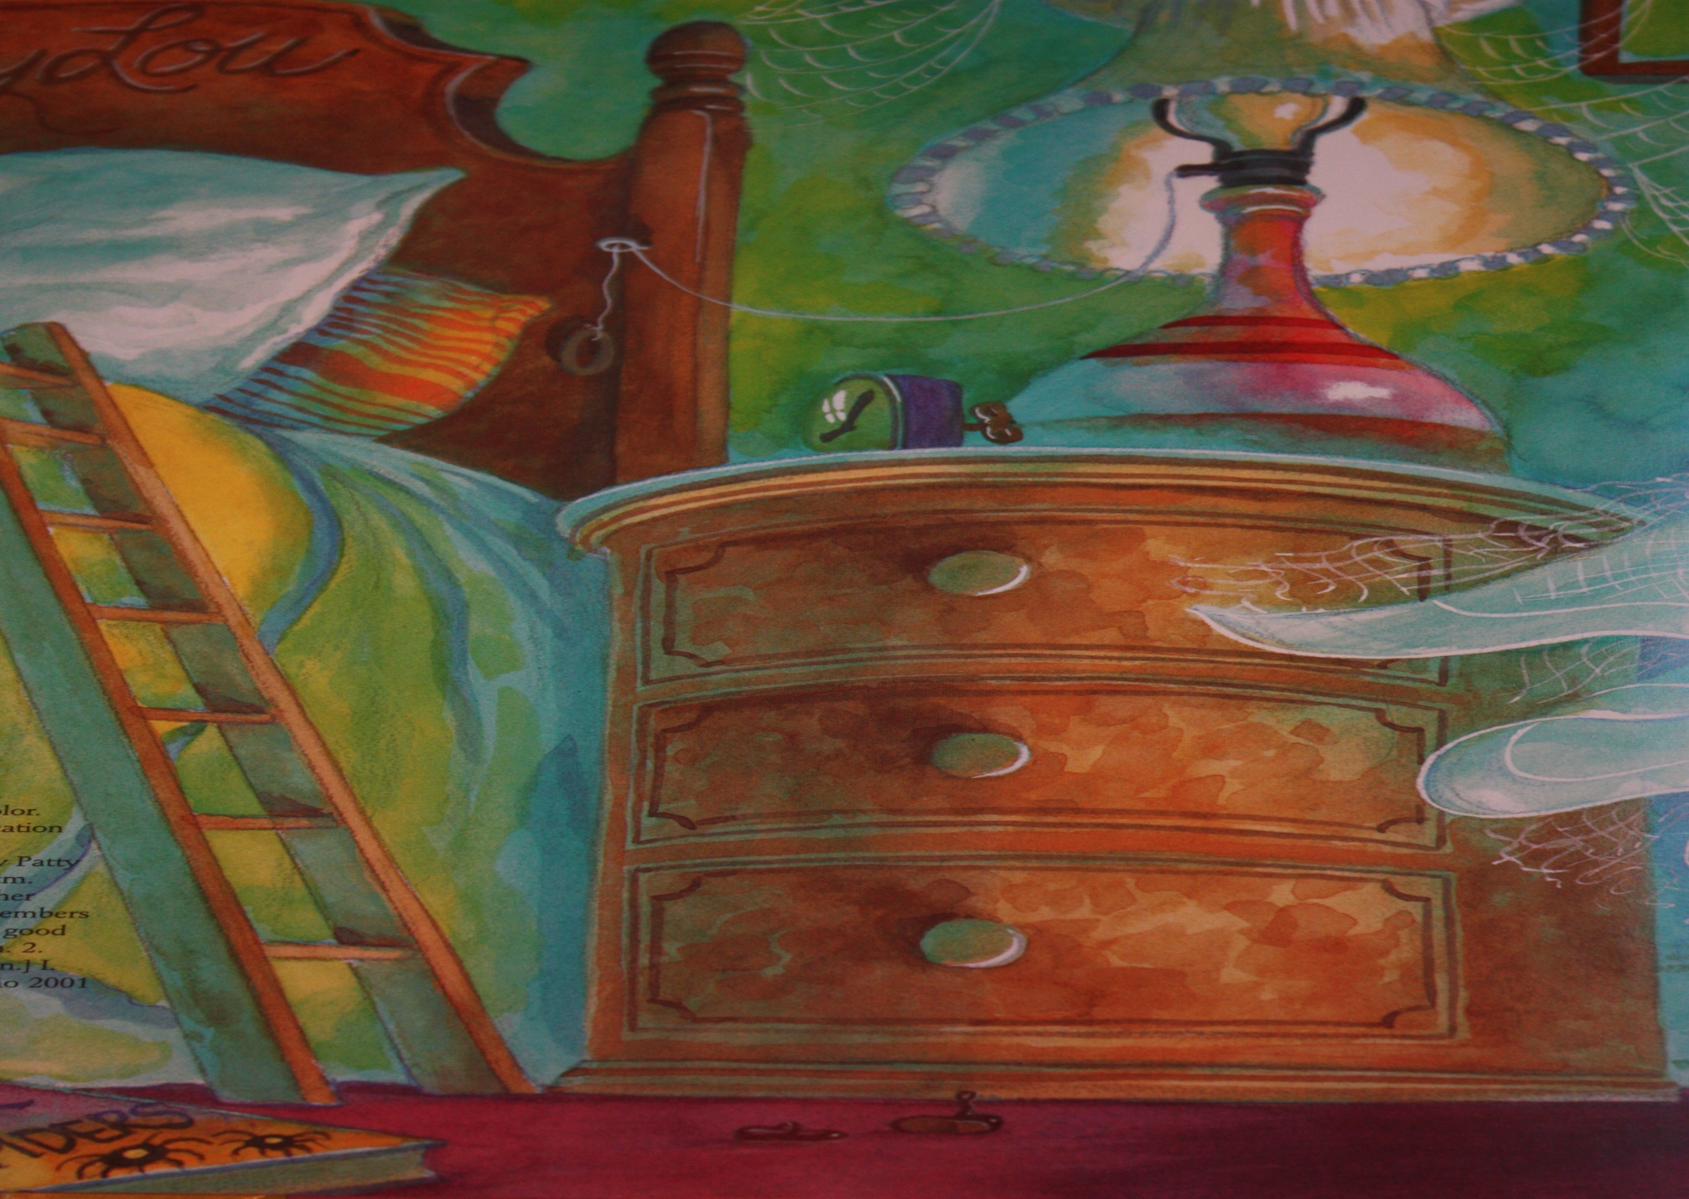
Molly Lou Melon is very tiny. She uses a ladder to get into bed. She is the shortest girl in school.

Slide 4
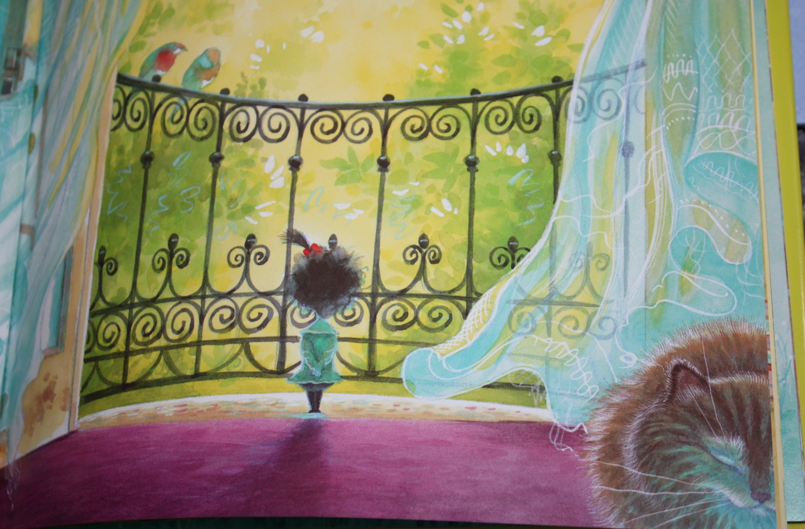
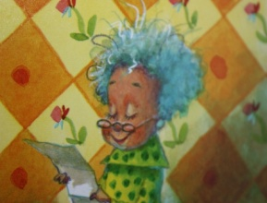
She doesn’t mind. Her grandma said, “Walk as proudly as you can. Everyone will look up to you.”

Slide 5
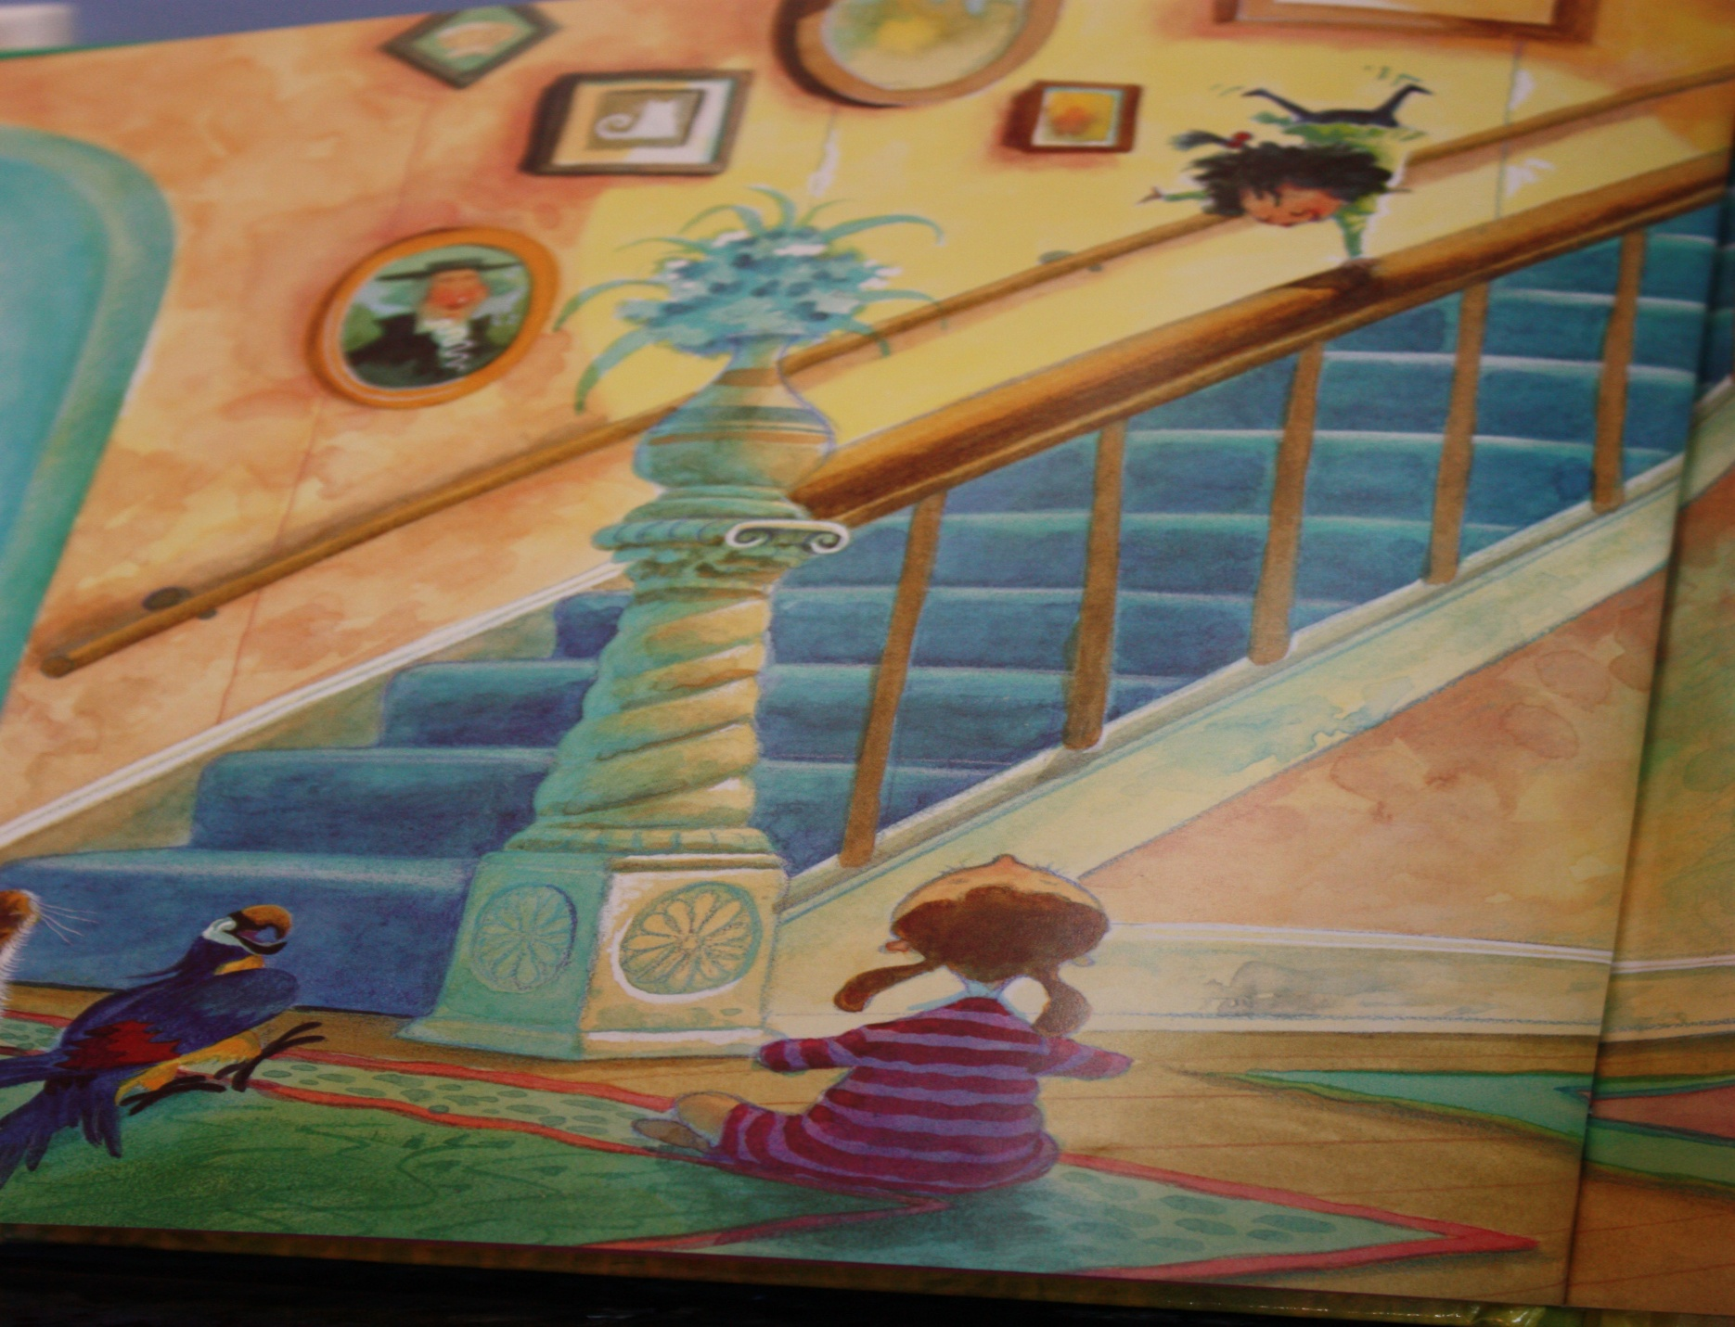
So she did!

Slide 6
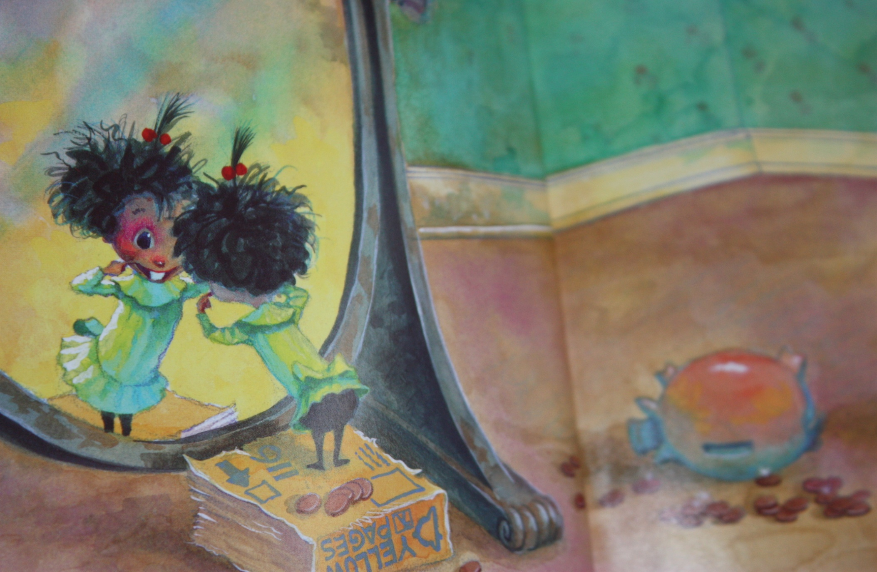
One day, Molly Lou Melon said, “Grandma, my buck teeth stick out so far. I can stack pennies on them.”

Slide 7
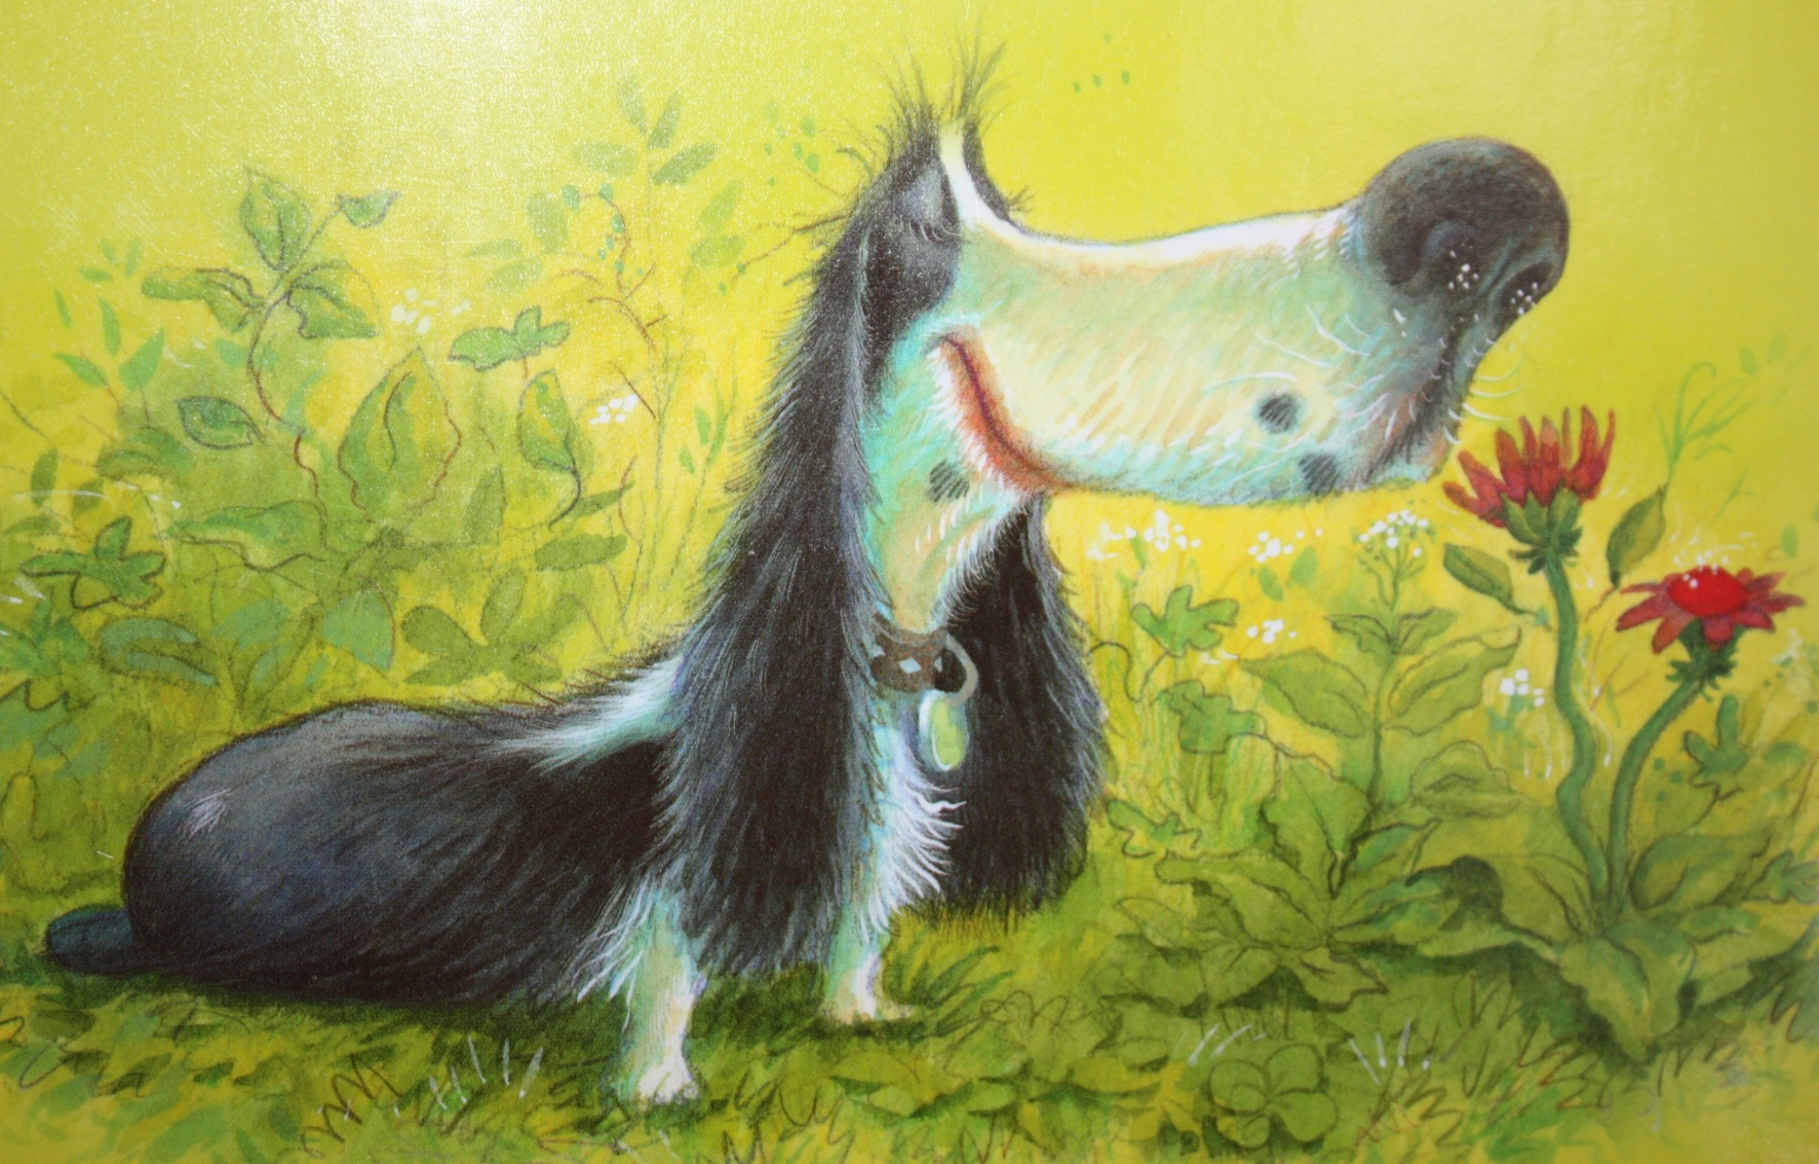
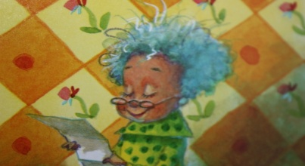
Grandma said, “Smile big! Everyone will smile with you.”

Slide 8
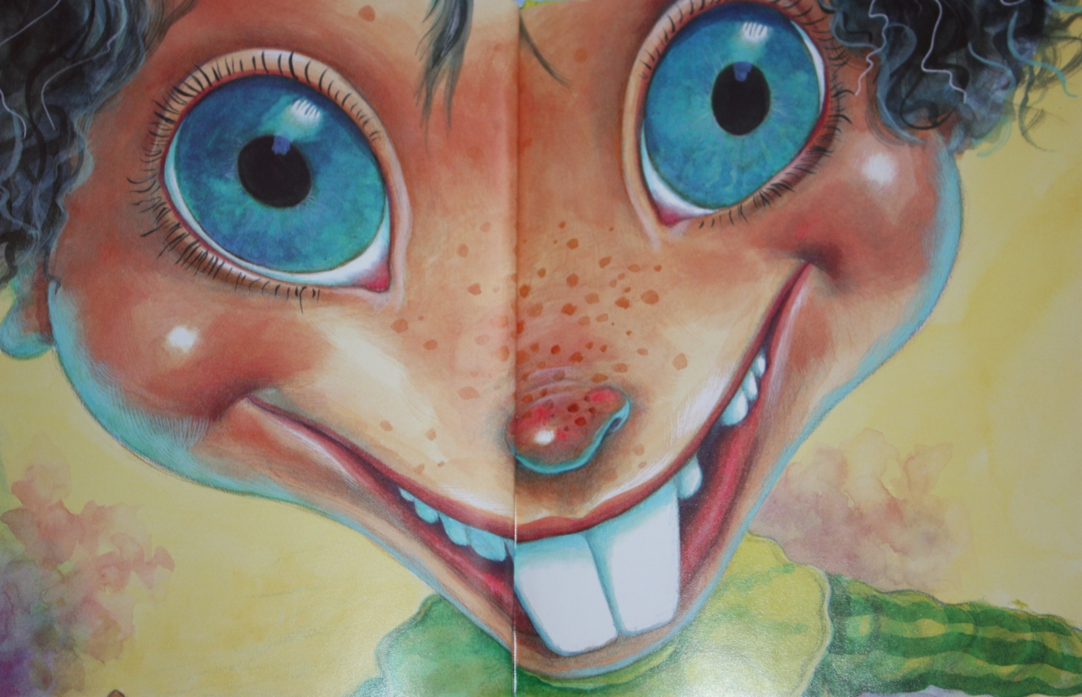
So she did!

Slide 9
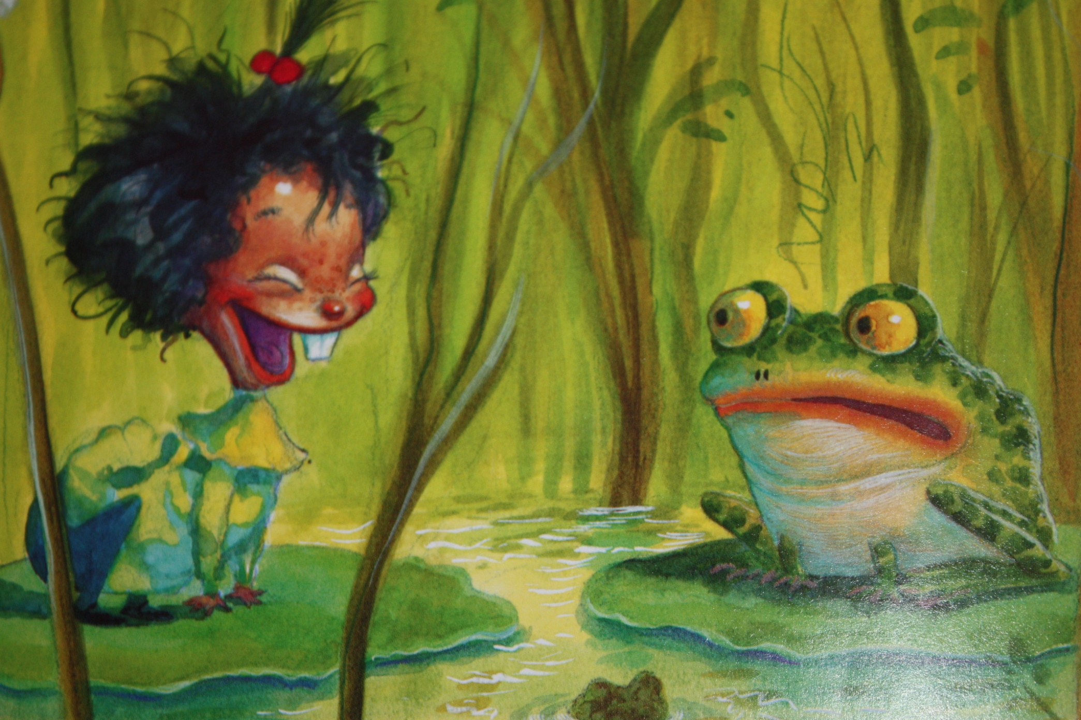
Then, Molly Lou Melon said, “Grandma, I sound like a bullfrog.”

Slide 10
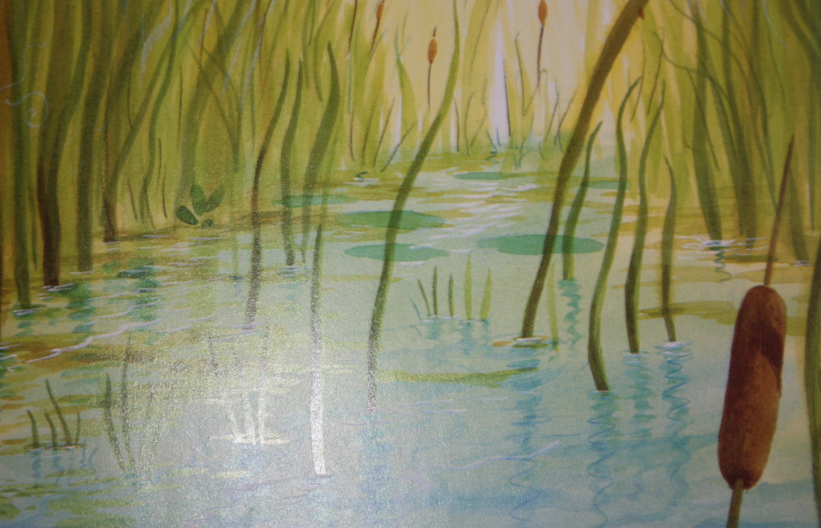
Grandma said, “Sing out clear and strong! Everyone will be happy.”

Slide 11
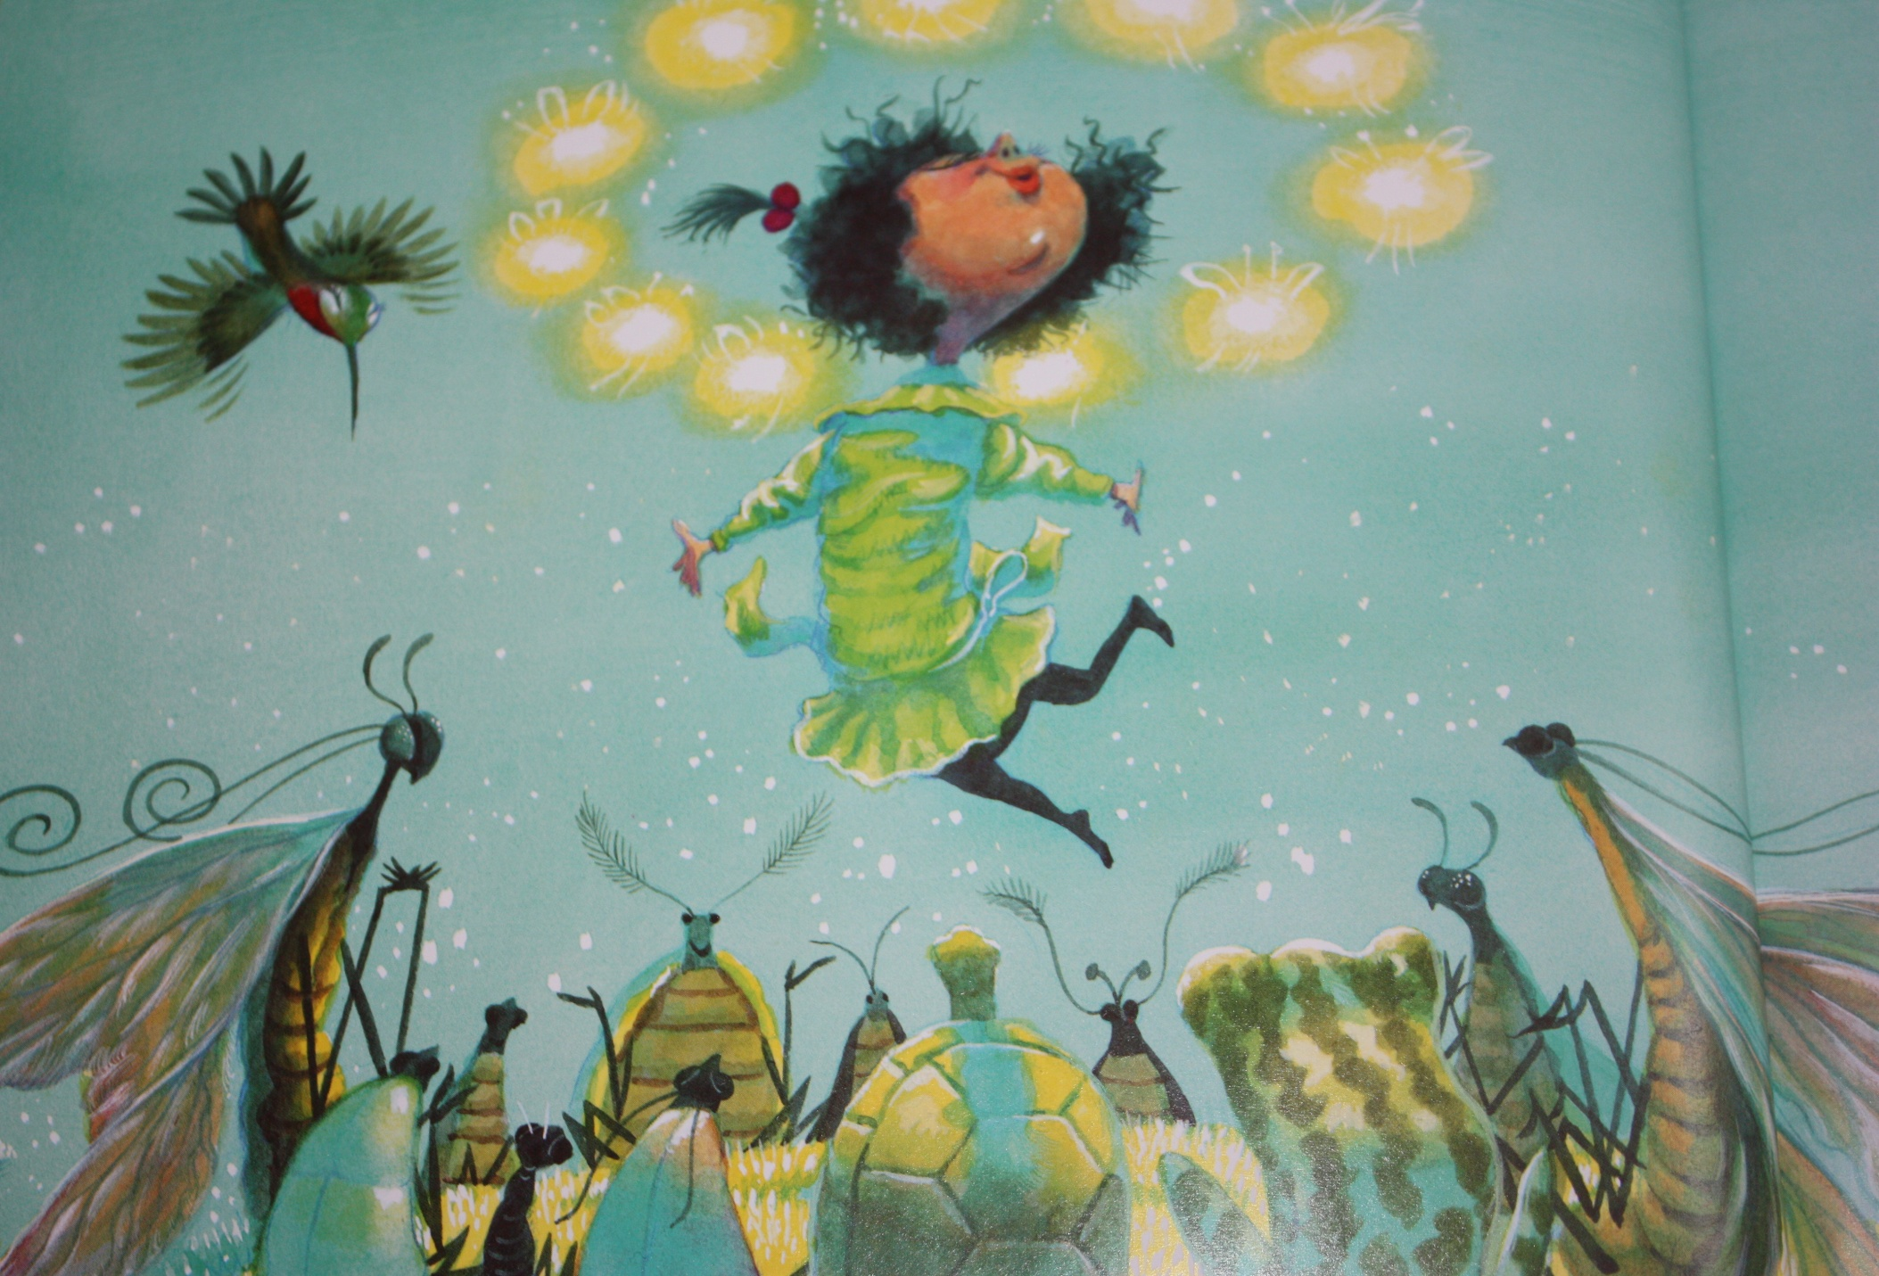
So she did!

Slide 12
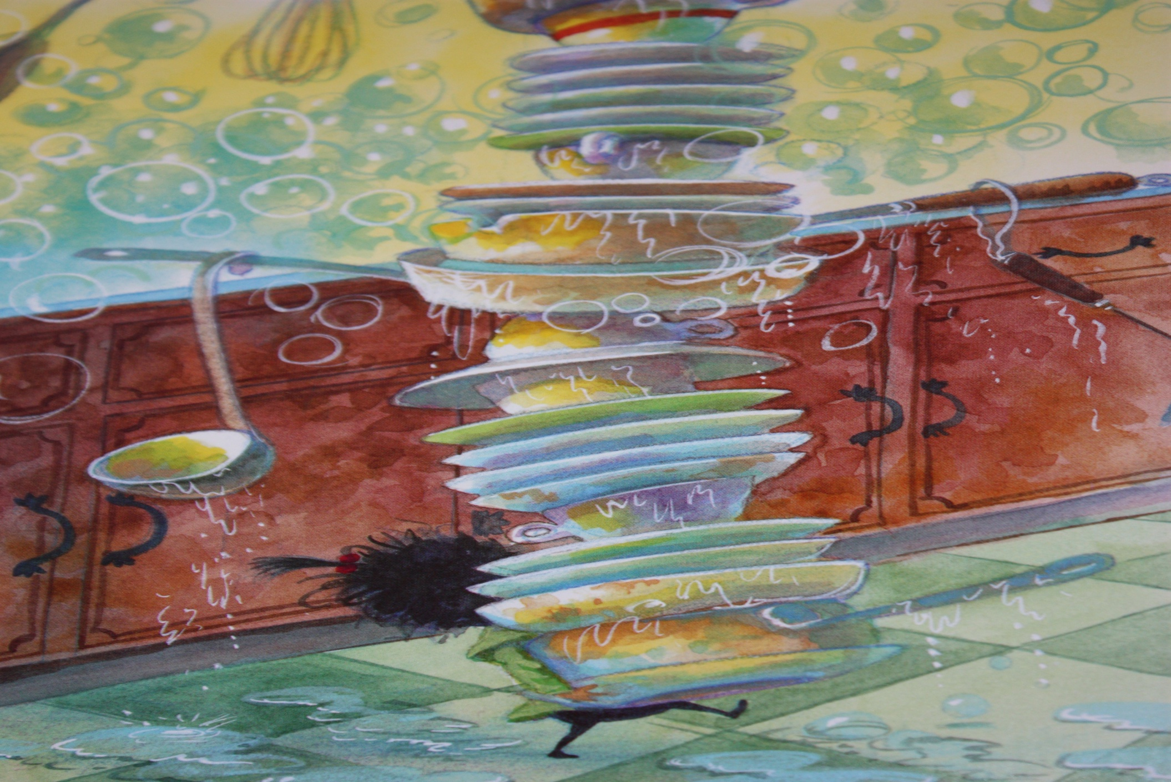
Molly Lou Melon said,
“Grandma, I am so clumsy.”

Slide 13
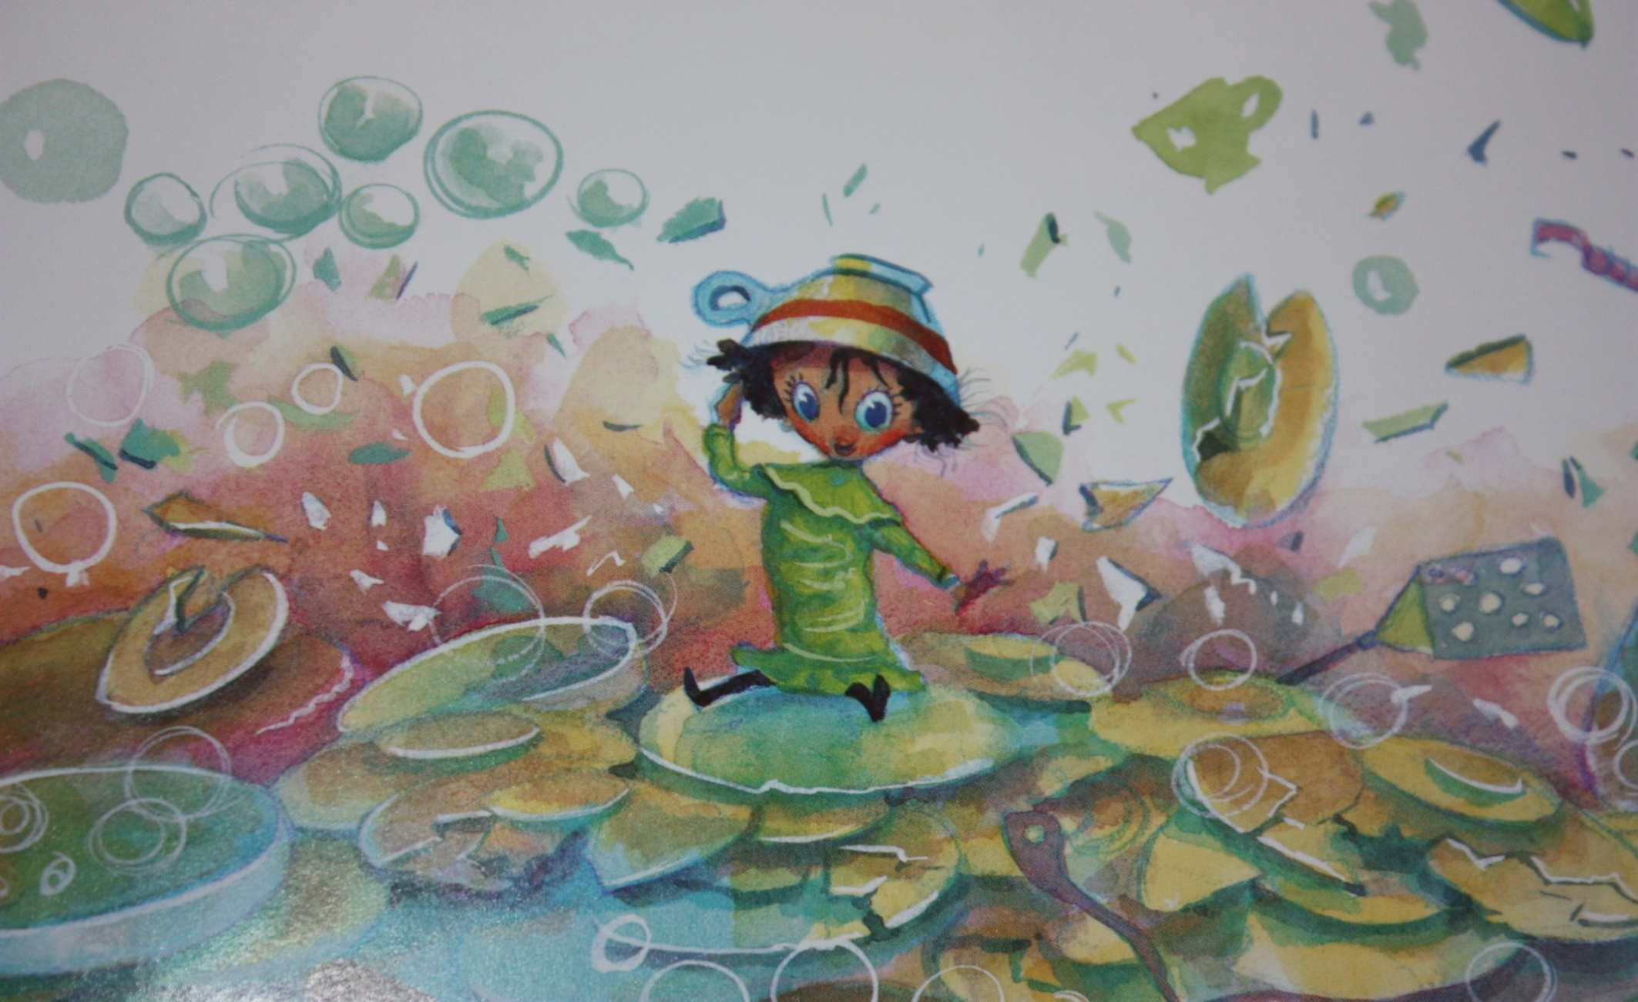
Grandma told her, “Believe in yourself! Everyone will believe in you too!”

Slide 14
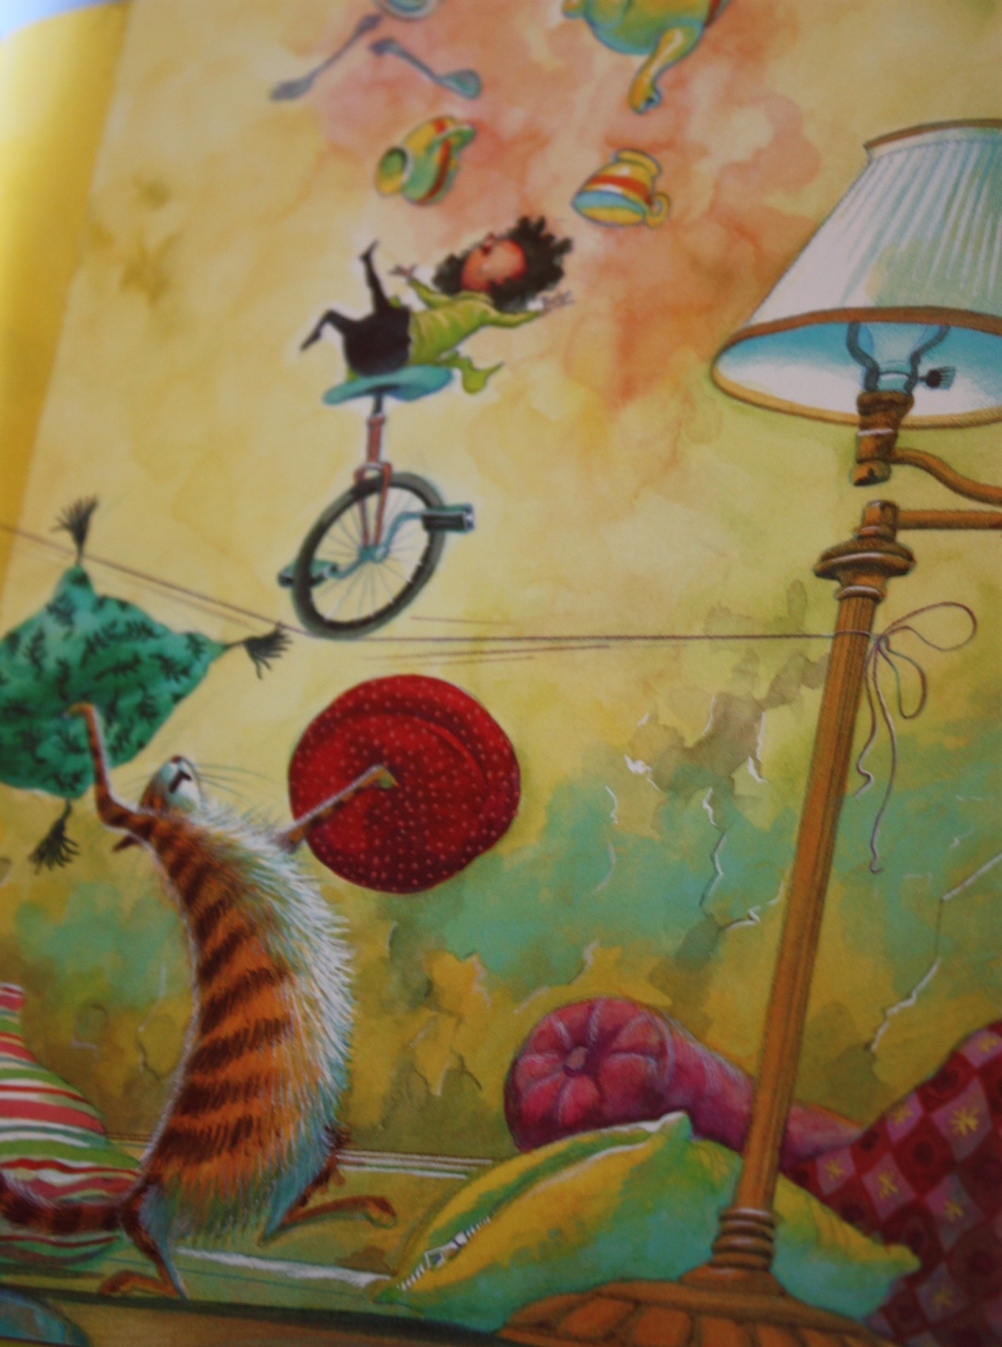
So she did!

Slide 15
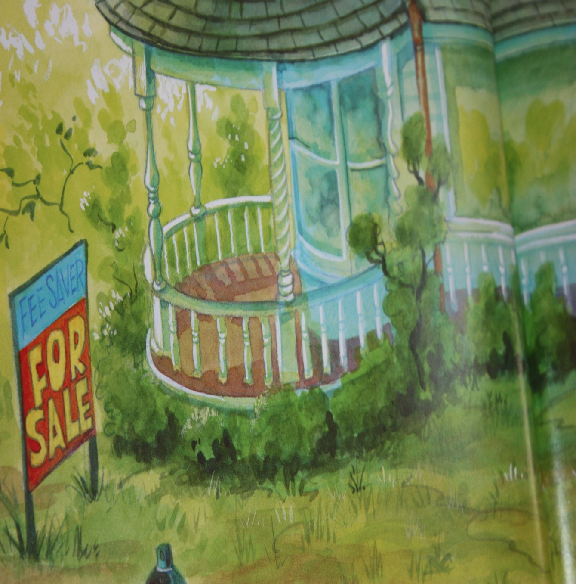
Molly Lou Mellon’s house was for sale. She had to move to a new town.

Slide 16
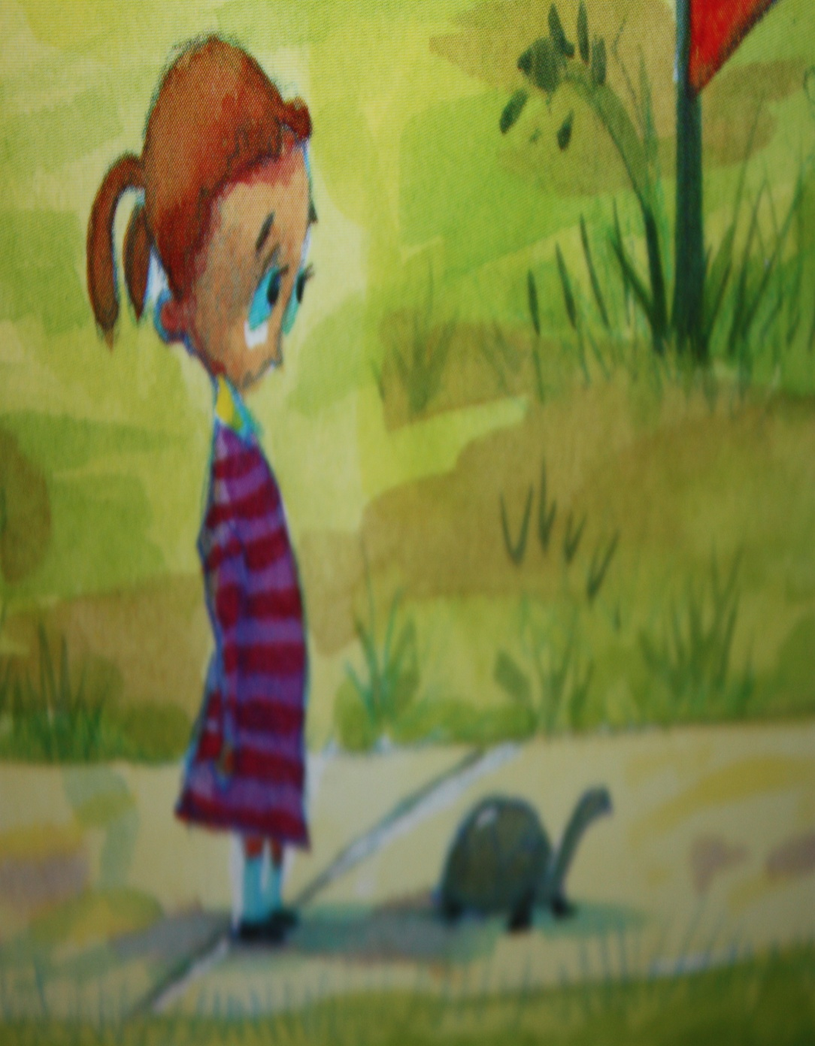
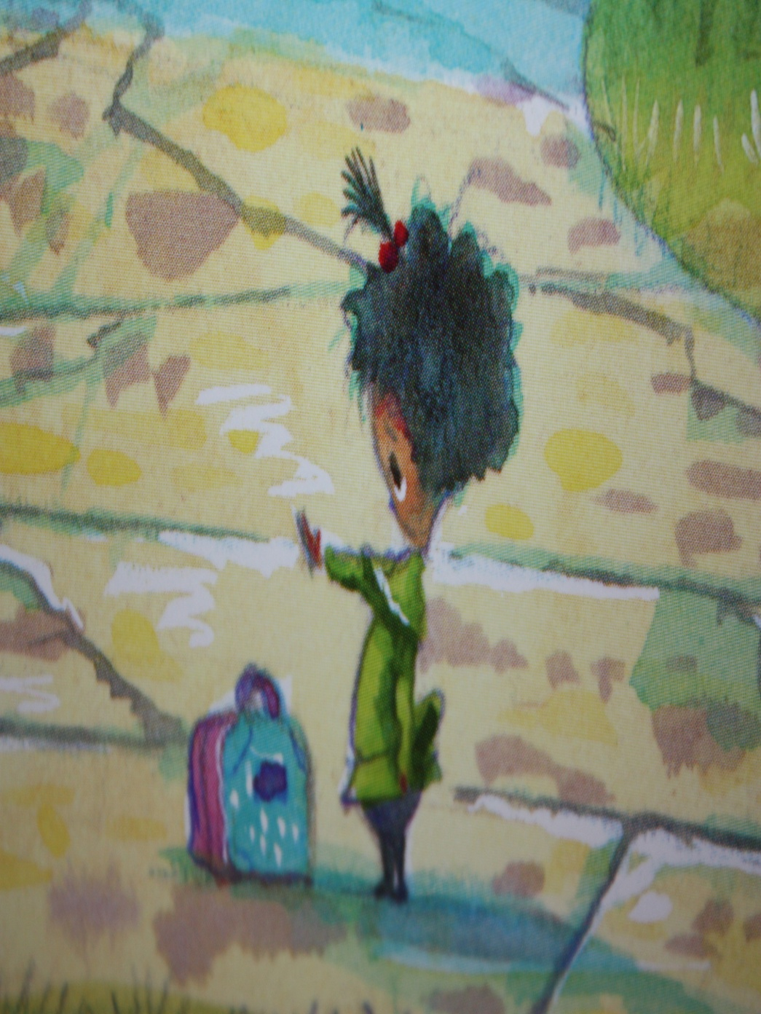
Molly Lou Melon said, “Goodbye” to her friend.

Slide 17
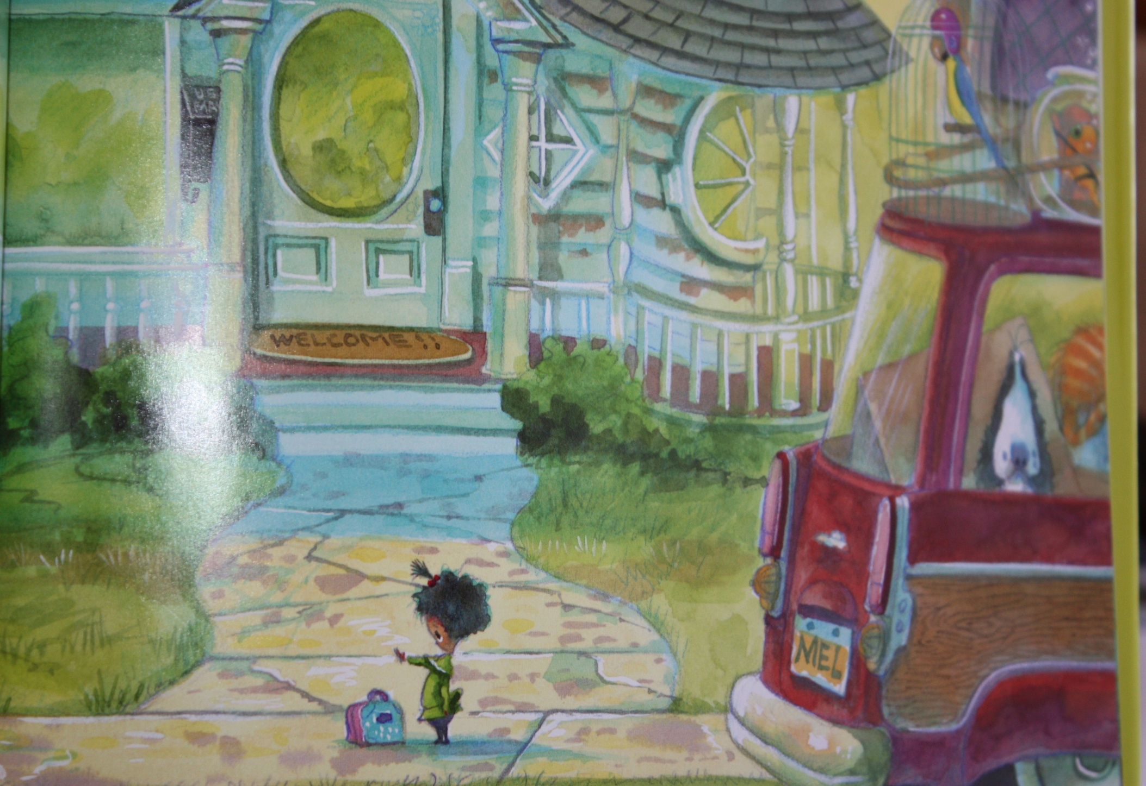
She was very sad.

Slide 18
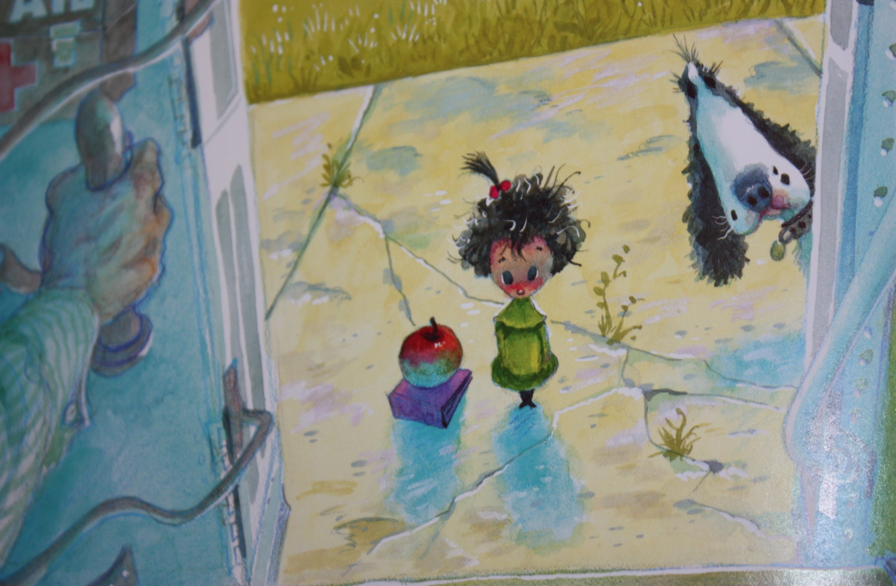
Molly Lou Melon took a new bus to a new school. She had to meet new friends. She was very scared.

Slide 19
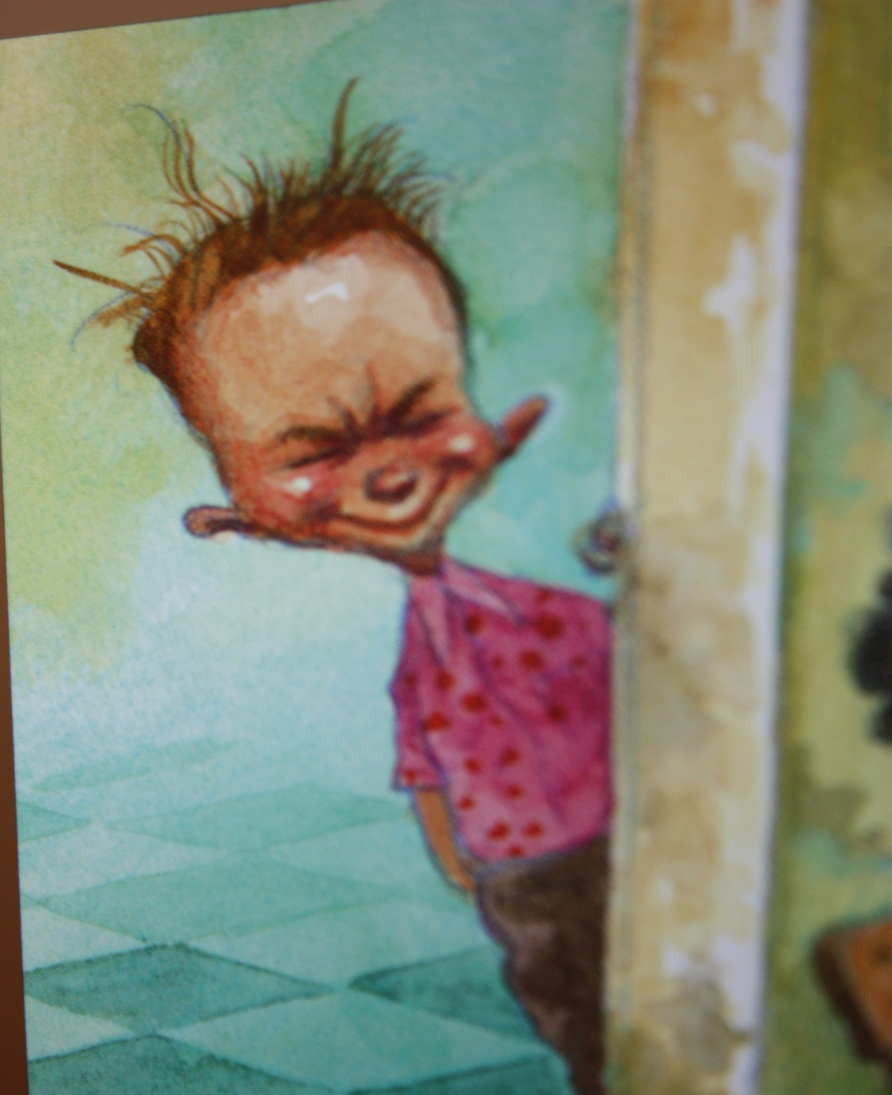
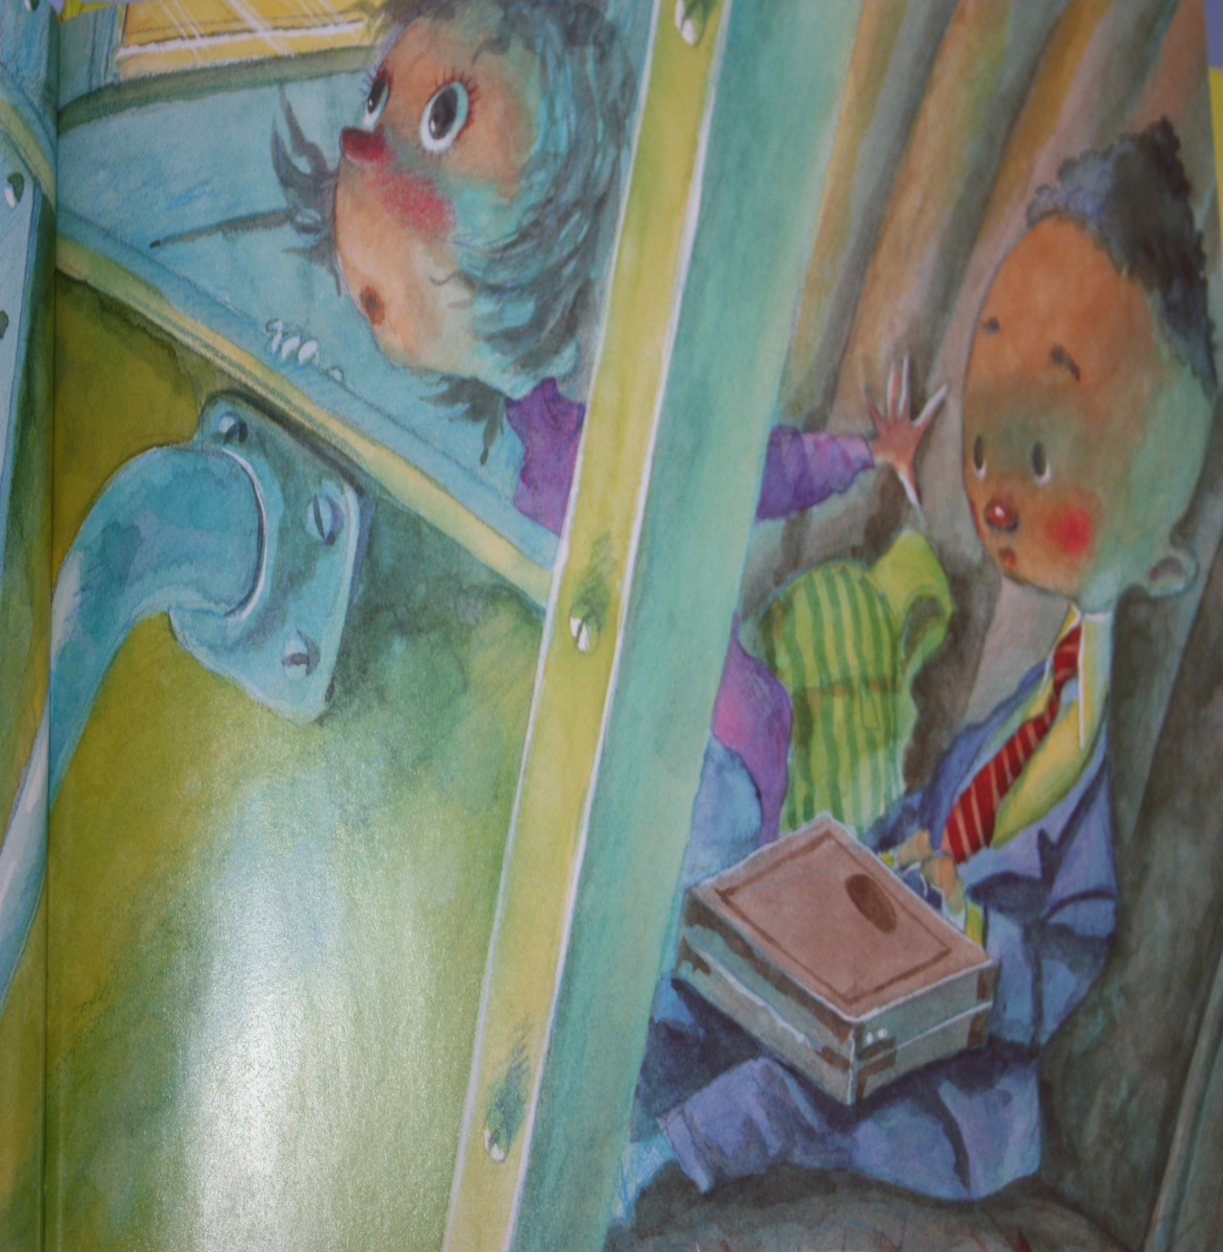
Everyone looked at her. Even the school bully, named Ronald Durkin.

Slide 20
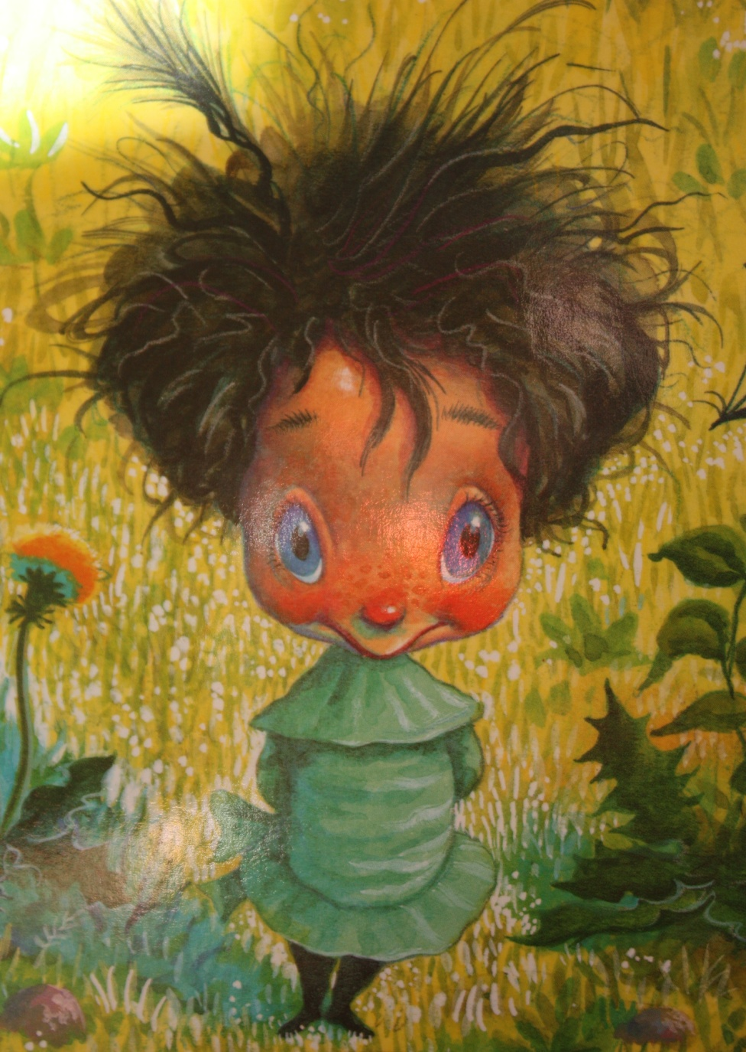
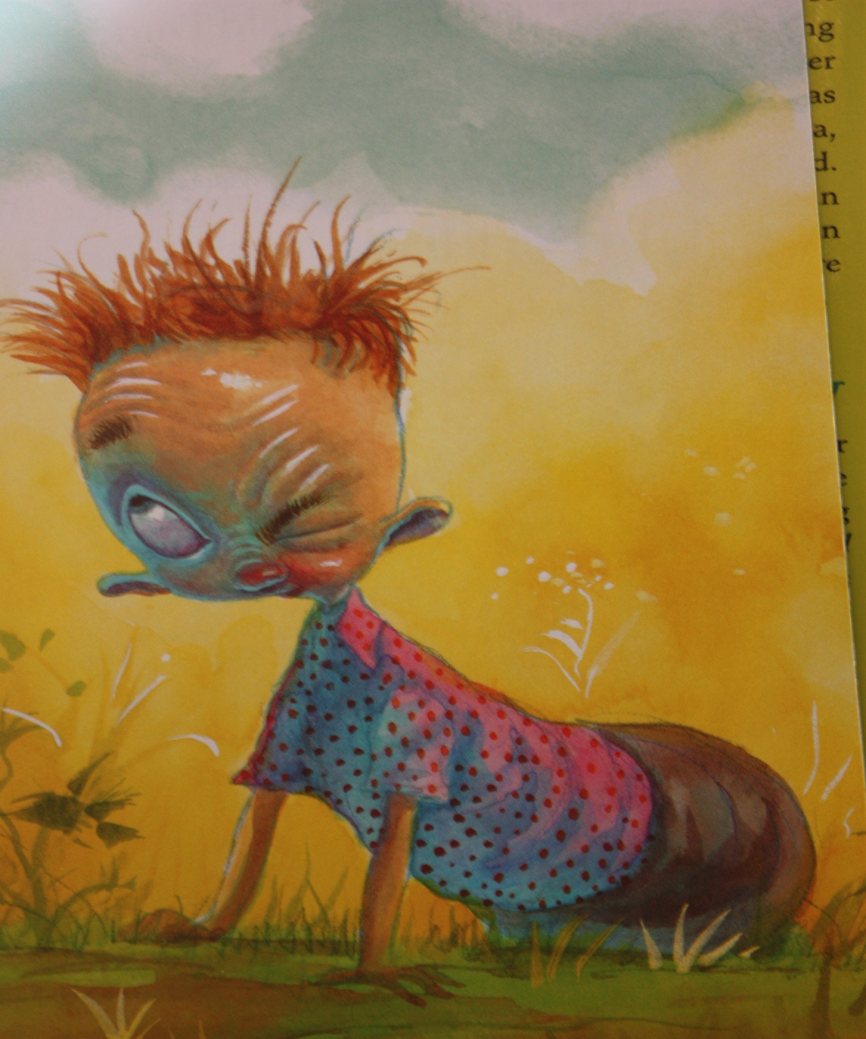
On the first day of school, in gym class, Ronald Durkin called her “SHRIMPO!”

Slide 21
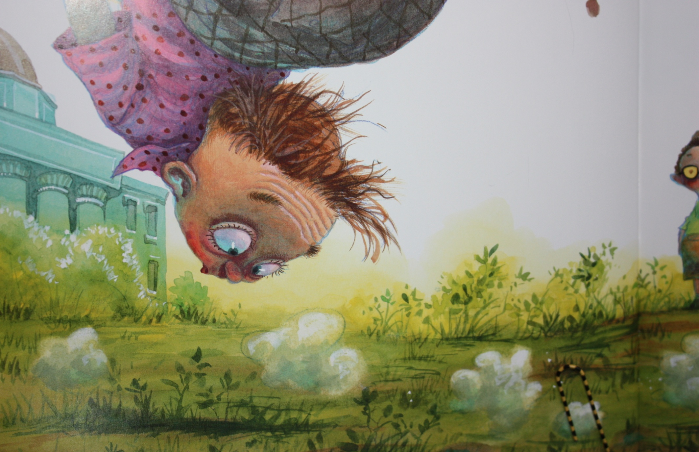
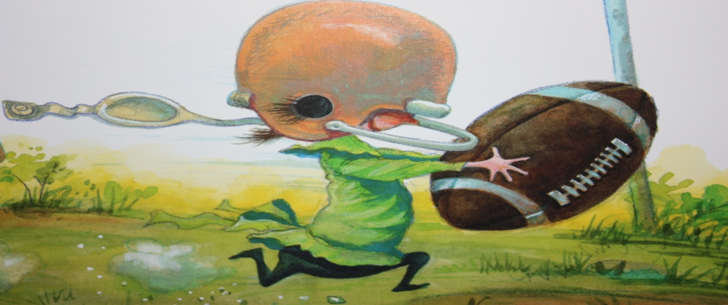
When the game started, Molly Lou Melon caught the football. She ran right under Ronald Durkin’s legs.

Slide 22
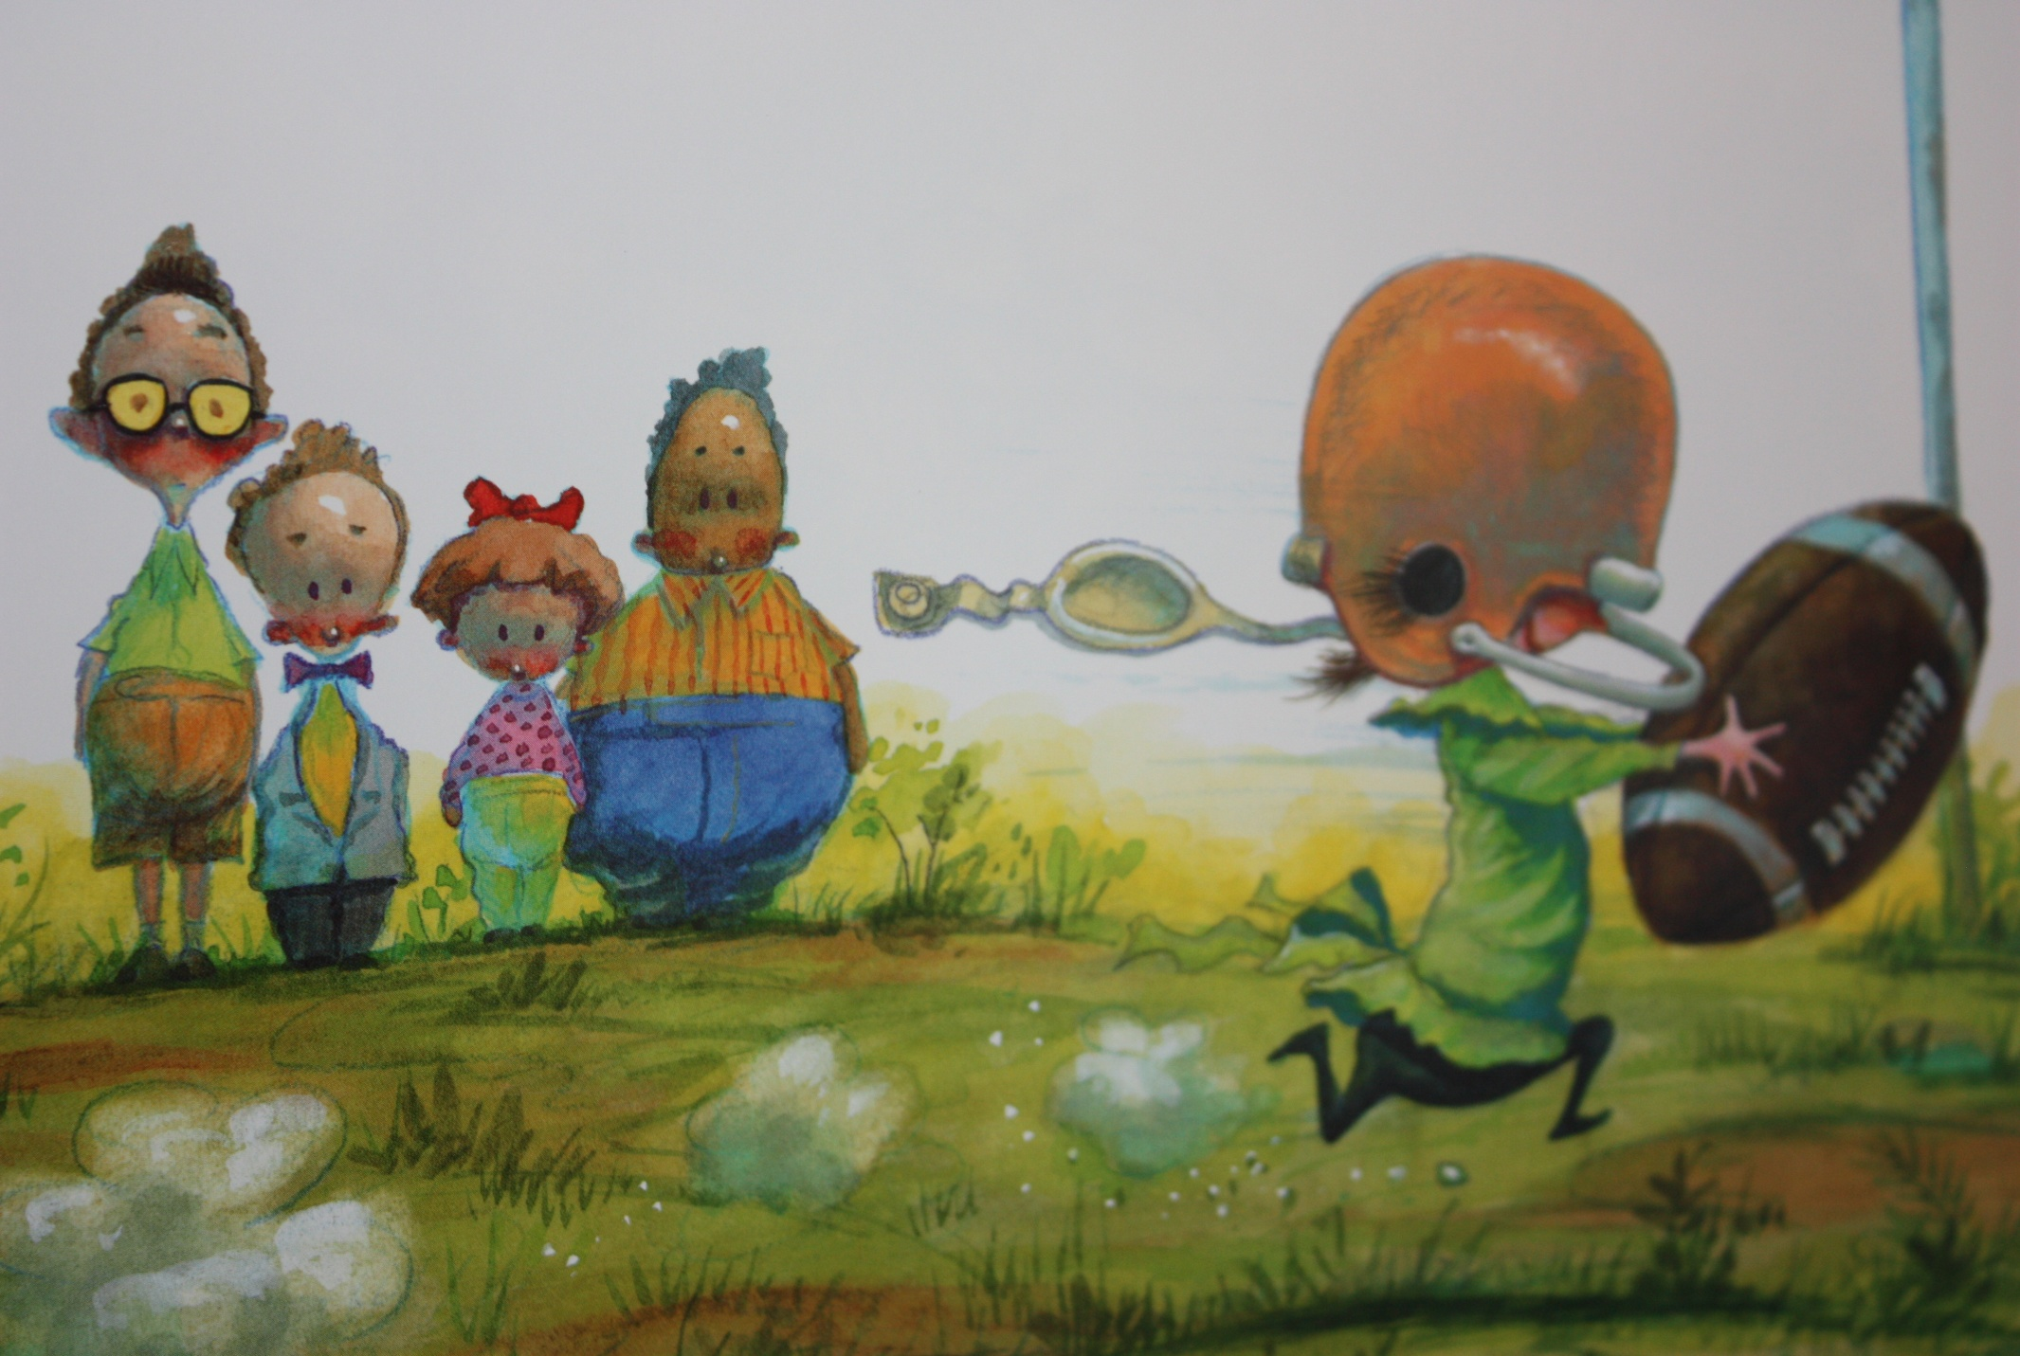
Molly Lou Melon scored a touchdown. Everyone thought, “Wow, she’s good!” Ronald Durkin felt very silly.

Slide 23
On the second day of school, Ronald Durkin called her, “Bucky-Tooth Beaver!”

Slide 24
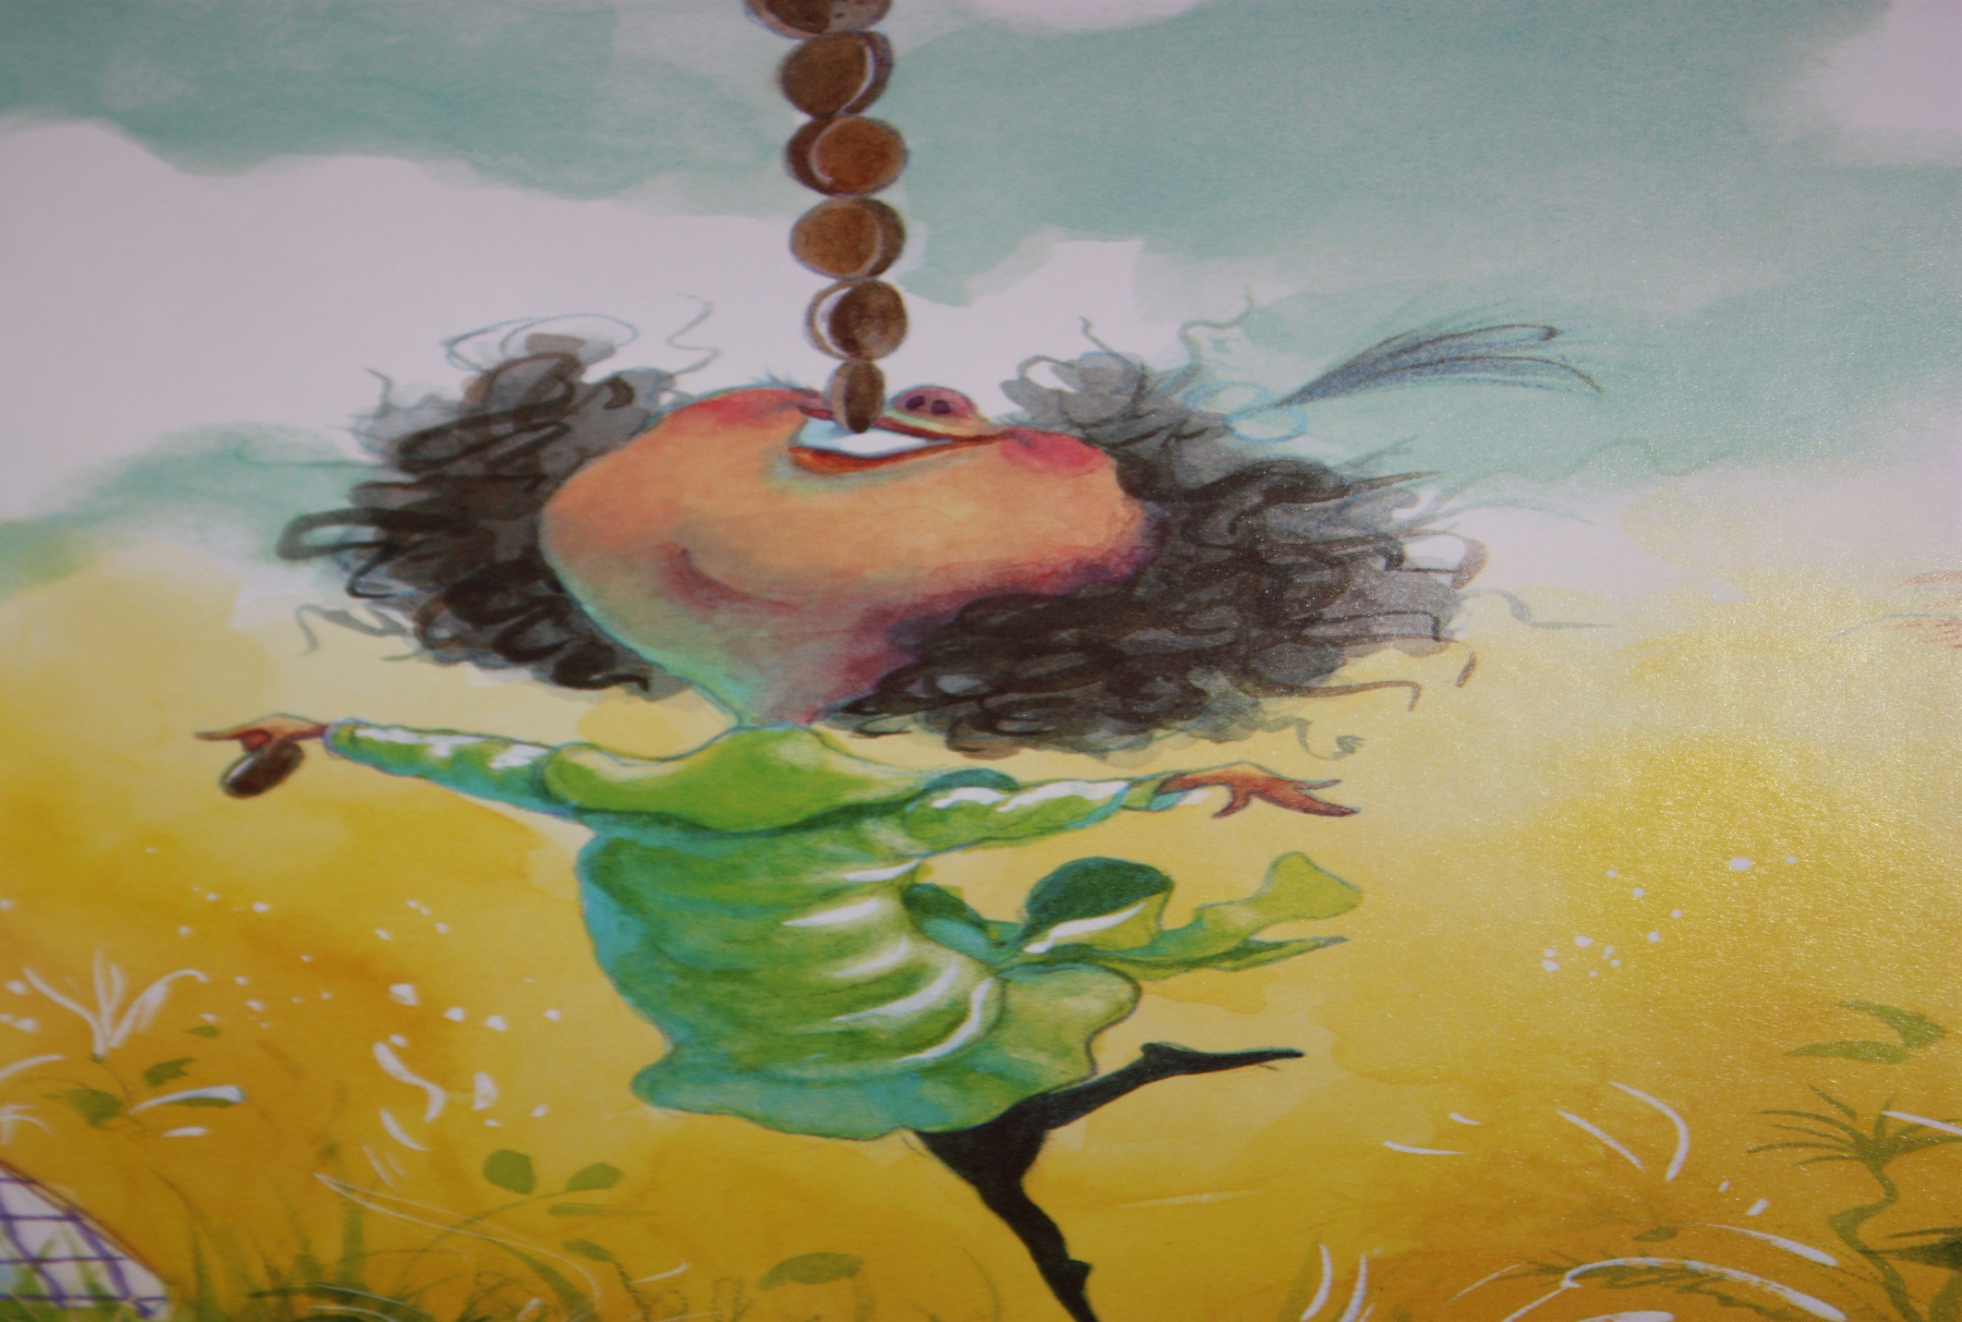
Molly Lou Melon took out her pennies. She stacked ten pennies high on her teeth. Then, smiled very big.

Slide 25
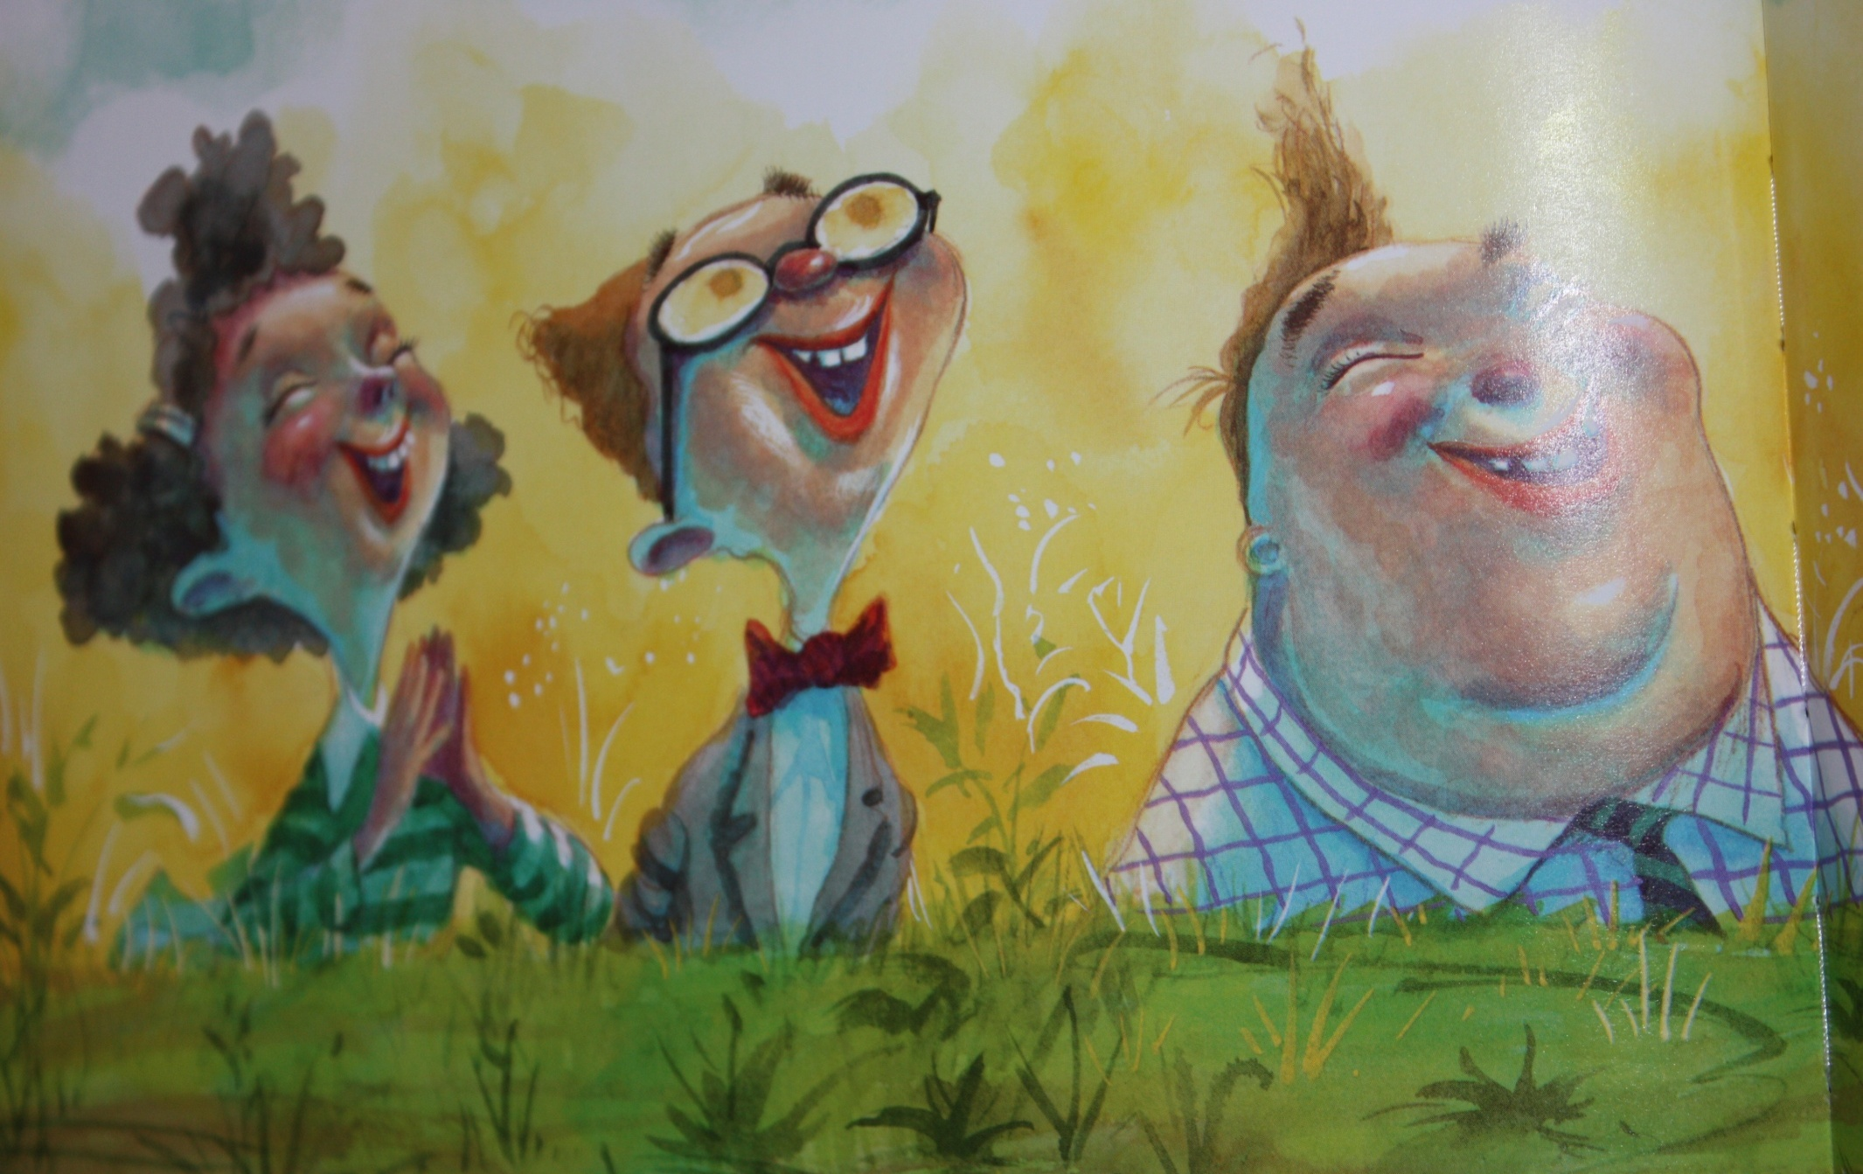
Everyone said, “Hooray!”
They smiled and clapped for her!

Slide 26
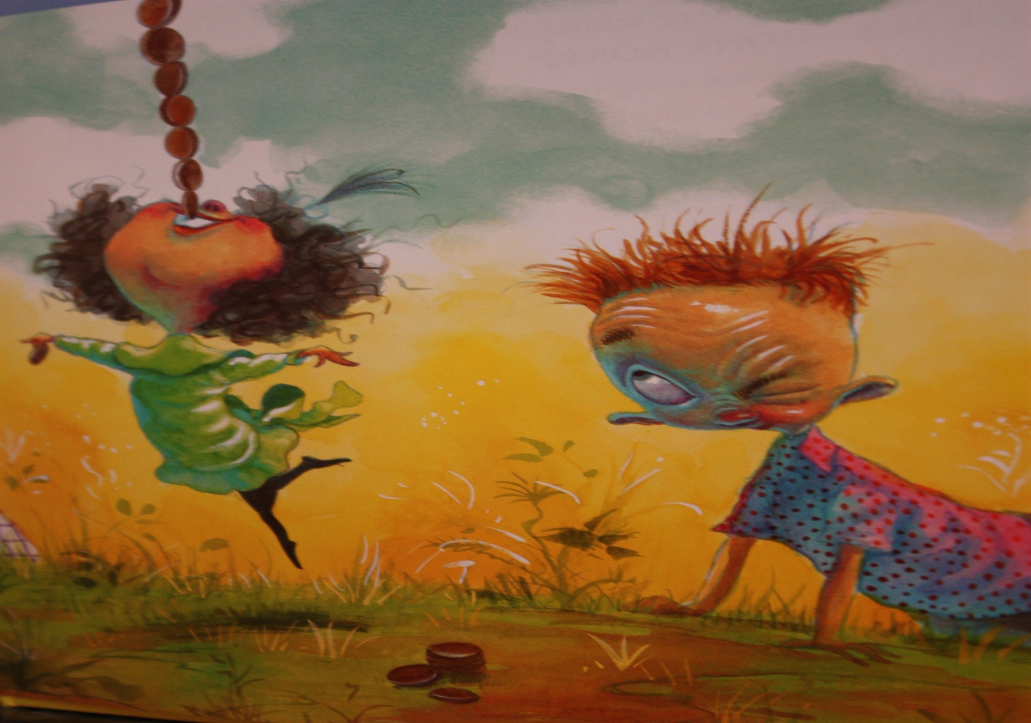
Ronald Durkin felt very silly.

Slide 27
On the third day of school, Ronald Durkin said, “You sound like a sick duck – “HONK HONK!”

Slide 28
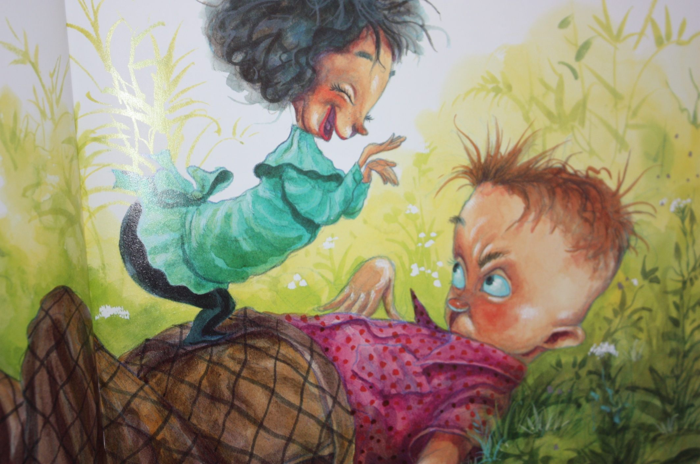
Molly Lou Melon said, “QUACK!” Ronald Durkin fell backwards. He hit his head and went to the nurse.

Slide 29
No one wanted to see Ronald get hurt, but everyone was happy. They were free of Ronald Durkin for the day.

Slide 30
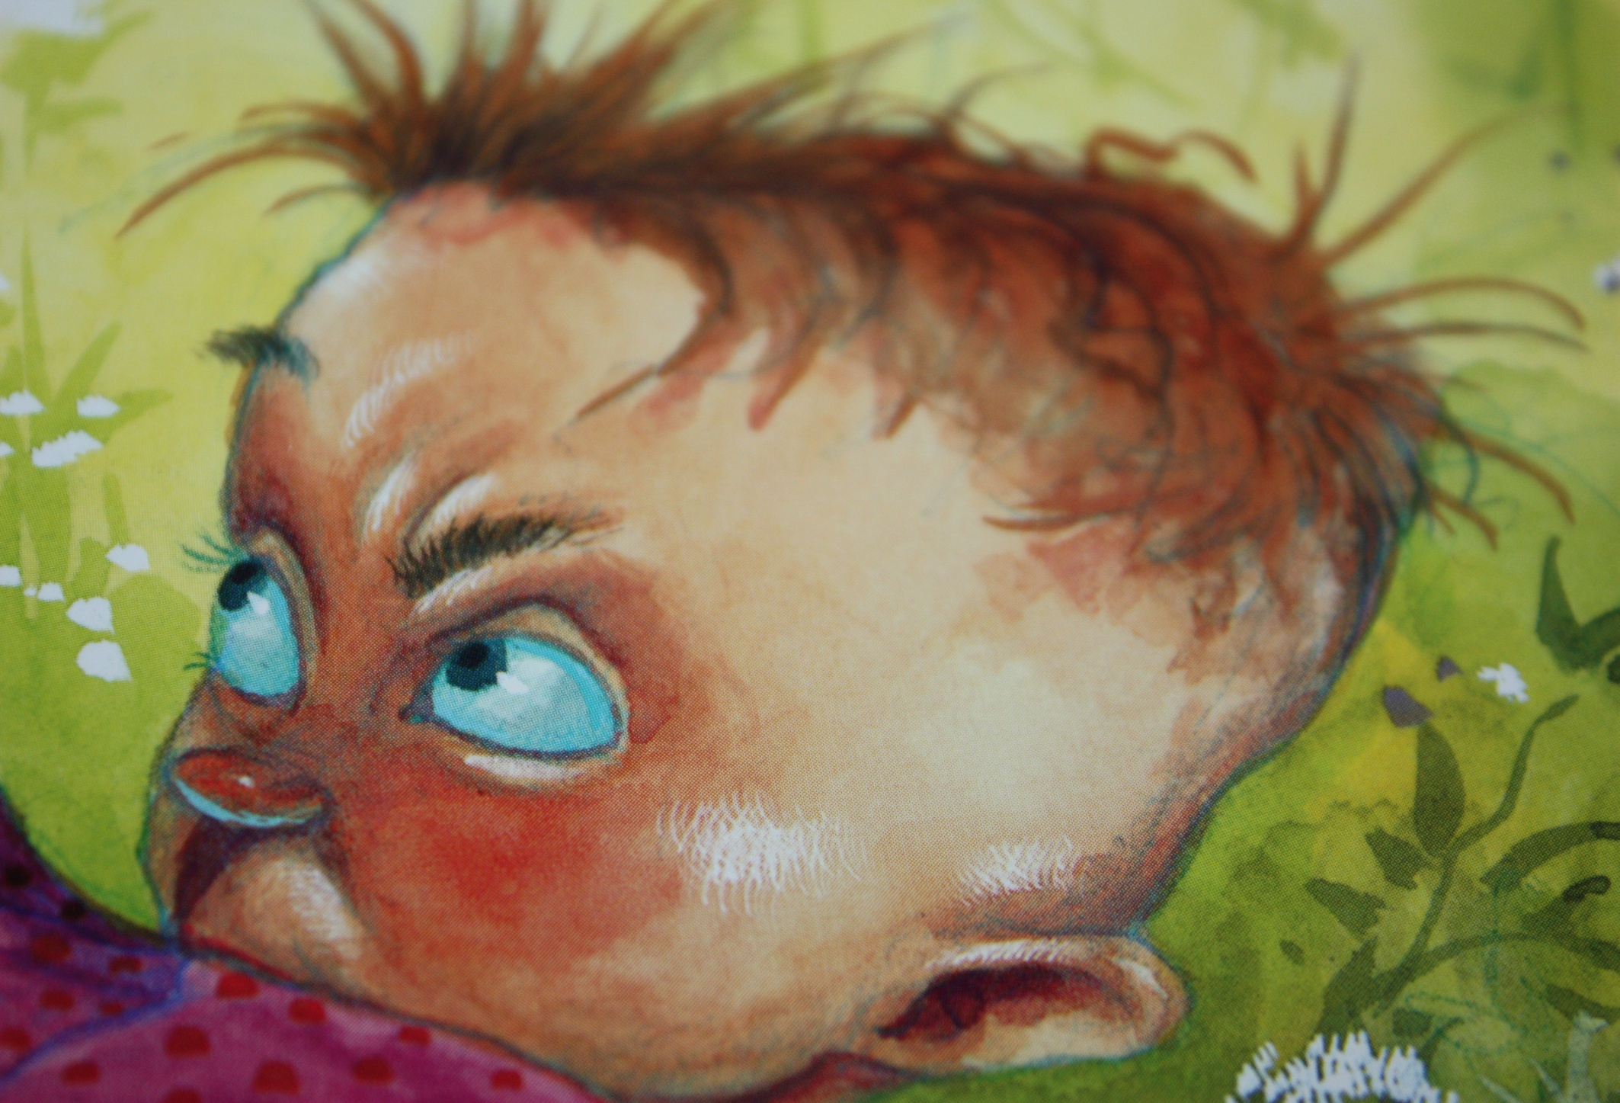
Ronald Durkin felt very silly.

Slide 31
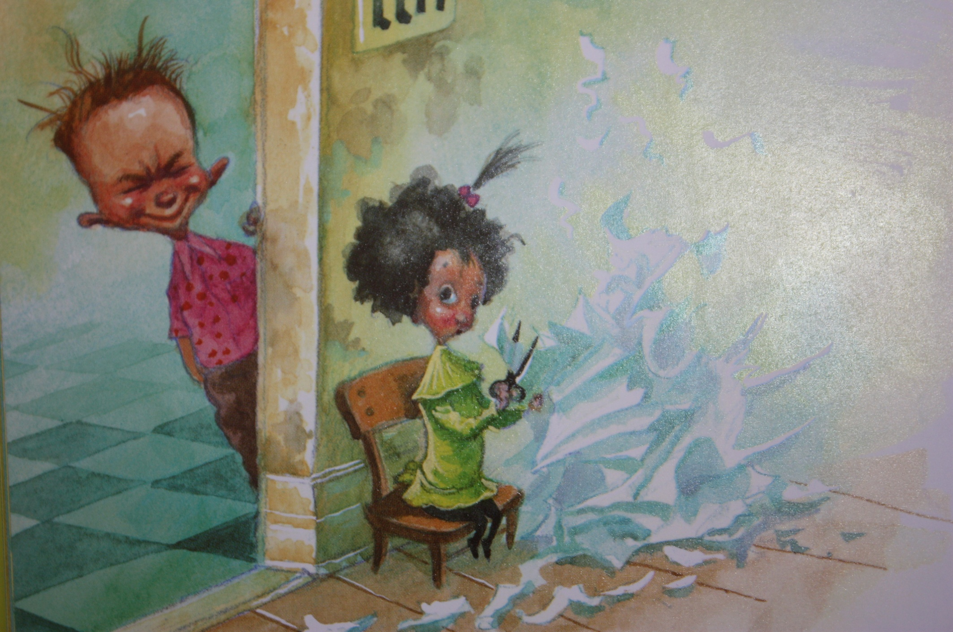
On the fourth day of school, Ronald Durkin said, “Ha! You made your snowflake wrong!”

Slide 32
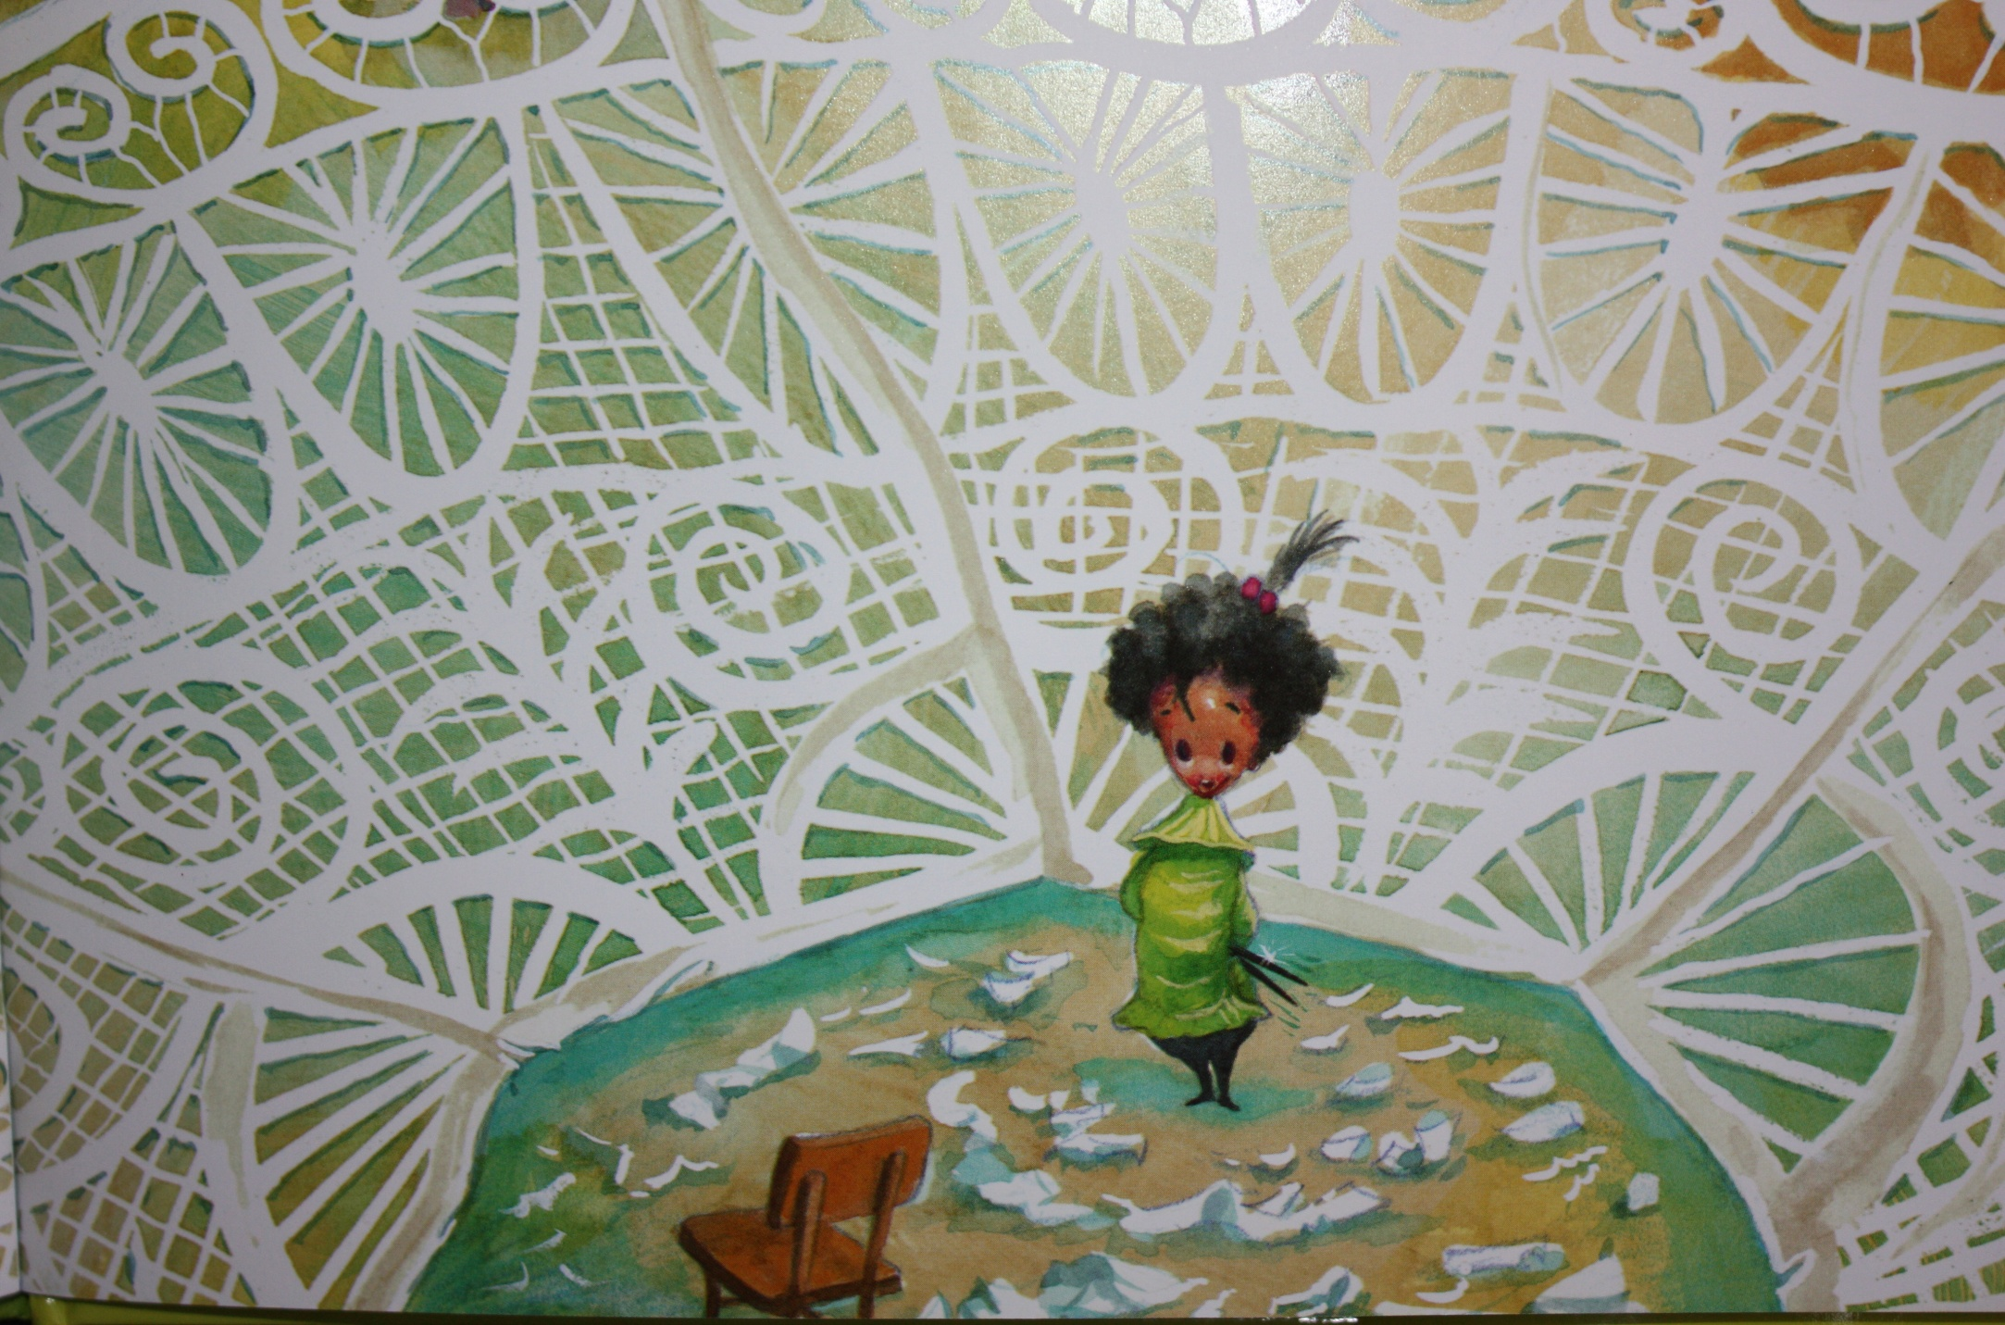
Then, Molly Lou Melon opened the paper. Her snowflake was beautiful!

Slide 33
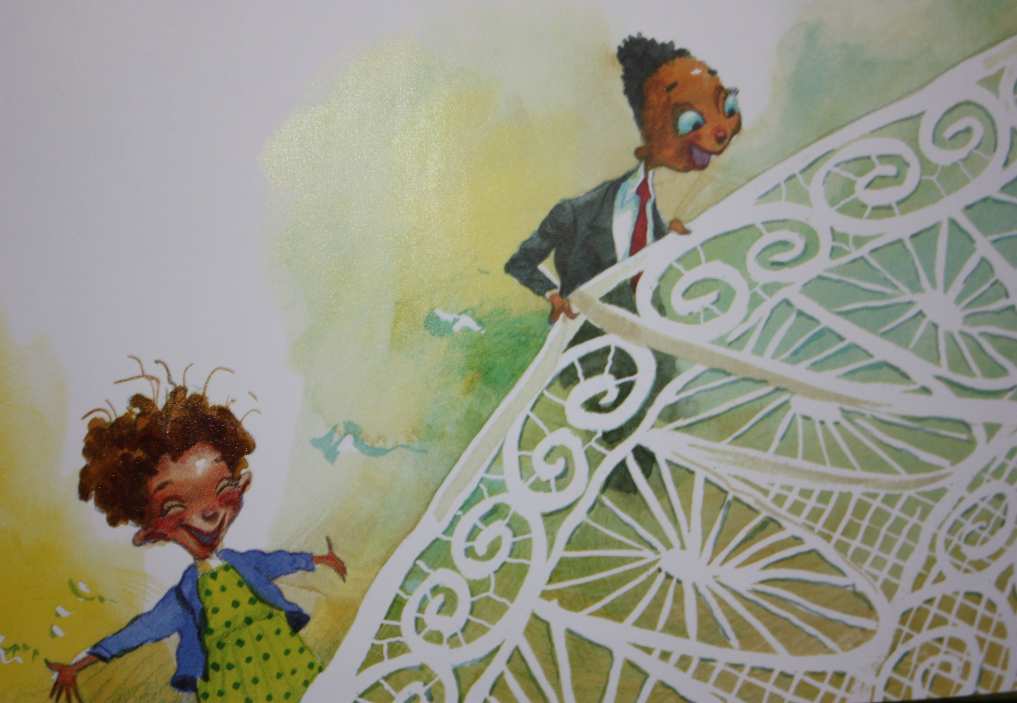
Everyone said, “WOW” and “HOORAY”!

Slide 34
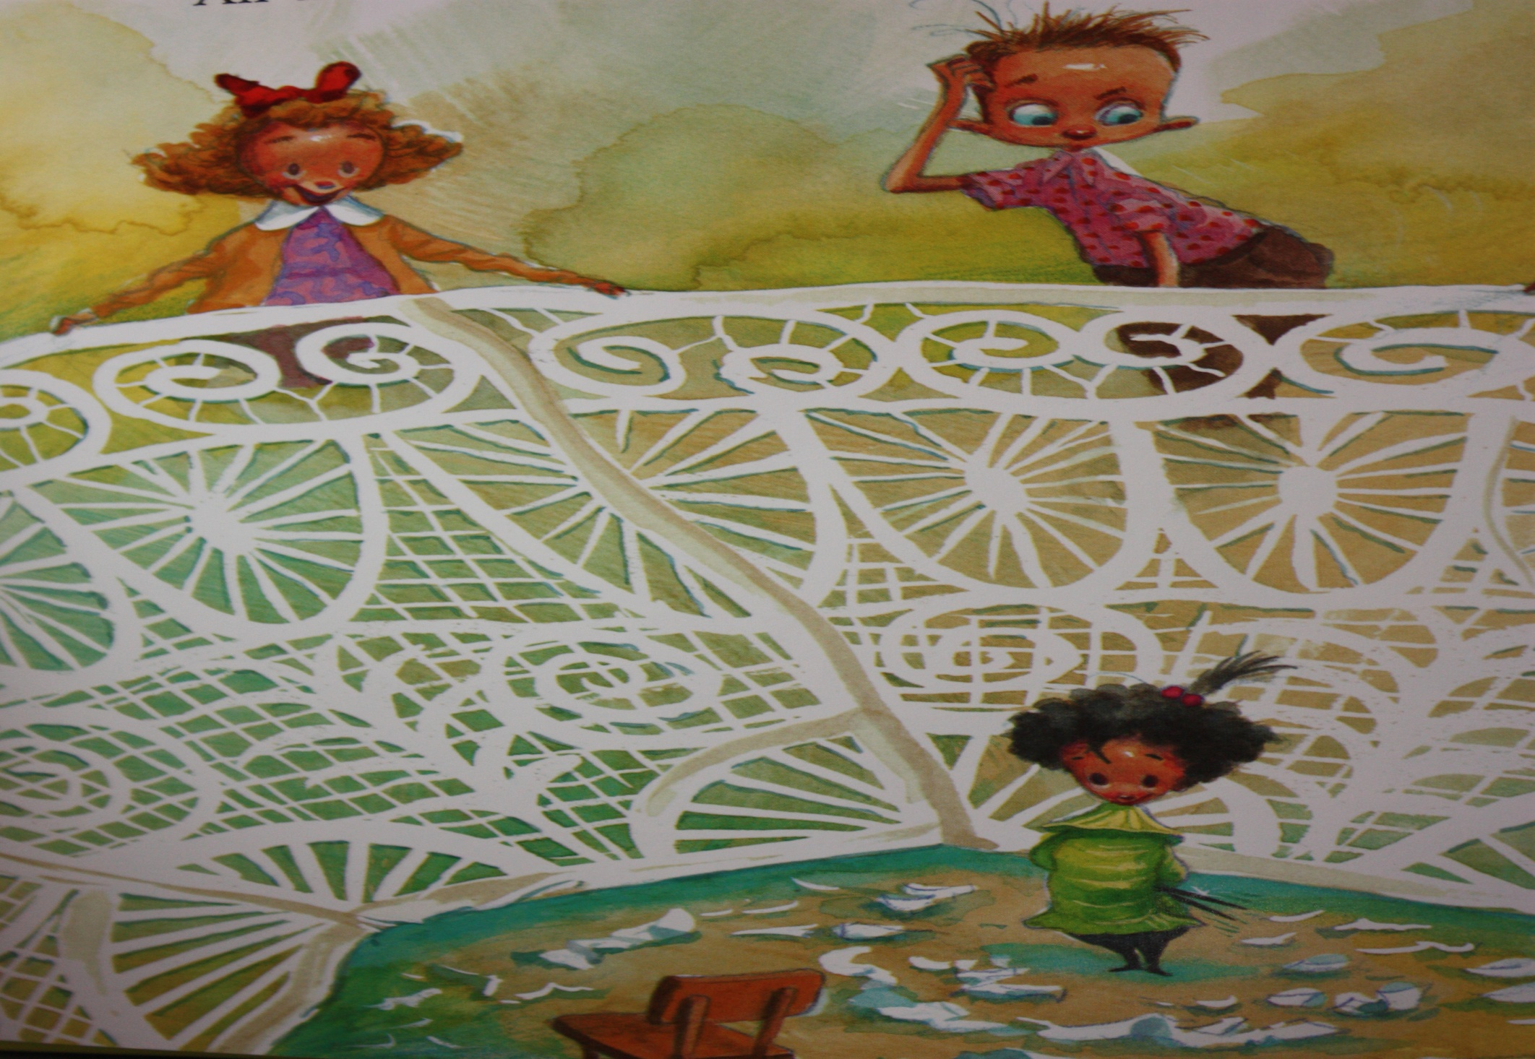
Even Ronald Durkin said, “Wow!”

Slide 35
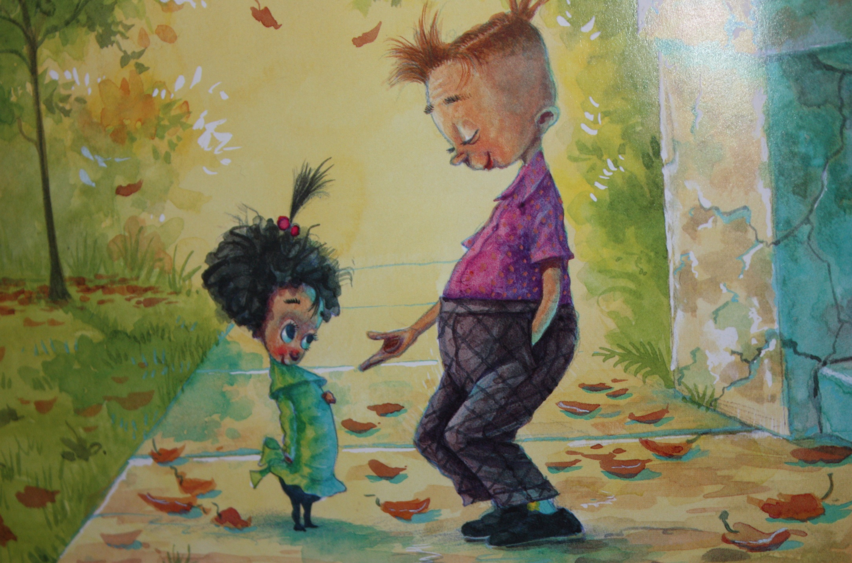
On the fifth day of school, Ronald Durkin smiled at Molly Lou Melon. Then, he gave her a stacking penny for her teeth.

Slide 36
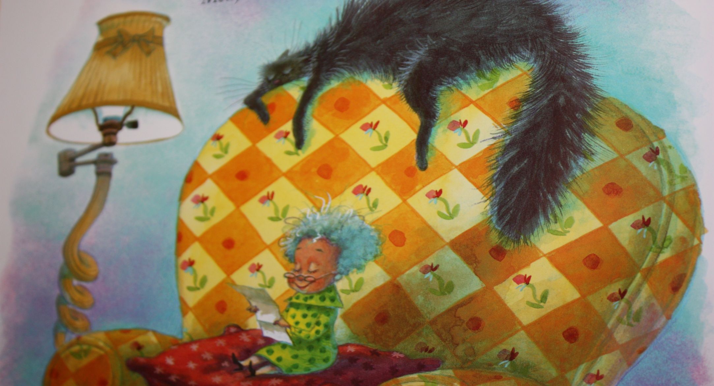
That night, Molly Lou Melon wrote a letter to her grandma:
Dear Grandma,
I wanted to tell you that everything you said was right!
Love,
Molly Lou Melon

Slide 37
CREDITS
Abby Laverdiere as Molly Lou Melon
Jake Laverdiere as Ronald Durkin
Grandma Roy as Grandma
Sandra Laverdiere as Narrator
Original book written by Patty Lovell and illustrated by David Catrow

Slide 38
This Adapted Literature resource is available through the Sherlock Center Resource Library. The text and graphics are adapted from the original source. These resources are provided for teachers to help students with severe disabilities participate in the general curriculum. Please limit the use and distribution of these materials accordingly.
Paul V. Sherlock Center on Disabilities / RI College
600 Mt. Pleasant Avenue, Providence RI 02908
www.sherlockcenter.org

