Slide 1
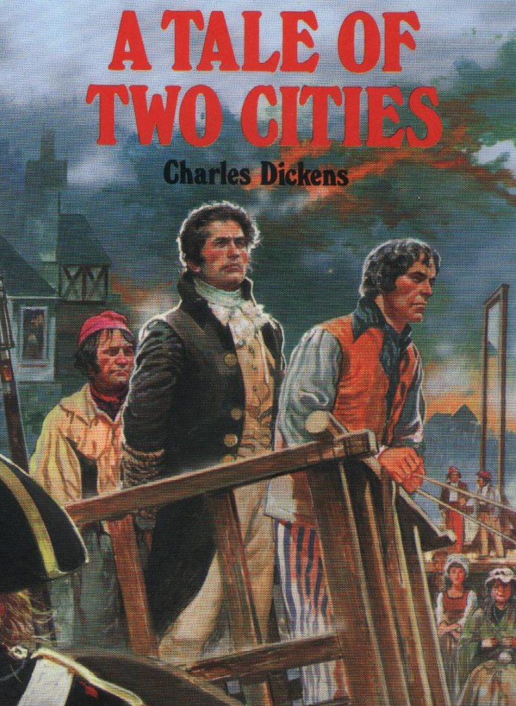
Adapted from the original text, A Tale of Two Cities, by Charles Dickens.
Notes:
A Tale of Two Cities. Adapted from the original text, A Tale of Two Cities, by Charles Dickens.

Slide 2
Notes:
It was 1775 in Europe. London is a city in England and Paris is a city in France. Jarvis Lorry rode in a carriage. Jarvis got a letter from his bank. The letter had a secret message. Jarvis Lorry and a woman, named Lucie Manette, met for dinner. Lucie says that she received a letter. Jarvis Lorry was curious.

Slide 3
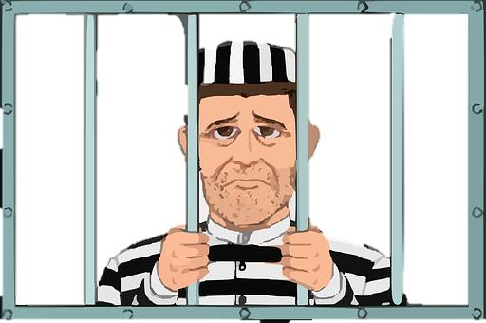
Notes:
The letter said Lucie must go to France to see her family's land . Jarvis Lorry said Lucie's father, Dr. Manette, had been in jail in France for 18 years. Dr Manette was released from jail but was very ill.

Slide 4
Notes:
Chapter 2 Saint Antoine was a poor place in Paris. The people were hungry and looked for food. Mr.DeFarge saw Jarvis and Lucie Manette in his store.

Slide 5
Notes:
Chapter 3. Jarvis and Lucie went to a secret house. Lucie saw her father. He was making shoes and could barely speak. Lucie was worried.

Slide 6
Notes:
The old man looked at Lucie and asked, "Who are you?" The old man looked at Lucie's hair. "You are my daughter!" Lucie brought her father to England to live with her.

Slide 7
Notes:
Chapter 4 A man named Charles Darnay was on trial. The court thought Charles Darnay told government secrets to a French king and where English soldiers hid during the Revolutionary War. Lucie spoke at the court. Lucie said that Charles Darnay was nice to her father. Her father could not remember seeing Charles Darnay telling secrets.

Slide 8
Notes:
Charles Darnay’s lawyer asked the court if the criminal could have been someone who looked like Charles Darnay. Charles Darnay looked at a man in the court. Sidney Carton looked like Charles Darnay! Charles Darnay and Sidney Carton were NOT GUILTY and they were happy.

Slide 9
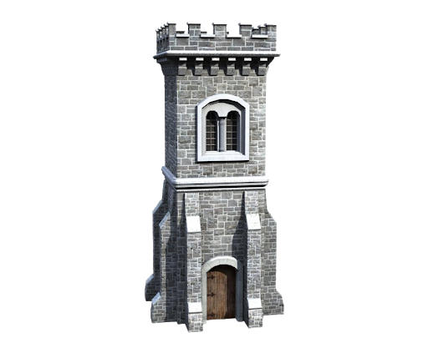
Notes:
Chapter 5 Jarvis Lorry went to Dr. Manette's house. Jarvis saw his shoemaker's bench and tools. Dr. Manette is feeling mostly better. Dr. Manette , Jarvis, and Lucie meet in the garden. Charles Darnay goes to the garden also. They talk about the Tower in the jail. Many things happened in the Tower. Dr. Manette was afraid, so they stopped talking and went in the house.

Slide 10
Notes:
Chapter 6 Charles Darnay’s uncle, Marquis, went to a fancy dinner at the palace. Marquis wore fancy clothes and jewelry.
Marquis left quickly in a coach and was going too fast. Marquis's coach killed a child. Marquis threw a coin to the child's father, Mr. Defarge. Mr. and Mrs. Defarge are angry. Marquis drove to Charles Darnay's house.

Slide 11
Notes:
Charles Darnay heard what Marquis had done and returned to help the poor family. Charles Darnay was angry at Marquis. Marquis was killed as he slept that night.

Slide 12
Notes:
Chapter 7 A year passed. Charles Darnay loves Lucie and asks Lucie to marry him. Lucie's father, Dr. Manette, does not want to hear about the marriage. Sidney Carton also loves Lucie, but made unhealthy choices. Lucie wants Sidney Carton to change but Sidney Carton will not change. Lucie and Sidney Carton kiss goodbye. Sideny Carton said he would sacrifice anything for Lucie.

Slide 13
Notes:
Chapter 8 A boy saw a funeral march. The boy heard someone say the dead man was important. At night, the boy saw men robbing the grave.

Slide 14
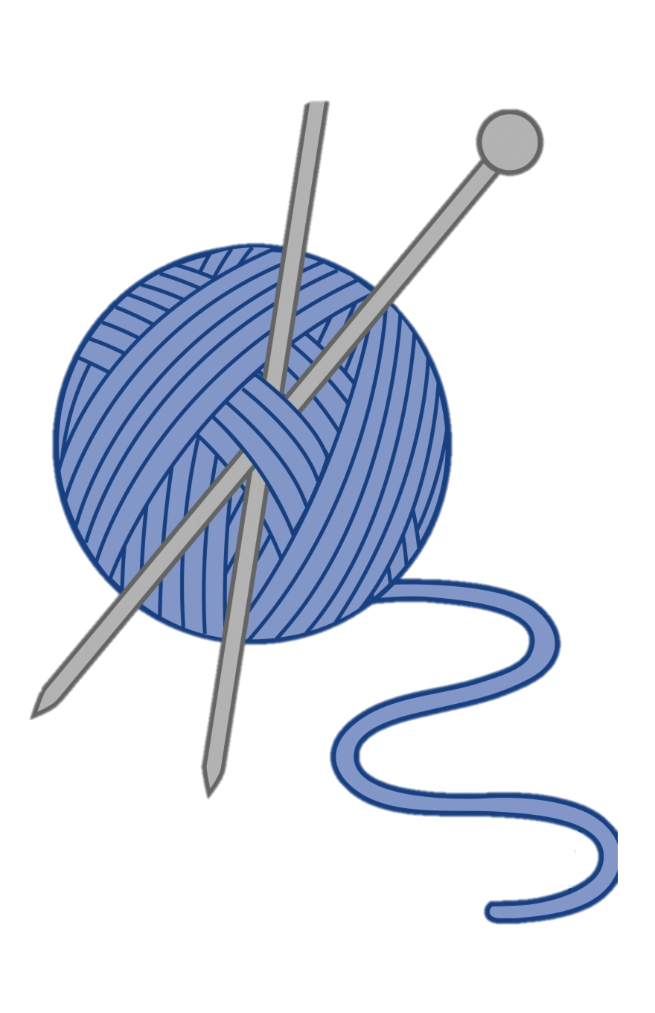
Notes:
chapter 9 Mr. Defarge brought a man home. The man was called Road Fixer. Mrs. Defarge knew Road Fixer . Road Fixer told Mrs. Defarge the name of enemies. Mrs. Defarge knit the names into her knitting design. Road Fixer told Mrs. Defarge to knit in John Barsad. John Barsad was an enemy.

Slide 15
Notes:
Chapter 10 Charles Darnay and Lucie get married. Dr. Manette becomes ill again and starts making shoes again.

Slide 16
Notes:
Dr. Manette gets better, but decides he needs to break his shoe making tools so he does not rely on them.

Slide 17
Notes:
Chapter 11 The people were at war. People had guns and Mr. Defarge helped them fight. They marched to the jail called the Bastille. The people fought and they won.

Slide 18
Notes:
Mr. Defarge marched to the jail Tower where Dr. Manette was held for 18 years. Mr. Defarge looked for a secret paper in the Tower. Prisons and palaces in France burned. The people were happy.

Slide 19
Notes:
Chapter 12 In 1792. Charles Darnay received a letter from a friend. The friend wanted Charles Darnay to help him get out of prison. Charles Darnay went to France to help his friend in jail.

Slide 20
Notes:
When Charles Darnay went to France, he gets stopped by a soldier. Charles Darnay had no papers. He went to jail.

Slide 21
Notes:
Chapter 13 Lucie and Dr. Manette went to France to help Charles Darnay. Dr. Manette spoke to French people . The people will help Charles Darnay get out of jail. Charles Darnay went to court. Charles Darnay would not die or have his head chopped off in a guillotine.

Slide 22
Notes:
Chapter 15 Charles Darnay gets arrested again right after he was released from jail. Charles Darnay goes back to court. A letter was read in the courtroom. Dr. Manette wrote the letter when he was in prison. The letter was hidden in the Tower wall. Dr. Manette said many people were bad. Charles Darnay was bad and killed people. The court decided Charles Darnay will die and go to the guillotine.

Slide 23
Notes:
Chapter 16 Sidney Carton took Dr. Manette and Lucie home. Mrs. Defarge said Sidney Carton looks like Charles Darnay. Mrs. Defarge is mad at Charles Darnay's family. Charles Darnay's family hurt Mrs. Defarge's family.

Slide 24
Notes:
Sidney Carton visited Charles Darnay in prison. Sidney Carton remembered he looks like Charles Darnay and would sacrifice anything for Lucie. Sidney Carton switched clothes with Charles Darnay. The prison police take Charles Darnay to Lucie. Sidney Carton stays in prison. Lucie, Charles Darnay, and Dr. Manette left France.

Slide 25
Notes:
Chapter 18 Mrs. Defarge meets two men. She wants to hurt Charles Darnay's family because his uncle hurt her family. She makes a plan. Mrs. Defarge and the two men went to Dr. Manette's house. But Mrs. Defarge gets hurt and dies. The two men are told they will have their heads chopped off at the guillotine. Sidney Carton dies by guillotine, sacrificing his life for Lucie’s husband.

Slide 26
Notes:
The End.

Slide 27
This Adapted Literature resource is available through the Sherlock Center Resource Library. The text and graphics are adapted from the original source. These resources are provided for teachers to help students with severe disabilities participate in the general curriculum. Please limit the use and distribution of these materials accordingly.
Paul V. Sherlock Center on Disabilities / RI College
600 Mt. Pleasant Avenue, Providence RI 02908
www.sherlockcenter.org

