Slide 1


Animals in their Habitats
Notes:
Animals in their habitats.

Slide 2
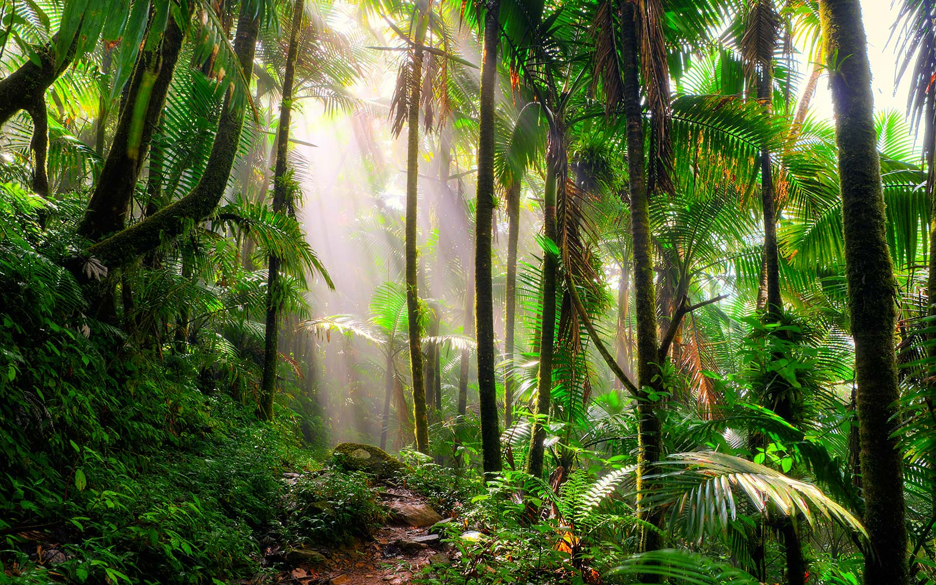
Notes:
This is the rainforest. The rainforest has many tall trees. The rainforest is very warm and wet.

Slide 3
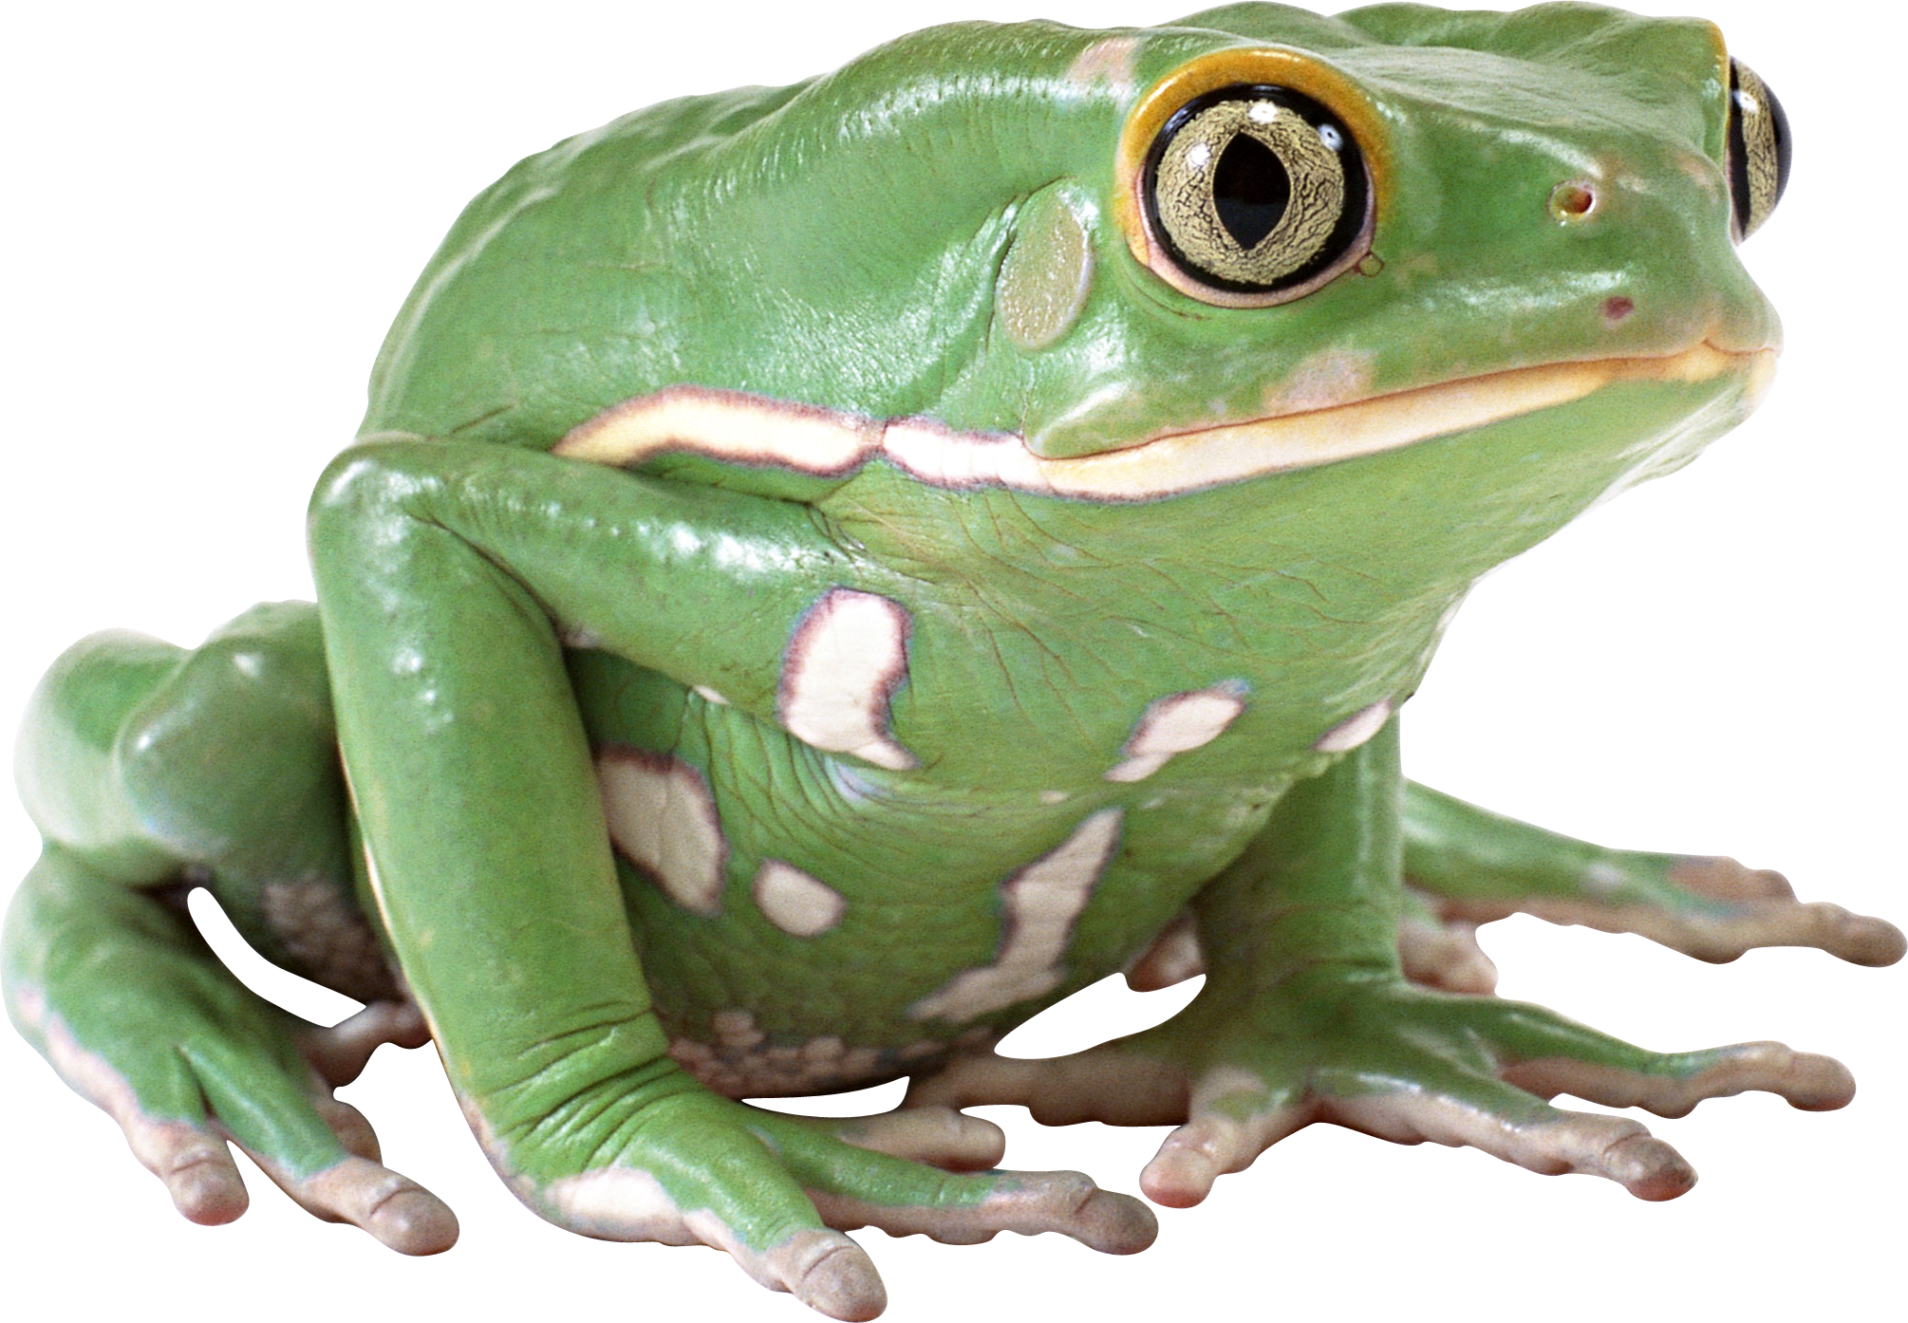
Notes:
Frogs live in the rainforest.

Slide 4
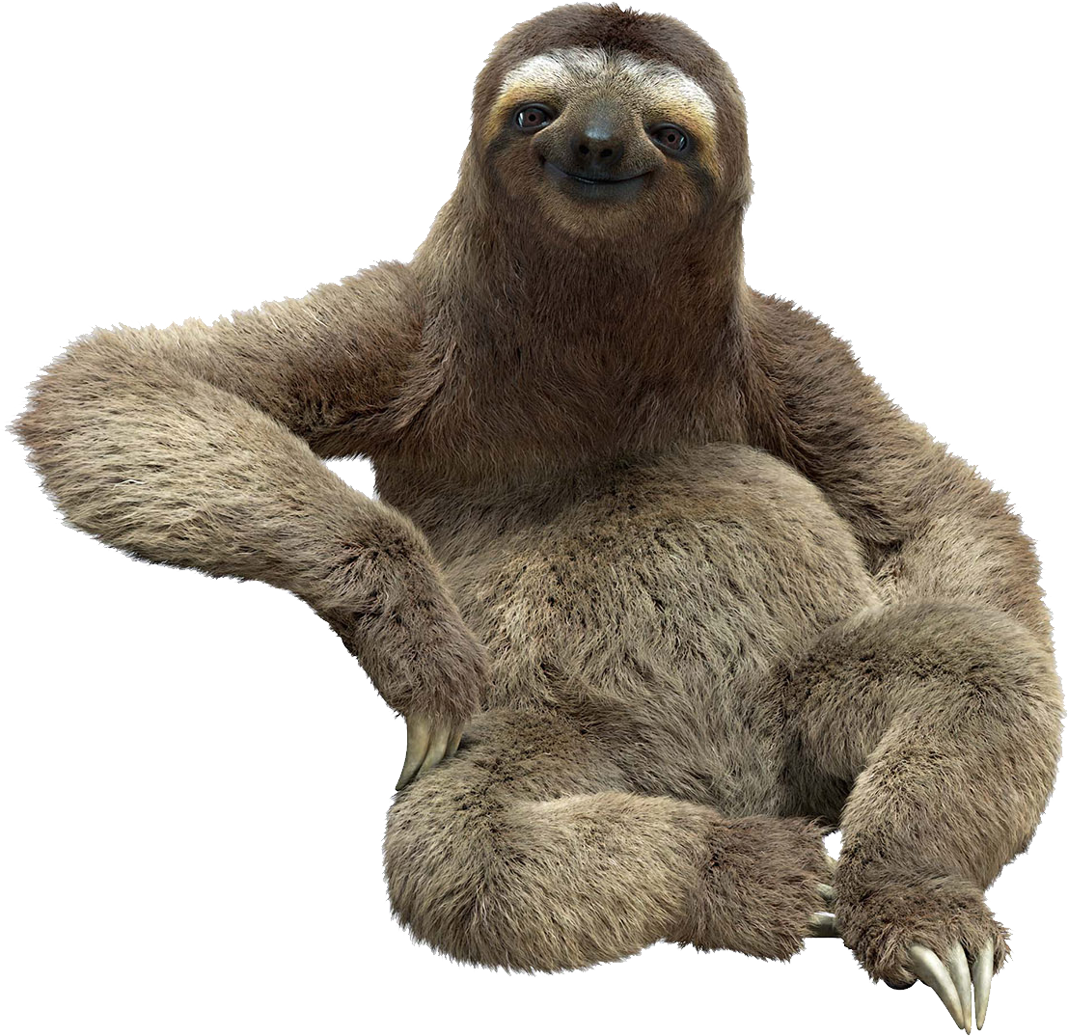
Notes:
Sloths live in the rainforest.

Slide 5
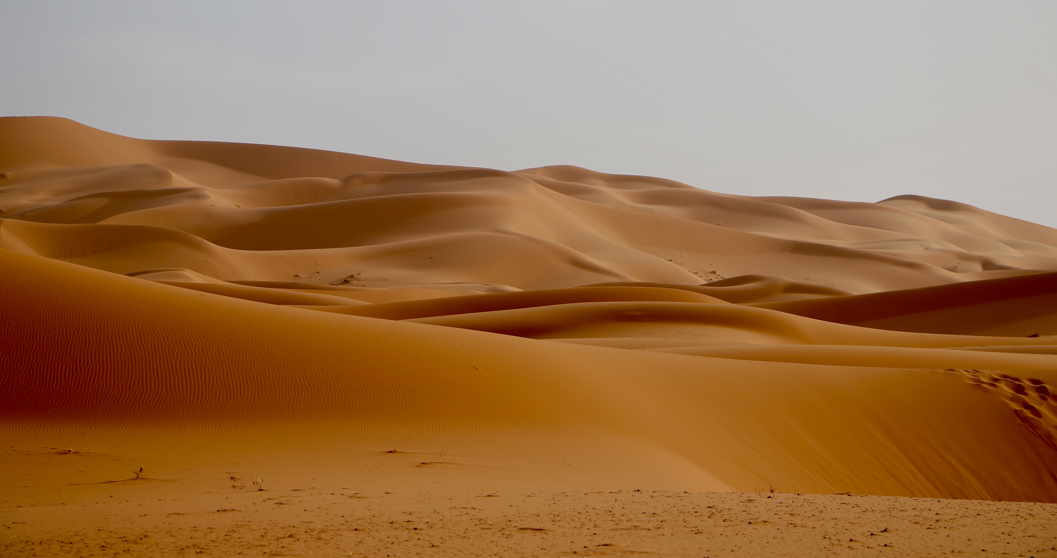
Notes:
This is the desert. Deserts are very hot and dry. There is a lot of sand in the desert.

Slide 6
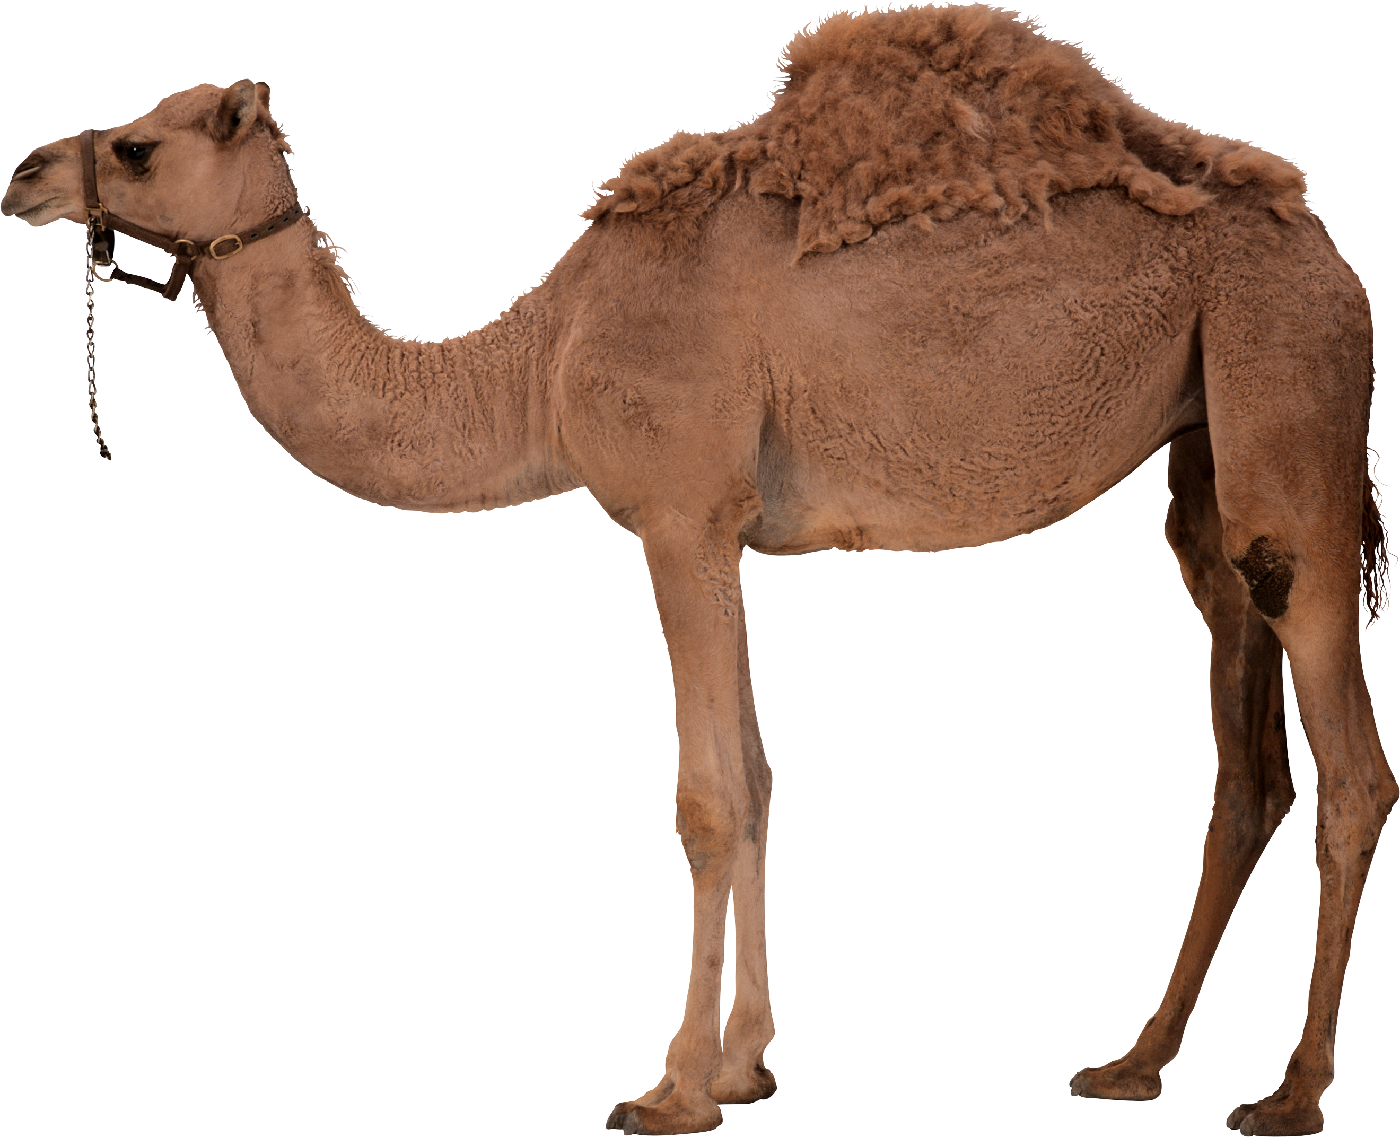
Notes:
Camels live in the desert.

Slide 7
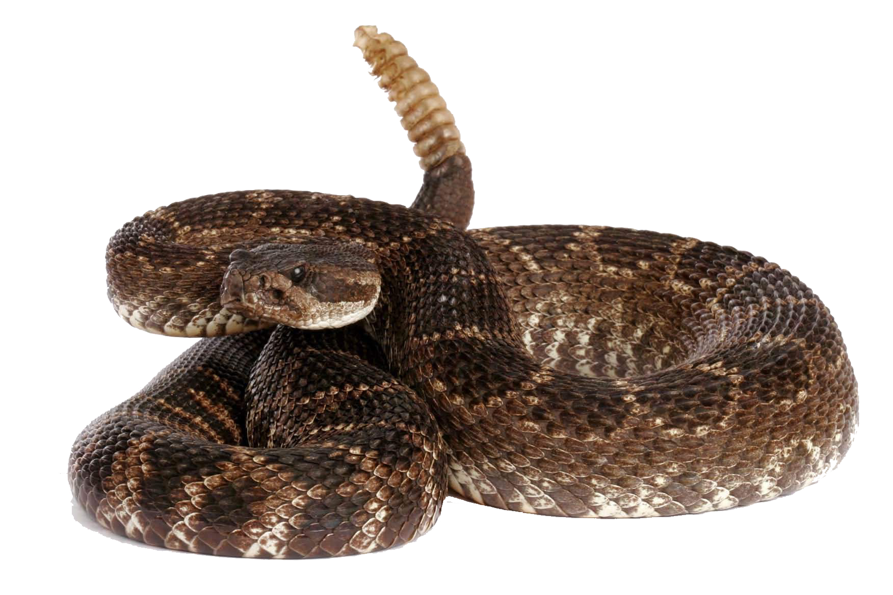
Notes:
Snakes live in the desert.

Slide 8
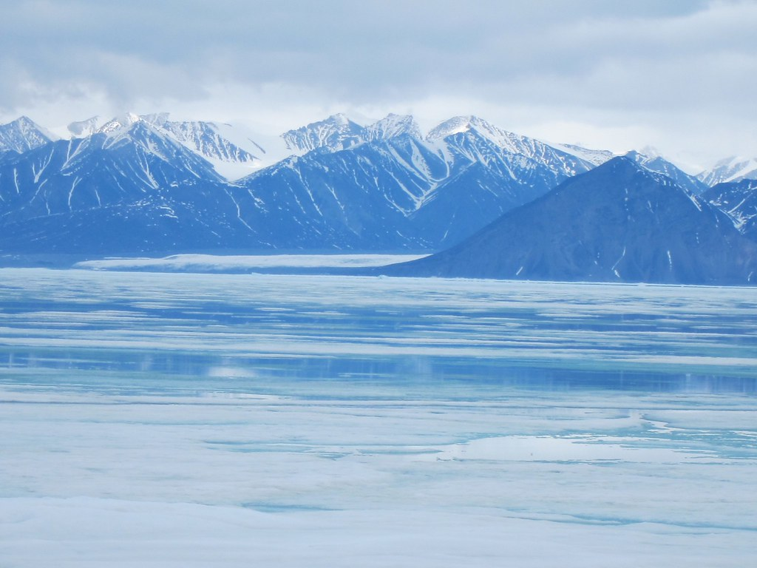
Notes:
This is the arctic. The arctic has very cold winters and cool summers. There is a lot of snow and ice in the arctic.

Slide 9
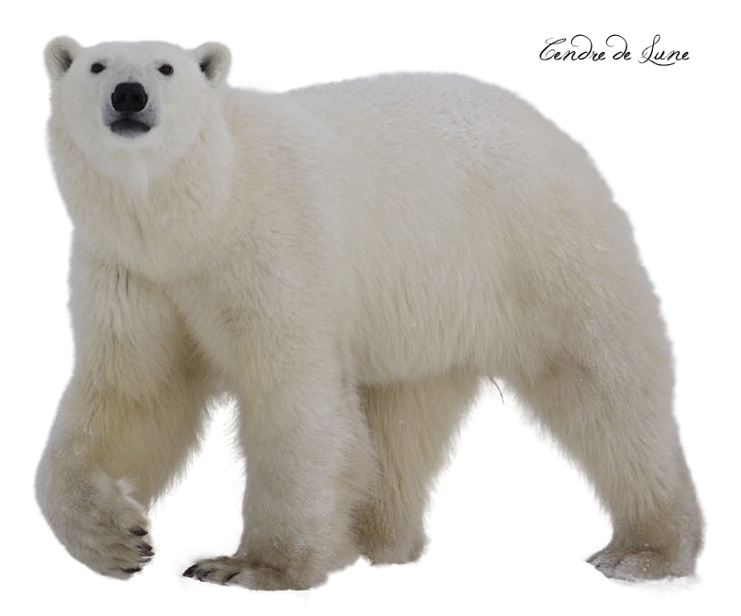
Notes:
Polar bears live in the arctic.

Slide 10
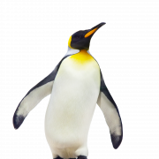
Notes:
Penguins live in the arctic.

Slide 11
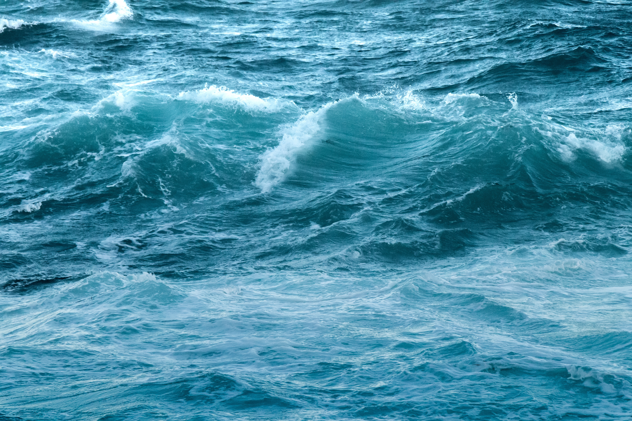
Notes:
This is the ocean. The ocean is made up of salt water and is very deep. Many types of plants and animals live in the ocean.

Slide 12
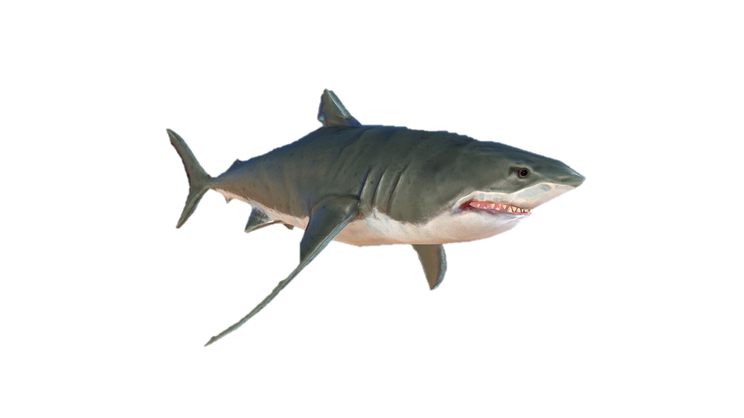
Notes:
Sharks live in the ocean.

Slide 13
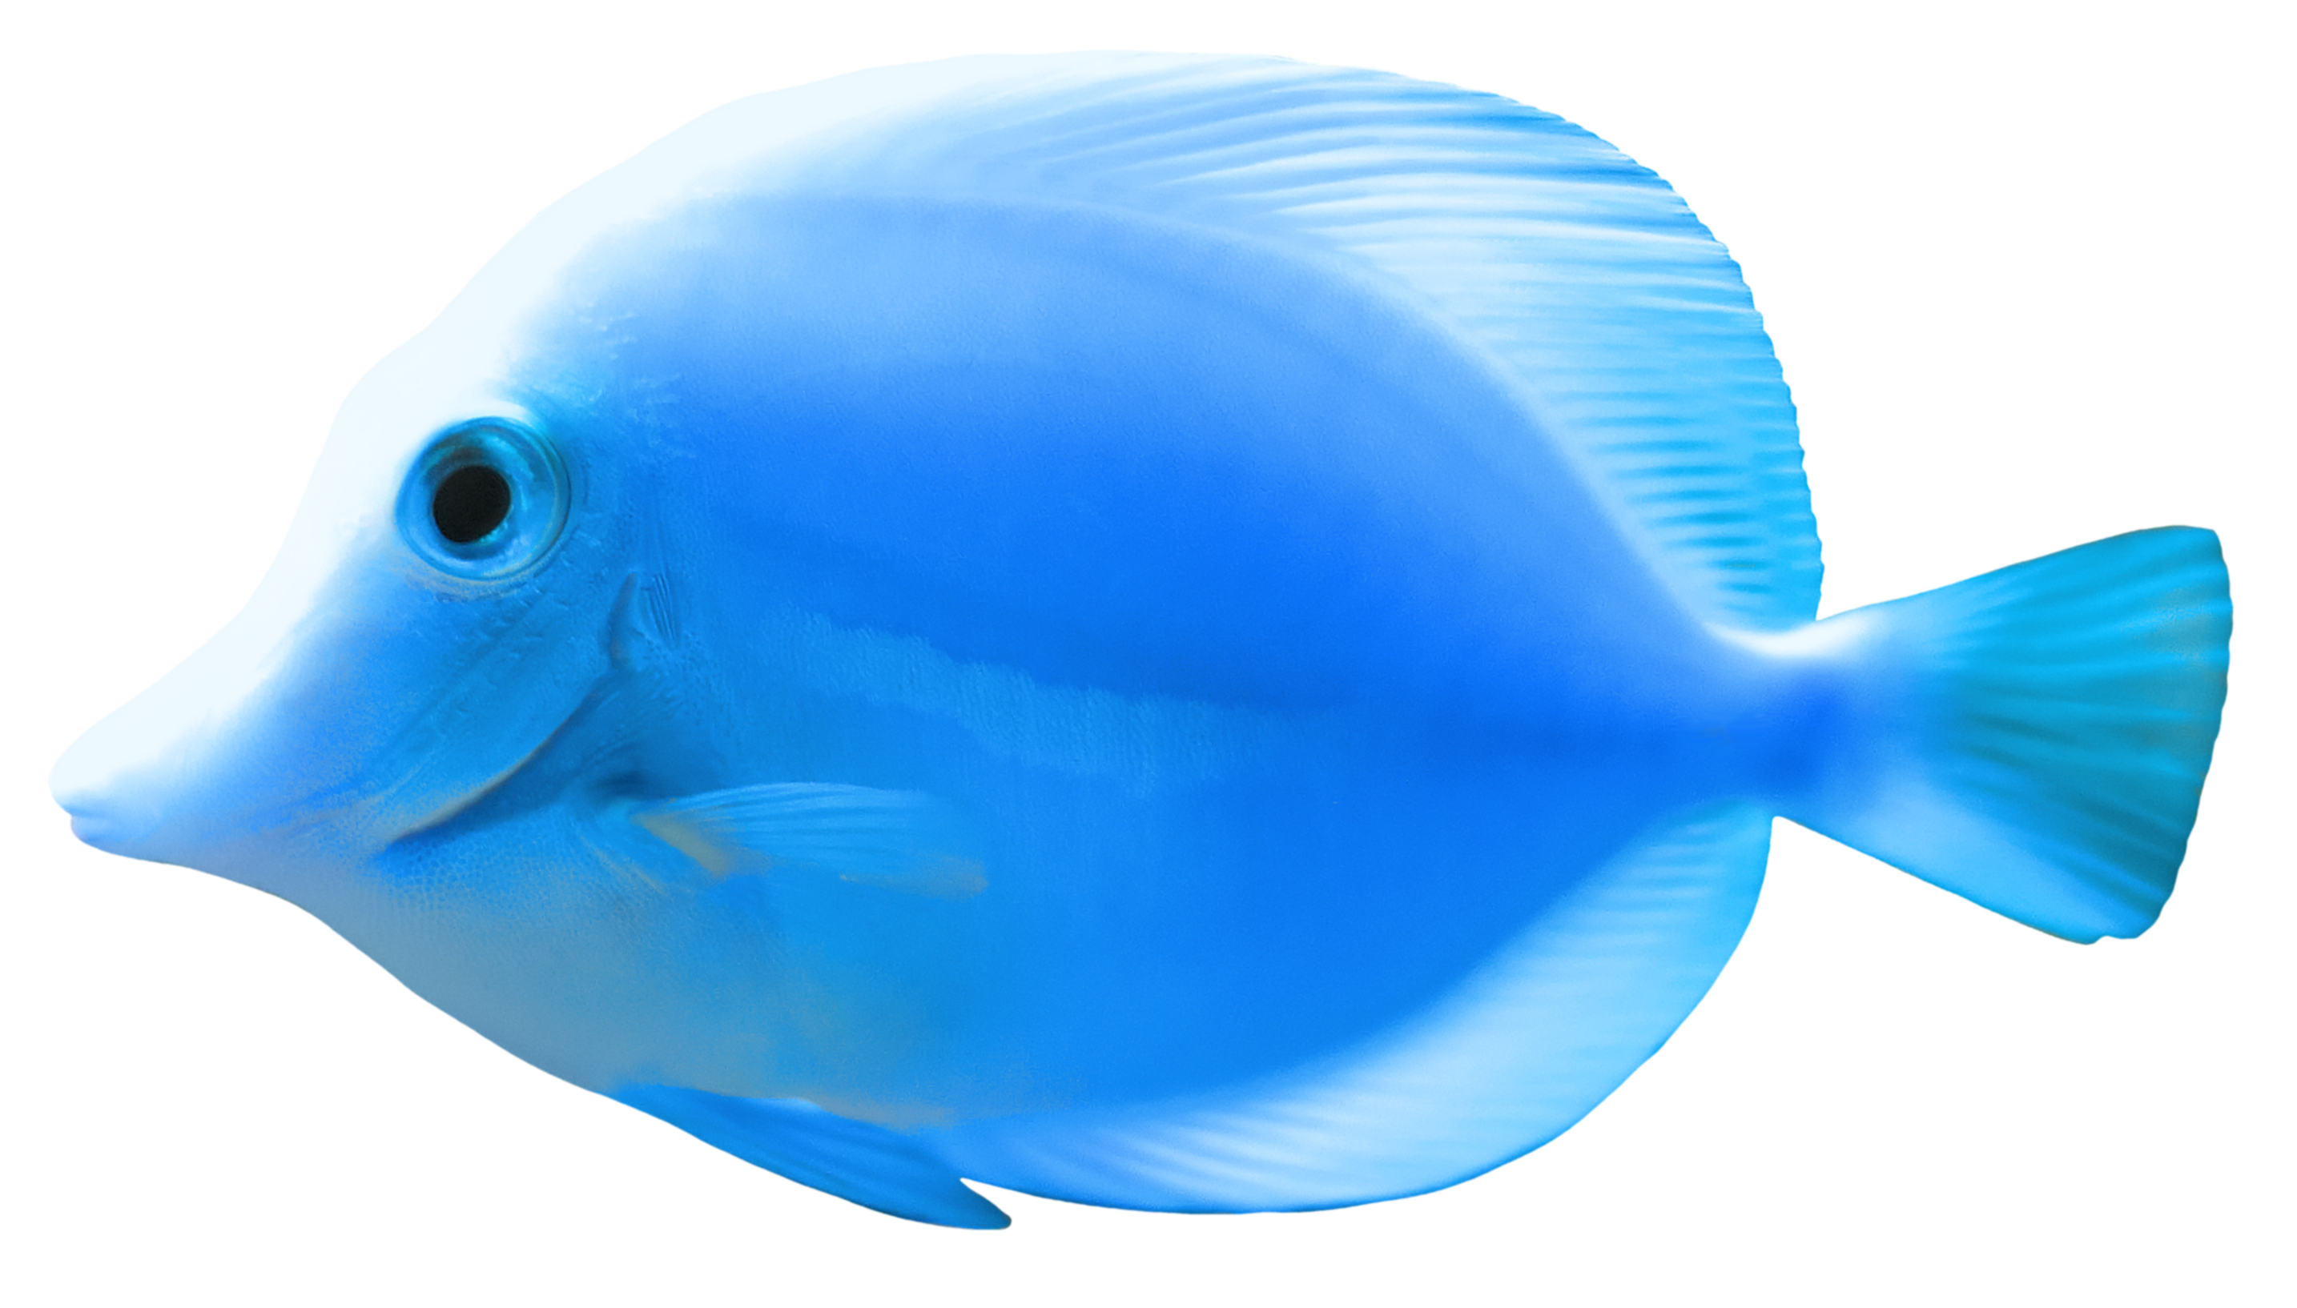
Notes:
Fish live in the ocean.

Slide 14
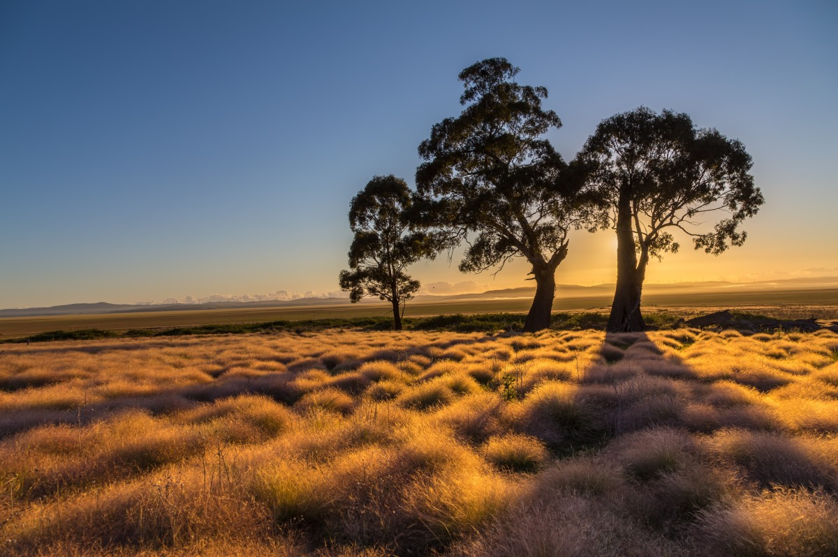
Notes:
This is the grassland. The grassland is an area of flat land that is full of grass.

Slide 15
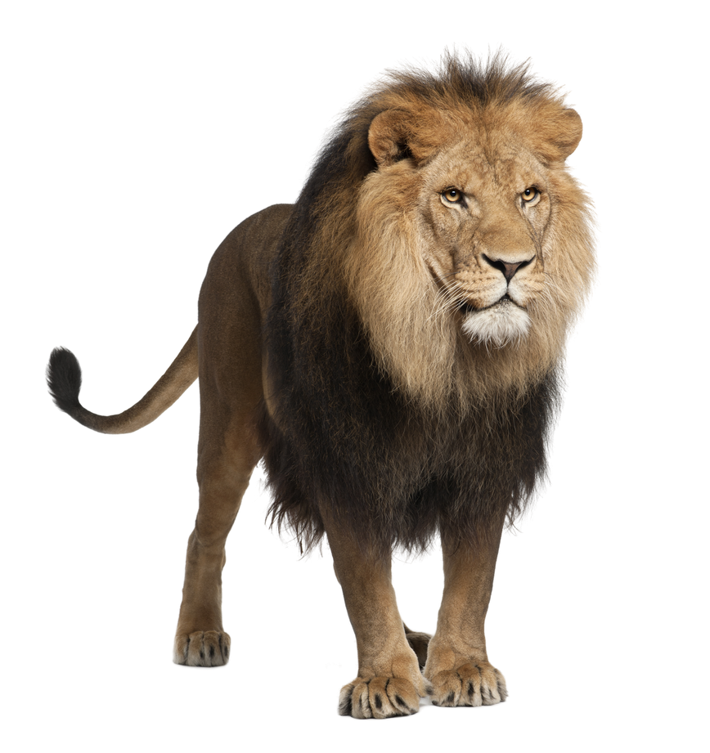
Notes:
Lions live in the grassland.

Slide 16
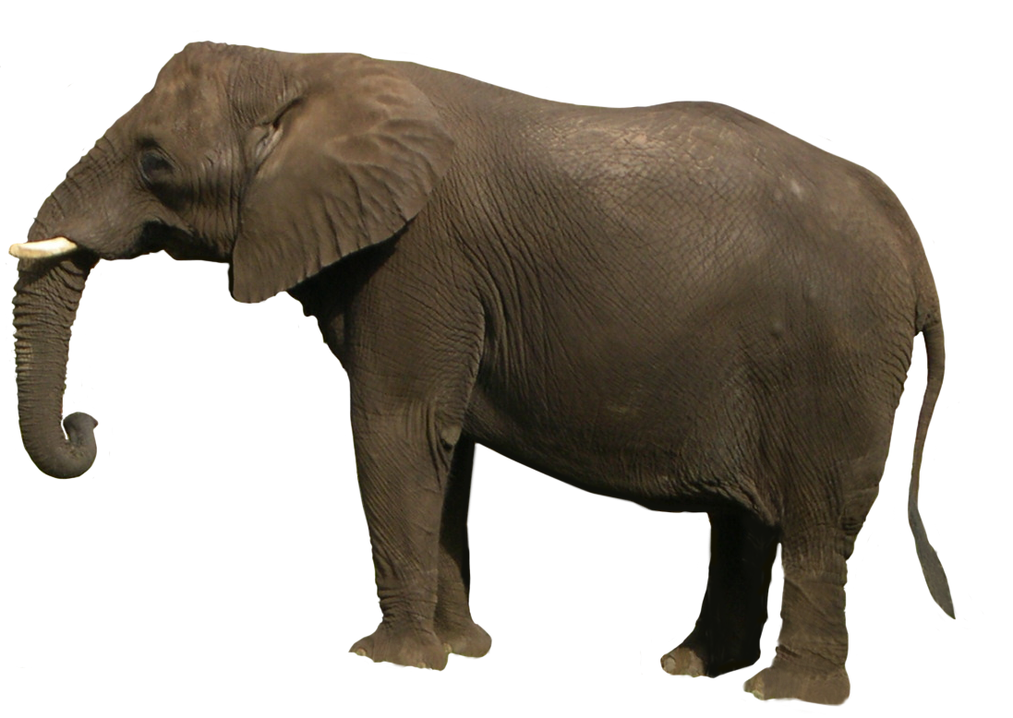
Notes:
Elephants live in the grassland.

Slide 17

Notes:
The end

Slide 18
This Adapted Literature resource is available through the Sherlock Center Resource Library. The text and graphics are adapted from the original source. These resources are provided for teachers to help students with severe disabilities participate in the general curriculum. Please limit the use and distribution of these materials accordingly.
Paul V. Sherlock Center on Disabilities / RI College
600 Mt. Pleasant Avenue, Providence RI 02908
www.sherlockcenter.org

