Slide 1

A Book About The Letter
W
Notes:
A book about the letter W
Adapted from the original text, Gingerbread Baby, written by Jan Brett, illustrated by Jan Brett

Slide 2
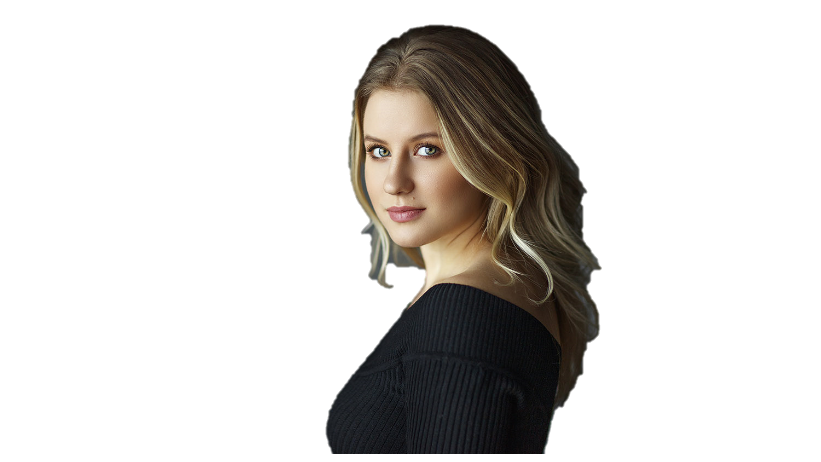
Notes:
This is a woman. Woman starts with W.

Slide 3
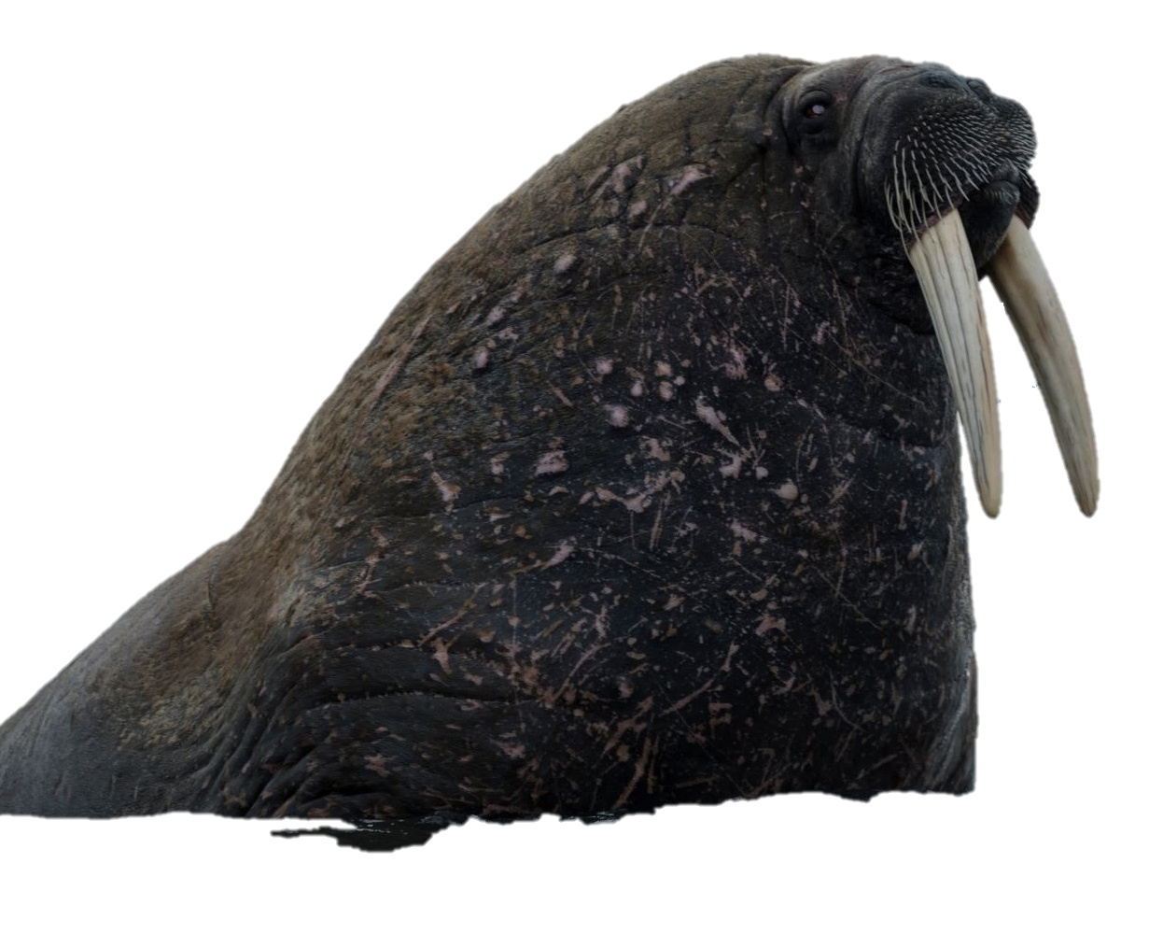
Notes:
This is a Walrus. A walrus likes to swim in the ocean.

Slide 4
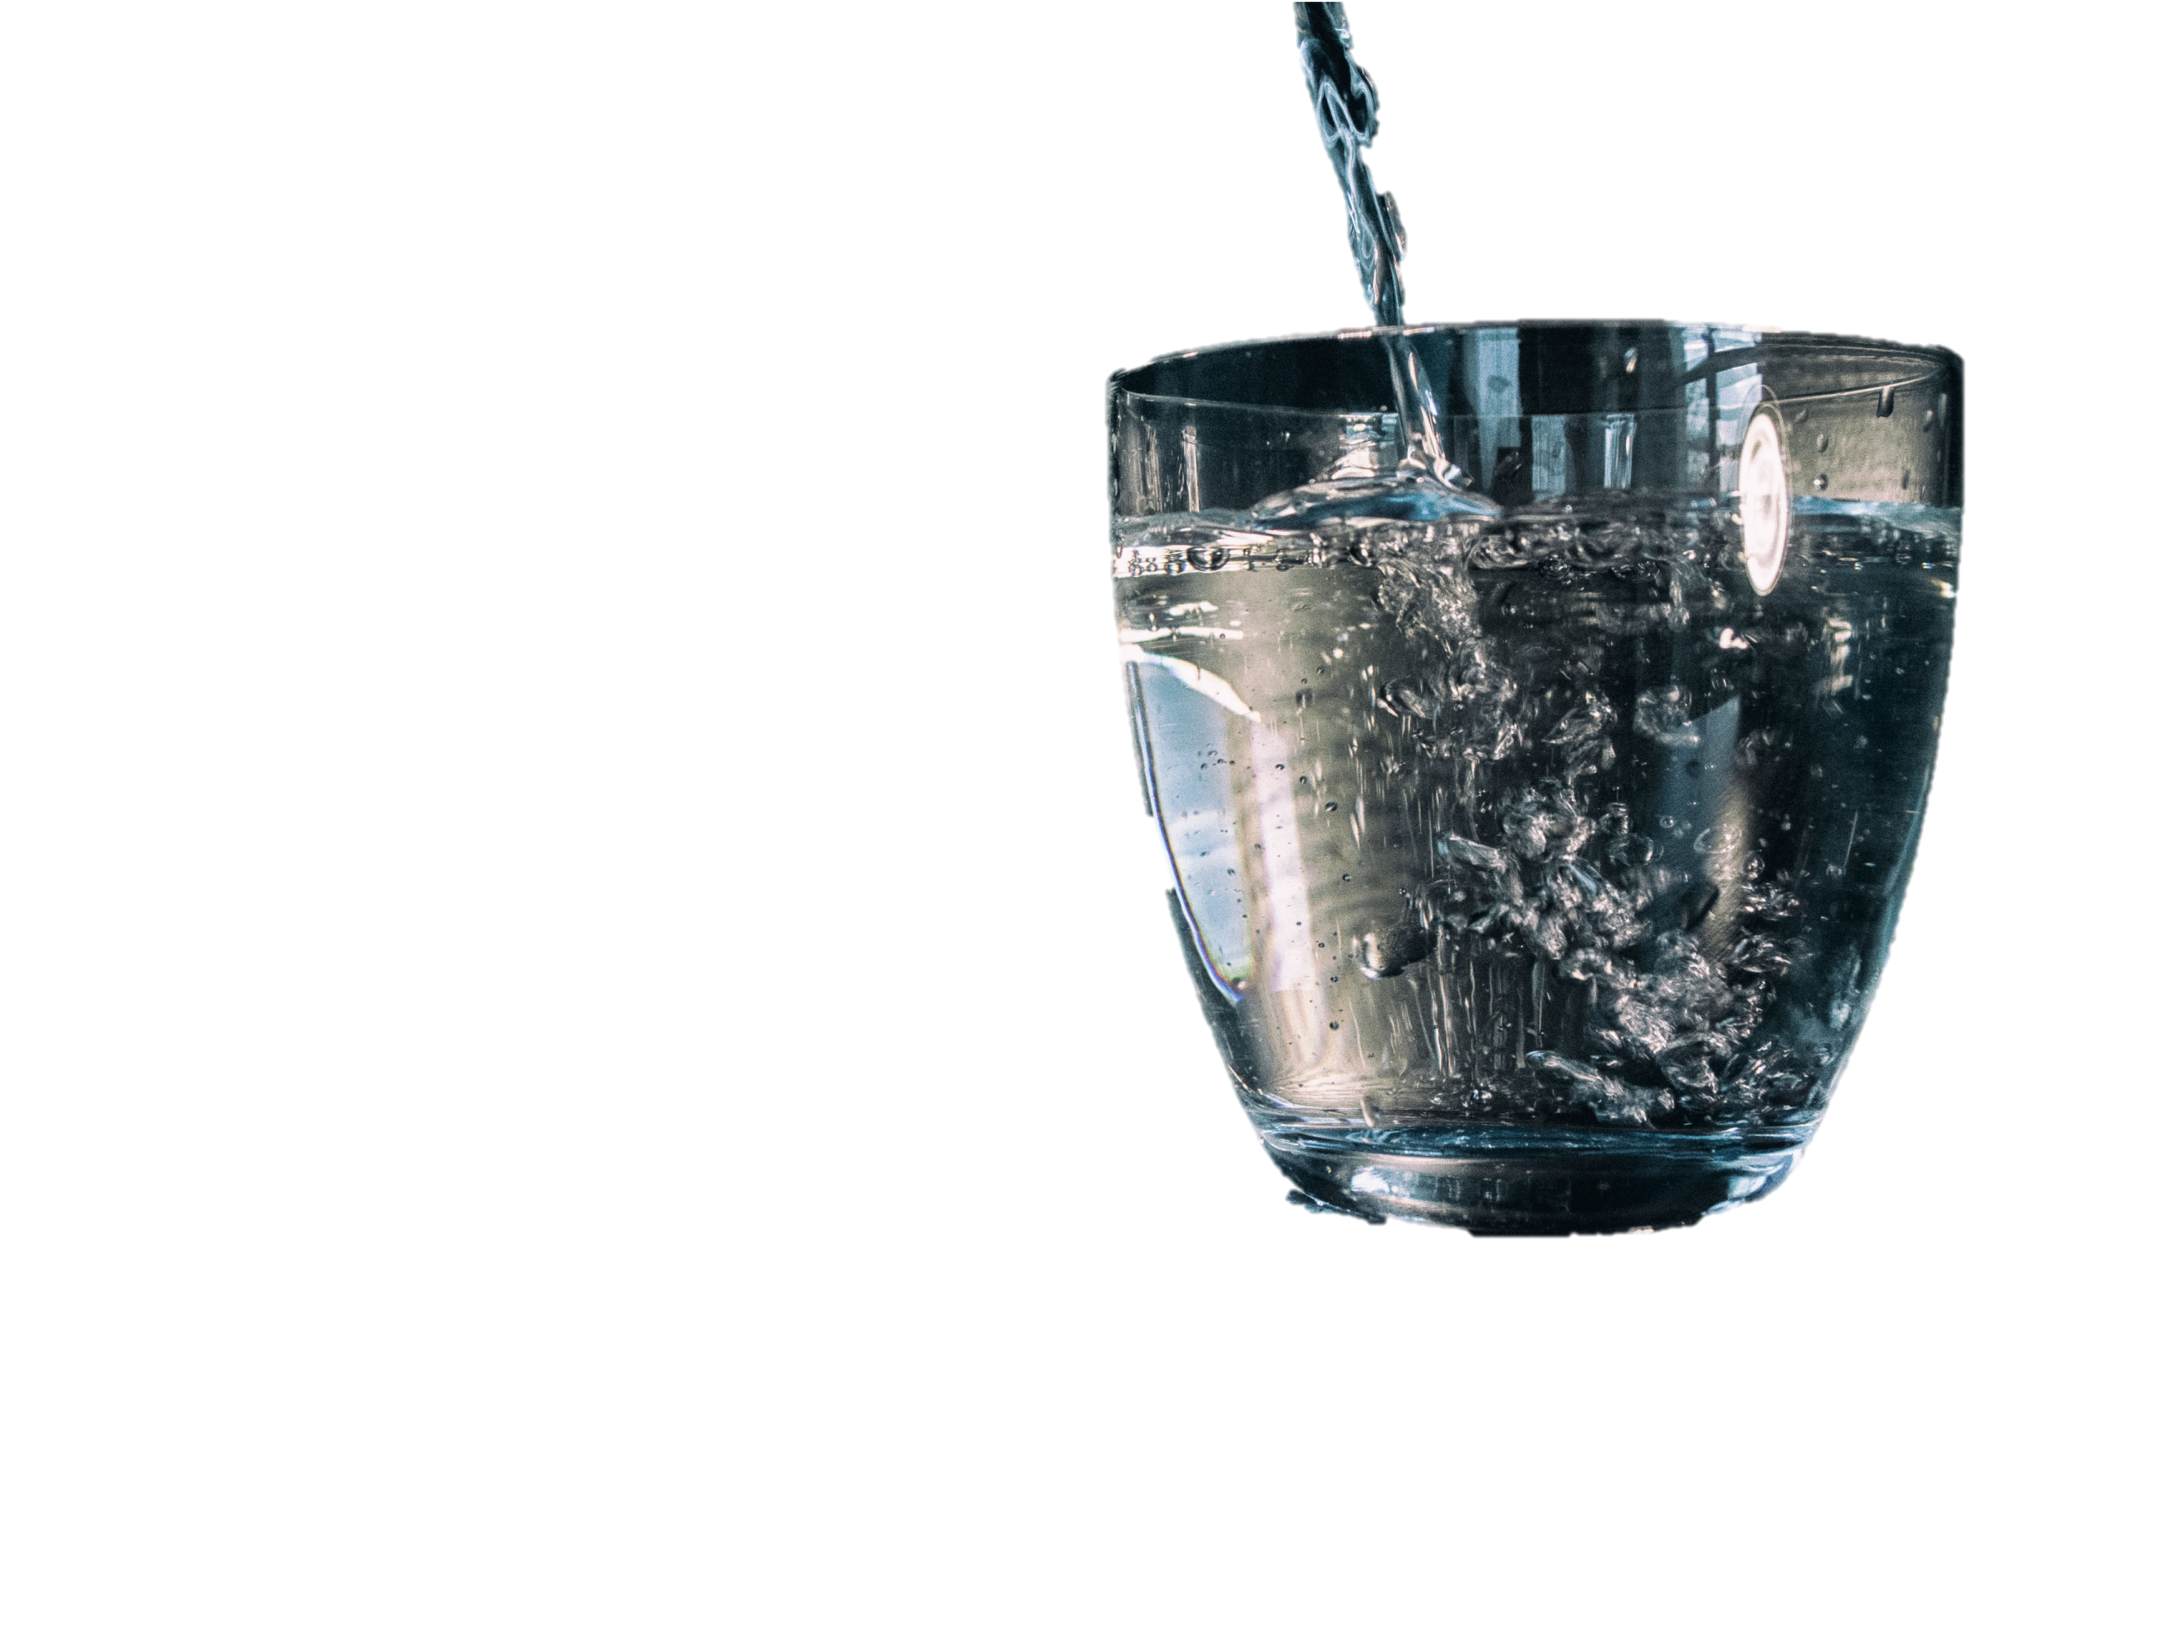
Notes:
This is a glass of water. Water begins with W.

Slide 5
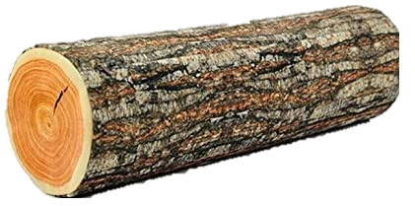
Notes:
W is for wood. This is a piece of wood.

Slide 6
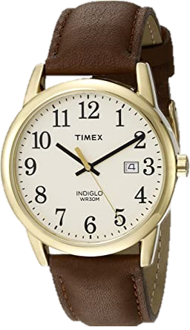
Notes:
This is a watch. Watches are used to tell time. Watch starts with W.

Slide 7


Notes:
She is waving. Waving starts with W.

Slide 8
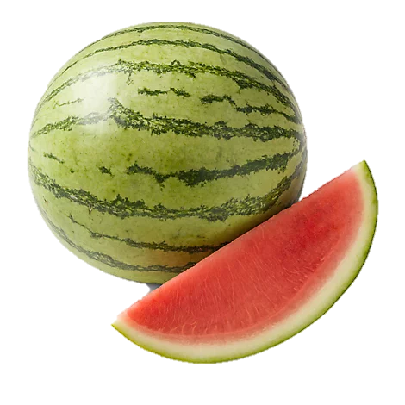
Notes:
This is a watermelon. A watermelon is a type of fruit.

Slide 9
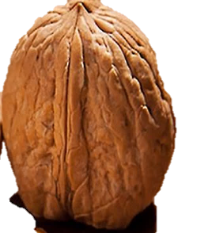
Notes:
These are walnuts. Walnut starts with W.

Slide 10
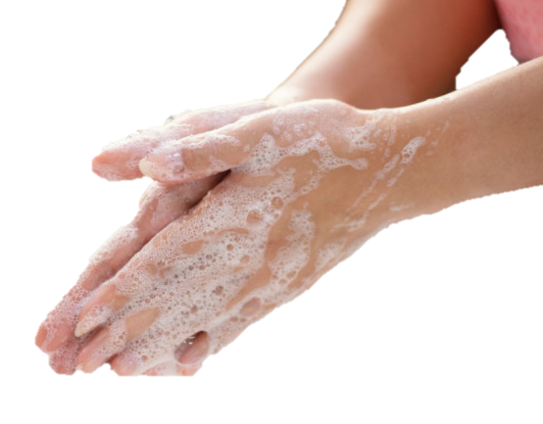
Notes:
She is washing her hands. Washing starts with W.

Slide 11
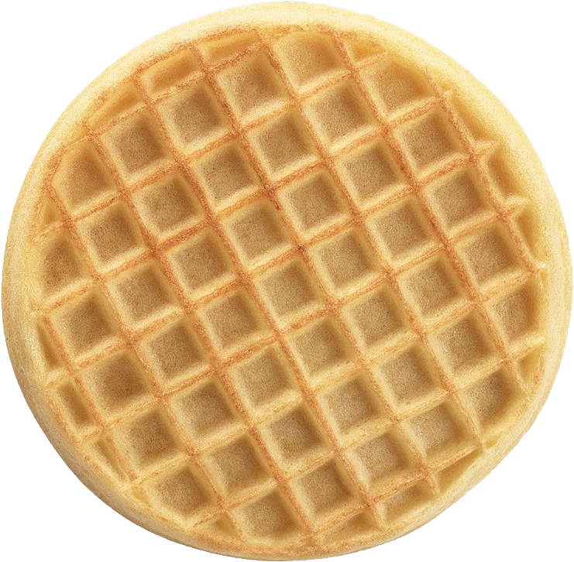
This Photo by Unknown Author is licensed under CC BY-NC
Notes:
W is for waffle. Waffles are yummy.

Slide 12
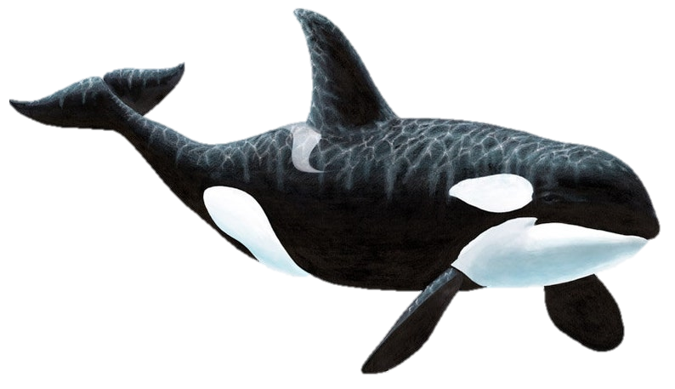
Notes:
This is a whale. Whales live in the ocean.

Slide 14
This Adapted Literature resource is available through the Sherlock Center Resource Library. The text and graphics are adapted from the original source. These resources are provided for teachers to help students with severe disabilities participate in the general curriculum. Please limit the use and distribution of these materials accordingly.
Paul V. Sherlock Center on Disabilities / RI College
600 Mt. Pleasant Avenue, Providence RI 02908
www.sherlockcenter.org

