Slide 1


Important Dates/Events in Massachusetts
Notes:
By Rebecca Dopp

Slide 2
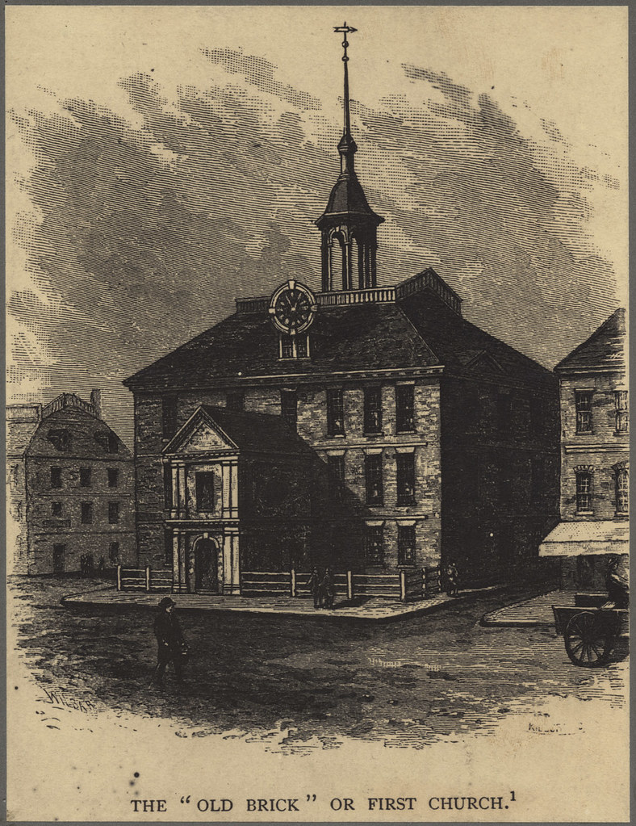
Notes:
In 1630, the first church was established in Boston.
It was founded by John Winthrop and the Puritan settlers.

Slide 3
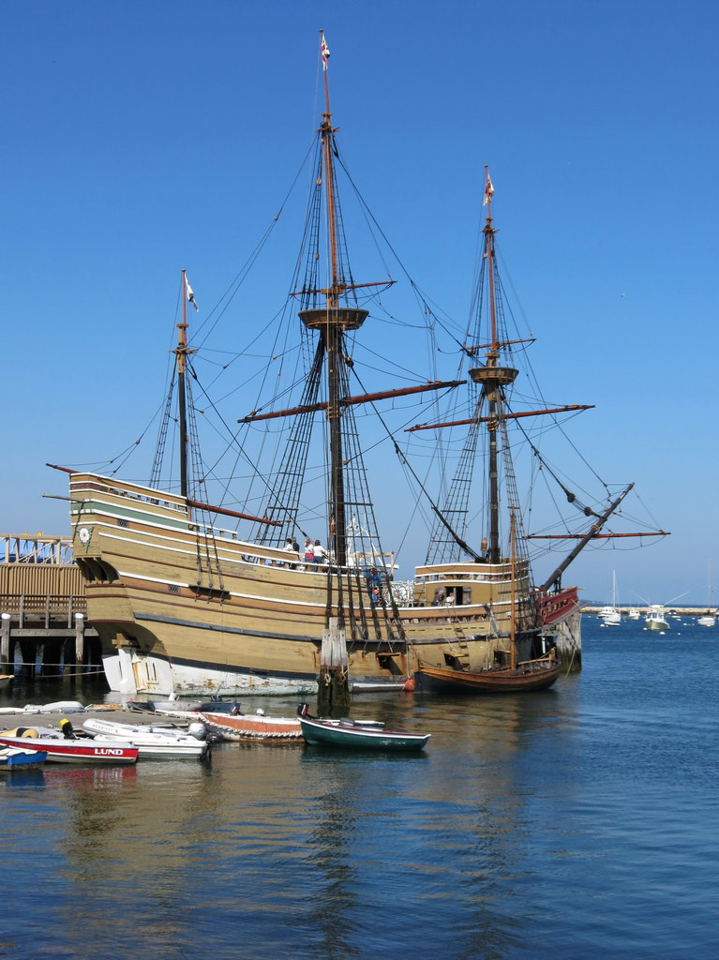
Notes:
In 1620, the Mayflower landed in Massachusetts.
The Mayflower was a boat that travelled from England.

Slide 4
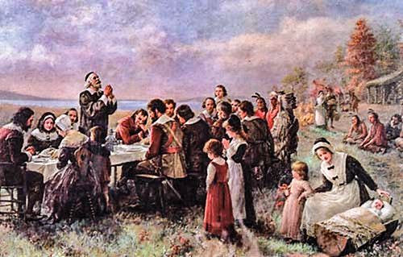
Notes:
In 1631, there was the first public Thanksgiving.
It was held in the Massachusetts Bay Colony.

Slide 5
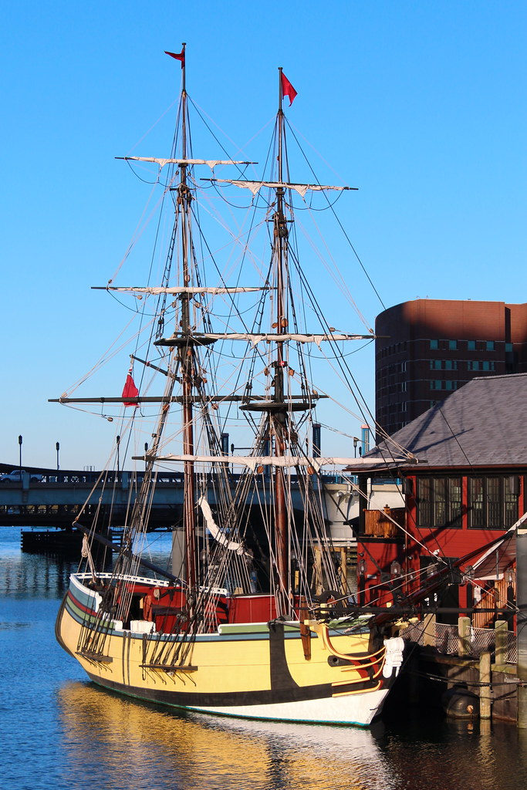
Notes:
On December 13th, 1773, protesters held the Boston Tea Party.
They threw tea into Boston Harbor.

Slide 6
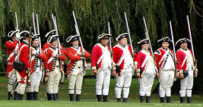
Notes:
On April 19th, 1775, the Revolutionary War began at Lexington and Concord.
The war lasted for 8 years.

Slide 7
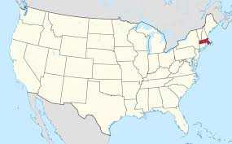
Notes:
On February 6th, 1788 Massachusetts became a state.
Massachusetts was the 6th state to join the union.

Slide 8
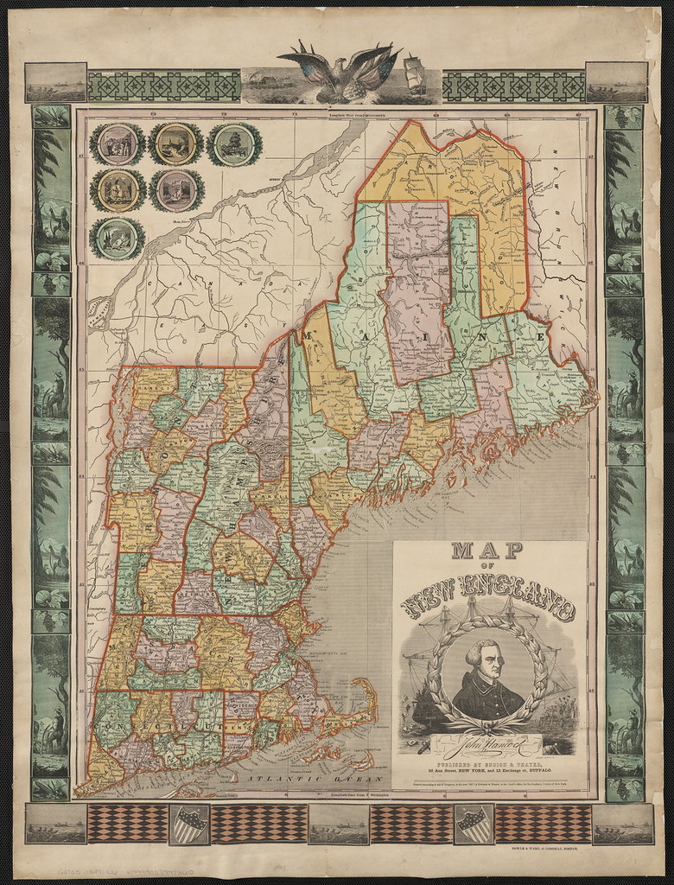
Notes:
On March 15th, 1829 Maine separated from Massachusetts.
Maine became the 23rd state to join the union.

Slide 9
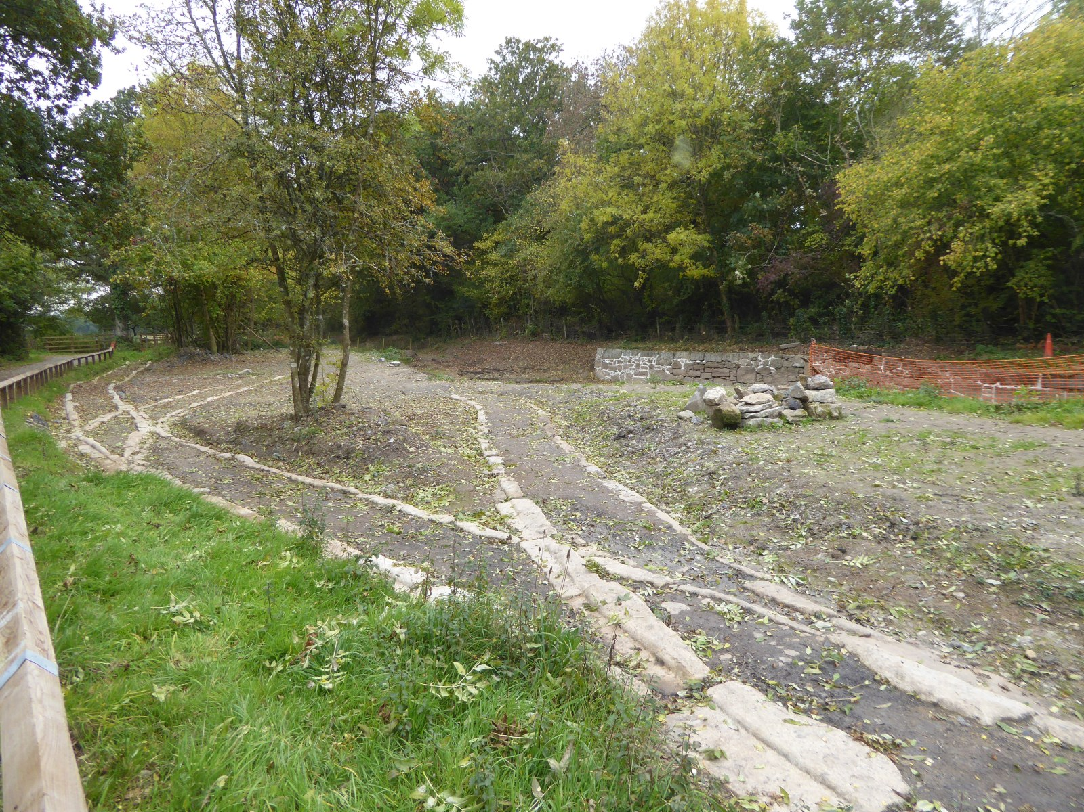
Notes:
In 1826, the Granite Railway became the first commercial rail in the nation.
It went from Boston to Lowell, Boston to Providence, RI, and Boston to Worcester.

Slide 10
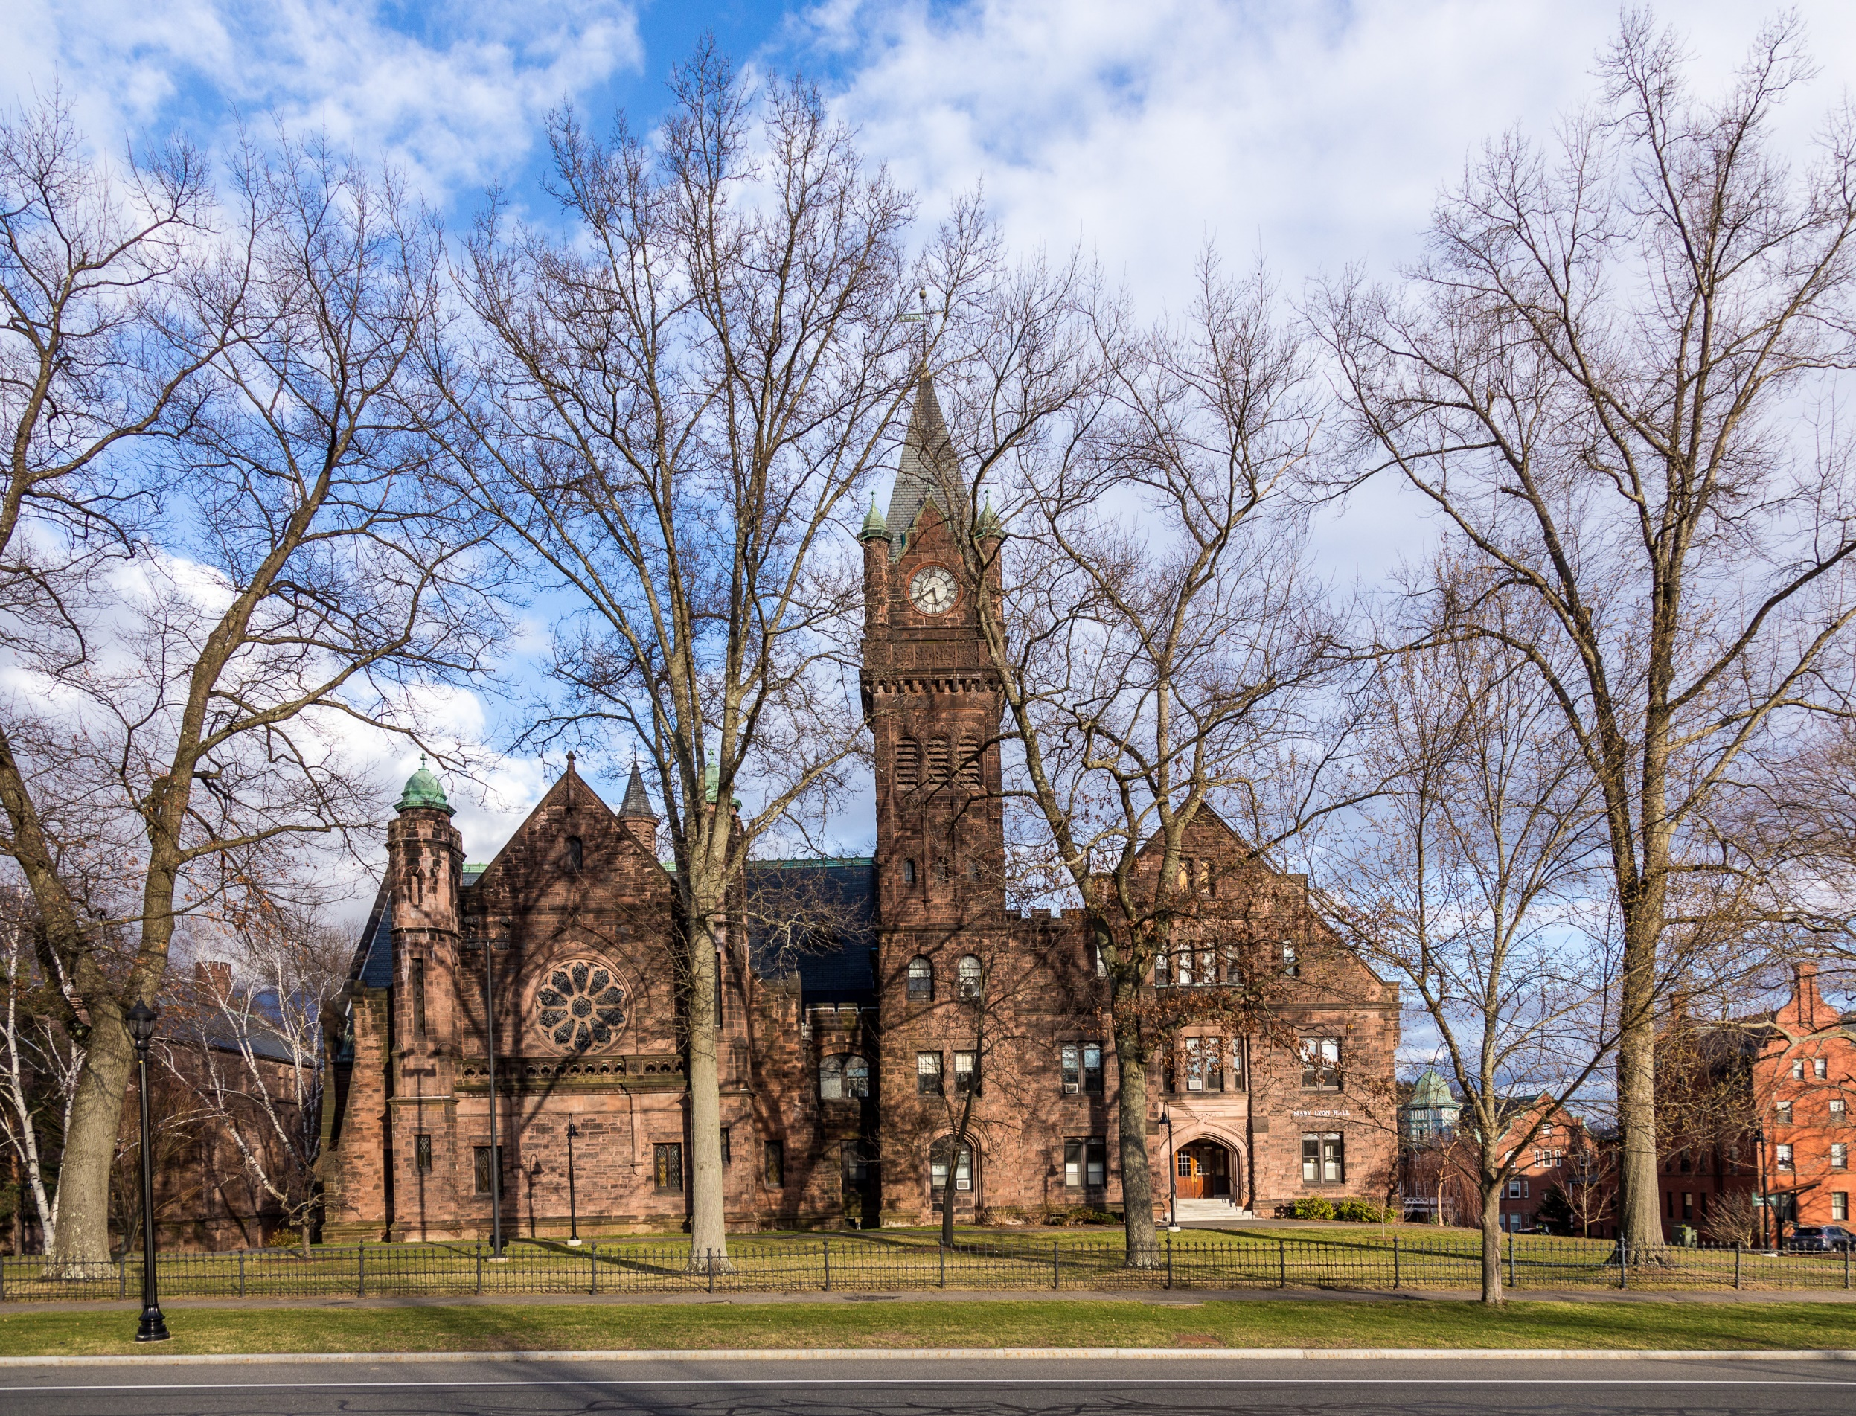
Notes:
In 1836, Mary Lyon opened Mount Holyoke College.
It was the first women’s college in America.

Slide 11
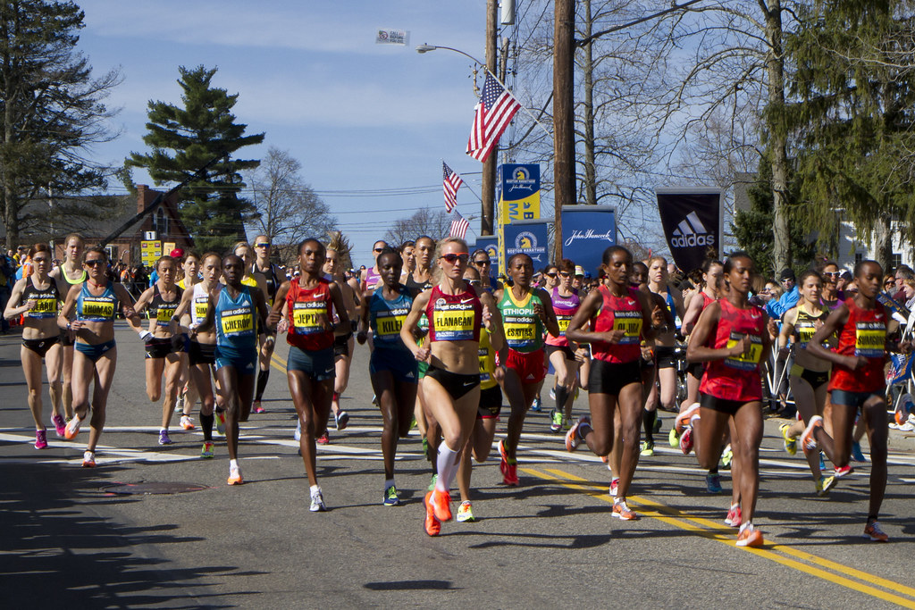
Notes:
Every year on the 3rd Monday in April, the Boston Marathon occurs.
Around 30,000 people run the marathon every year.

Slide 12
Notes:
The end

Slide 13

This Adapted Literature resource is available through the Sherlock Center Resource Library. The text and graphics are adapted from the original source. These resources are provided for teachers to help students with severe disabilities participate in the general curriculum. Please limit the use and distribution of these materials accordingly.
Paul V. Sherlock Center on Disabilities / RI College
600 Mt. Pleasant Avenue, Providence RI 02908
www.sherlockcenter.org

