Slide 1
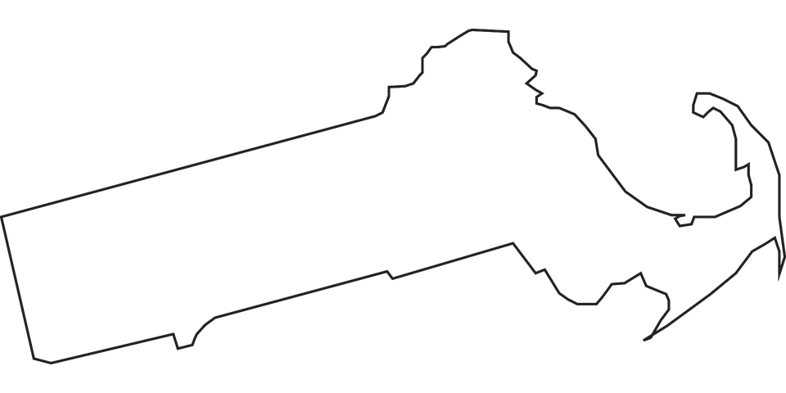

Famous People From
Massachusetts
Notes:
Famous People From Massachusetts

Slide 2
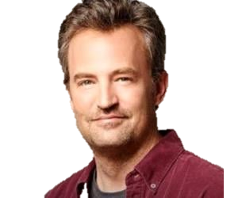
Notes:
Matthew Perry is a famous person from Massachusetts.
Matthew Perry is a famous actor most known for playing in the TV show "Friends".

Slide 3
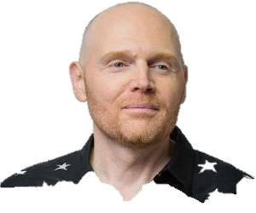
Notes:
Bill Burr is a famous person from Massachusetts.
Bill Burr is a famous comedian.

Slide 4
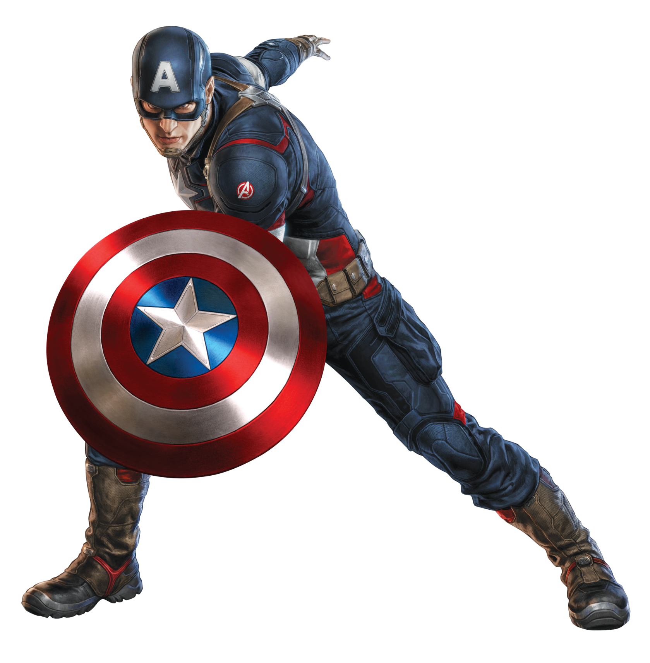
Notes:
Chris Evans is a famous person from Massachusetts.
Chris Evans is a famous actor most known for playing "Captain America".

Slide 5
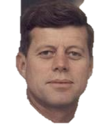
Notes:
John F. Kennedy is a famous person from Massachusetts.
John F. Kennedy was the 35th president of the United States of America.

Slide 6
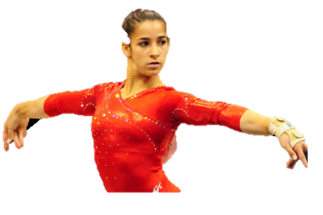
Notes:
Aly Raisman is a famous person from Massachusetts.
Aly Raisman is a famous Olympic gymnast.

Slide 7
Notes:
Edgar Allen Poe is a famous person from Massachusetts.
Edgar Allen Poe is a famous writer.

Slide 8
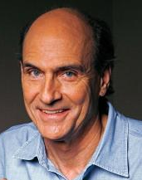
Notes:
James Taylor is a famous person from Massachusetts.
James Taylor is a famous singer.

Slide 9
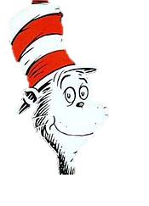
Notes:
Dr. Seuss is a famous person from Massachusetts.
Dr. Seuss is a famous author who wrote many children’s books such as The Cat in the Hat and The Lorax.

Slide 10
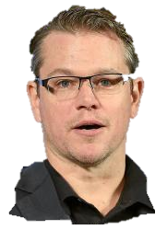
Notes:
Matt Damon is a famous person from Massachusetts.
Matt Damon is a famous actor.

Slide 11
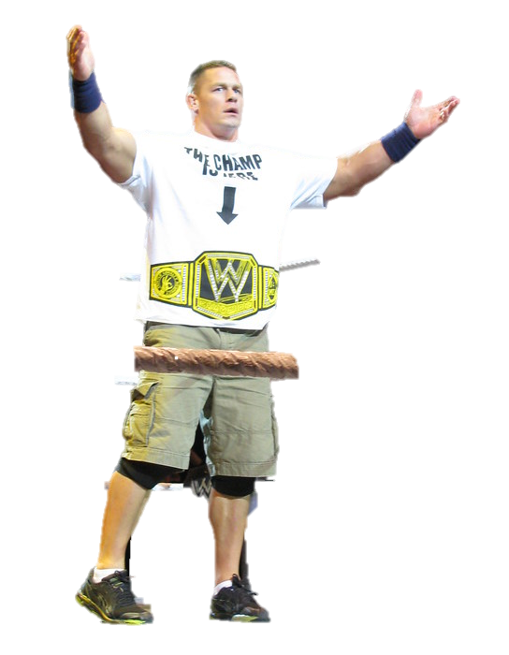
Notes:
John Cena is a famous person from Massachusetts.
John Cena is a famous wrestler.

Slide 12
Notes:
The end

Slide 13

This Adapted Literature resource is available through the Sherlock Center Resource Library. The text and graphics are adapted from the original source. These resources are provided for teachers to help students with severe disabilities participate in the general curriculum. Please limit the use and distribution of these materials accordingly.
Paul V. Sherlock Center on Disabilities / RI College
600 Mt. Pleasant Avenue, Providence RI 02908
www.sherlockcenter.org

