Slide 1
Plants Grow
Notes:
Plants Can Grow

Slide 2
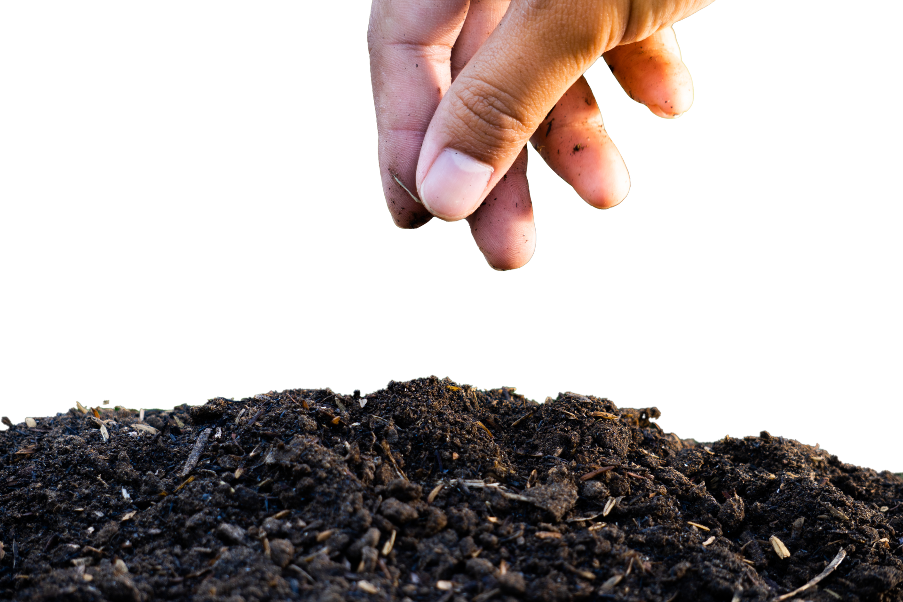
Notes:
A plant starts as a seed. A seed is planted in soil.

Slide 3
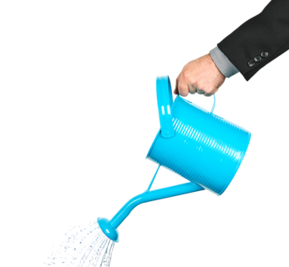
Notes:
Plants need water to grow. You can use a watering can to water your plants.

Slide 4
Notes:
Plants need sunlight to grow.

Slide 5
Notes:
Healthy plants grow bigger and bigger.

Slide 6
Notes:
Plants can grow leaves.

Slide 7
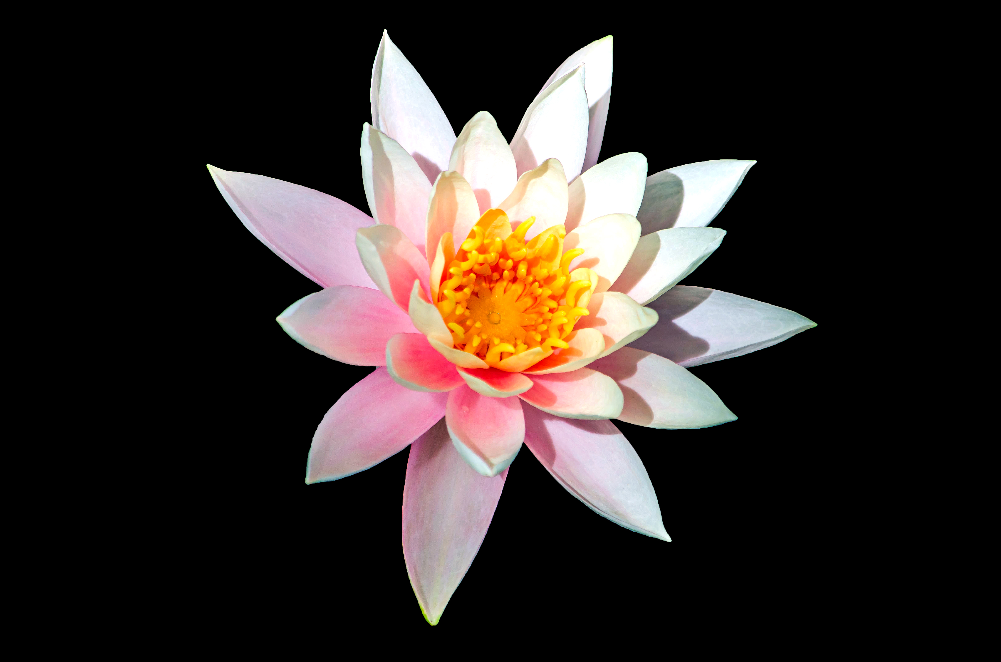
Notes:
Plants can grow flowers.

Slide 8
Notes:
Plants can grow fruits.

Slide 10
This Adapted Literature resource is available through the Sherlock Center Resource Library. The text and graphics are adapted from the original source. These resources are provided for teachers to help students with severe disabilities participate in the general curriculum. Please limit the use and distribution of these materials accordingly.
Paul V. Sherlock Center on Disabilities / RI College
600 Mt. Pleasant Avenue, Providence RI 02908
www.sherlockcenter.org

