Slide 1


What Will the Weather Be Like Today?
Notes:
Adapted from the original text, “What Will the Weather be Like Today?”, written by Paul Rogers, illustrated by Kazuko

Slide 2

This Photo by Unknown Author is licensed under CC BY-NC
Notes:
Just at the moment when night becomes day, when the stars in the sky begin fading away,

Slide 3

Notes:
You can hear all the birds and the animals say, “What will the weather be like today?”

Slide 4

Notes:
Will it be windy? Will it be warm?

Slide 5

Notes:
Will there be snow? Or a frost?

Slide 6



Notes:
Or a storm?

Slide 7
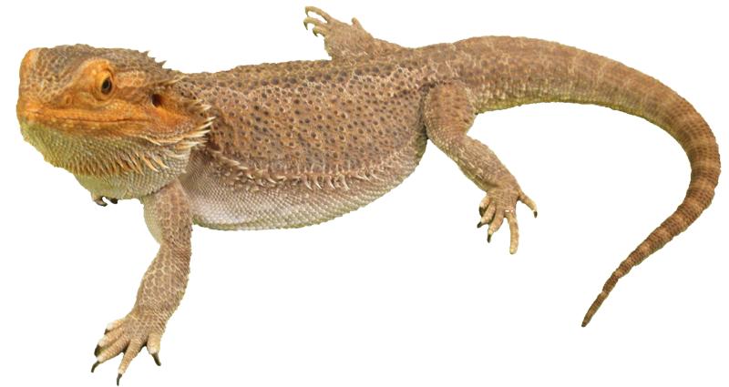
Notes:
“Be dry,” says the lizard, “and I won’t complain.”

Slide 8

Notes:
The frog in the bog says, “Perhaps it will rain.”

Slide 9
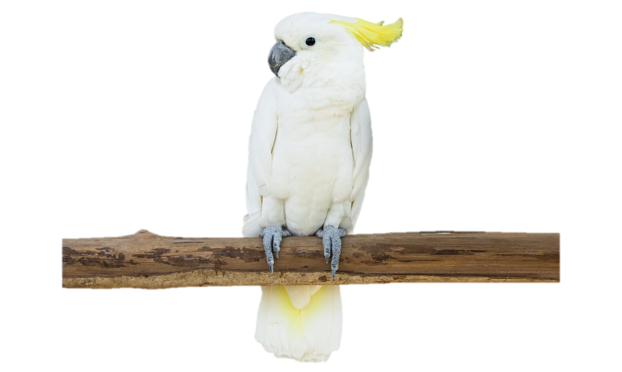
Notes:
The white cockatoo likes it steamy and hot.

Slide 10
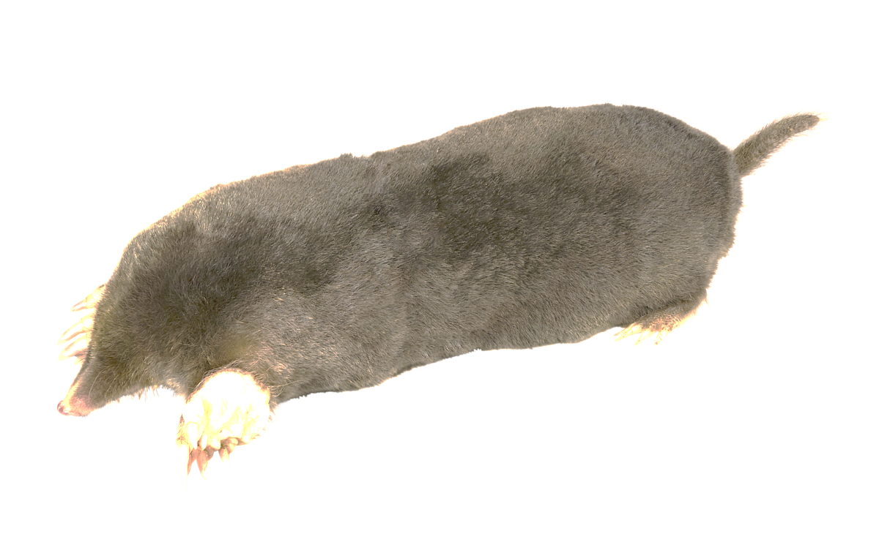
Notes:
The mole doesn’t know if it’s raining or not.

Slide 11

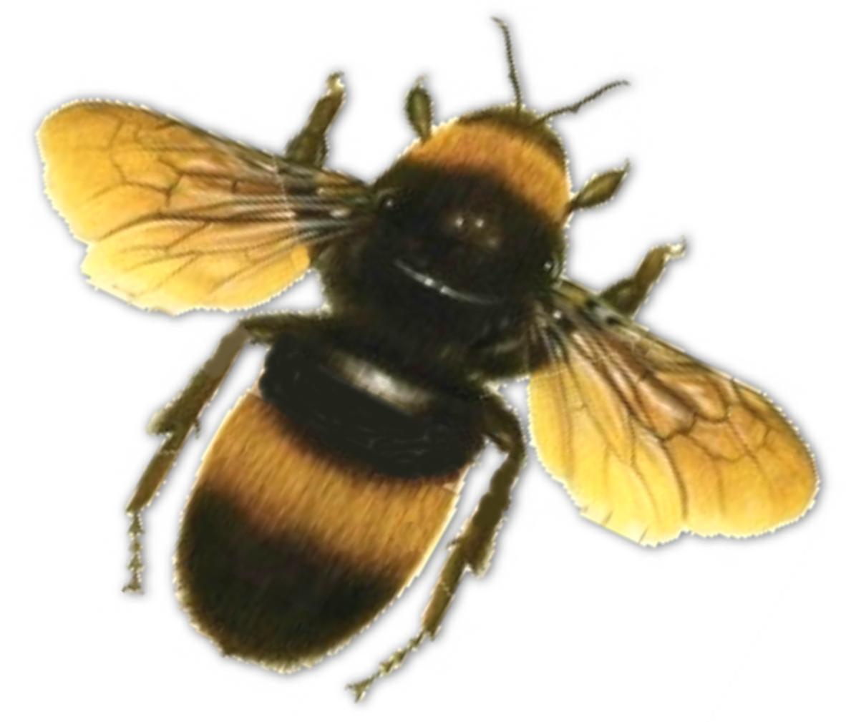
This Photo by Unknown Author is licensed under CC BY-NC
Notes:
“Whatever the weather, I work,” says the bee.

Slide 12
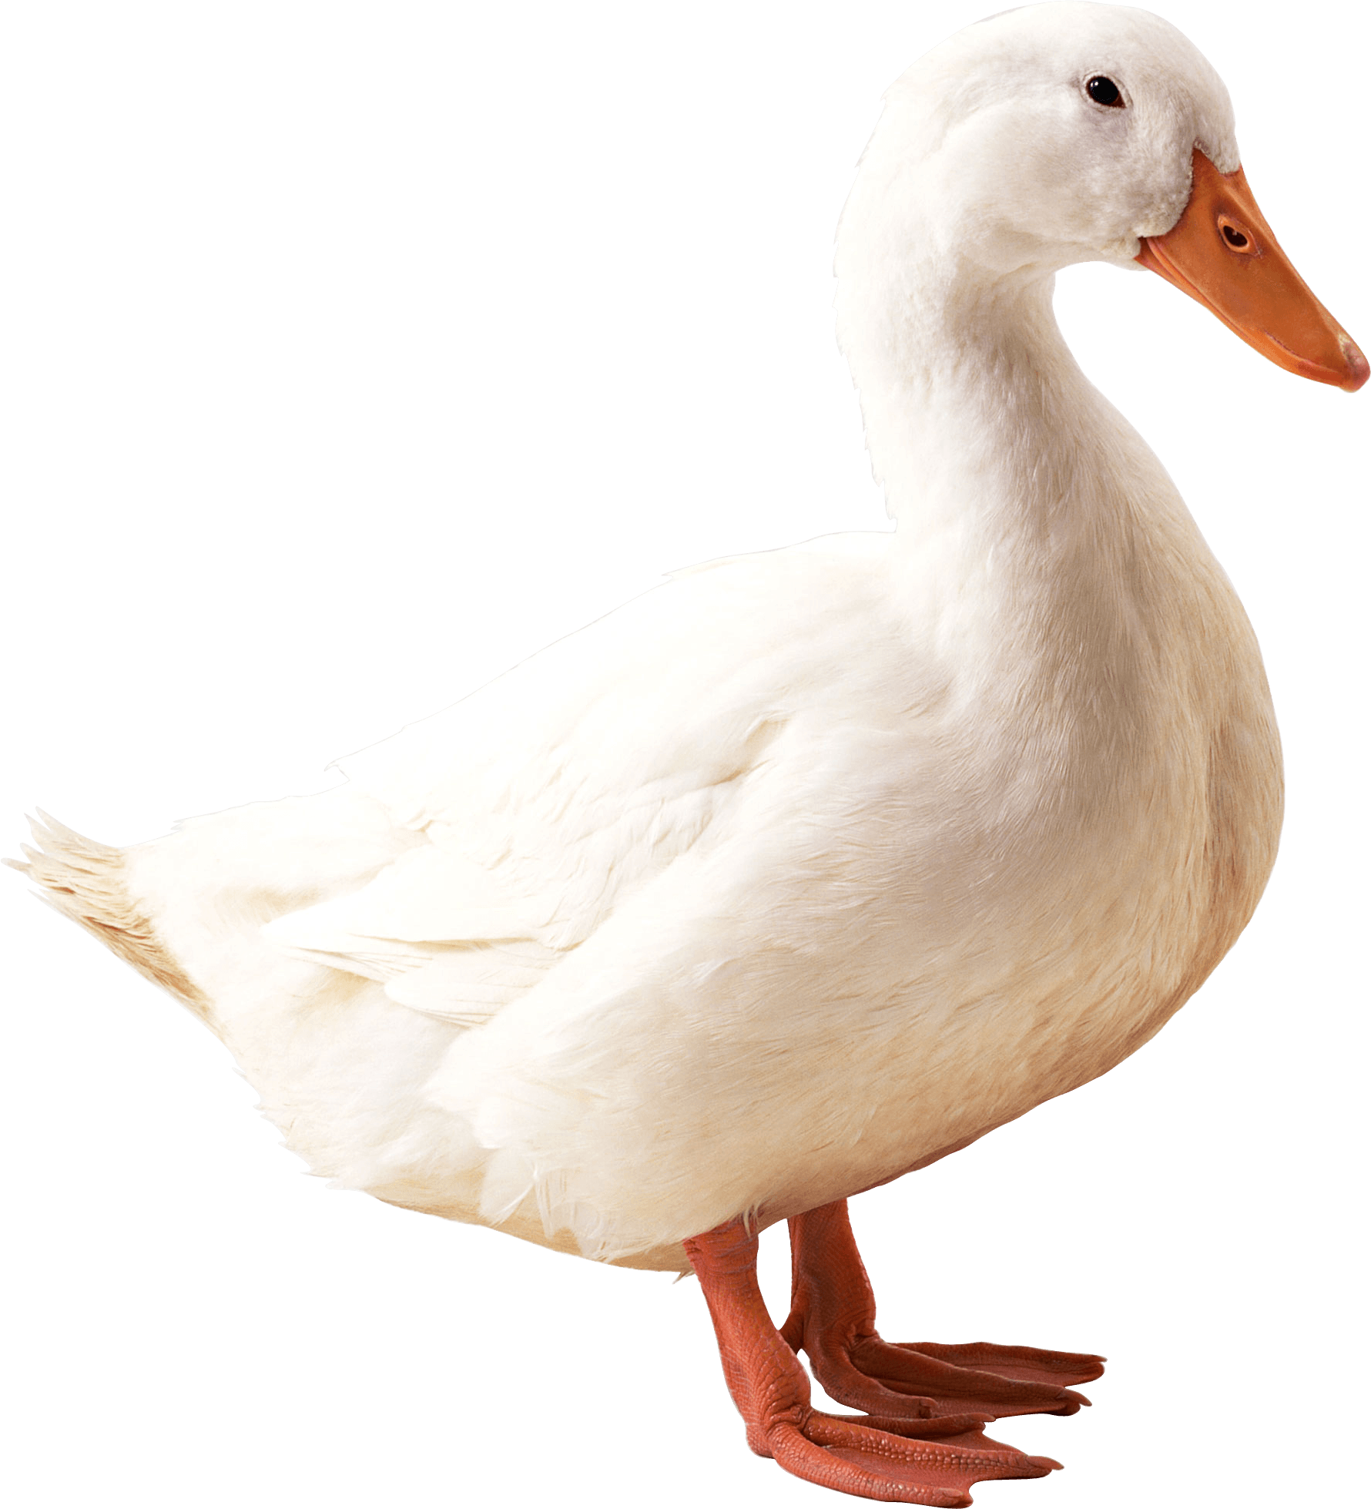
Notes:
“Wet,” says the duck, “is the weather for me.”

Slide 13
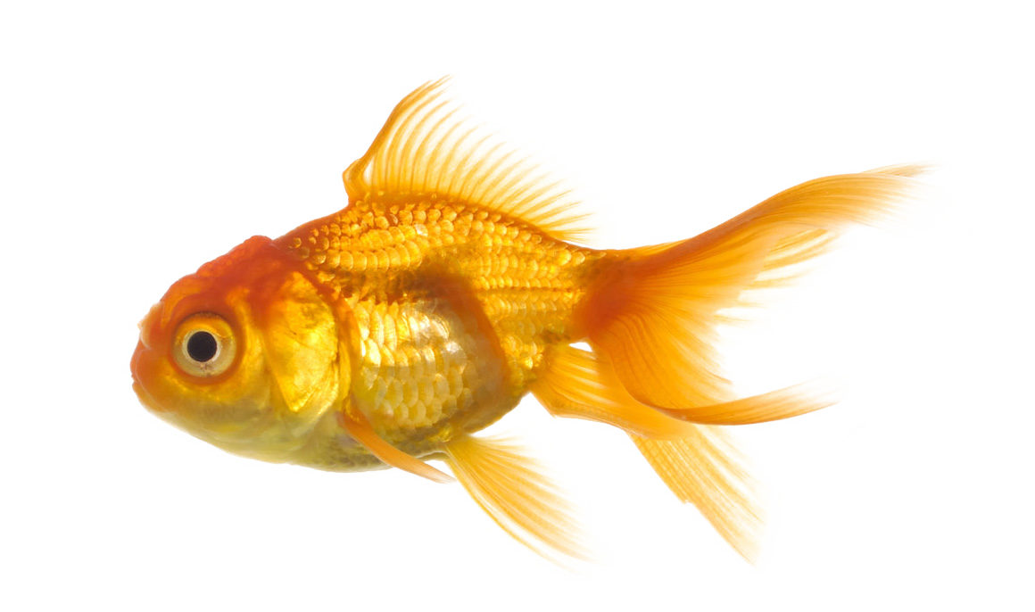
Notes:
“Weather? What’s that?” say the fish in the sea.

Slide 14
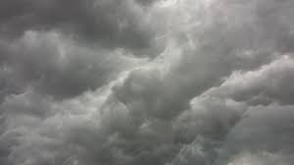
Notes:
The world has awakened. The day has begun, and somewhere it’s cloudy.

Slide 15

Notes:
And somewhere there’s sun!

Slide 16

Notes:
And somewhere the sun and the rain meet to play and paint a bright rainbow to dress up the day!

Slide 17
Notes:
What is the weather where you are today?

Slide 18
Notes:
The end

Slide 19
This Adapted Literature resource is available through the Sherlock Center Resource Library. The text and graphics are adapted from the original source. These resources are provided for teachers to help students with severe disabilities participate in the general curriculum. Please limit the use and distribution of these materials accordingly.
Paul V. Sherlock Center on Disabilities / RI College
600 Mt. Pleasant Avenue, Providence RI 02908
www.sherlockcenter.org

