Slide 1

By: Sharon M. Draper

Slide 2
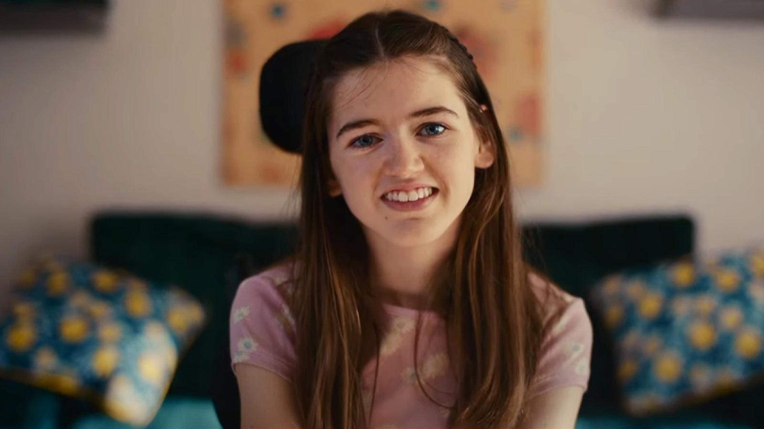
Melody has cerebral palsy. She cannot talk.

Slide 3
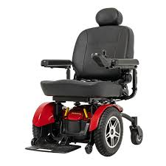
Melody uses a wheelchair. She is not able to walk.

Slide 4

Melody is very smart inside.

Slide 5
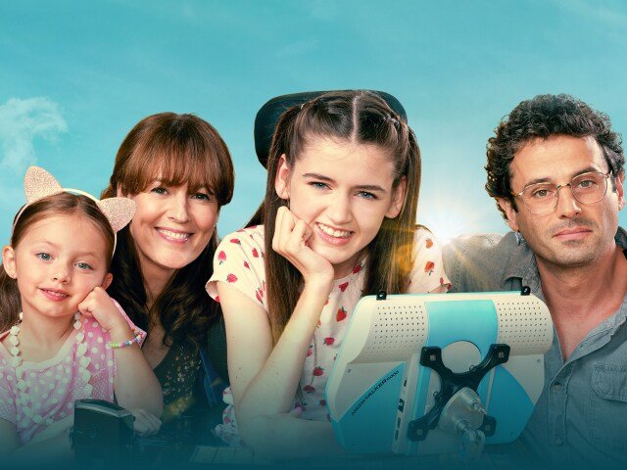
.
Melody’s parents love her.

Slide 6
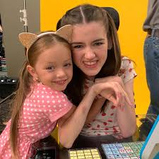
She has a baby sister named Penny.

Slide 7


Melody loves music.

Slide 8

Kids at school do not understand Melody.

Slide 9
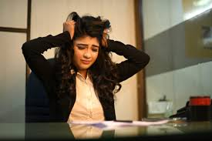
They think that she cannot learn. Melody feels frustrated.

Slide 10
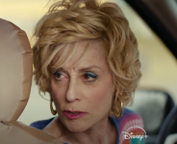
Melody has a neighbor named Mrs. V. Mrs. V knows that Melody is smart.

Slide 11

Mrs. V helps Melody learn.

Slide 12
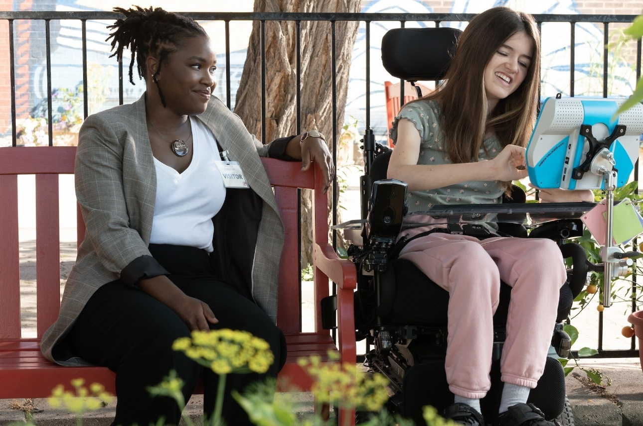
Melody gets an aide named Catherine. Catherine listens to Melody.

Slide 13
Catherine helps Melody at school.

Slide 14
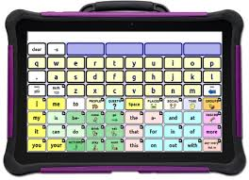
Melody gets a computer called a Medi-talker. Now Melody is able to talk with others using her Medi-Talker.

Slide 15
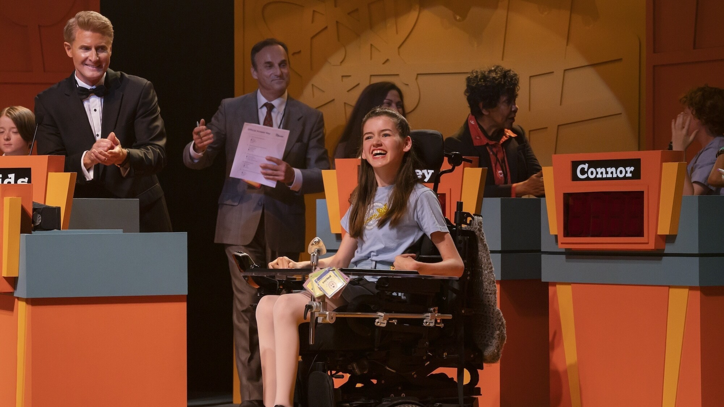
Melody joins the quiz team at school. Some kids do not want her there. Melody knows that she is very smart.

Slide 16
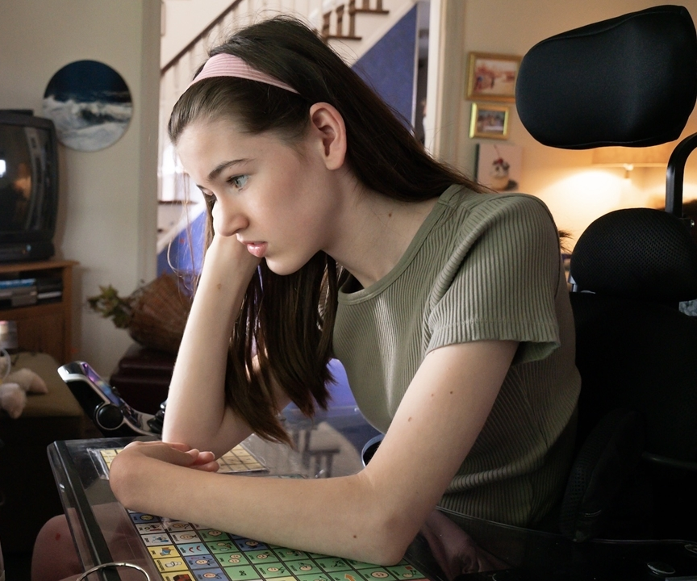
The team leaves Melody behind for a trip. She feels very sad and angry. People still do not understand her.

Slide 17
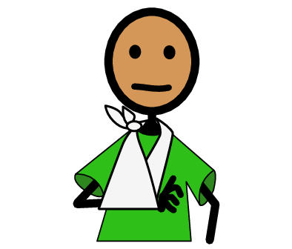
Penny, Melody’s little sister, gets hurt. Melody tries to warn her mom, but no one listens.

Slide 18
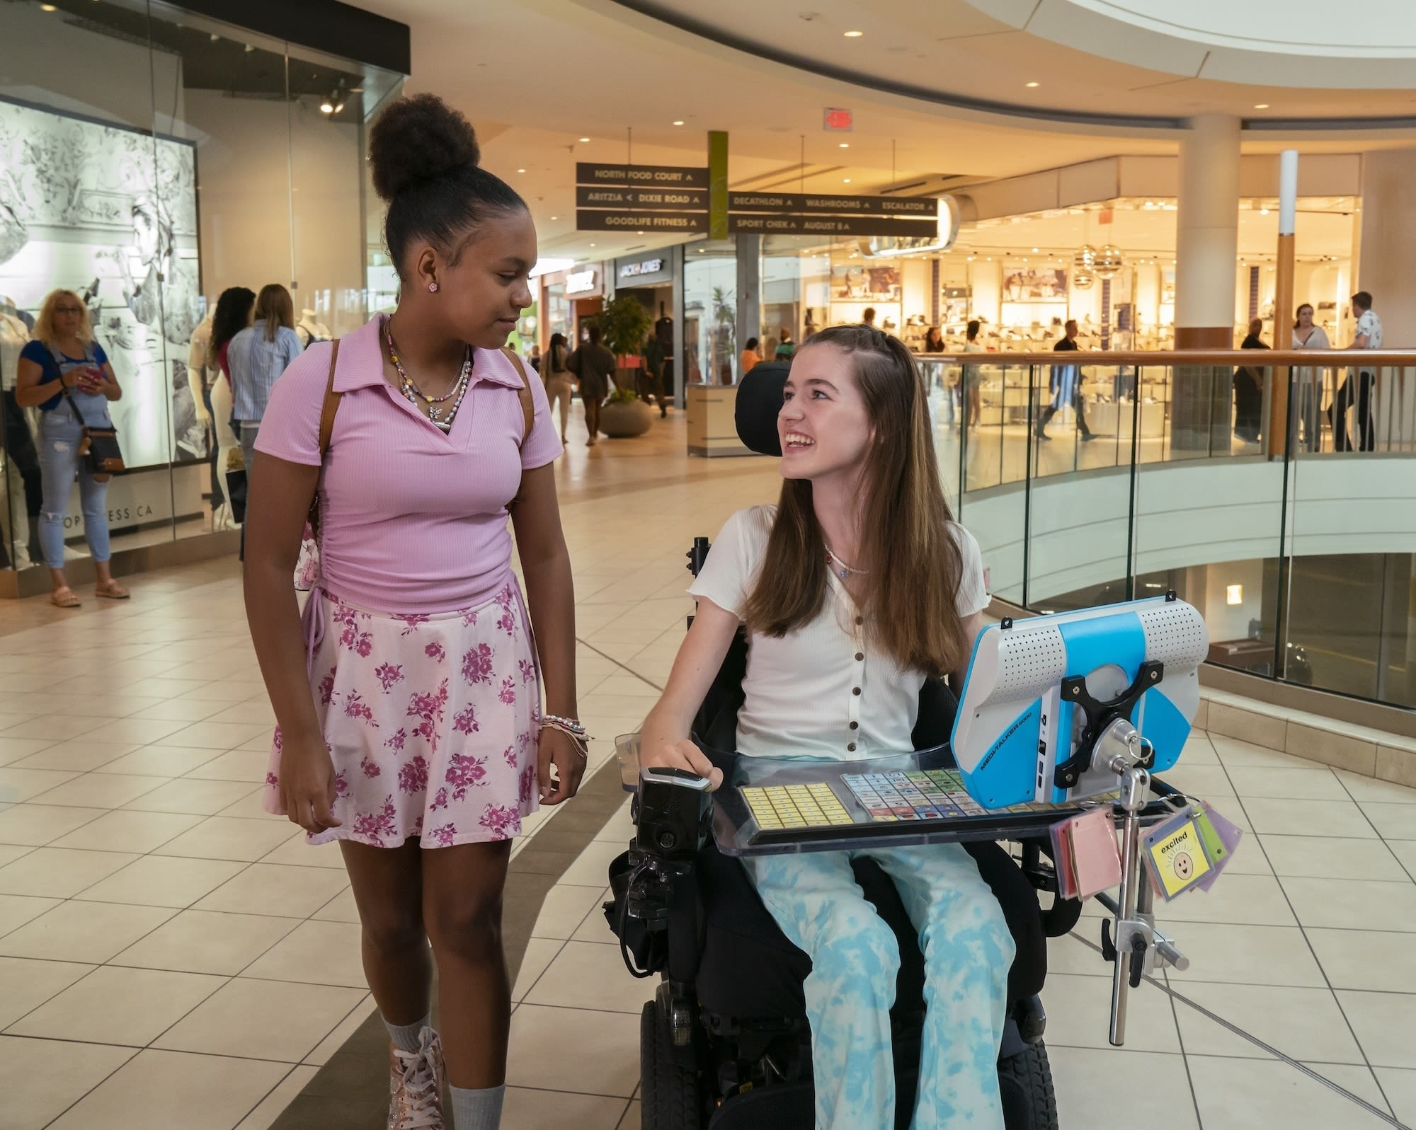
People start to understand Melody and start listening to her.

Slide 19
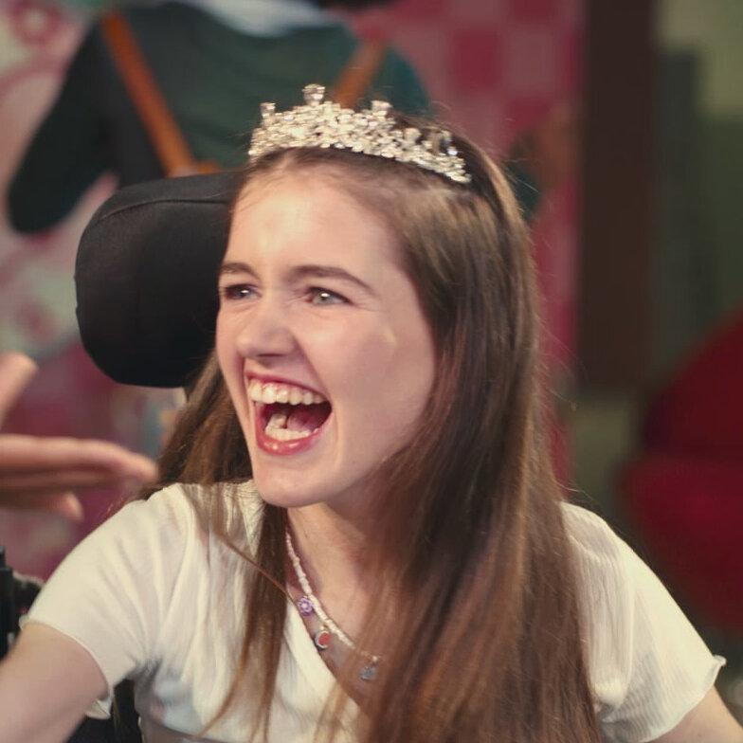
Melody is proud of herself. She knows that she is smart and that her voice matters.

Slide 20
This Adapted Literature resource is available through the Sherlock Center Resource Library. The text and graphics are adapted from the original source. These resources are provided for teachers to help students with severe disabilities participate in the general curriculum. Please limit the use and distribution of these materials accordingly.
Paul V. Sherlock Center on Disabilities/RI College
600 Mt. Pleasant Avenue, Providence RI 02908
Website: www.sherlockcenter.org

