Slide 1


To Kill a Mockingbird
Adapted from the Original Text by Harper Lee

Slide 2
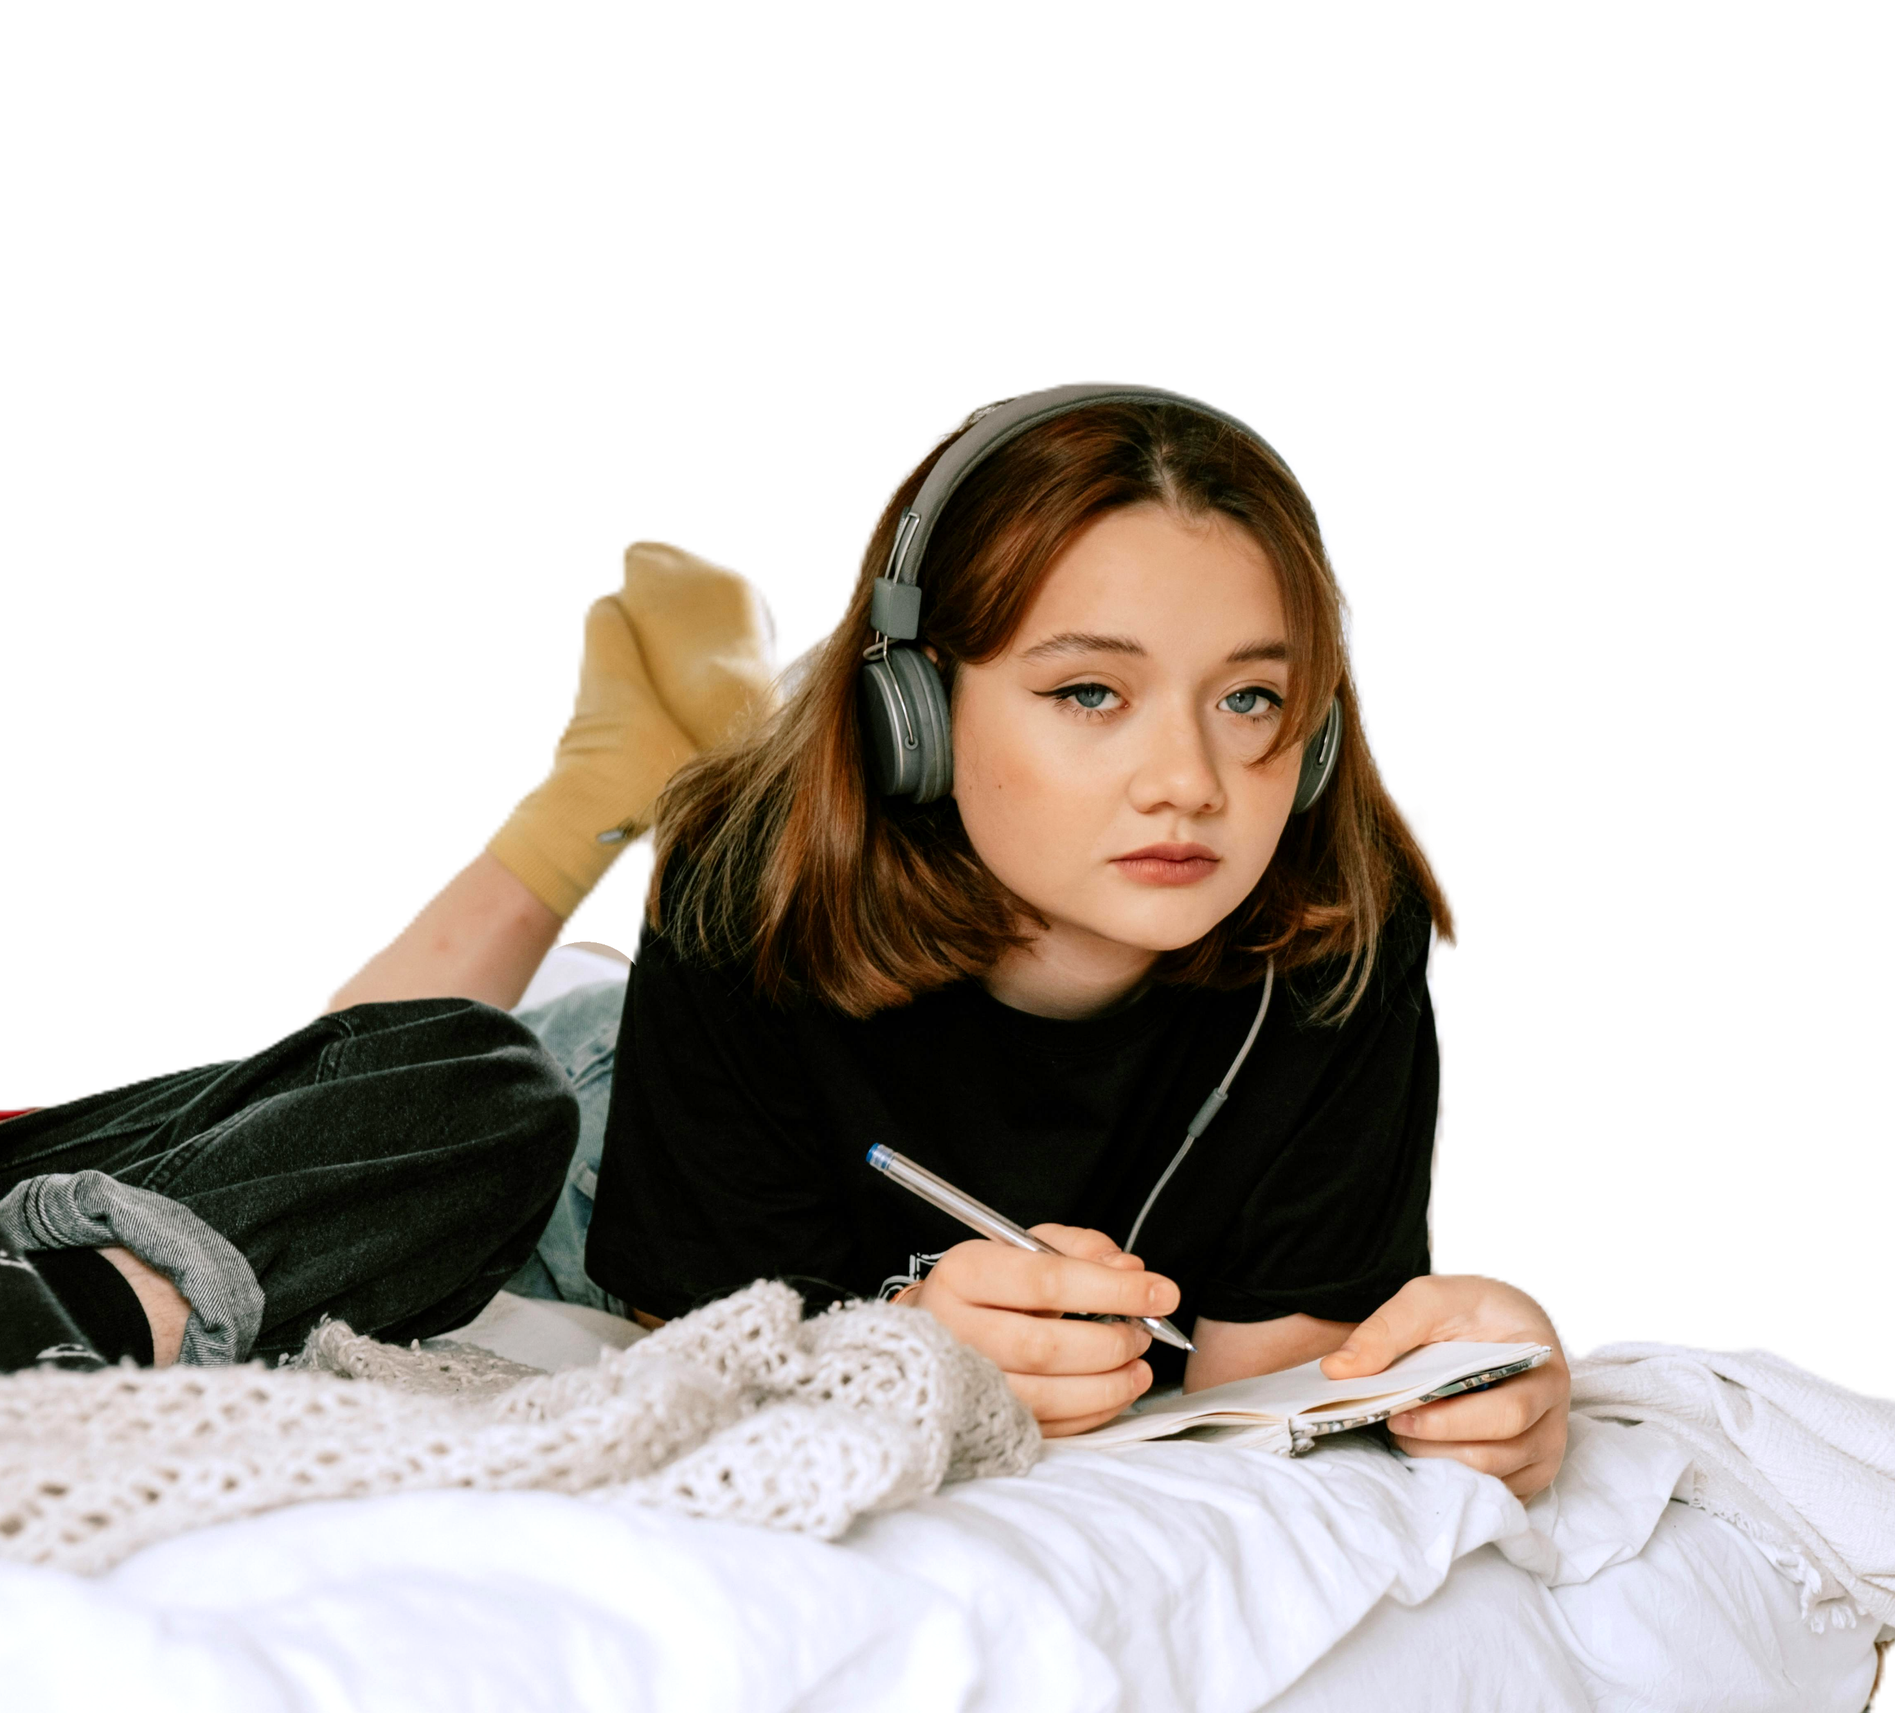

Scout

Slide 3


Different People

Slide 4
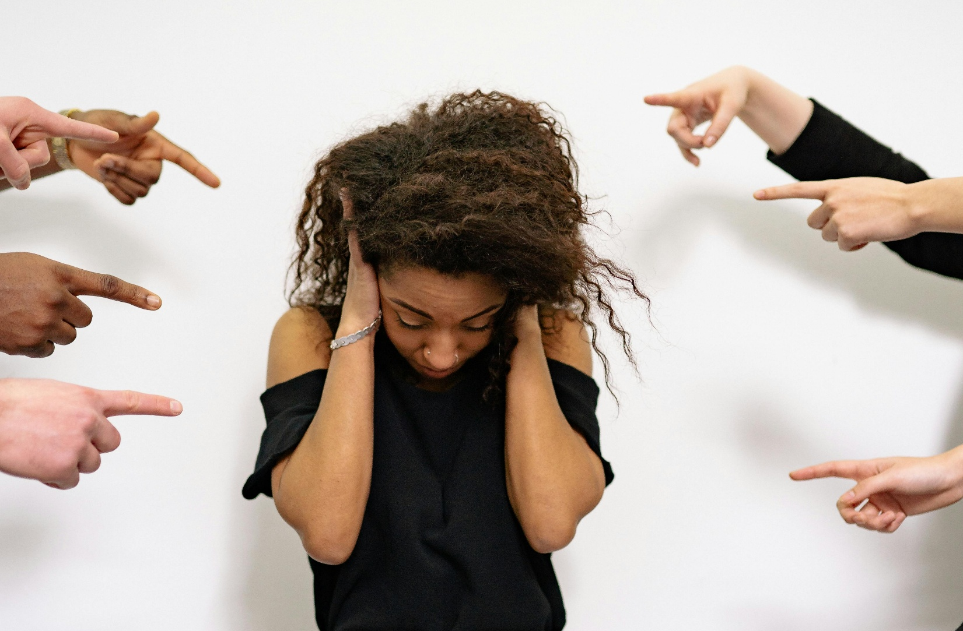

Mean People

Slide 5


Scout’s Dad

Slide 6


Dad Helps

Slide 7

Hurt

Slide 8
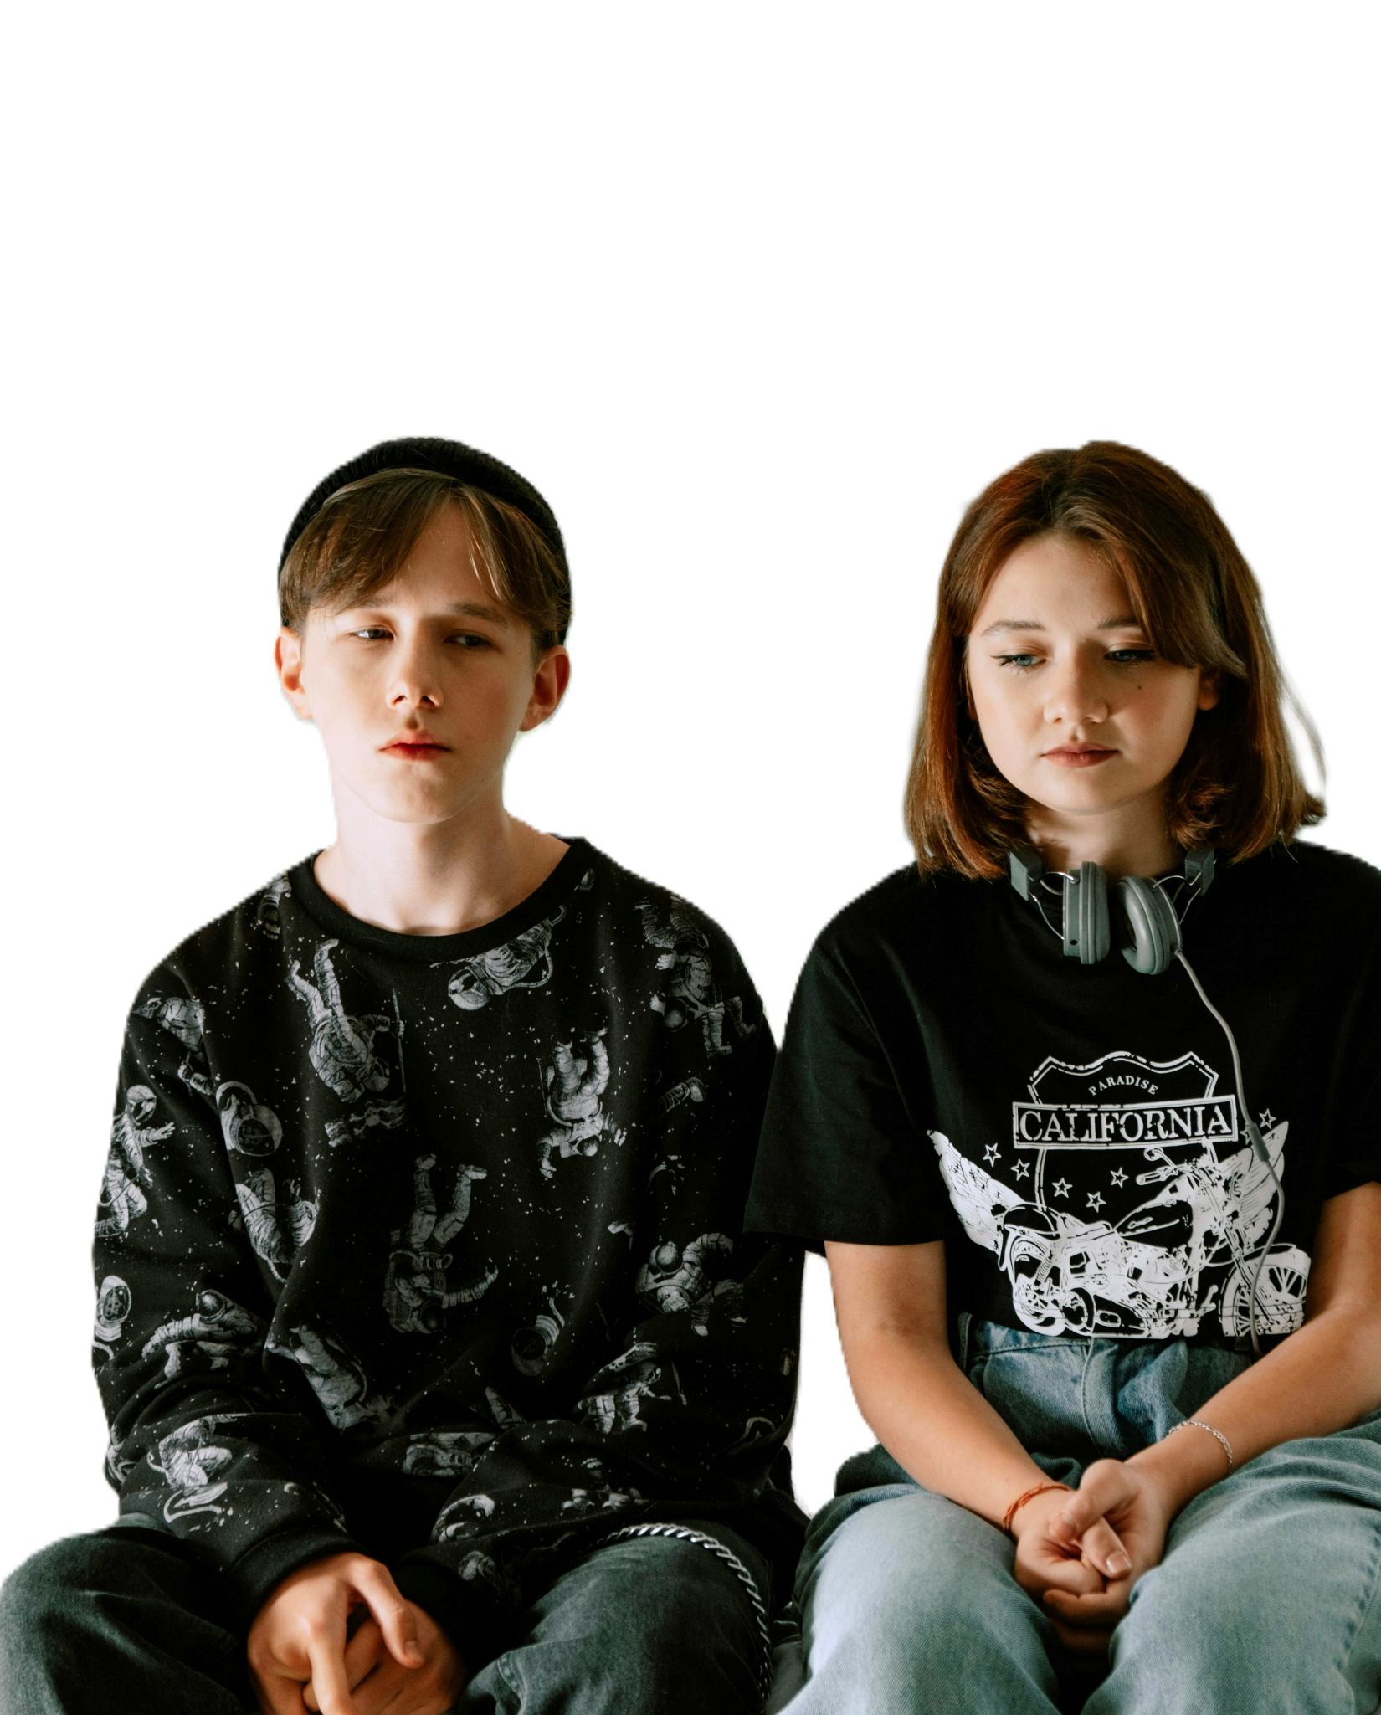

Sad

Slide 9


Scout Helps

Slide 10
Disclaimer and Credits
This Adapted Literature Resource is available through the Paul V. Sherlock Center on Disabilities Resource Library. The text is adapted from the original source. Graphics were provided by Pexels. These resources are provided for teachers to help students with severe disabilities participate in the general curriculum. Please limit the use and distribution of these materials accordingly.
Photo Credits: Scout, Group of Men, Woman Being Bullied, Atticus, Atticus and Tom, Jem and Scout, and Holding Hands from Pexels
Paul V. Sherlock Center on Disabilities / RI College
600 Mt. Pleasant Avenue, Providence RI 02908
www.sherlockcenter.org

